Slide 1
Quasi-parallel & Quasi-perpendicular Magnetosheath Jets Using MMS Savvas Raptis, Tomas Karlsson KTH - Department of Space and Plasma Physics Swedish Space Plasma Meeting 2019 2019/02/07, Uppsala

Slide 2
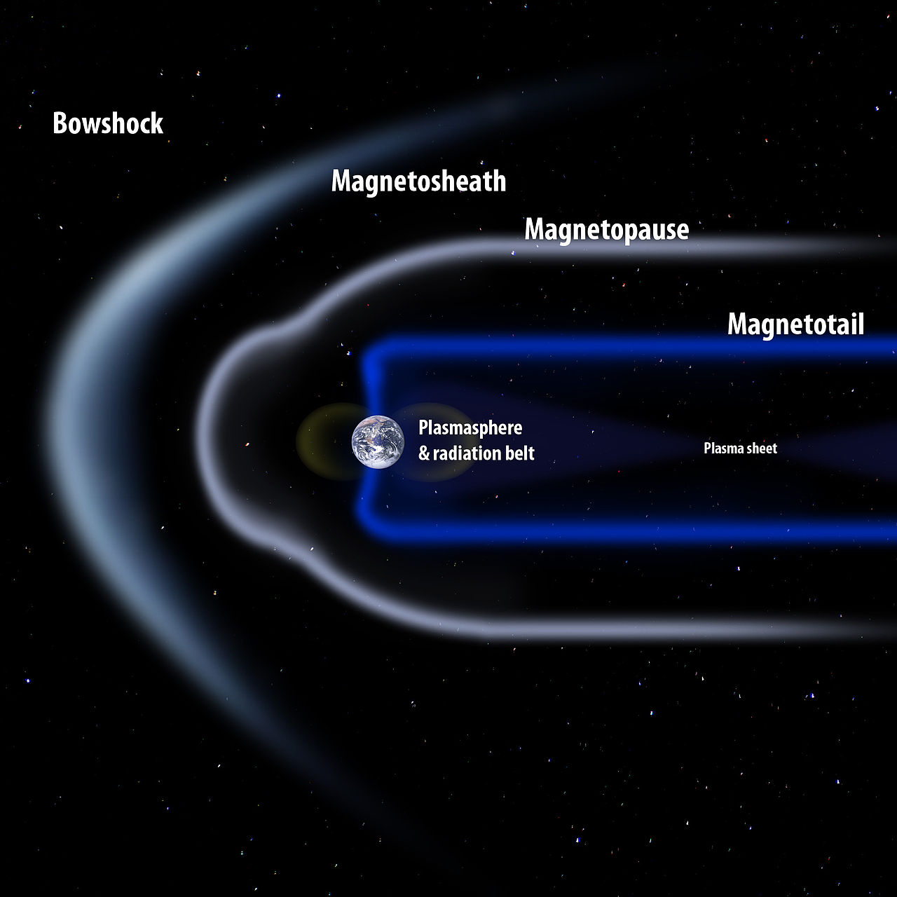
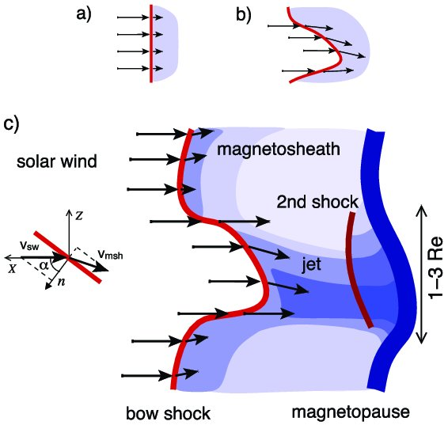
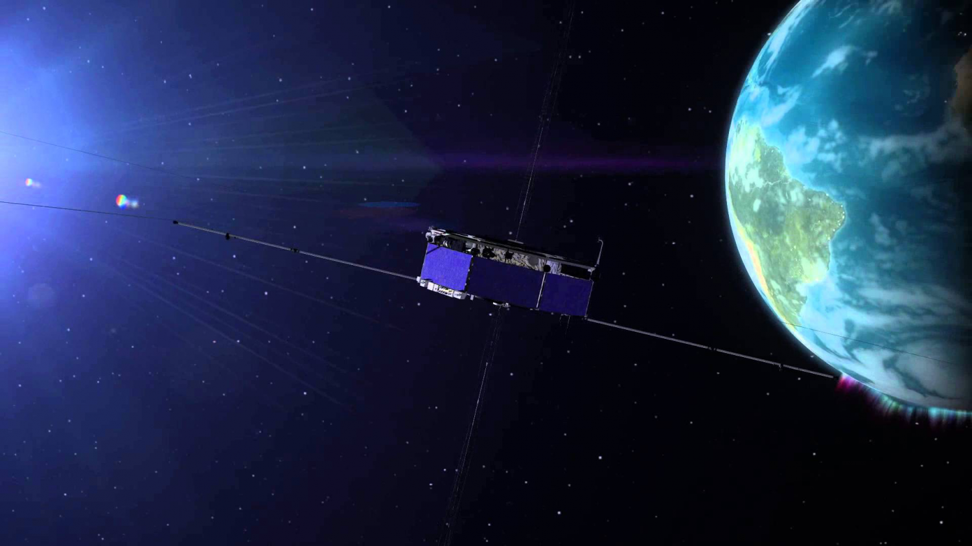
Magnetosheath Jets
What: Enhancements of dynamic pressure above the general fluctuations level.
Where: Magnetosheath
Data: MMS
How: Many possible mechanisms (Foreshock waves, SW Discontinuities, Magnetic reconnection etc. )
Why: Interaction of SW & Magnetosphere, magnetopause reconnection, radiation belts, auroral features…
Hietala et al. (2012)

Slide 3
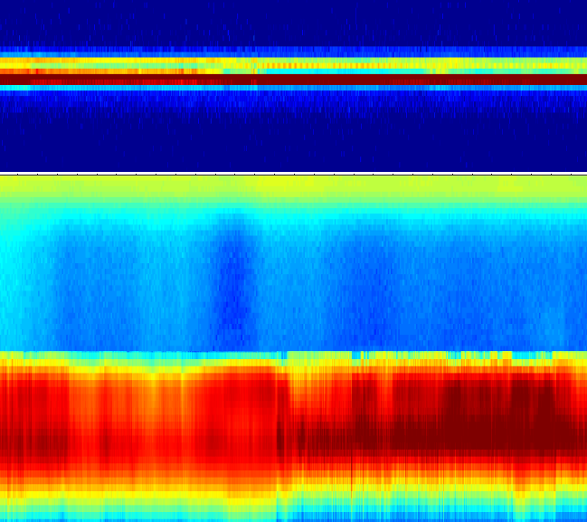
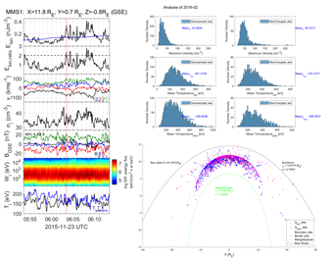
Searching for Jets
Loading MMS data
Classify regions (MS/SW/PSH)
Search for Magnetosheath Jets on MS
Save Area and Jet Values ($v,P_{dyn},ρ,P,Β,Ε, T,θ$...)
Save Area and Jet Values (v,𝑃_𝑑𝑦𝑛,𝜌,𝑃,Β,Ε, T,θ...)
Advanced area & jet classification (orientation to BS)
Statistically compare their characteristics
TBD…
SW
PSH
MS

Slide 4
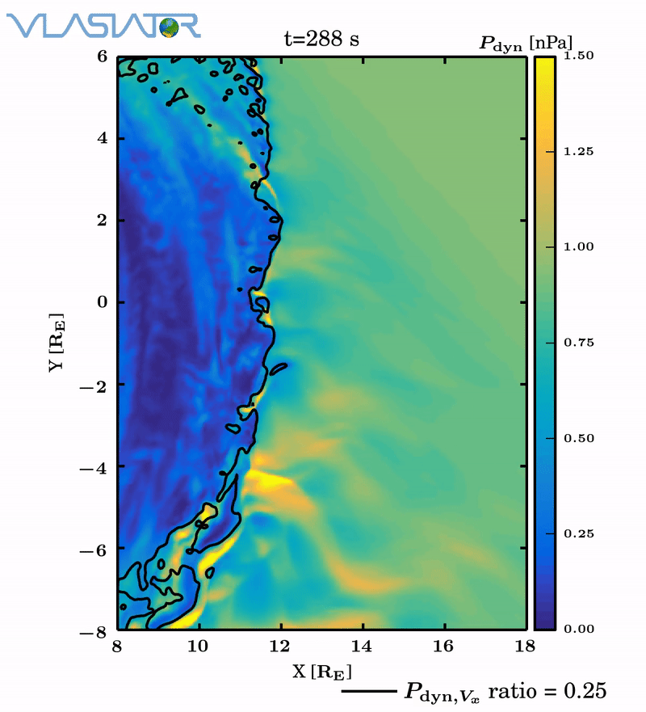
Derived database for Jets
Time Period
1/9/2015 – 1/12/2018
Total | Downsampled $dt<60 s$ | High Energy $$E_{kin}>3 nJ m^{−3}$$
13050 | 7020 | 817
Palmroth Minna et al. (2018)

Slide 5
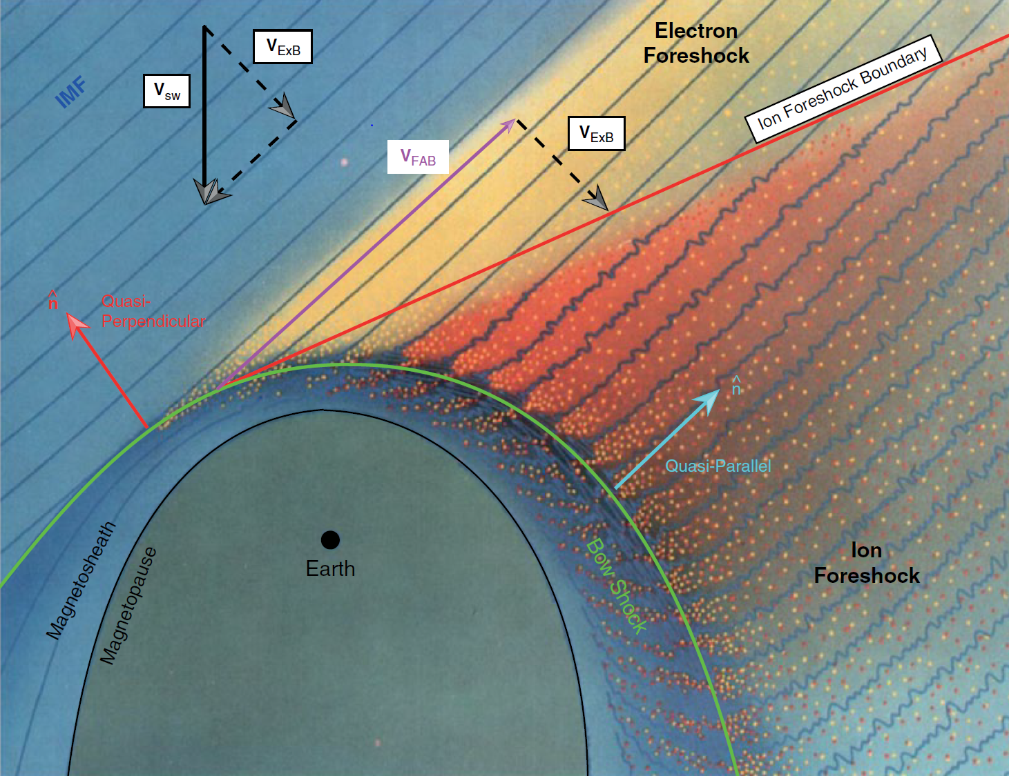
Motivation – Subcategories
Fact: Fluctuations are found mainly in Quasi-parallel shock ($θ_{n}<45°$).
However, fluctuations also found in Quasi Perpendicular regions.
Hypothesis of different type of jets, origin, generation mechanism & characteristics.
$$Q_{par}$$ | $$Q_{per}$$ | Boundary
L. B. Wilson (2016)

Slide 6
Preliminary Results

Slide 7
Main Categories
Qpar Jet
Qperp Jet
Boundary Jet
Encapsulated Jet

Slide 8
“Necessary Evil” Categories
Border Jets
Unclassified Jets

Slide 9
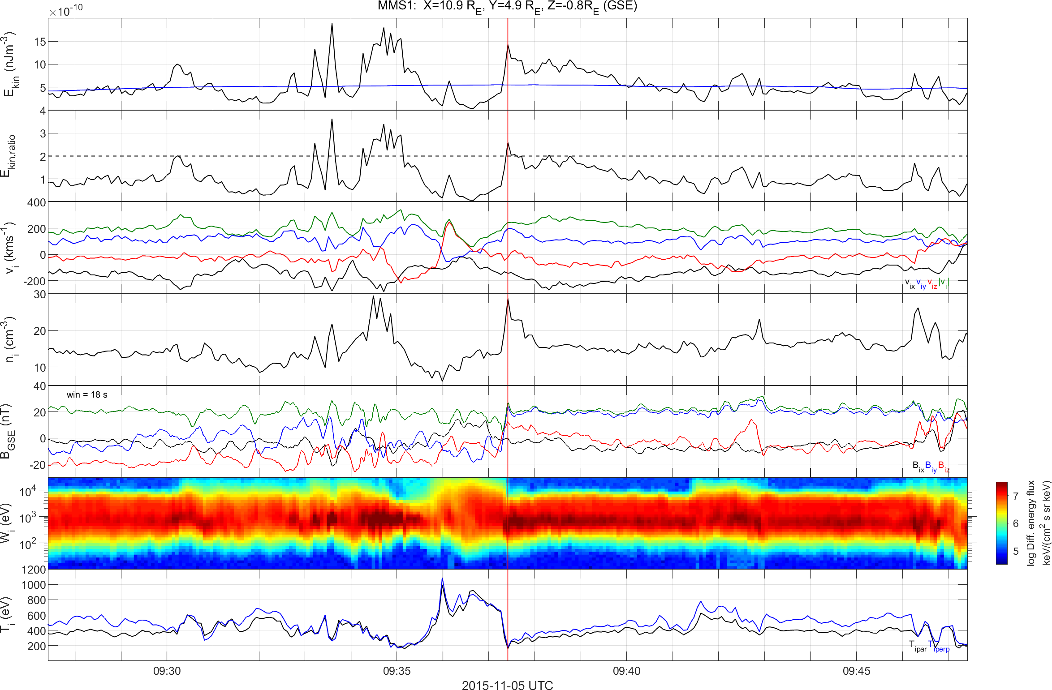
Boundary Example

Slide 10
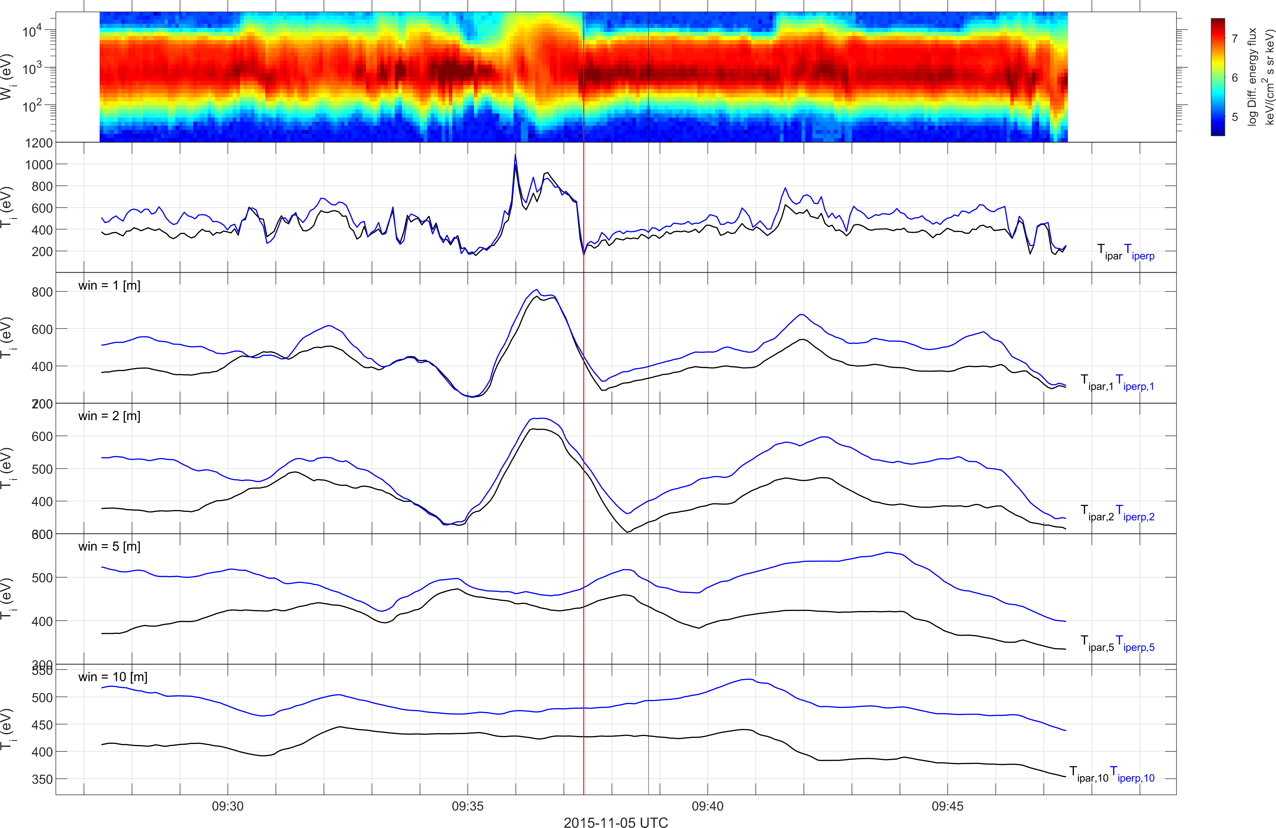
Classifying Jets – Boundary Example – Temperature

Slide 11
Classifying Jets – Boundary Example – Anisotropy

Slide 12
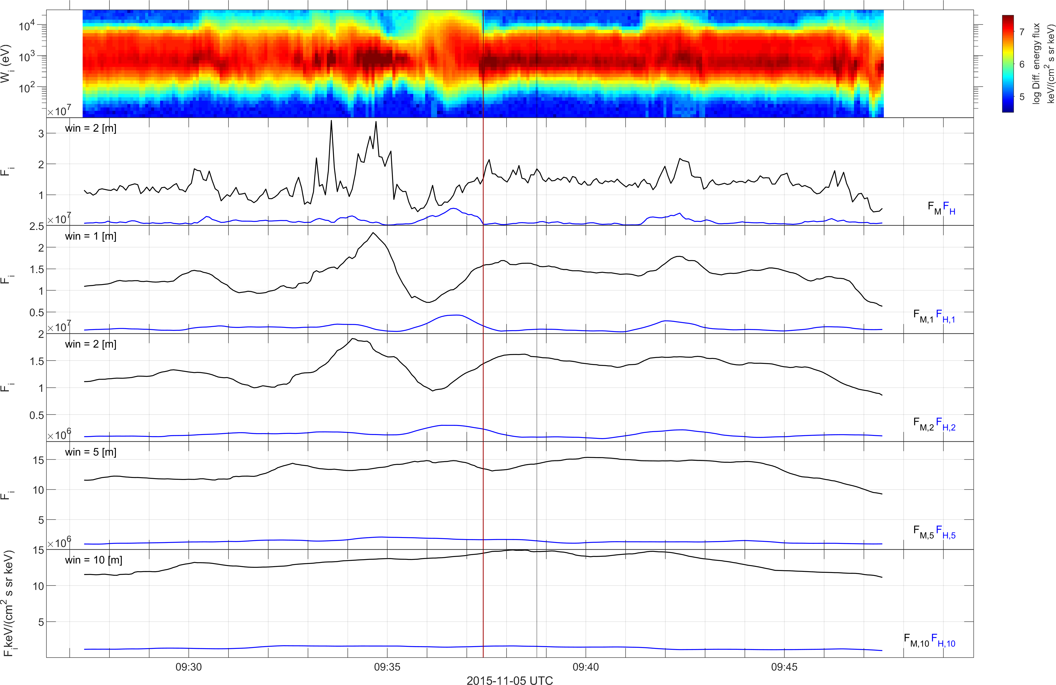
Classifying Jets – Boundary Example – Flux

Slide 13
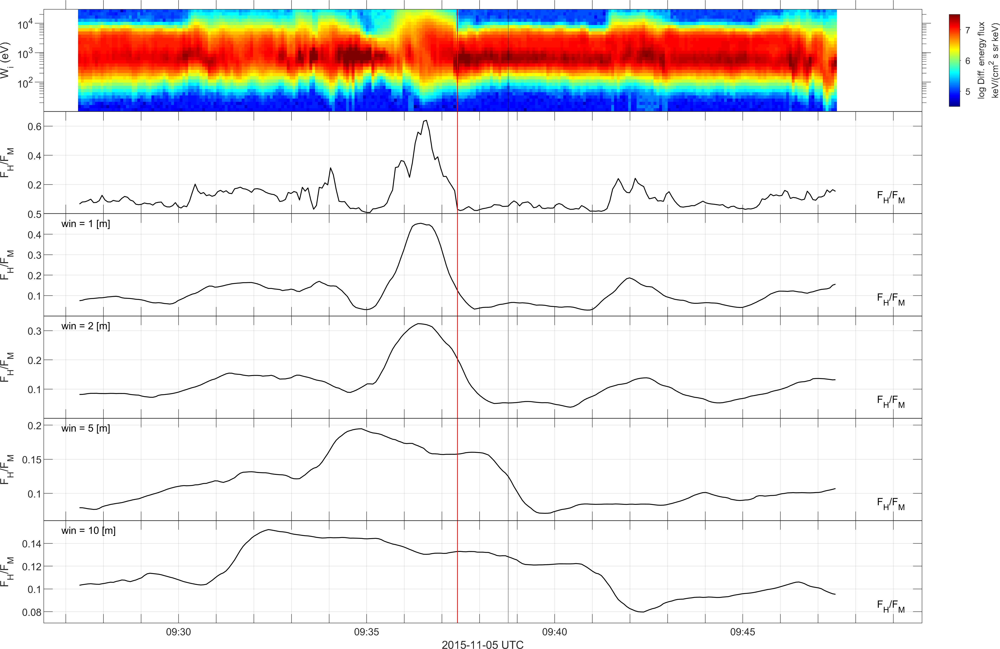
Classifying Jets – Boundary Example – Flux Ratios

Slide 14
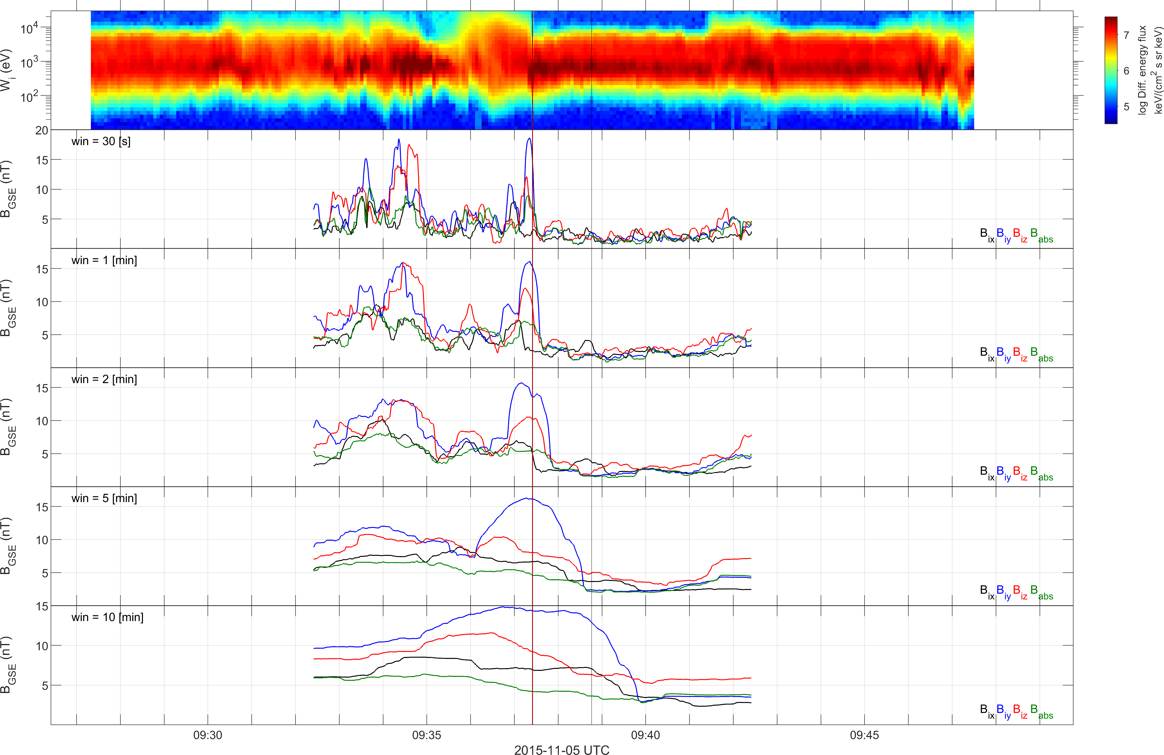
Classifying Jets – Boundary Example – STD($\vec{B}$)

Slide 15
Updated database for Jets (Example)
Time Period
1/9/2015 – 1/12/2018
Downsampled $dt<60 \left[s\right]$ | Quasi – Parallel jets | Quasi – Perpendicular jets | Boundary Jets | Border Jets | Unclassified/ Unknown
7020 | 4174 | 274 | 910* | 690 | 962
Qpar > $0.05$ ${\left(\frac{F_{H}}{F_{m}}\right)}_{5}$ Qperp < $0.02 {\left(\frac{F_{H}}{F_{M}}\right)}_{5}$
Notes:
Data does not provide well behaved boundaries for each case → misclassification can not be avoided.
A lot of handpicked values (Pre-jet and Post-jet periods, Thresholds, smooth filters, Definitions…).

Slide 16
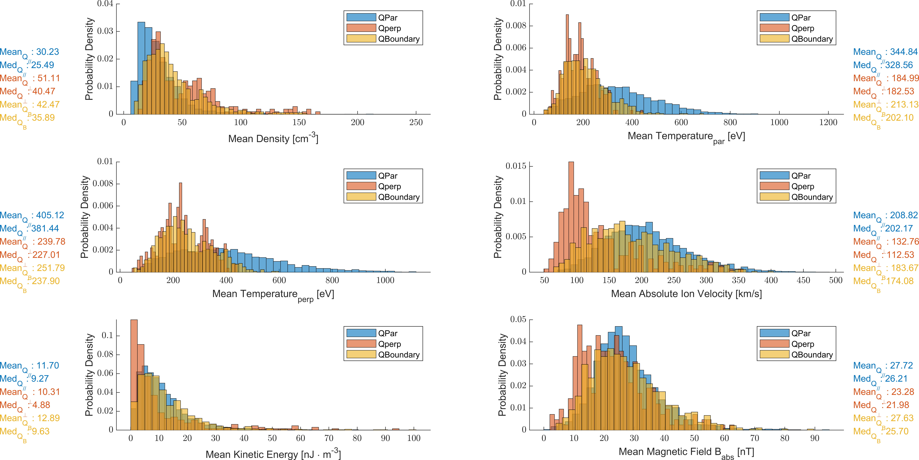
Characteristics of each category

Slide 17
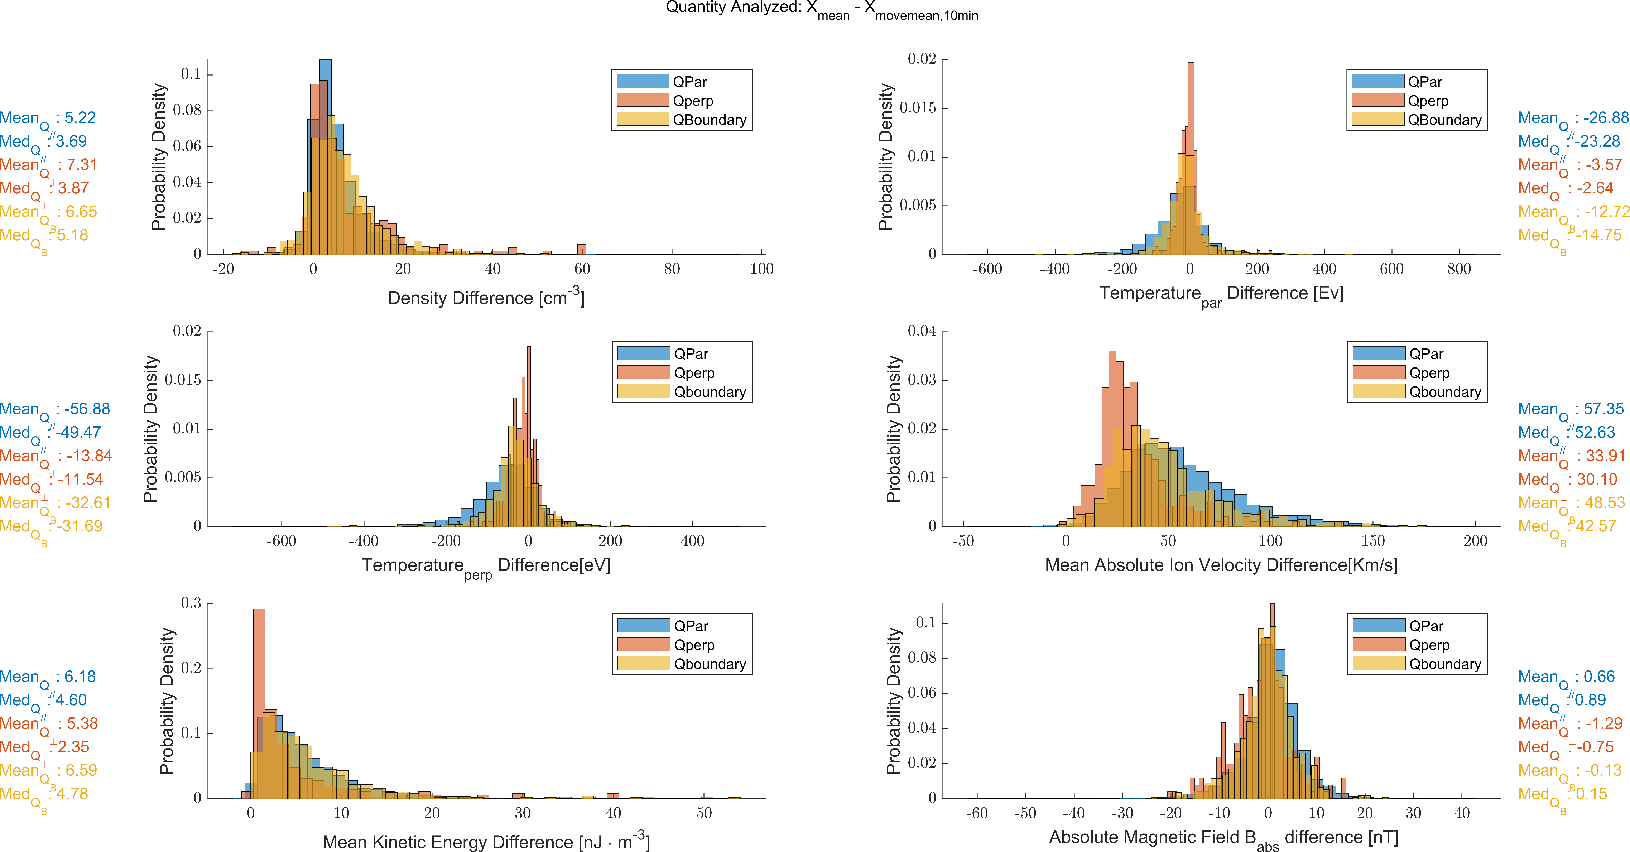
“Background Difference” Statistics

Slide 18
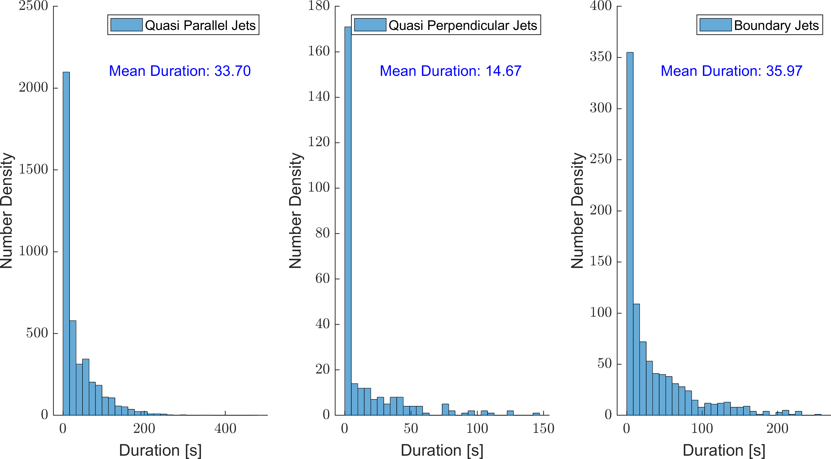
Duration of Jets

Slide 19
Conclusion
Summary
Obtained a large database of Magnetosheath Jets using all available MMS data.
Analyzed their statistical characteristics and found interesting similarities and differences compared with earlier results.
Successfully classified them into different categories showing different characteristics.
Future Work
Quantify true negative and false positive situations from classification.
Verify classification algorithms via Machine Learning (Hierarchical, k-means, SOM etc.)
Investigate pre-jet and post-jet plasma properties in comparison to each category.
Connect each category to a generation mechanism and origin candidate.

Slide 20
Extras

Slide 21
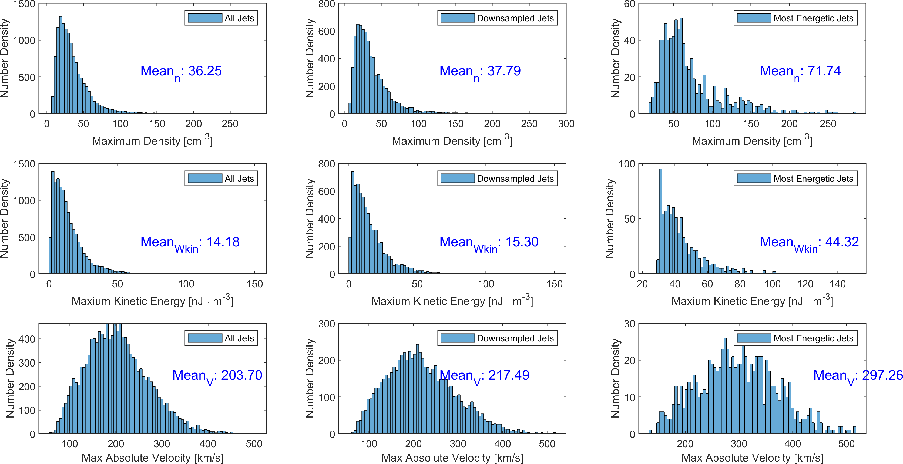
Some General Properties of Jets

Slide 22
Where are they?

Slide 23
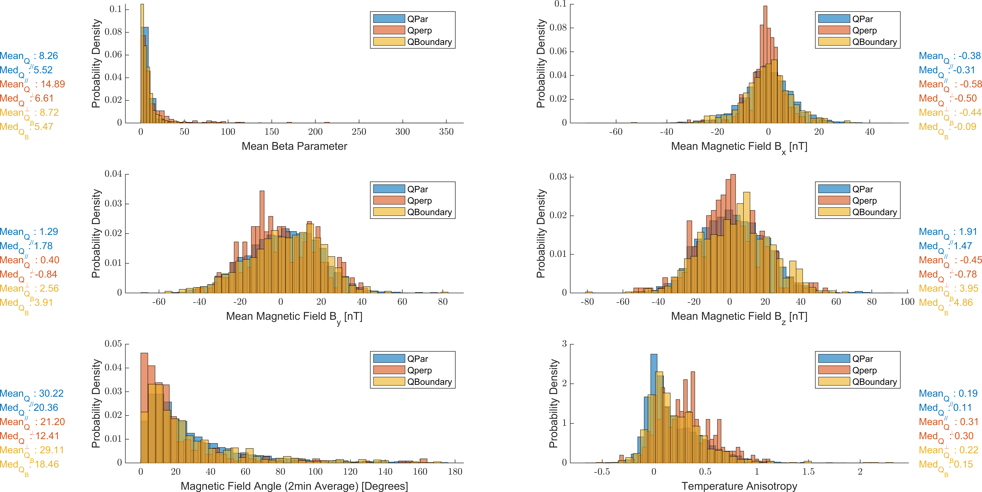
Characteristics of each category

Slide 24
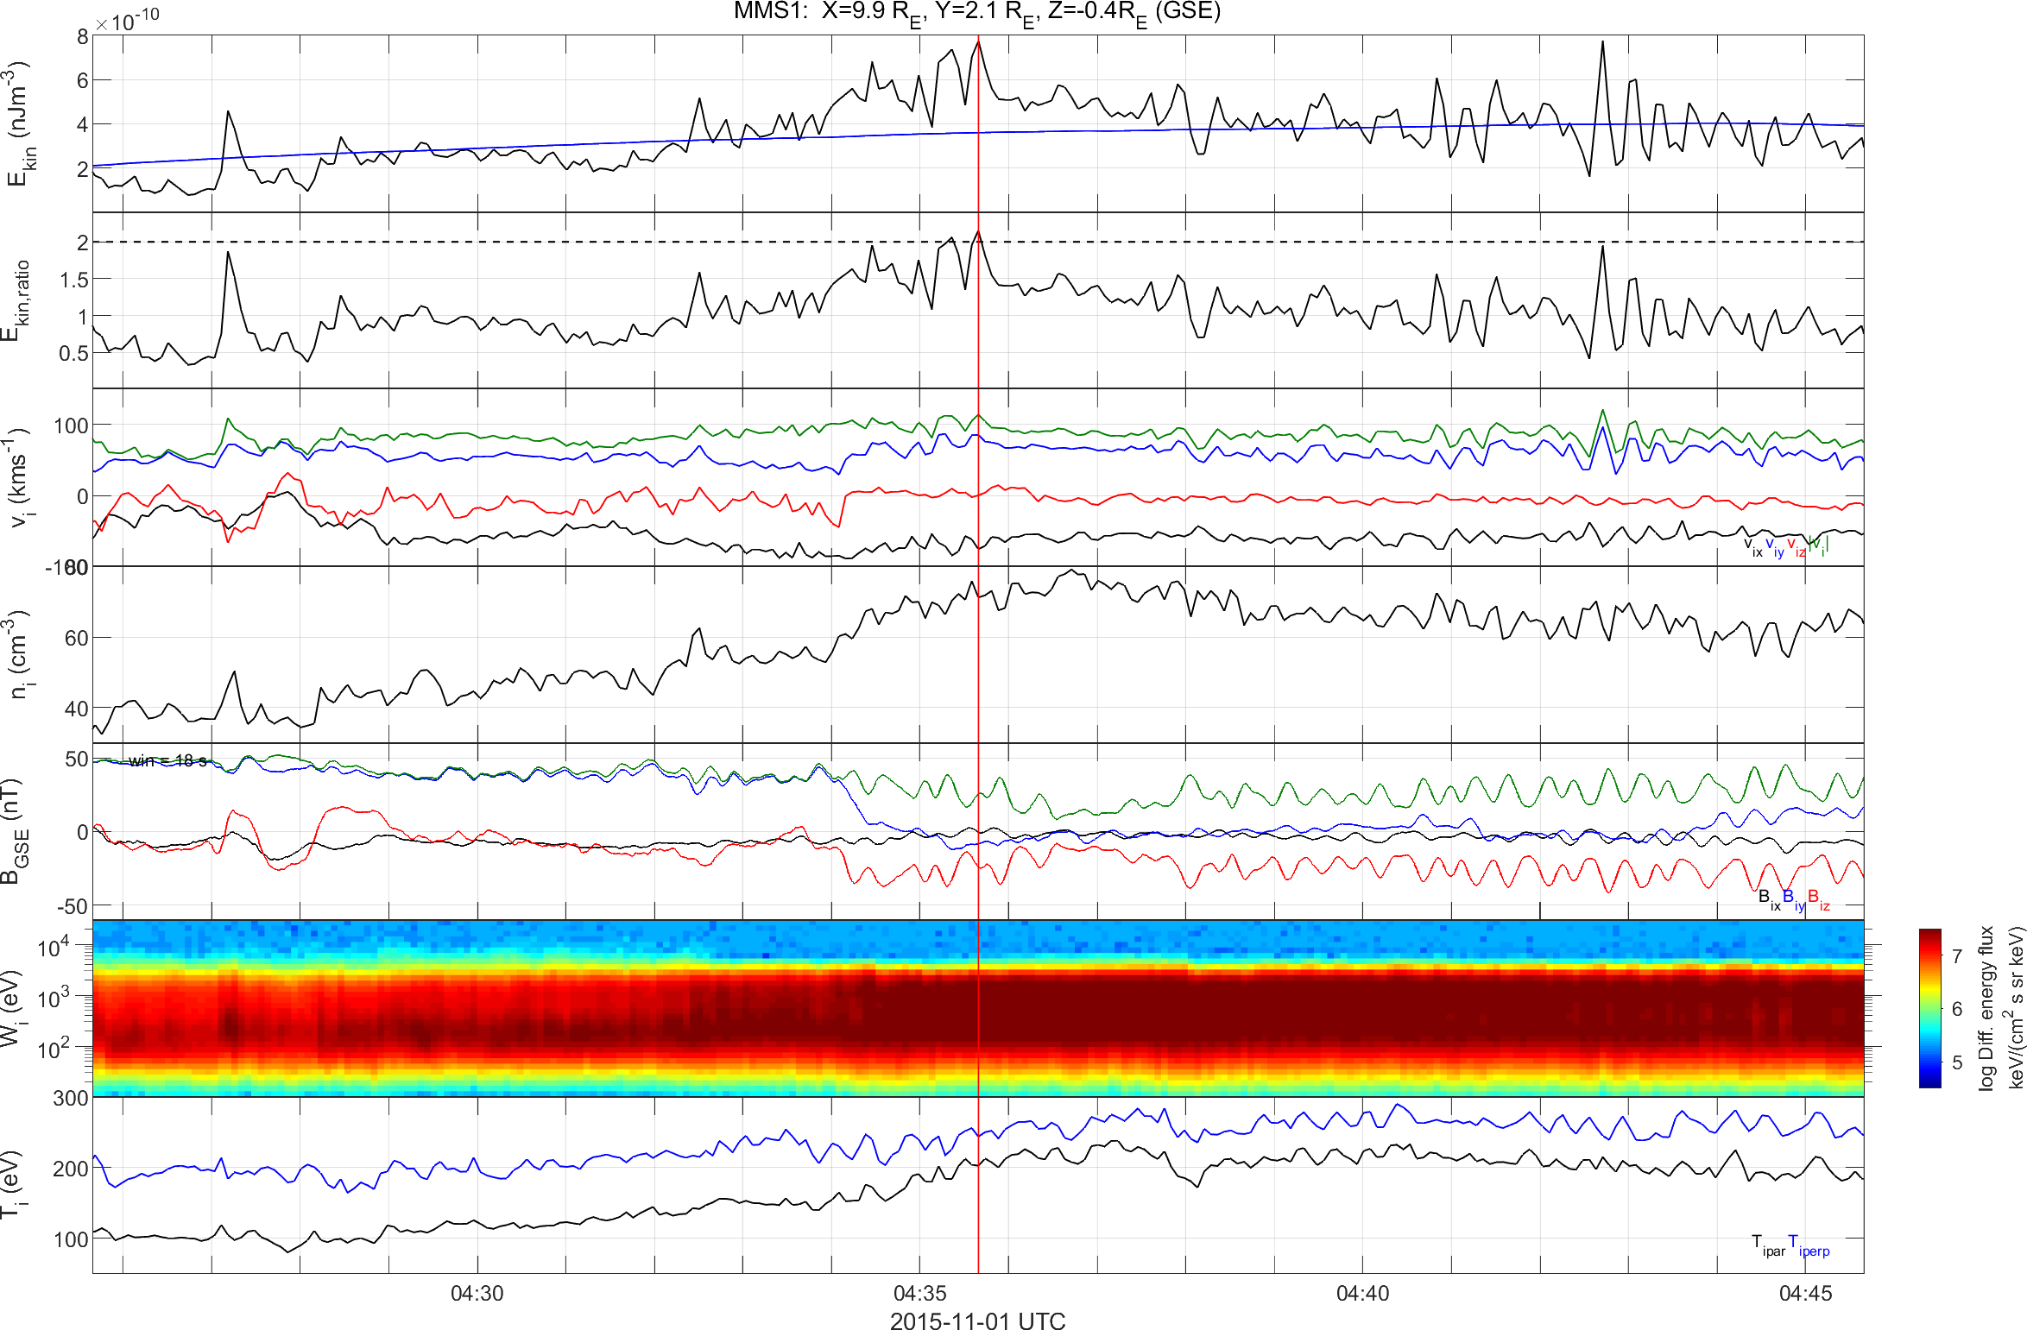
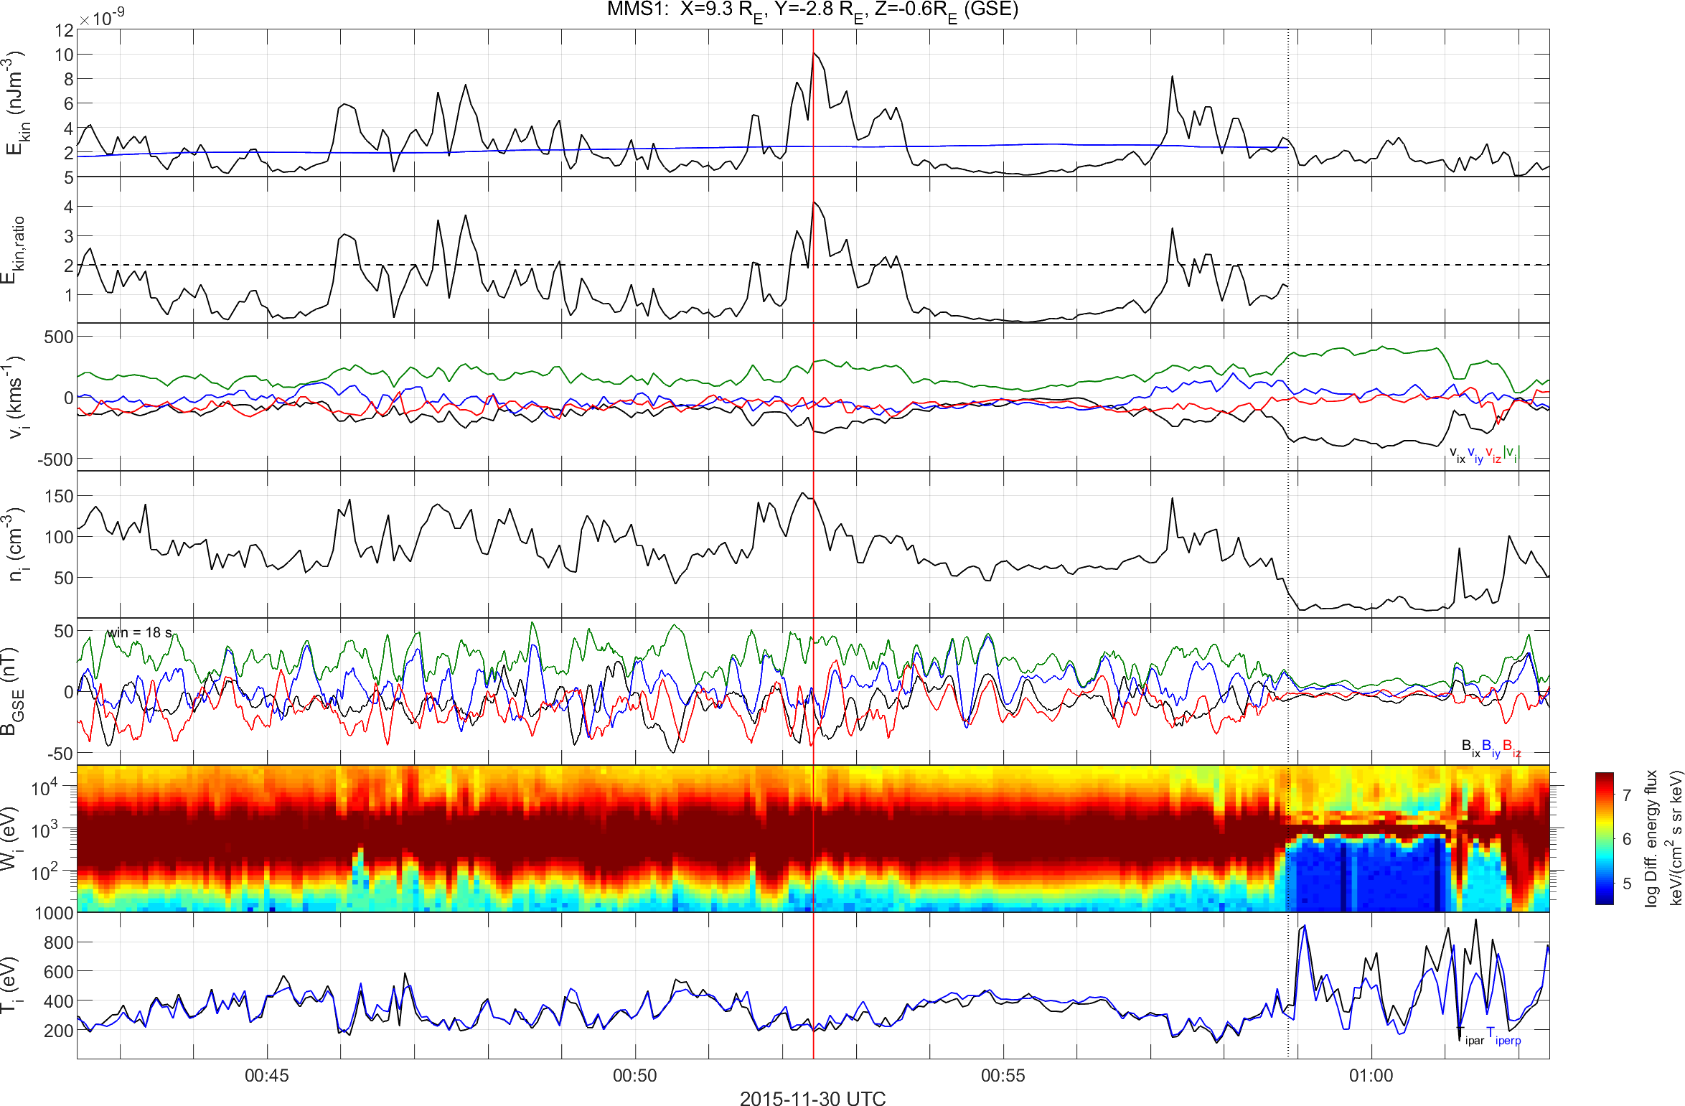
How Jets look like from MMS?
Can see many different characteristics (Density/Energy/Velocity/Magnetic Field etc.)

