Slide 1

Differentiating Between Convective and Nested Structures With a Single Spacecraft
Savvas Raptis, Tomas Karlsson, ISSI Team 465
Division of Space and Plasma Physics, KTH Royal Institute of Technology
Swedish Space Plasma Meeting 2021
02/02/2021

Slide 2
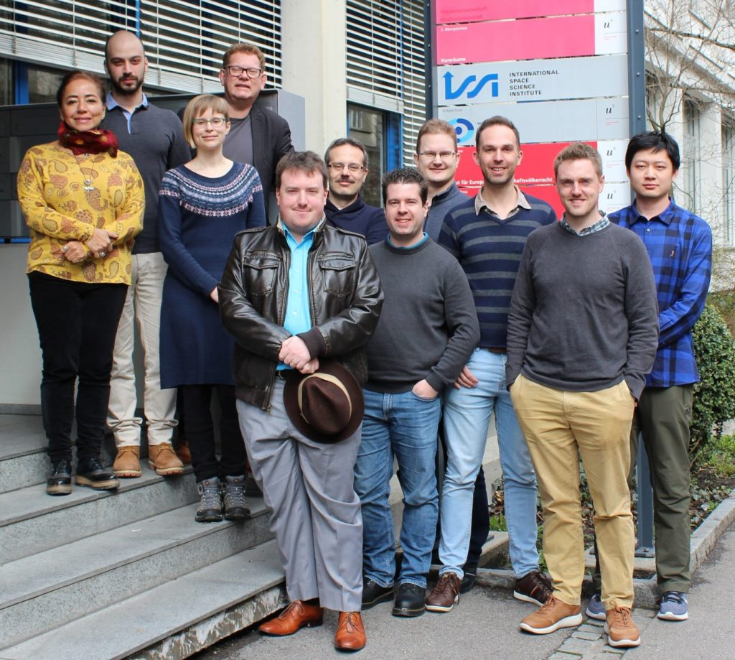
Introduction – Context
Foreshocks Across The Heliosphere: System Specific Or Universal Physical Processes?
Heli Hietala, UK (leader)
Ferdinand Plaschke, Austria (co-leader)
Martin Archer, UK
Markus Battarbee, Finland
Cesar Bertucci, Argentina
Xochitl Blanco-Cano, Mexico
Glyn Collinson, USA
Tomas Karlsson, Sweden
Terry Zixu Liu, USA (young scientist)
David Long, UK
Merav Opher, USA
Savvas Raptis, Sweden (young scientist)
Nick Sergis,Greece
2nd March 2020 - “before” the pandemic
https://www.issibern.ch/teams/heliosysspec/

Slide 3
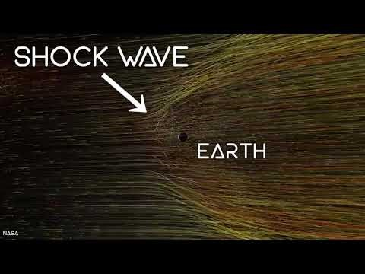
30-second introduction to the ISSI group
Martin Archer’s YouTube channel : http://www.youtube.com/martinarcherdr

Slide 4
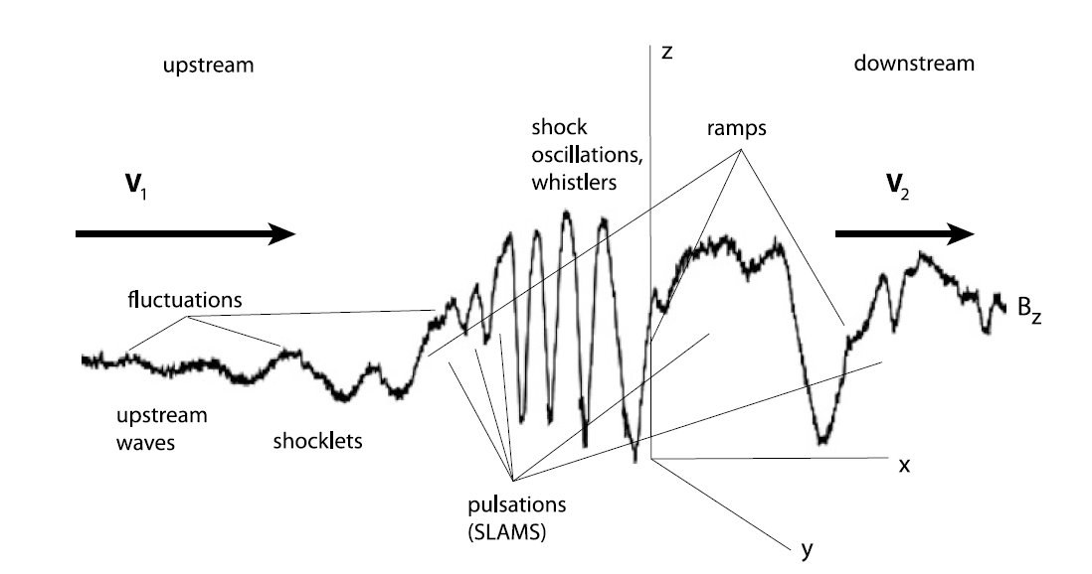
SLAMS
SLAMS (Short Large Amplitude Magnetic Structure)
Balogh, 2013
Schwartz & Burgess, 1991

Slide 5
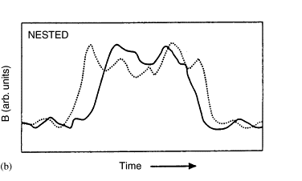
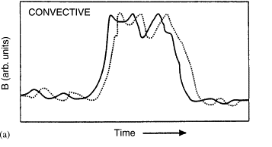
SLAMS (Convective) vs Bow Shock Movement (Nested)

Slide 6
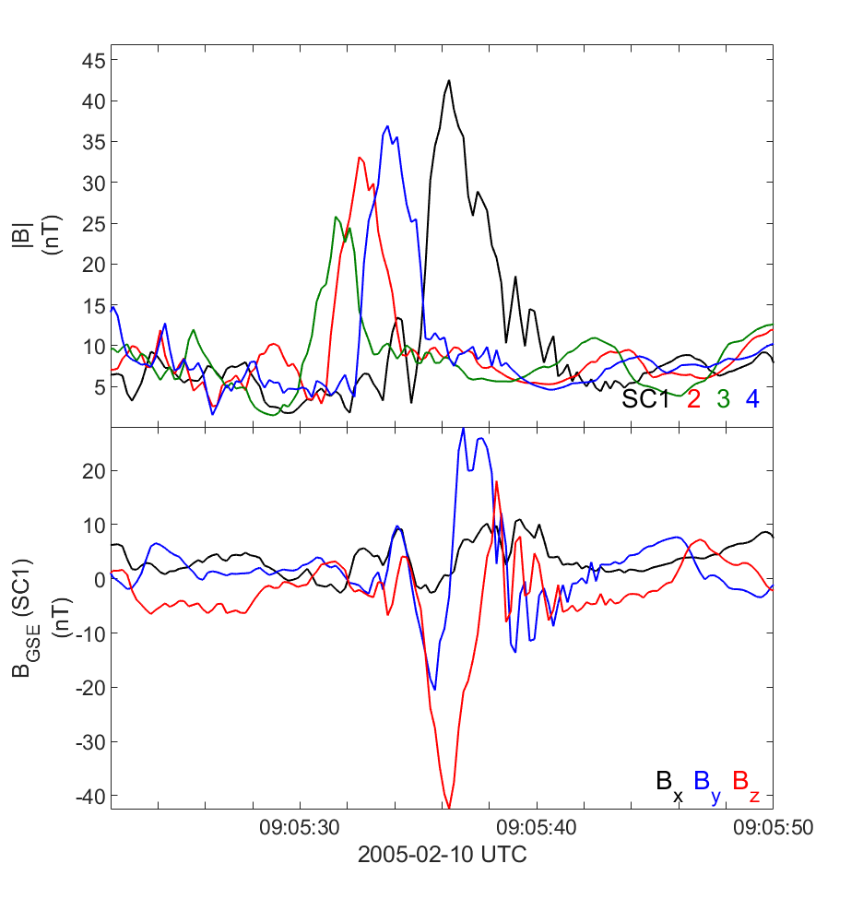
Mutli-spacecraft measurements
MMS & Cluster can do the trick
Tomas Karlsson

Slide 7
Single-spacecraft measurements
e.g. Juno, THEMIS, Cassini, MESSENGER, etc.
Tomas Karlsson

Slide 8
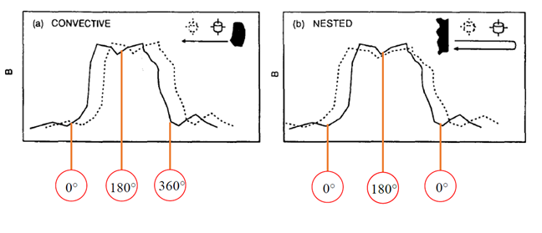
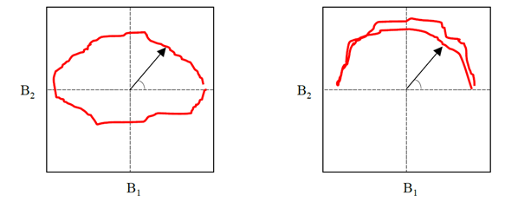
SLAMS (Convective) vs Bow Shock Movement (Nested)
Goal: Quantify the difference of these two.
Tomas Karlsson

Slide 9
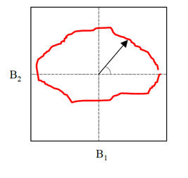
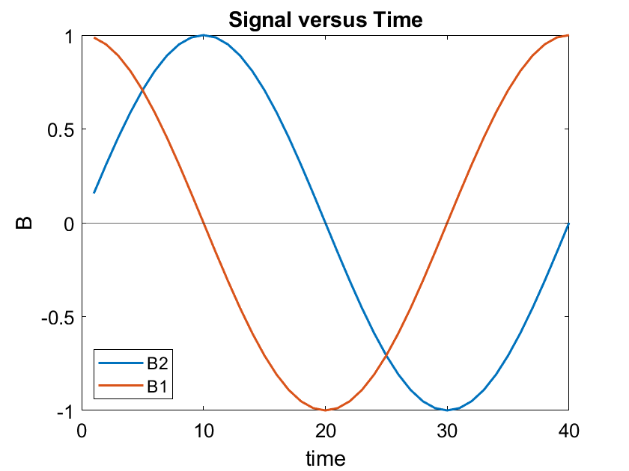
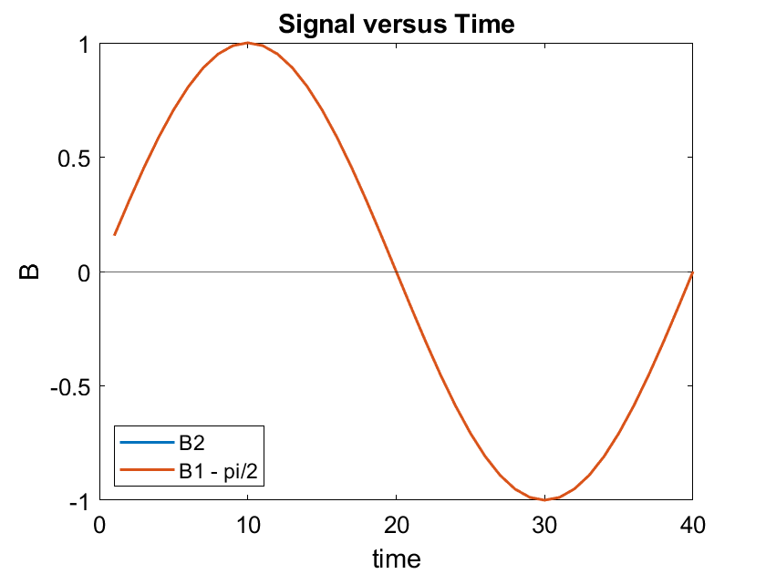
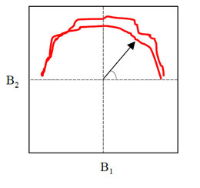
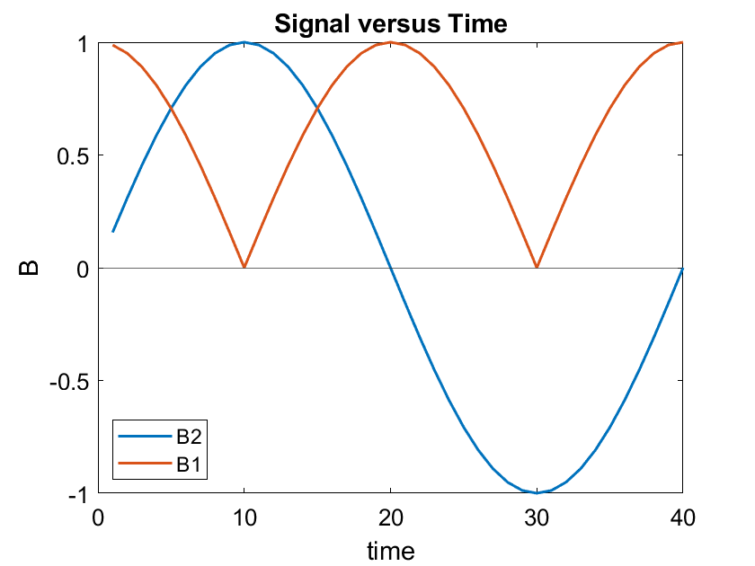
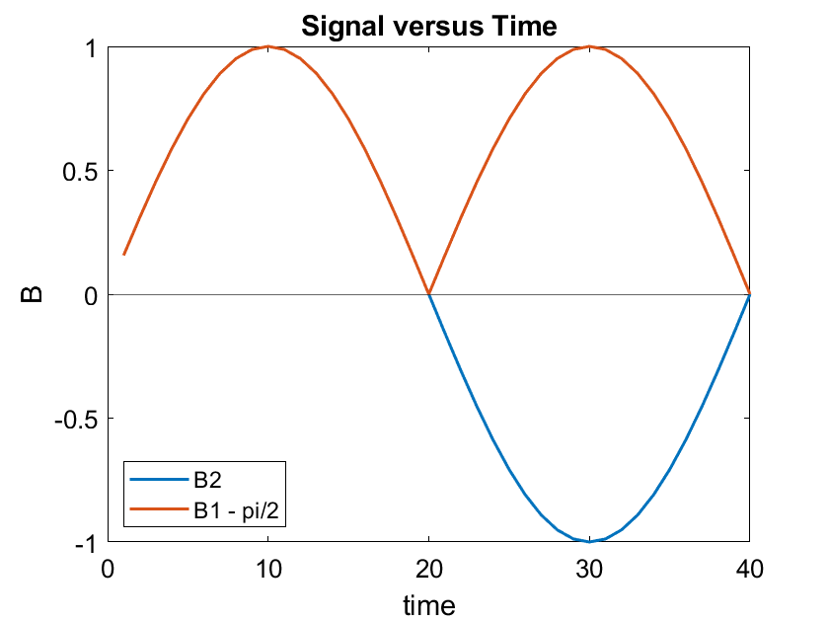
How to quantify?
Hodograms of SLAMS → ideally two sinusoids with a phase difference
SLAMS
NO – SLAMS

Slide 10
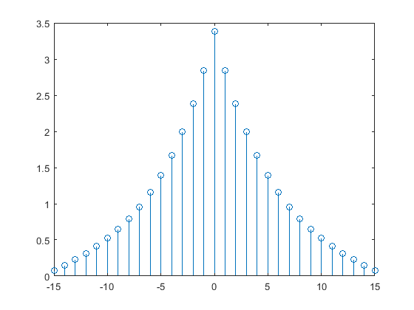
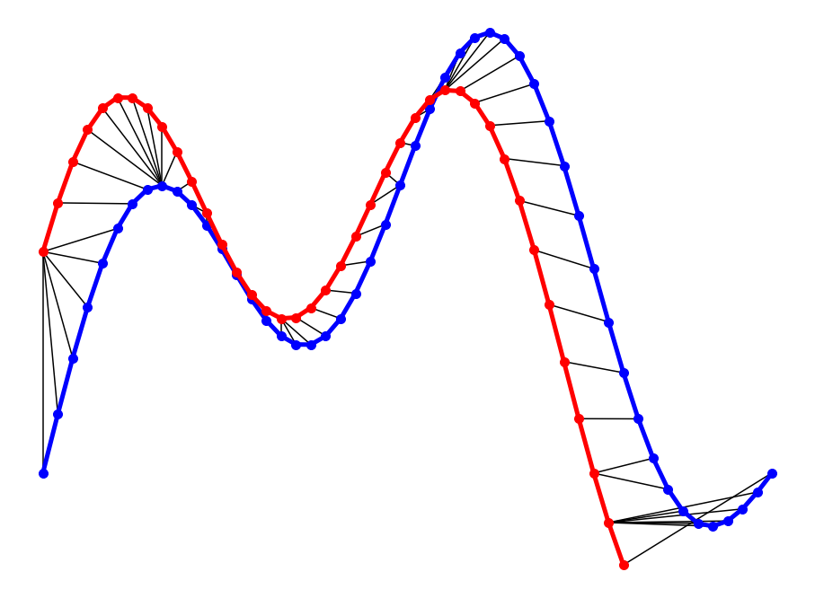
Methods of quantifying
Dynamic Time Warping (DTW)
Time Lag Correlation
“stretches two vectors, x and y, onto a common set of instants such that dist, the sum of the Euclidean distances between corresponding points, is smallest”
Time cross correlation (script)
x = crosscorr(B1,B2,'NumLags',15)
y = max(abs(x))

Slide 11
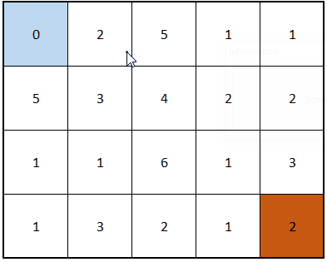
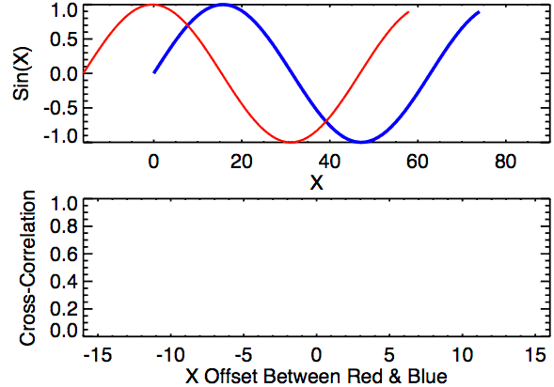
Visualization of each method
Dynamic Time Warping (DTW)
Time Lag Correlation
“DTW is simply matching one point in 1st time series with the closest point of the 2nd”
https://towardsdatascience.com/an-intuitive-approach-to-dtw-dynamic-time-warping-f660ccb77ff4
https://towardsdatascience.com/an-illustrative-introduction-to-dynamic-time-warping-36aa98513b98

Slide 12
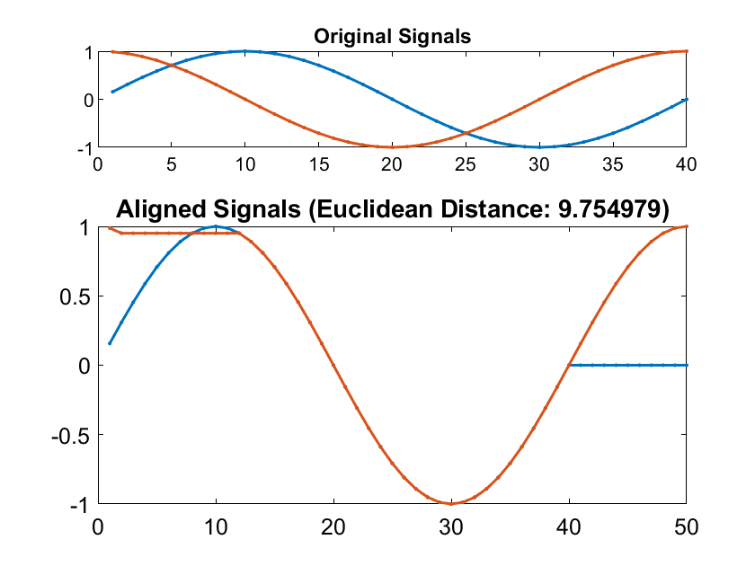
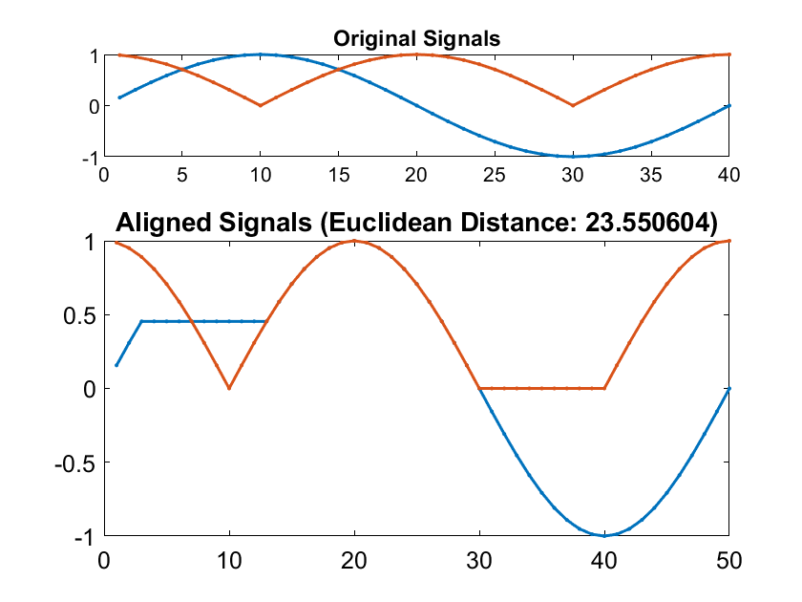
Methods of quantifying – Examples
Dynamic Time Warping (DTW)
Time Lag Correlation
SLAMS
0.9
NO – SLAMS
0.1389

Slide 13
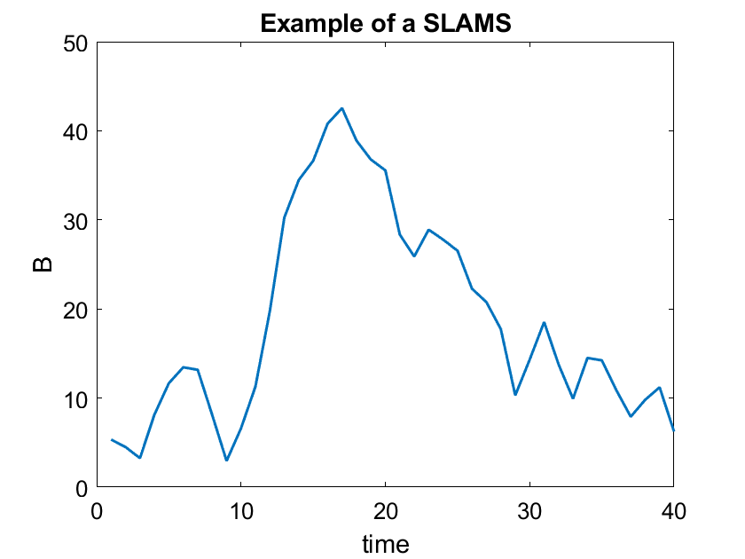
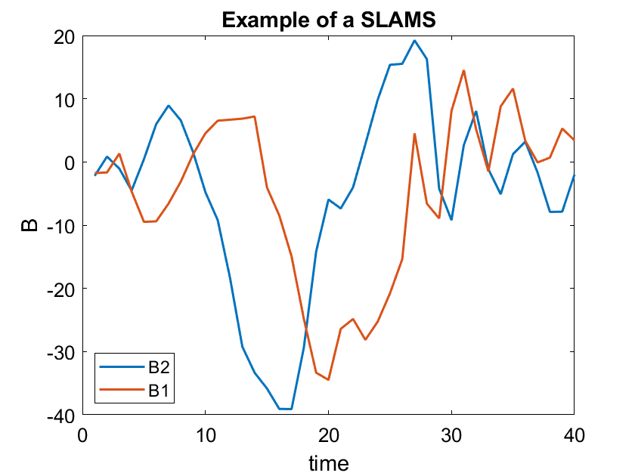
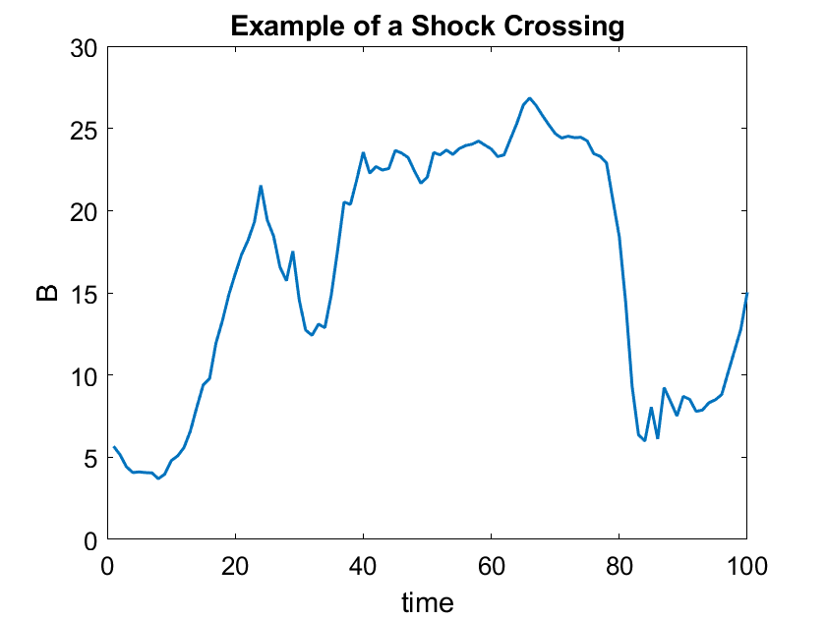
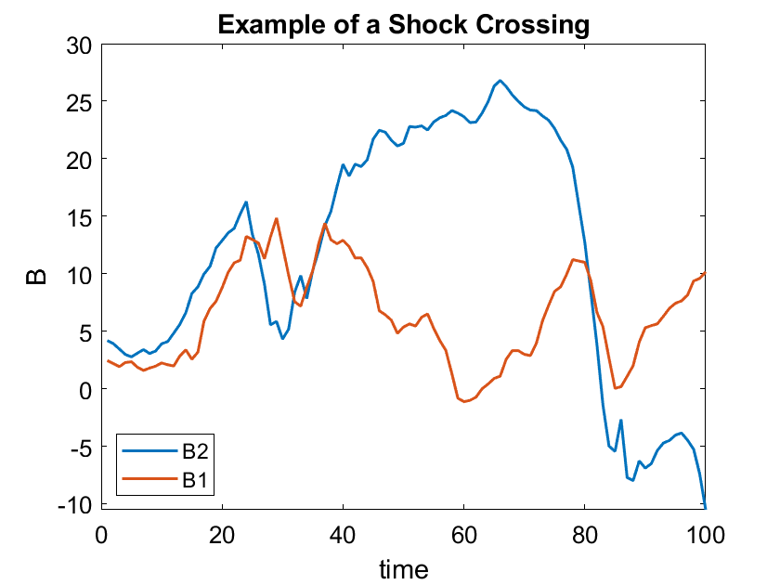
Real Examples Cluster
SLAMS
NO – SLAMS

Slide 14
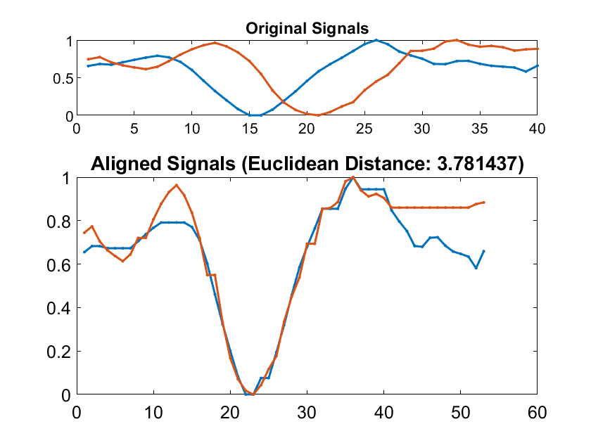
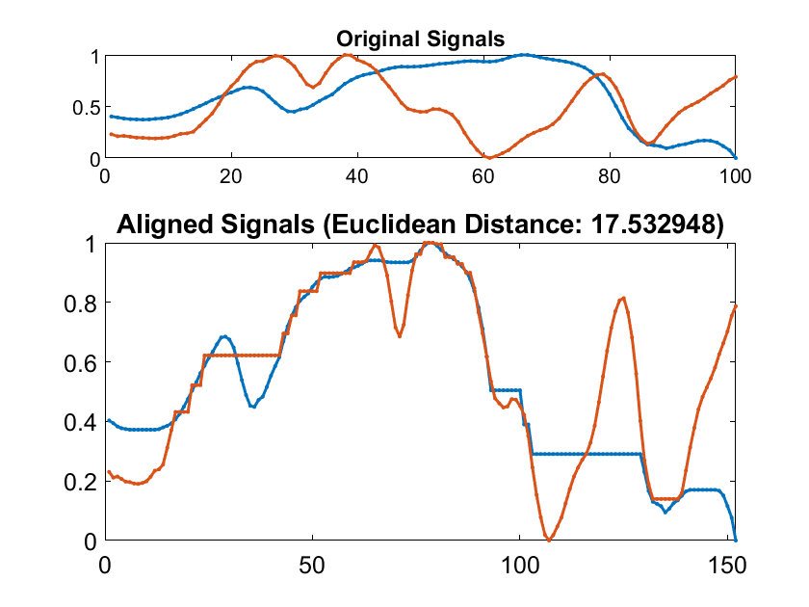
Methods of quantifying – Real Examples Cluster
Dynamic Time Warping (DTW)
Time Lag Correlation
SLAMS
0.95
NO – SLAMS
0.29

Slide 15
Results – Evaluation
Simple threshold so far works.
Dynamic Time Warping (DTW) Time Lag Correlation
SLAMS
3.7814 9.6638 8.9911 5.2317 3.4553
0.8394 0.7677 0.5562 0.8724 0.6067
NO – SLAMS
12.5774 17.5329 10.7416 15.8715 12.6228
0.2579 0.2888 0.5244 0.1580 0.5435

Slide 16
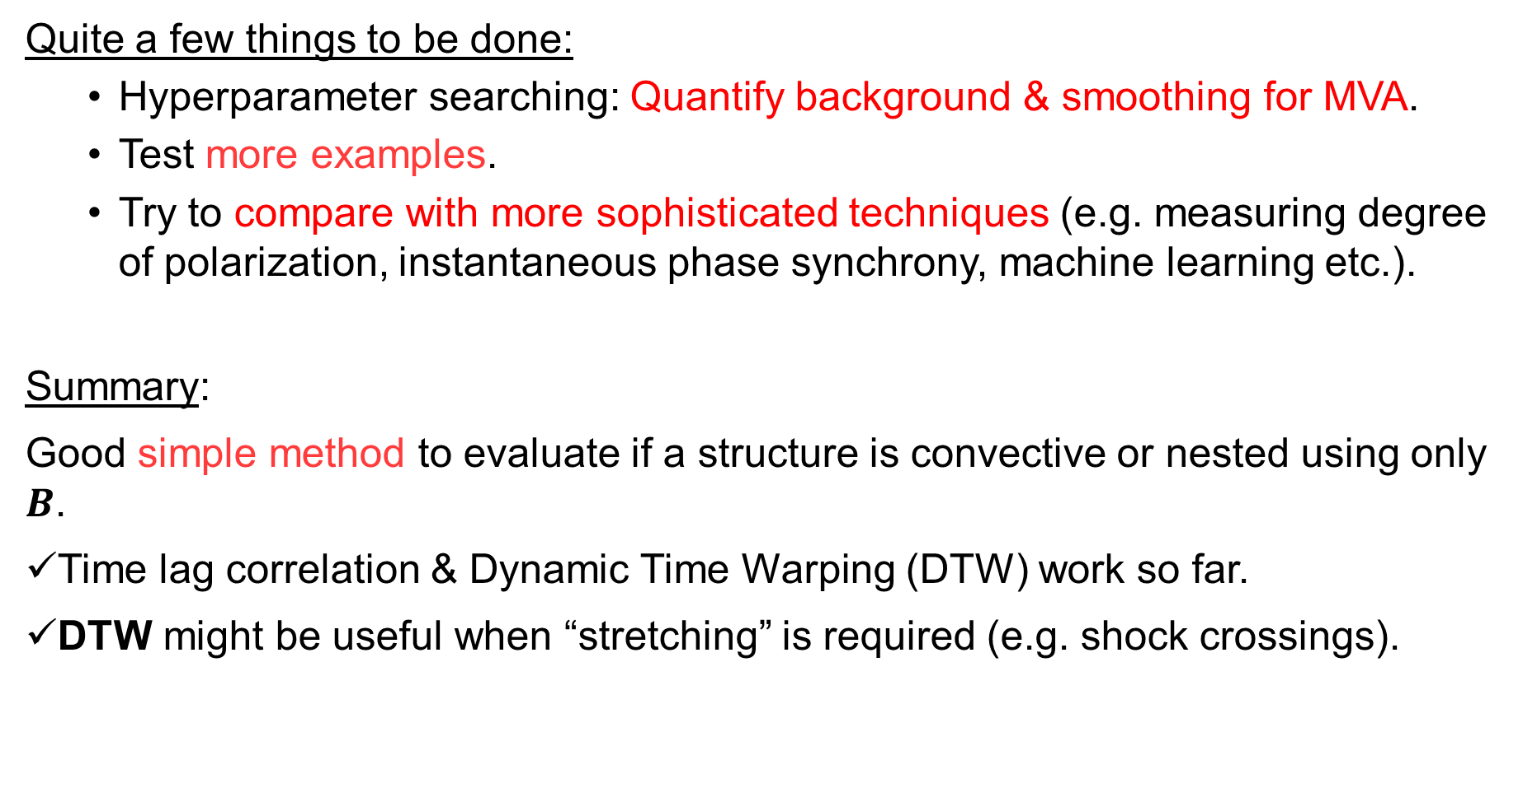
Summary & Conclusion
Quite a few things to be done:
  Hyperparameter searching: Quantify background & smoothing for MVA.
  Test more examples.
  Try to compare with more sophisticated techniques (e.g. measuring degree of polarization, instantaneous phase synchrony, machine learning etc.).
Summary:
Good simple method to evaluate if a structure is convective or nested using only $B$.
Time lag correlation & Dynamic Time Warping (DTW) work so far.
DTW might be useful when “stretching” is required (e.g. shock crossings).

