Slide 1
High-speed jets at Earth's magnetosheath & more Savvas Raptis KTH - Space and Plasma Physics, Stockholm Sweden European Space Agency (ESA), ESTEC, Leiden, The Netherlands CGS weekly meetings 18/01/2023
Soon…

Slide 2
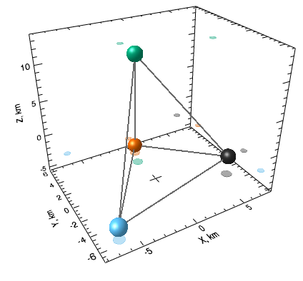
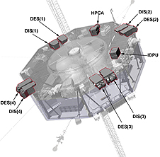
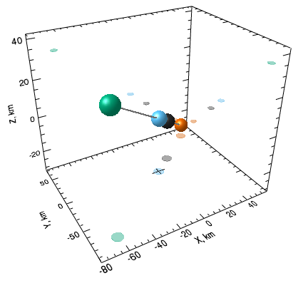
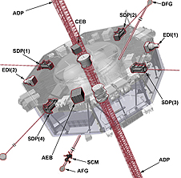
MMS mission & instrumentation
Formation
Instrumentation
Mode
Tetrahedron
String-of-pearls
FPI
FGM
fast/srvy
FPI (ions): 4.5s
FGM: 0.0625s
brst
FPI(ions): 0.15s
FGM: 0.0078s

Slide 3
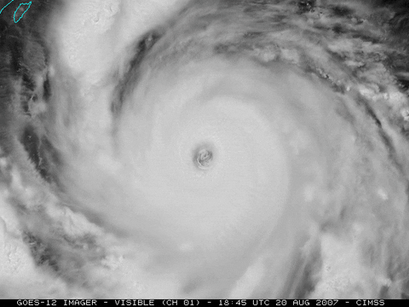
Transient events – weather
Hurricanes
Rain
Snowstorms

Slide 4
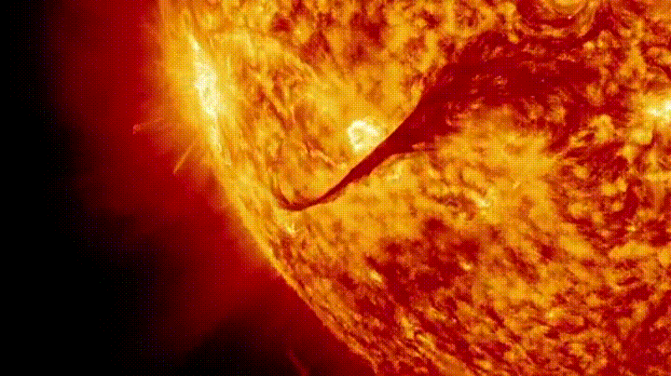
Transient events – weather
CMEs/Solar Flares
Rain
Snowstorms

Slide 5
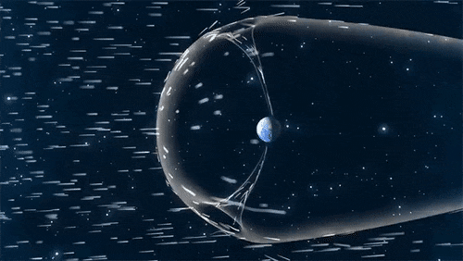
Transient events – weather
CMEs/Solar Flares
Rain
Solar cycle, streams, discontinuities
Credits : NASA

Slide 6
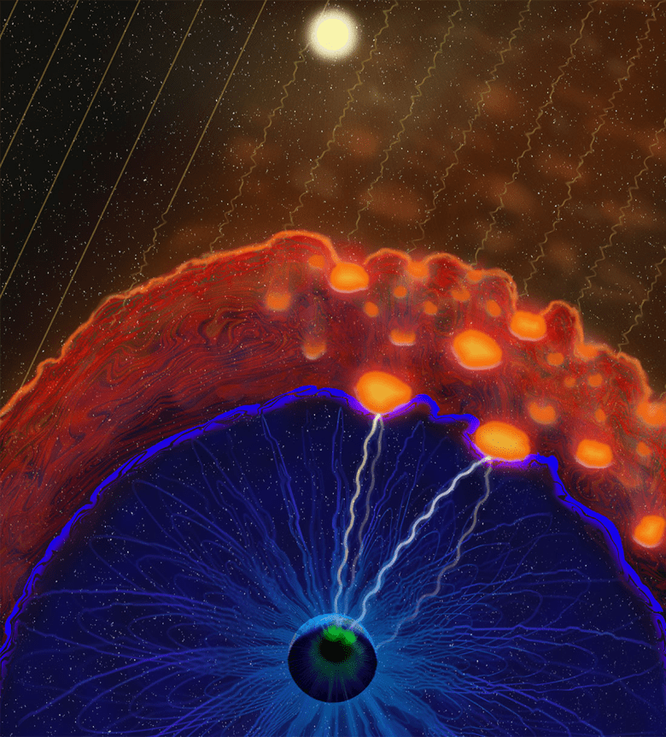
Transient events – space weather
CMEs/Solar Flares
Foreshock structures & plasma jets
Solar cycle, streams, discontinuities
Credits : NASA
Credits: Vuorinen et al. (2022) https://eos.org/features/space-raindrops-splashing-on-earths-magnetic-umbrella

Slide 7
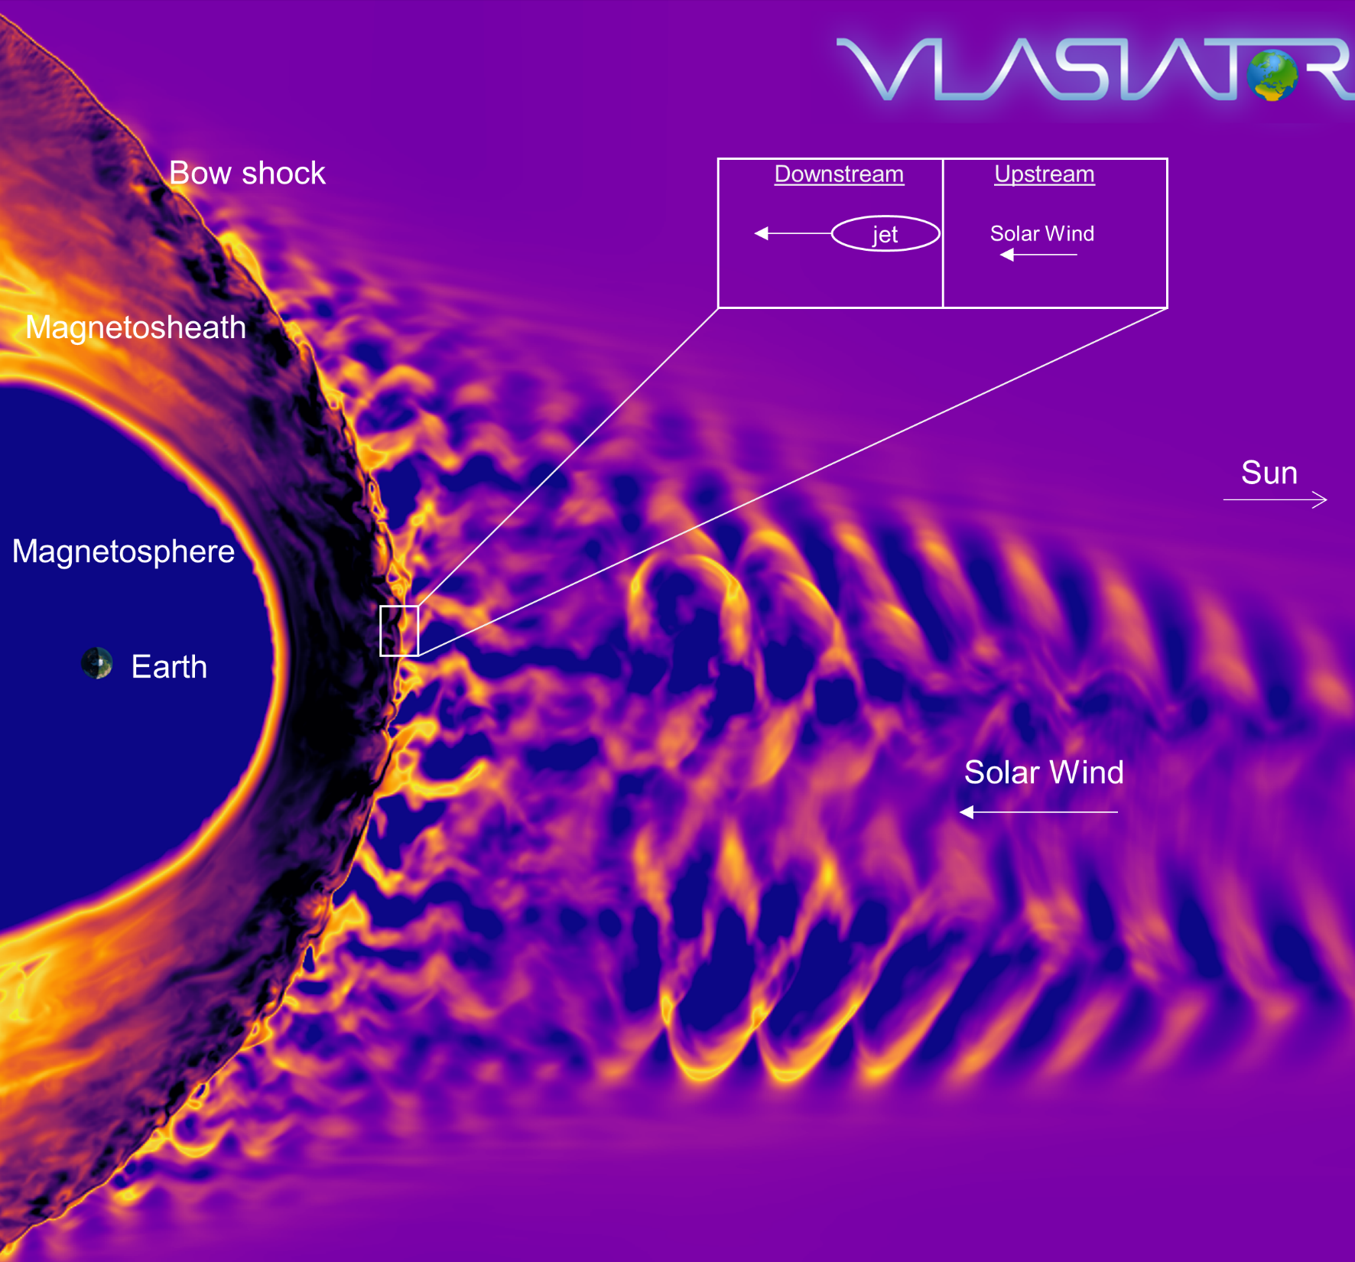
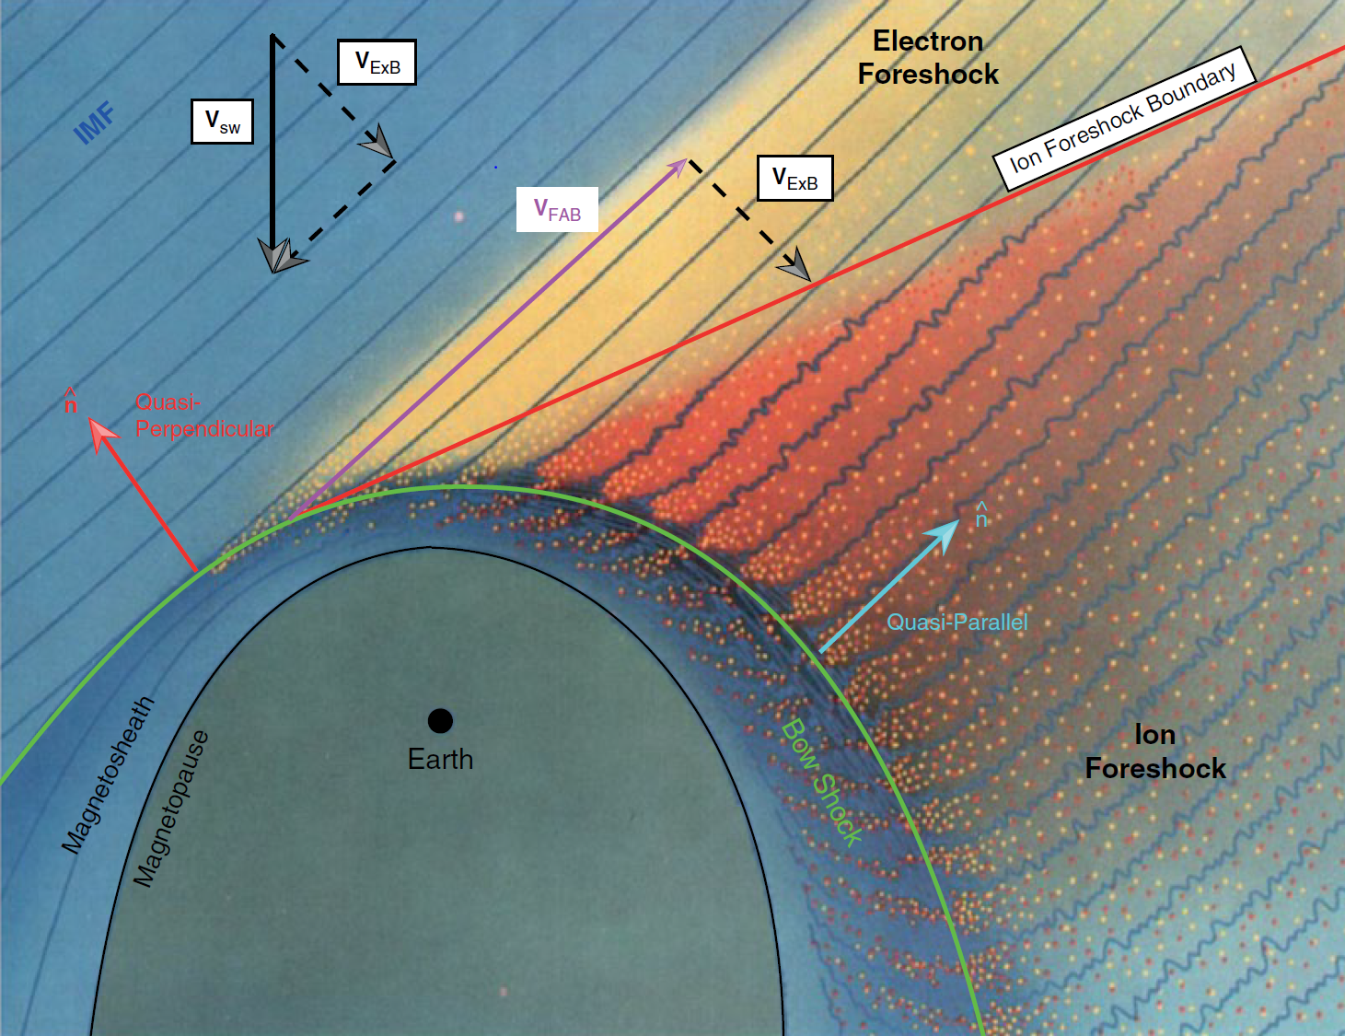
Earth’s magnetosphere & shock environment
Courtesy of M. Palmroth, U Helsinki
L. B. Wilson (2016)
Notes:
Reflection from cross field potential
A bow shock is just a nonlinearly steepened bow wave. Higher dynamic pressures compress the magnetosphere and bring the bow shock closer to Earth. Also for lower Mach number the wave speed is larger relative to the flow speed, so that a wave will travel further upstream in a given nonlinear steepening time, implying that the shock will be found further upstream
Particles that get reflected gyrate and gain energy by their motion parallel to the convection electric field of the SW. This causes downstream to develop a “ring” in the velocity phase due to the gyro-phase distribution. If you know include the upcoming non-reflected SW this causes a core and ring which is now characterized by a large temperature anisotropy.

Slide 8
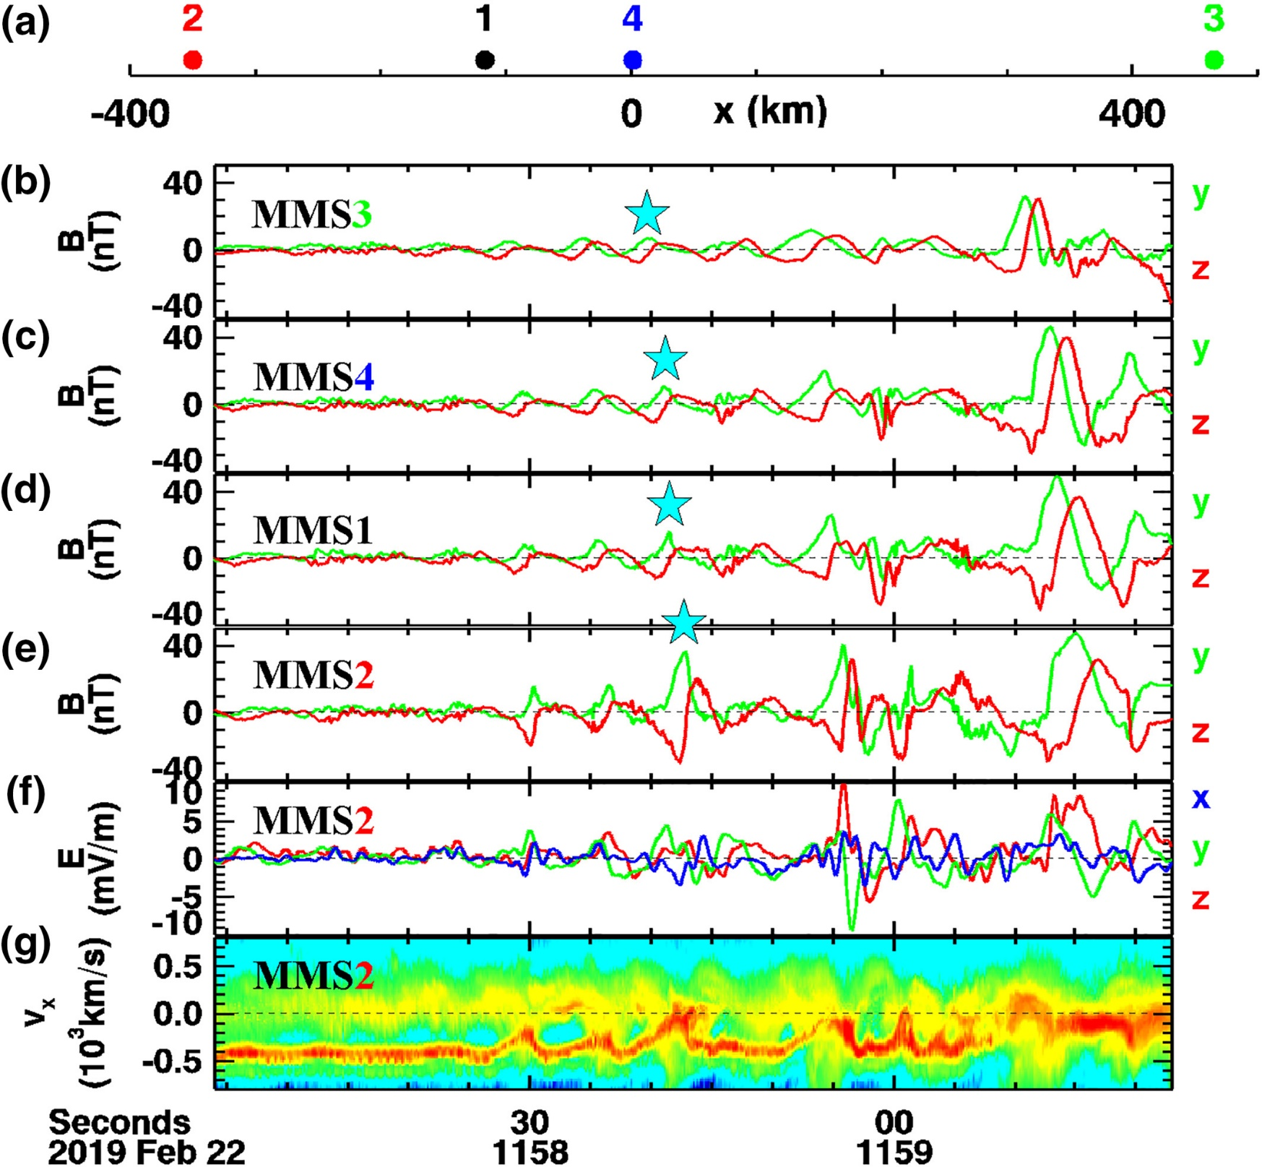
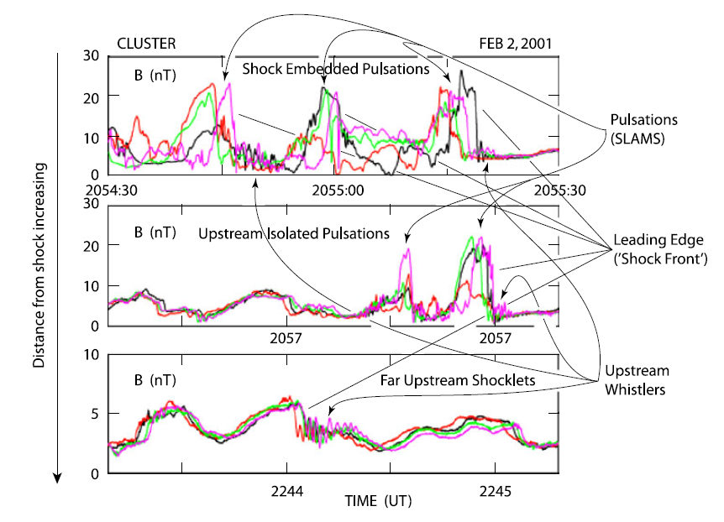
Foreshock & evolution of ULF wavefield
MMS
Cluster
Chen et al. 2021
Lucek et al, 2002

Slide 9
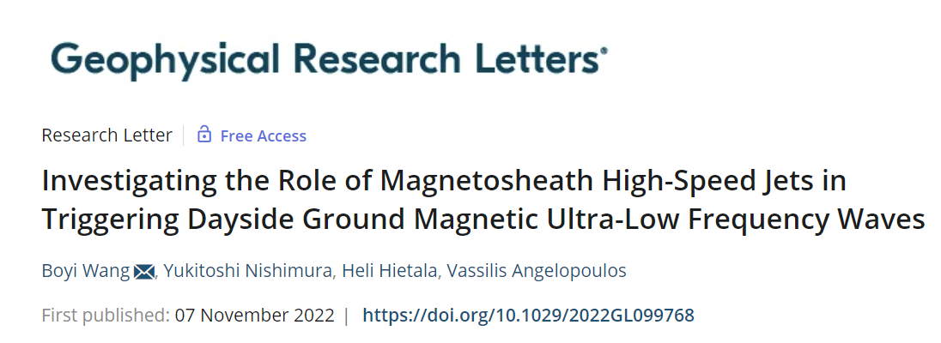
Why do we care? “big picture”
(skipping the real scientific reason, i.e., plasma, shock physics, waves etc.)

Slide 10
Jets – references update (>2019)
Associated phenomena & effects
Excitation of surface eigenmodes at magnetopause: Archer et al. (2019, 2021)
Mirror mode waves and jets: Bianco-Cano et al. (2020)
Bursty magnetic reconnection at the Earth's magnetopause: Ng et al. (2021)
Ground-based magnetometer response: Norenius et al. (2021)
Generation of Pi2 pulsations: Katsavrias et al. (2021)
B in jets, Bz variations near magnetopause: Vuorinen et al. (2021)
High-Speed Jets Triggering Dayside Ground ULF: Wang et al (2022)
Modeling & formation
Velocity & magnetic field alignment in jets: Plaschke et al. (2020)
Classification of jets using MMS & Neural Networks: Raptis et al. (2020a,2020b)
Comparison MMS vs simulations: Palmroth et al. (2021)
Solar wind effect on jet formation: LaMoury et al. (2021)
Magnetosheath Jets and Plasmoids - Hybrid Simulations: Preisser et al. (2020)
Formation of jets in Quasi-perpendicular magnetosheath: Primoz et al. (2021)
Occurrence in relation to CMEs and SIRs: Koller et al. (2022)
Shock reformation and the formation of high-speed jets: Raptis et al. (2022a)
Electron acceleration and bow waves in jets: Vuorinen et al. (2022)
Kinetic structure of jets and partial plasma moments: Raptis et al. (2022b)
Jets Downstream of Collisionless Shocks
Plaschke et al. (2018)
https://link.springer.com/article/10.1007/s11214-018-0516-3
And more : Liu et al. (2020a,2020b), Omelchenko et al (2021), Sibeck et al. (2021), Suni et al. (2021), Tinoco-Arenas et al. (2022) … etc.

Slide 11
Magnetosheath high-speed jets

Slide 12
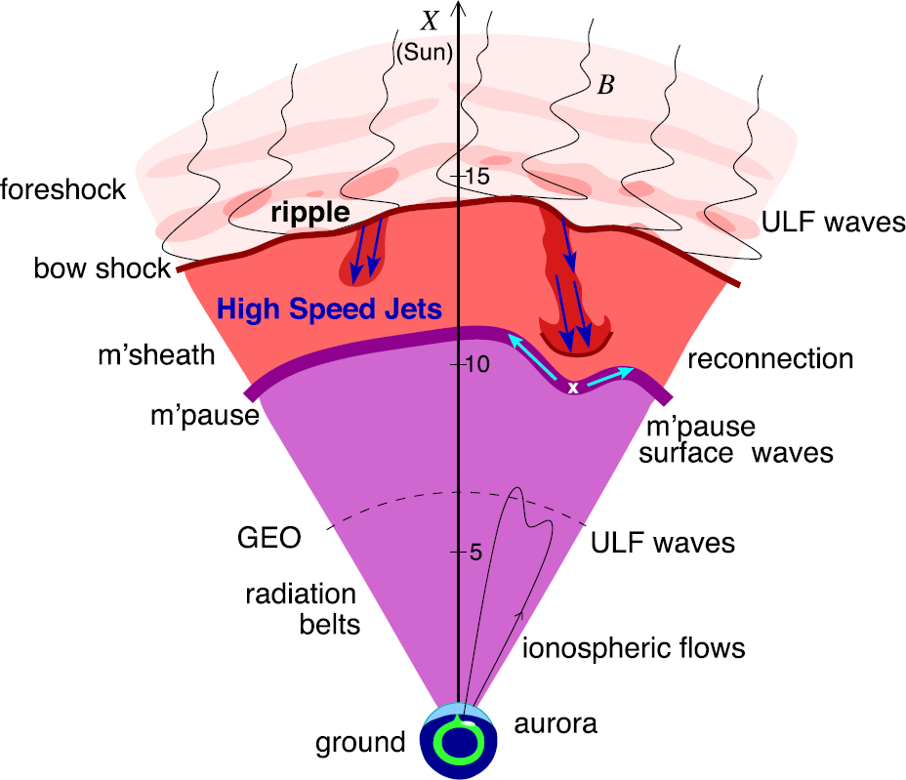
Magnetosheath jets effects
Definition
Magnetosheath jets are transient localized enhancements of dynamic pressure (density and/or velocity increase)
e.g., 200% dynamic pressure enhancement compared to background magnetosheath
Shock acceleration
Related phenomena
Radiation belts
Throat aurora
Magnetopause reconnection
Magnetopause penetration
Shock acceleration
Magnetopause surface eigenmodes
ULF waves
Substorms
Ground magnetometer detection
Plaschke F. et al. (2018); sketch by H. Hietala | Space Sci. Rev

Slide 13
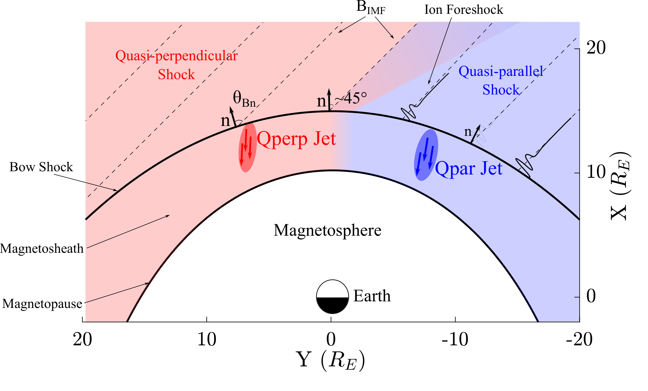
Shock, magnetosheath & jet classification
“$Θ_{Βn}$ is the angle between the IMF and the shock’s normal vector”
Qpar = $Θ_{Βn}≲{45}^{∘}$
Qperp = $Θ_{Βn}≳{45}^{∘}$
Raptis, Aminalragia-Giamini et al. (2020) | Front. Astron. Space Sci
Notes:
”~10 times more often in Qpar MSH”

Slide 14
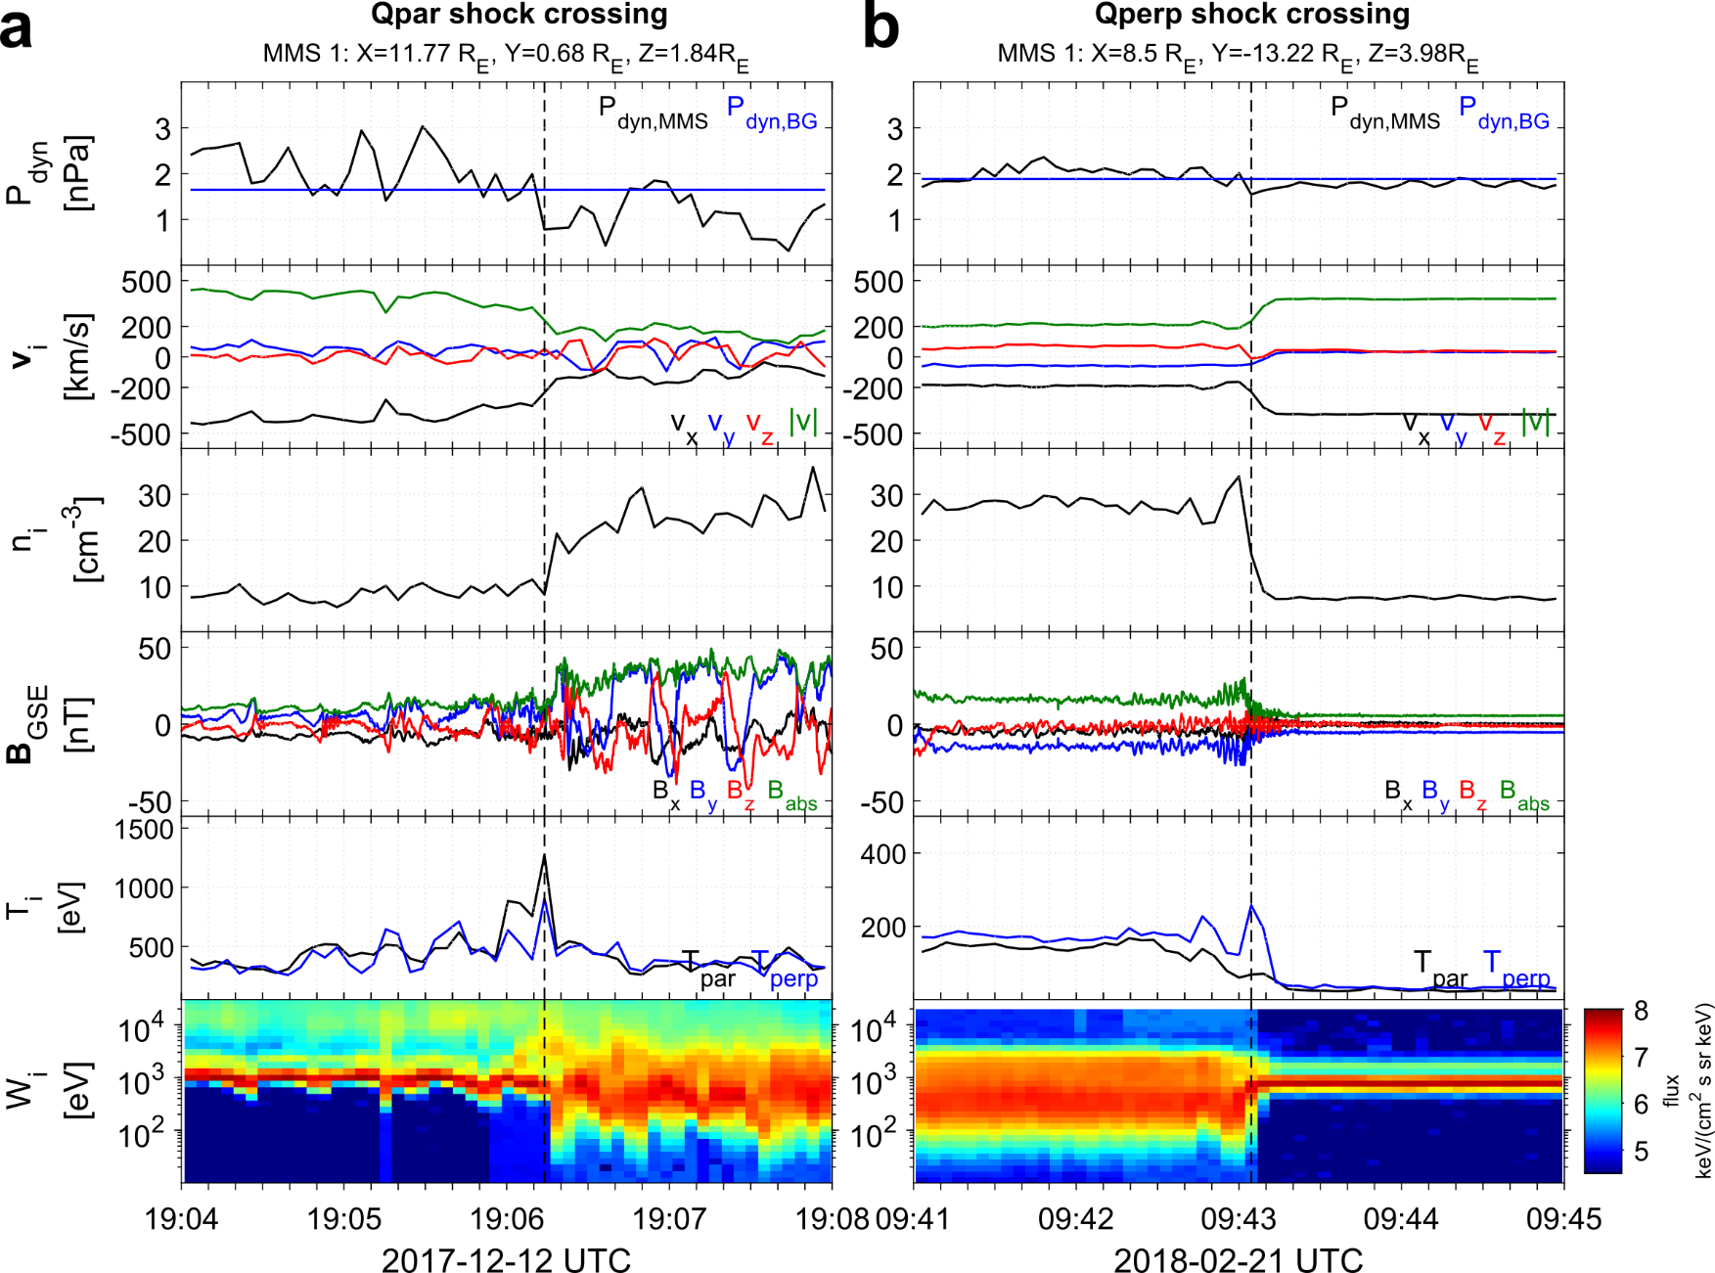
Shock transitions with MMS
SW
MSH
MSH
SW
high-energy ions

Slide 15
Recent Results of Jets

Slide 16
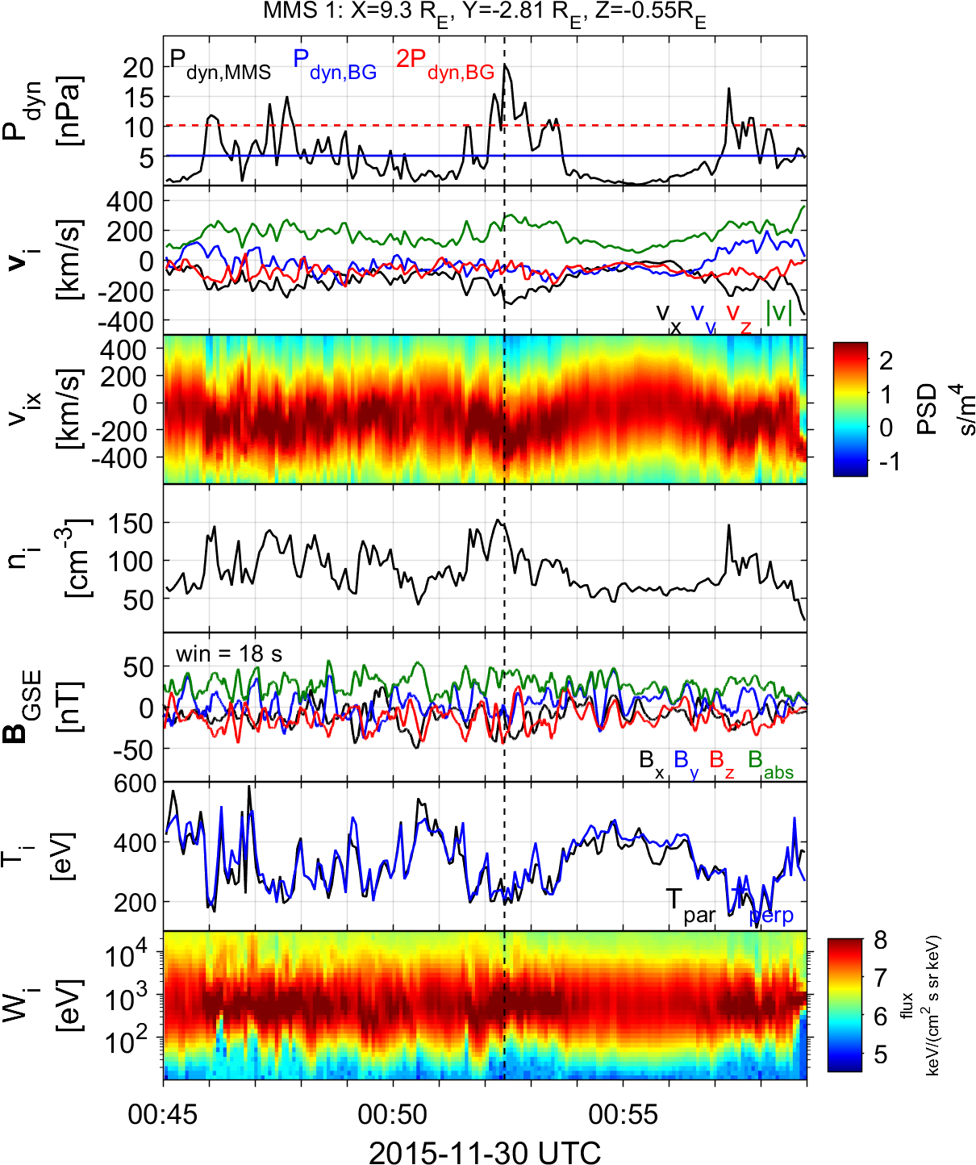
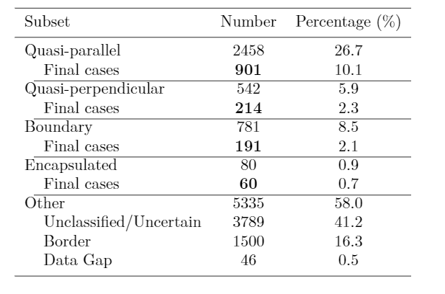
Summarized properties – Quasi parallel
Most common
High dynamic pressure
Primarily Earthward
Associated with low temperature (ΔΤ)
Associated with high |B| & ΔΒ
Δβ<0
Qpar Jet
Jets found in $Q_{∥}$ MSH
Raptis S., Karlsson T., et al. (2020) | JGR

Slide 17
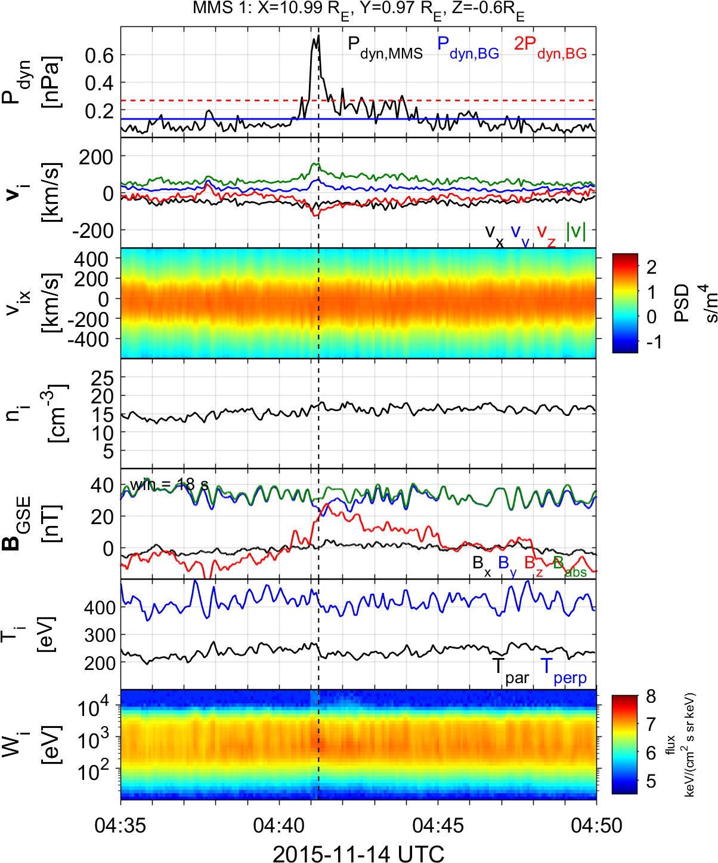
Summarized properties – Quasi perpendicular
Less common
Less Energetic
Mainly velocity driven
Very small duration (~4 sec)
Could be connected to MSH reconnection, mirror mode waves or FTEs
Qperp Jet
Jets found in $Q_{⊥}$MSH
Raptis S., Karlsson T., et al. (2020) | JGR

Slide 18
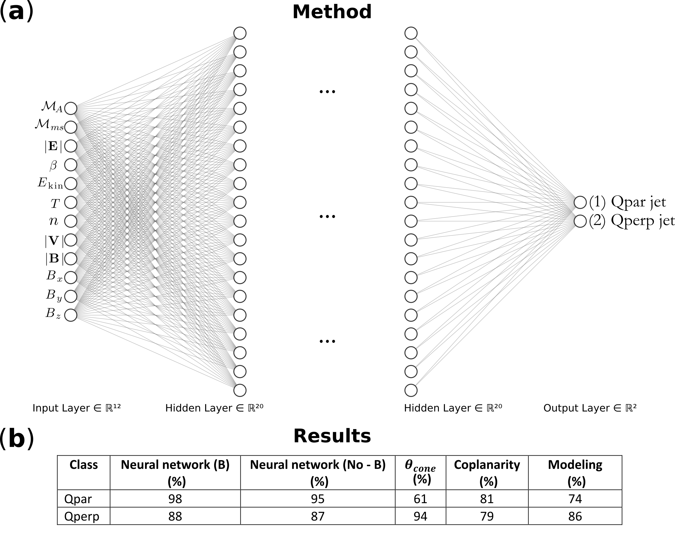
Classifying jets with Neural Networks
Upstream
SW
L1 OMNI
Downstream
MSH
MMS
Raptis, Aminalragia-Giamini et al. (2020) | Front. Astron. Space Sci

Slide 19
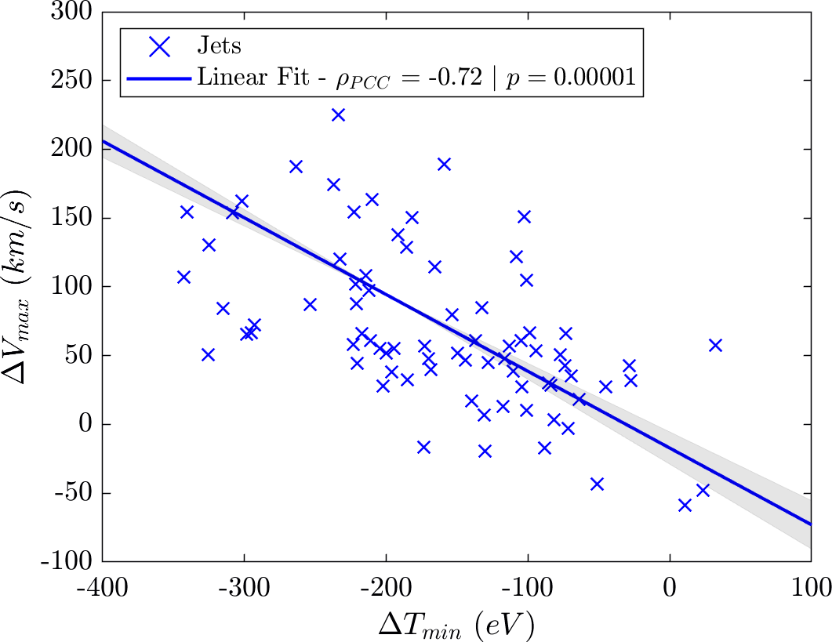
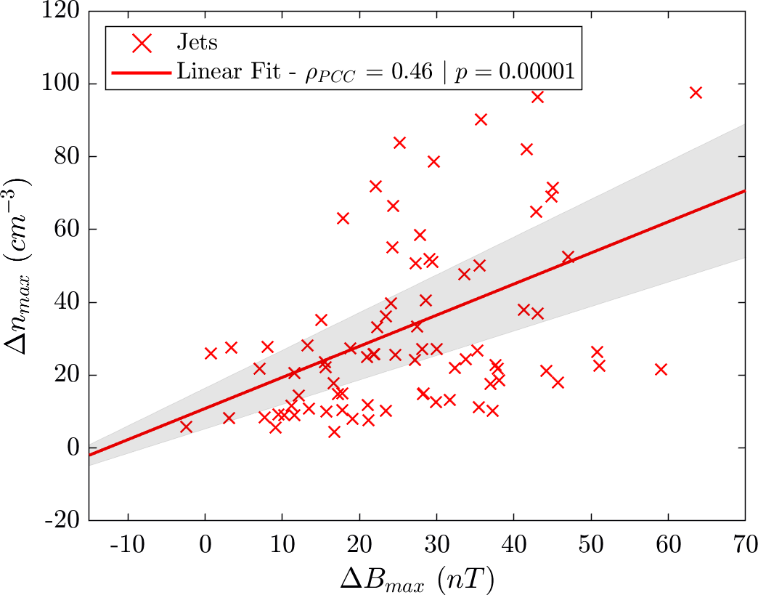
Example: statistics of subset close to bow shock
$$n=90$$
$95\% CI:[−0.81 , −0.6$]
$95\% CI:[0.27 , 0.62$]
(unpublished data – Ongoing work)

Slide 20
Burst data of MMS

Slide 21
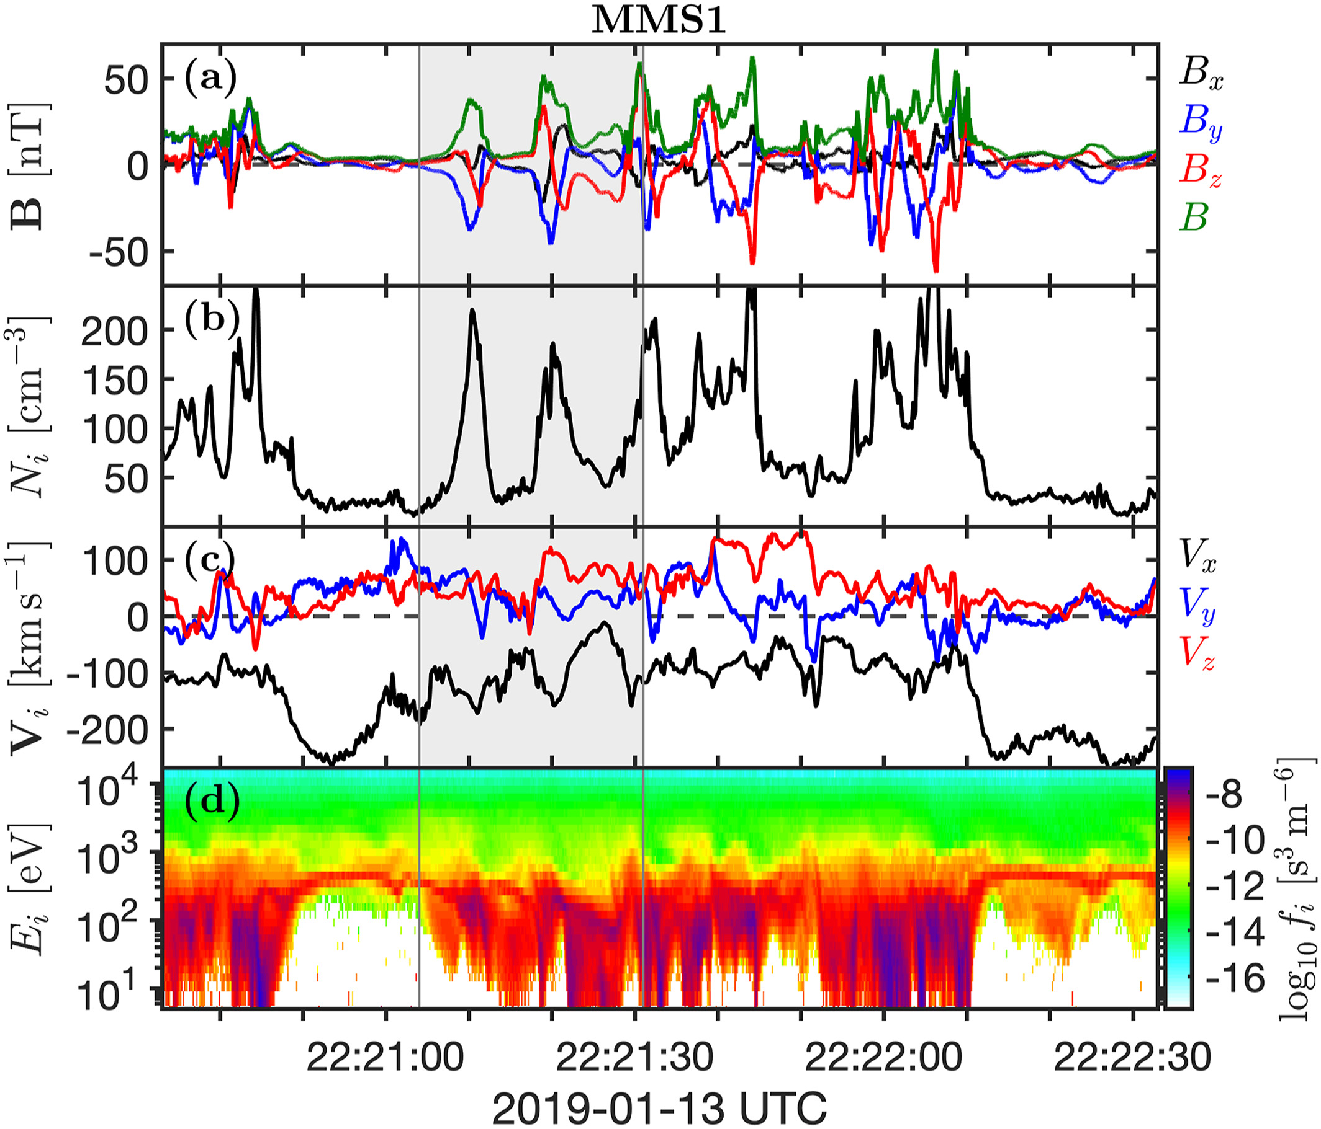
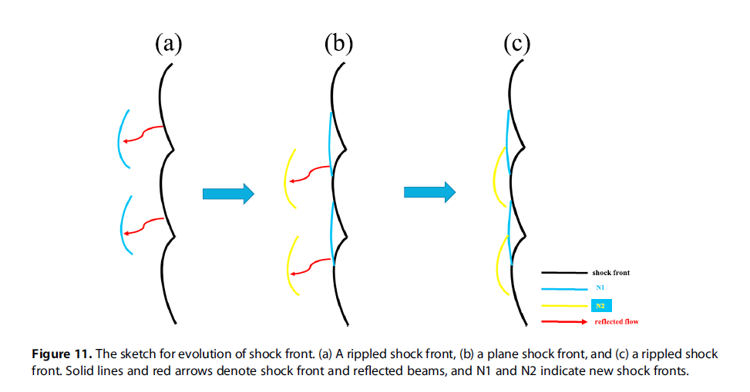
Shock global reformation
Shock Reformation
Burgess (1989): “the shock exhibits a cyclic behavior ….. cyclic shock reformation;”
Hao et al. (2017)
Similar definitions : Hao et al. (2016,2017), Liu et al. (2021), Johlander et al. (2022), Raptis et al. (2022a)
Johlander et al. (2022)
Notes:
Average ~20 seconds

Slide 22
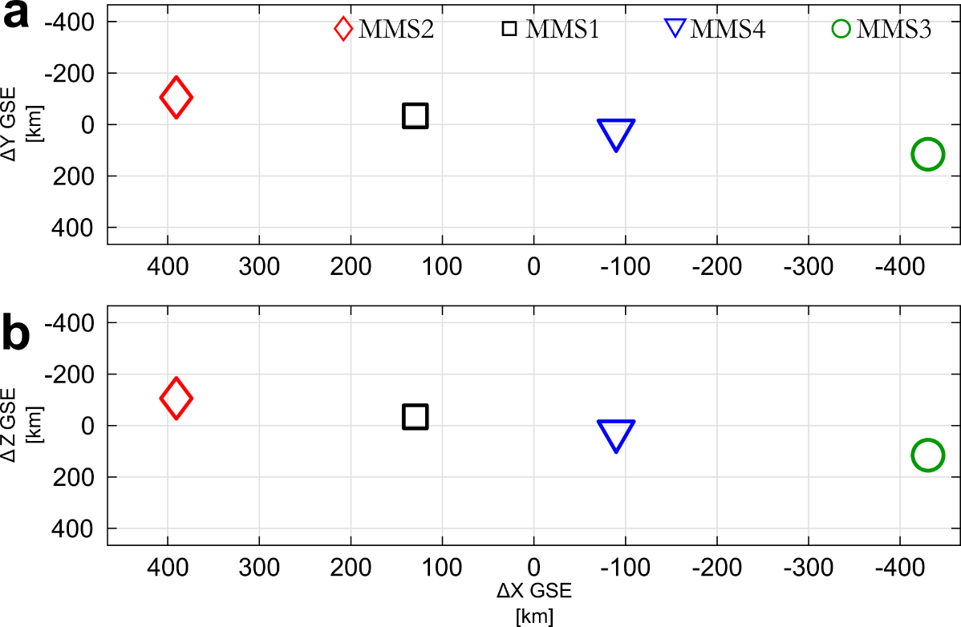
SLAMS – wave activity and reformation
Sun
Earth
Evolution of SLAMS
Interaction with upstream whistler
New peak /evolution*
Formation of downstream density enhancement**
* See similar examples by Turner et al. (2021), Chen et al. (2021) | (Self-) reformation
** See similar example by Liu et al. (2021) | (Global) reformation

Slide 23
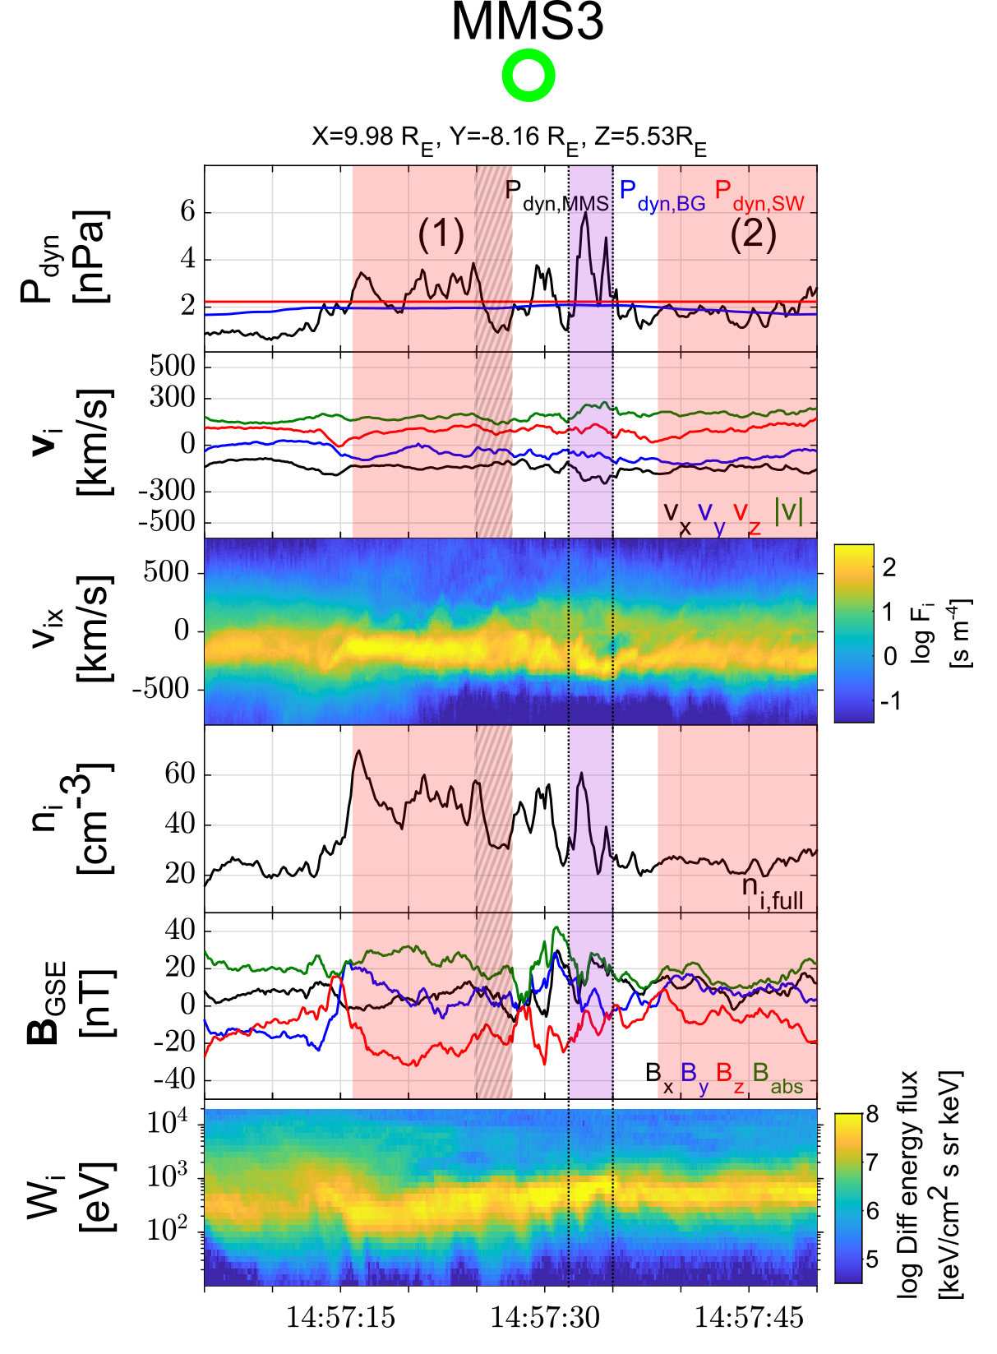
Jet “slipping through” the reformation cycle
Sun
Earth
Properties
Thermalized distribution
Compression
Dynamic pressure increase (i.e., increase in velocity and density)
Raptis S., et al. 2022a | Nat. Commun.

Slide 24
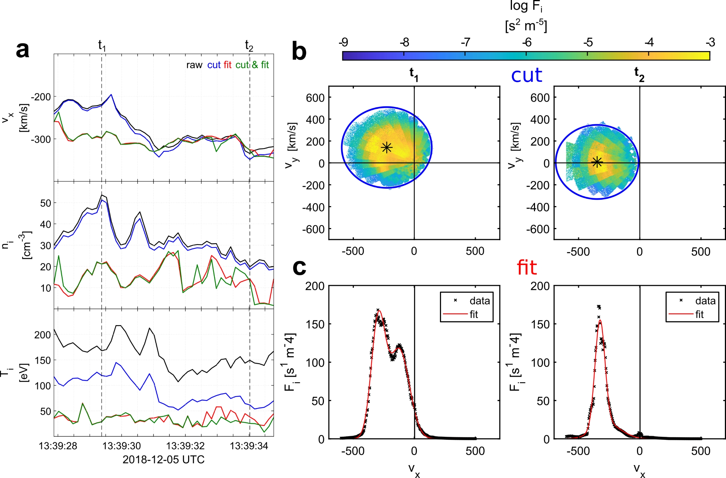
Partial moment derivation
Methods:
Cut : 1$v_{th}$ sphere in 3D VDF around bulk velocity
Fit : Fit 2 Maxwellians in 1D reduced VDFs
Raptis S, et al,. 2022b | GRL

Slide 25
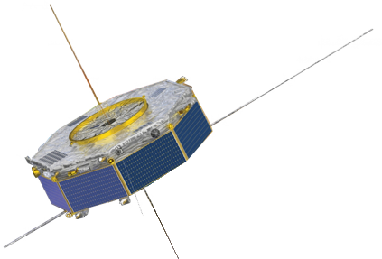
Comparison
MMS VS Vlasiator
Palmroth, M., Raptis, S., et al. (2021). Magnetosheath jet evolution as a function of lifetime: global hybrid-Vlasov simulations compared to MMS observations, Ann. Geophys., 39, 289–308, doi:10.5194/angeo-39-289-2021
Notes:
Vlasiator, treats proton as VDFs and electrons as massless charge-neutralizing fluid. Evolution through Vlasov equation

Slide 26
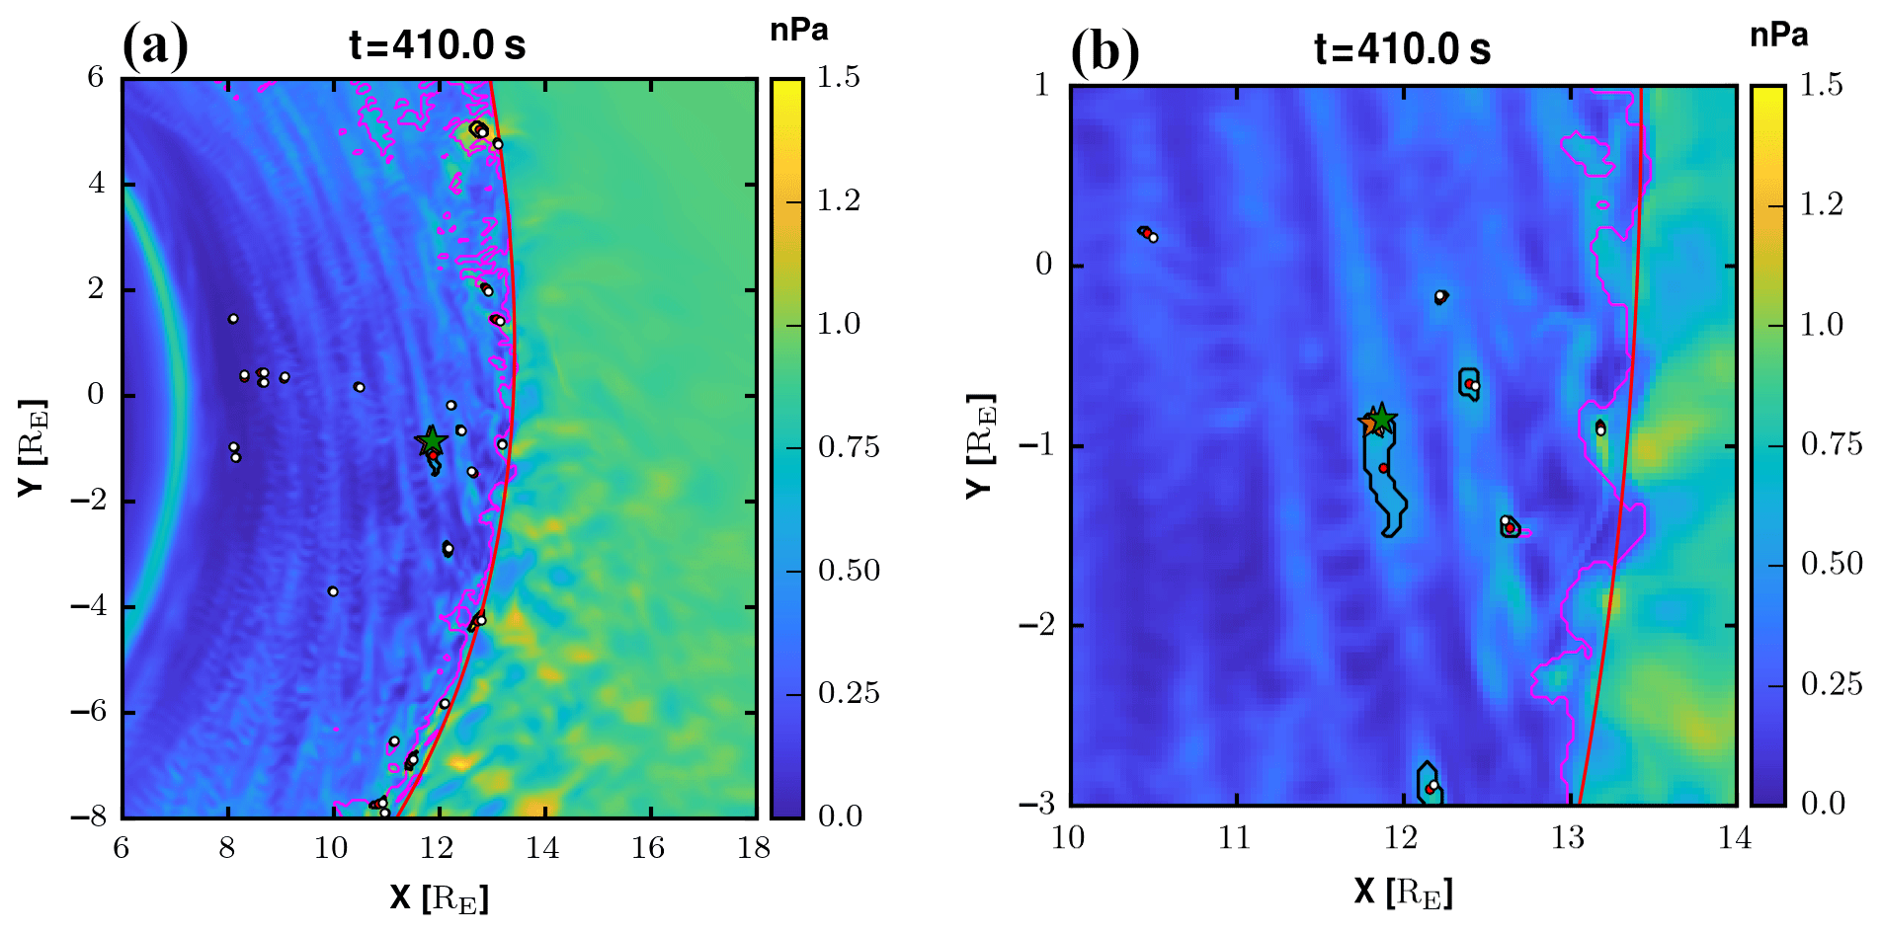
Jets in simulations
Palmroth, et al. (2018)
Palmroth, Raptis et al. (2021)

Slide 27
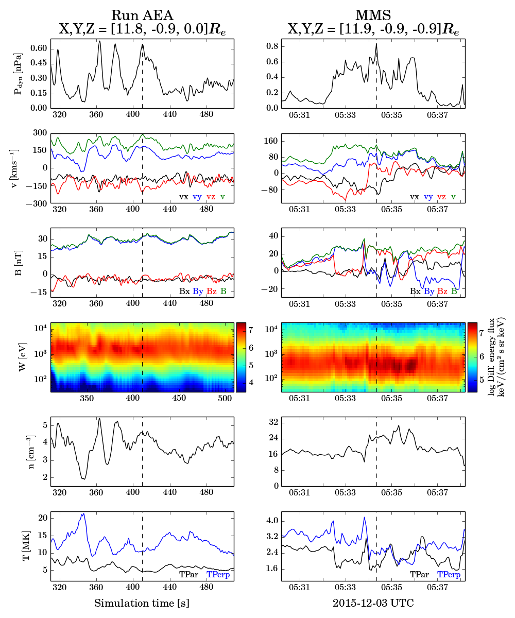
Case Comparison
Dynamic Pressure
Velocity
Magnetic Field
Ion Energy Spectrum
Density
Temperature
Palmroth M., Raptis S., et al. (2021) | Annales

Slide 28
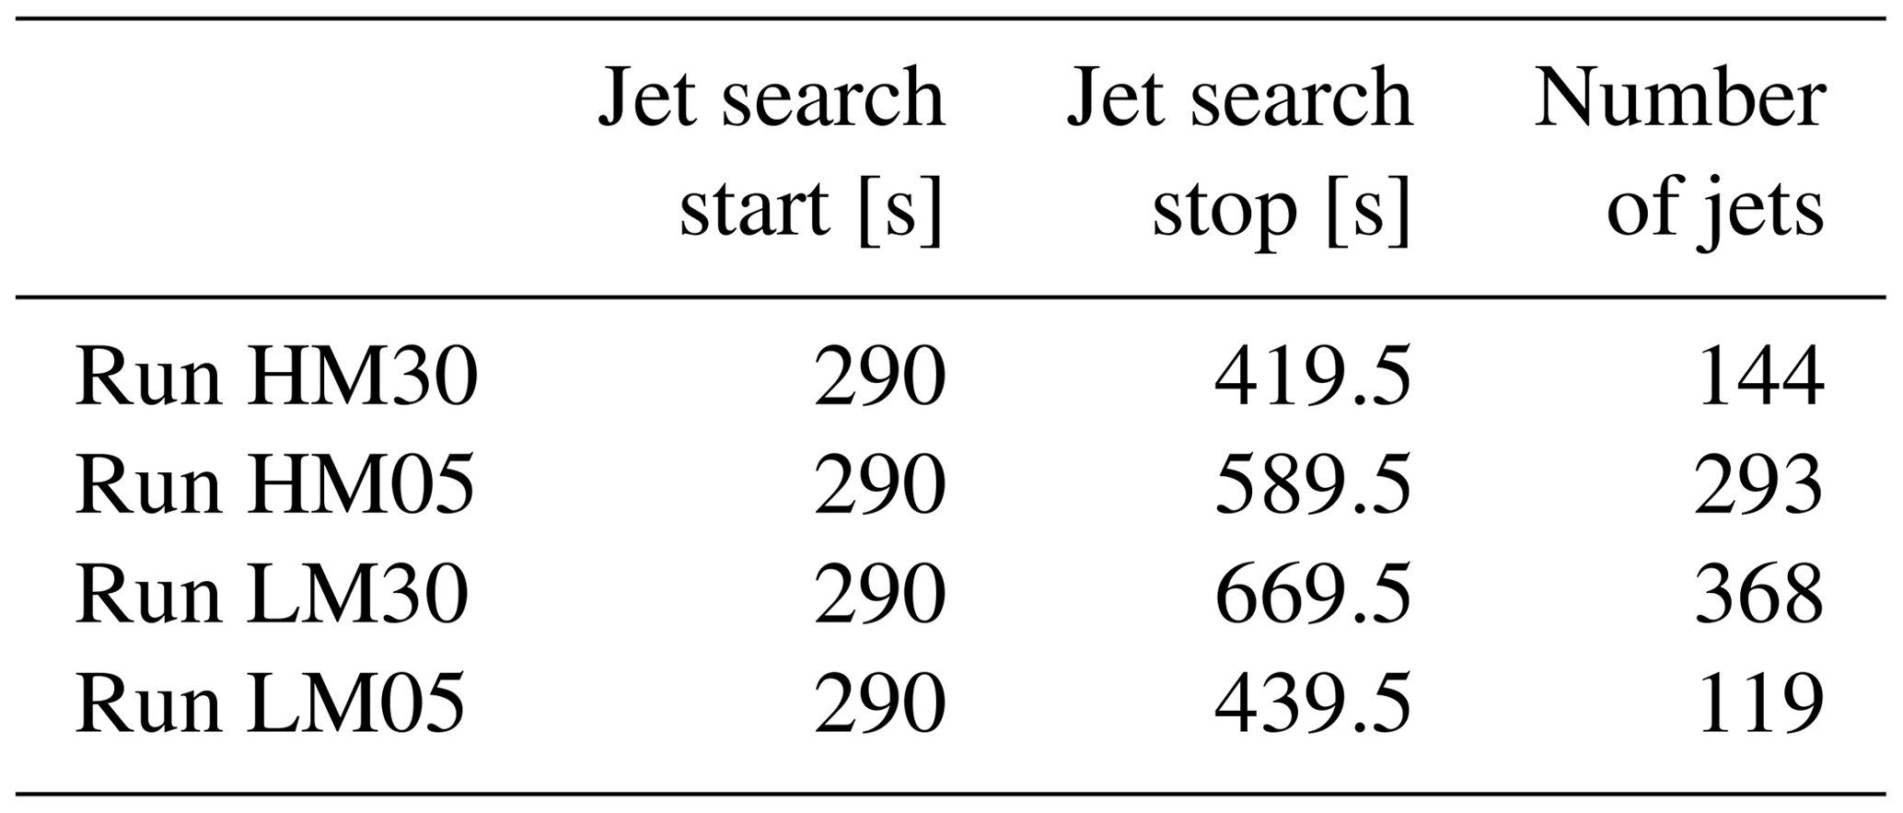
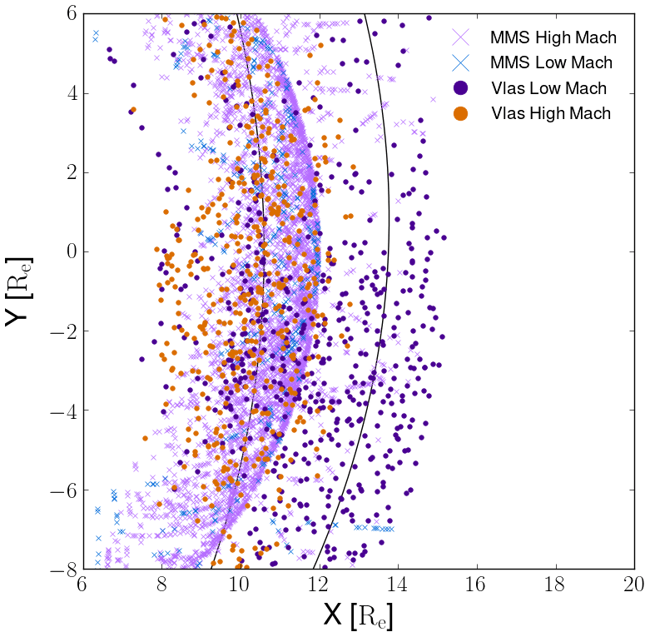
Run Details
Limitations & some details
BS position = Core population heated 3 times compared to SW
2D runs
Electrons are massless charge-neutralizing fluid
Temperature varies a lot during jets
Jet is regarded the same if 50% of cells are the same during previous time step.
Grid size: 30 km/s and 227 km
Palmroth M., Raptis S., et al. (2021) | Annales
Notes:
15 min before and 5 min after the jet is smaller than 45∘

Slide 29
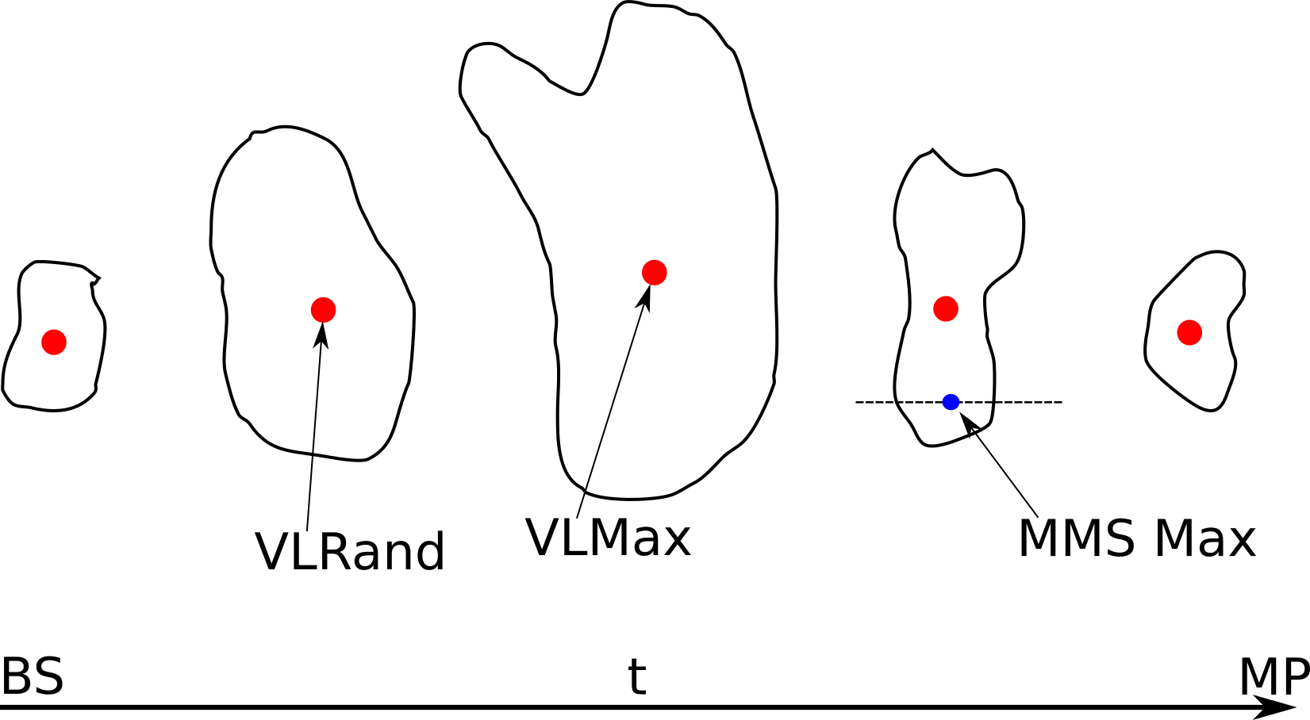
Main differences between MMS & Vlasiator
Palmroth M., Raptis S., et al. (2021) | Annales

Slide 30
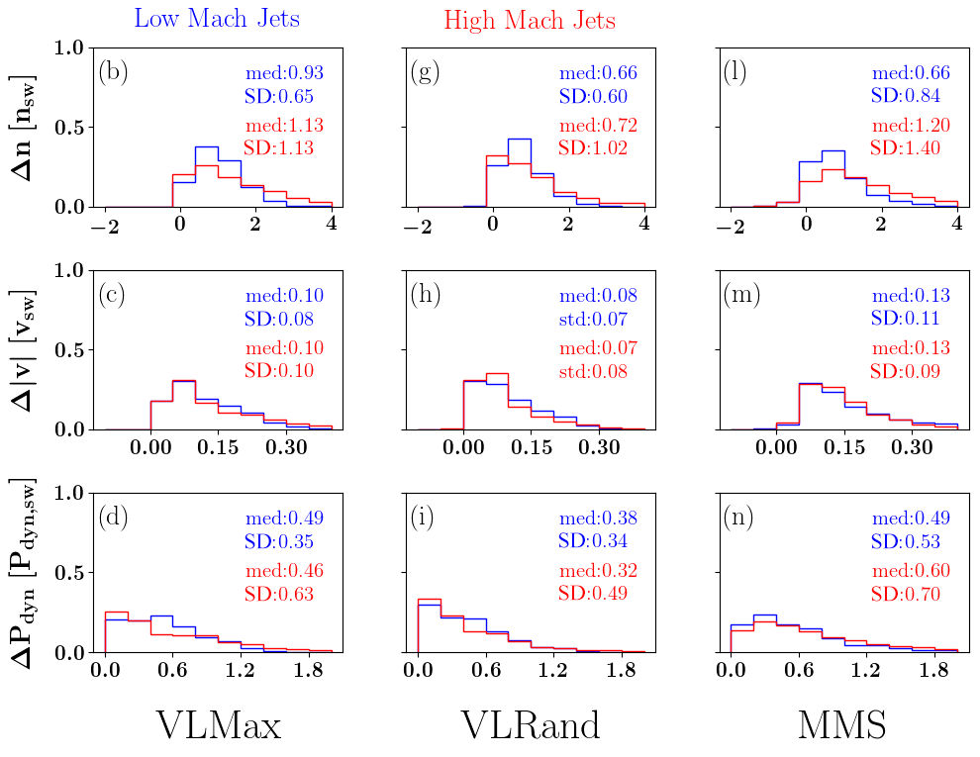
Comparison MMS & Vlasiator
Palmroth M., Raptis S., et al. (2021) | Annales

Slide 31
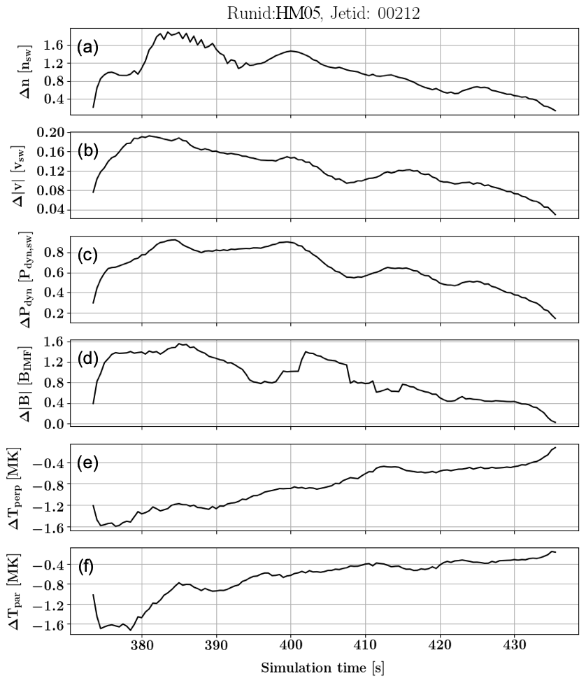
An evolution of a jet using Vlasiator
Palmroth M., Raptis S., et al. (2021) | Annales

Slide 32
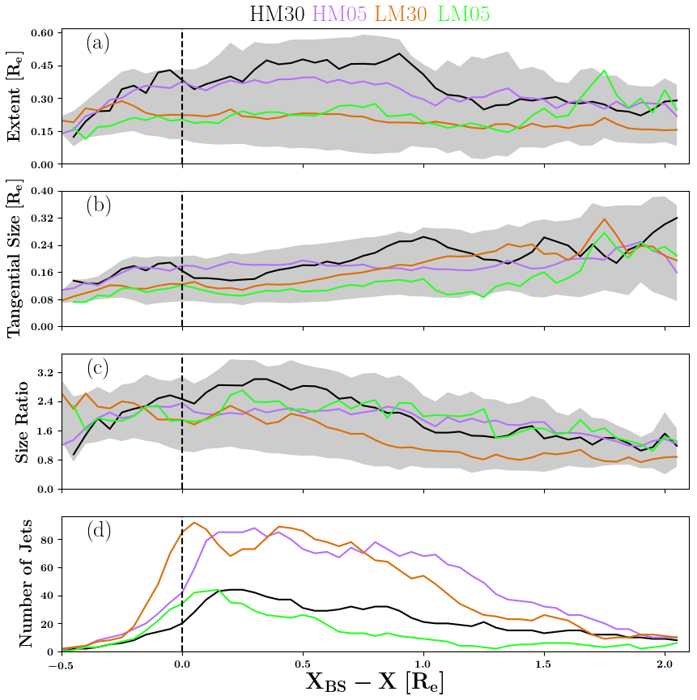
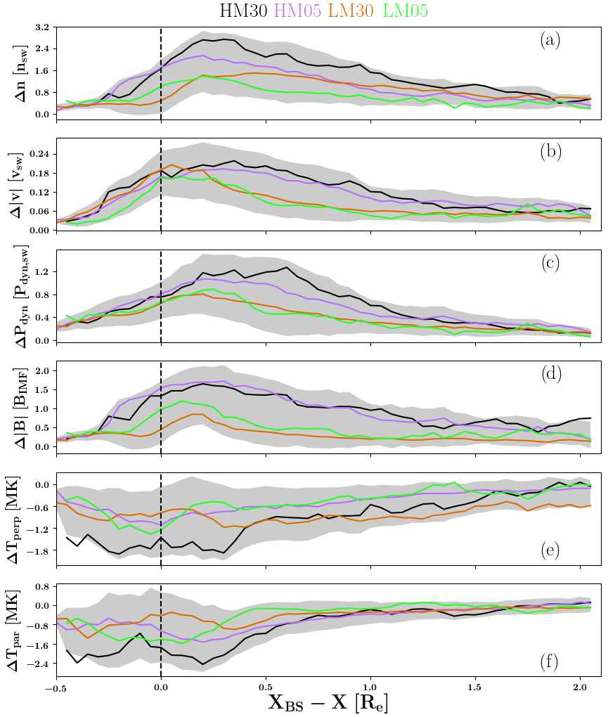
Superposed Epoch Analysis Vlasiator
Palmroth M., Raptis S., et al. (2021) | Annales

Slide 33
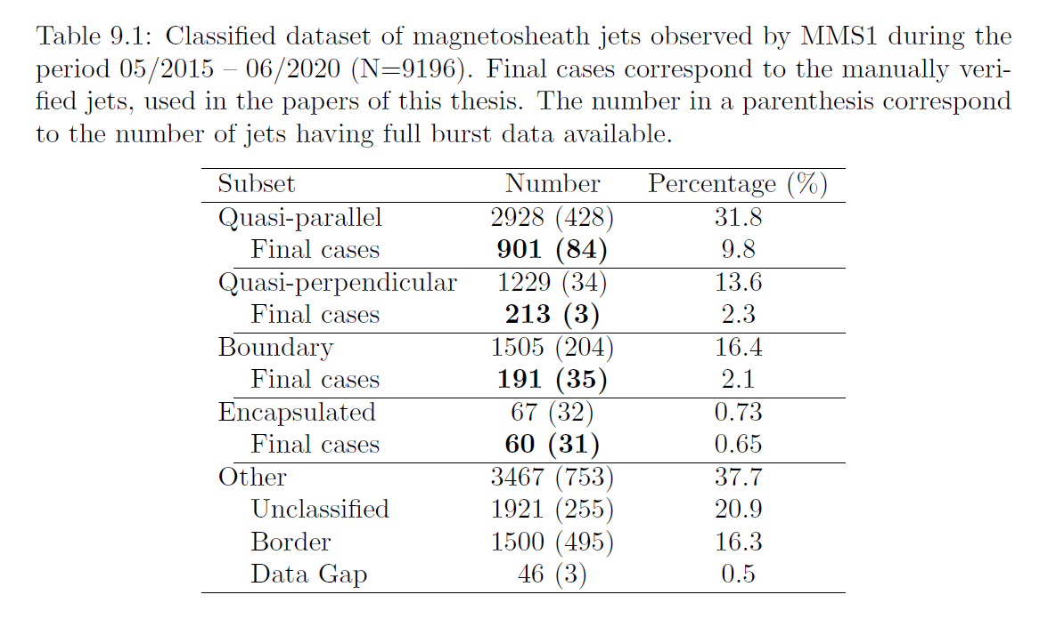
MMS – Finalized Jet Database
https://zenodo.org/record/7085778
Thesis: High-speed jets and related phenomena at Earth's bow shock and magnetosheath

Slide 34
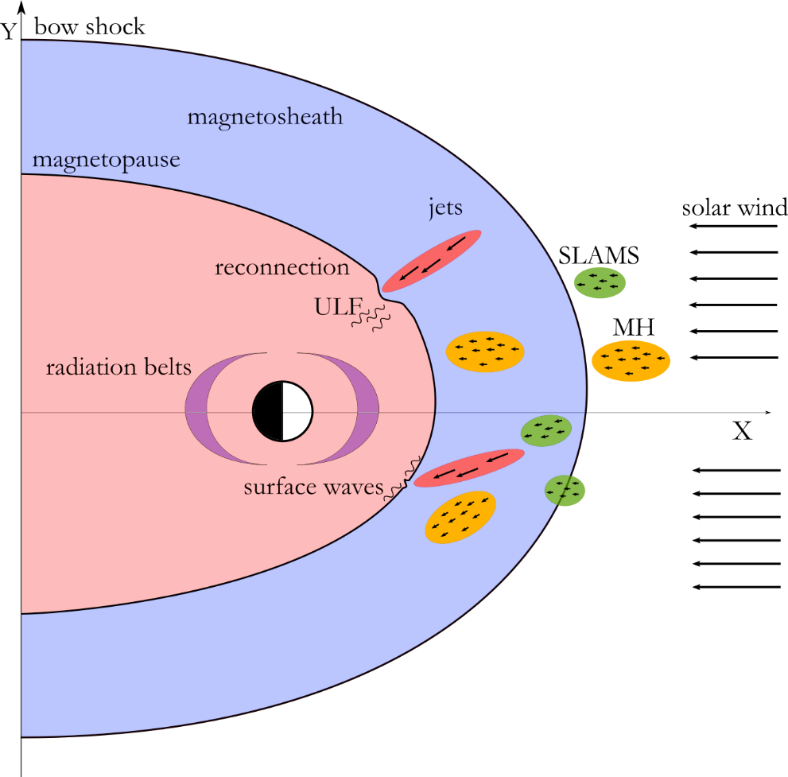
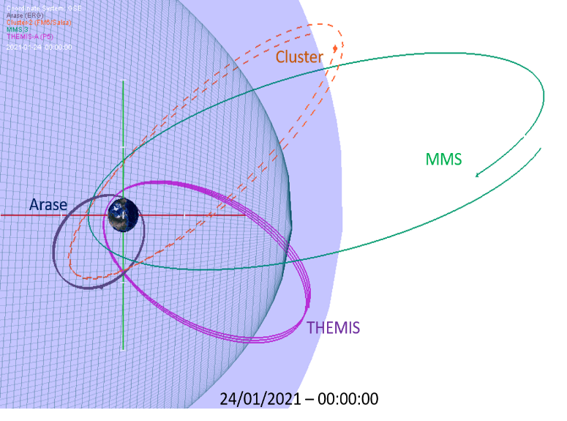
A lot of data are not fully used (conjunction example)
Currently, visitor at ESA/ESTEC working on conjunction list for multi-mission events

Slide 35
Bursty Bulk Flows
(nightside plasma jets)
A possible analogy

Slide 36
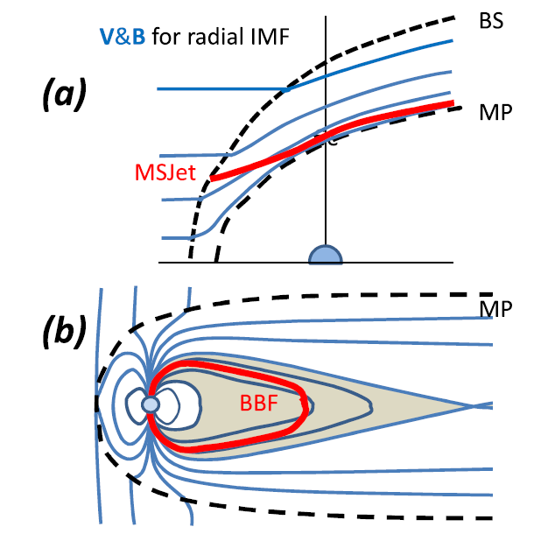
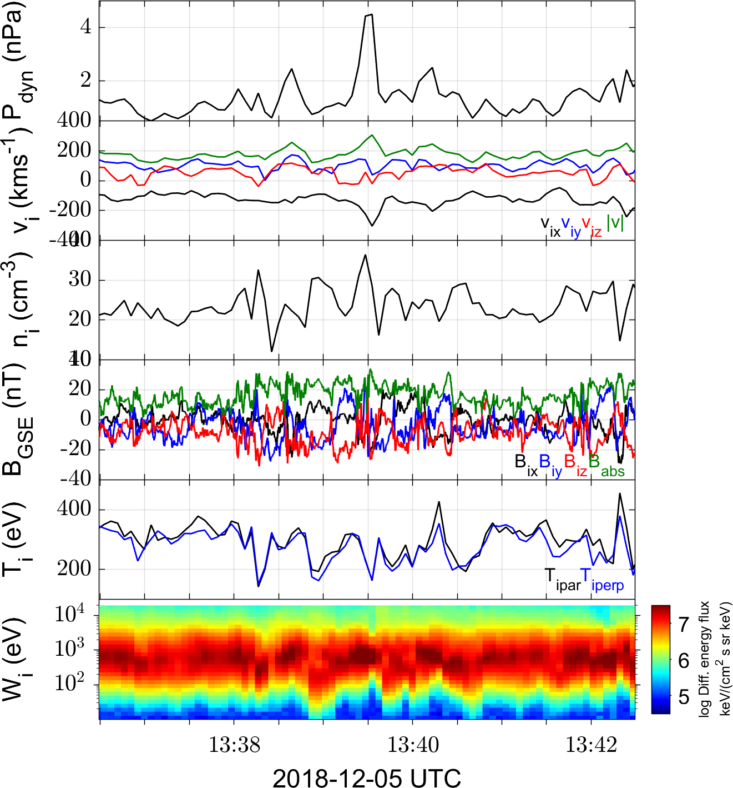
A dayside plasma jet
Plaschke F. et al. (2018) | Space Sci. Rev

Slide 37
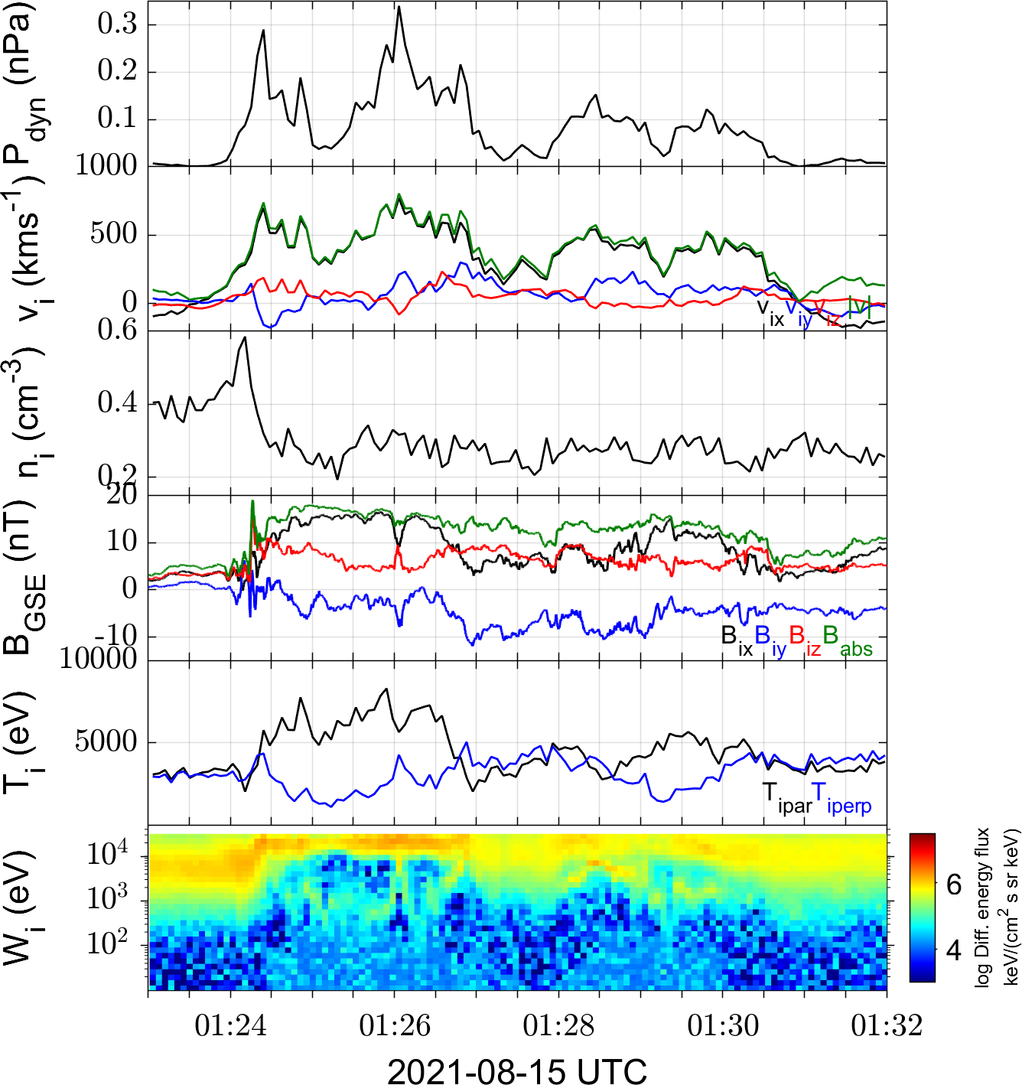
A nightside plasma jet
Plaschke F. et al. (2018) | Space Sci. Rev

Slide 38
Some similarities & differences
Similarities
Differences
Transient events
High-speed plasma flows
Both interact with surrounding plasma
Flow breaking / diversion process (?)
BBFs studied for more years
Vastly different criteria in literature
BBFs are typically longer and faster
Different origin (reconnection)
Different plasma environments (n, T)
MSH (kinetic) vs magnetotail (magnetic)
Open vs closed field lines
TLDR : different environment, scales, observational/modeling limitations…

Slide 39
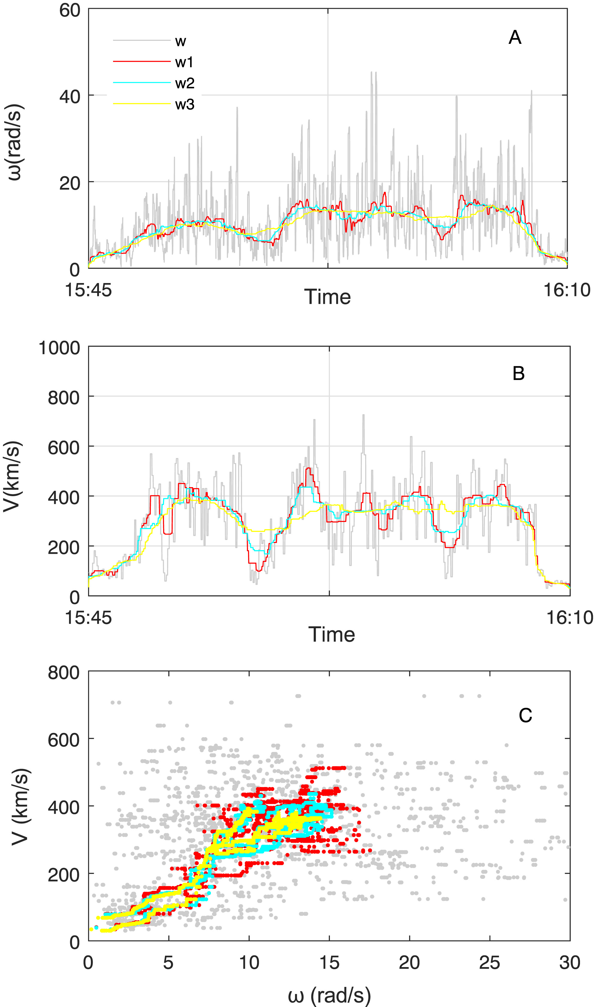
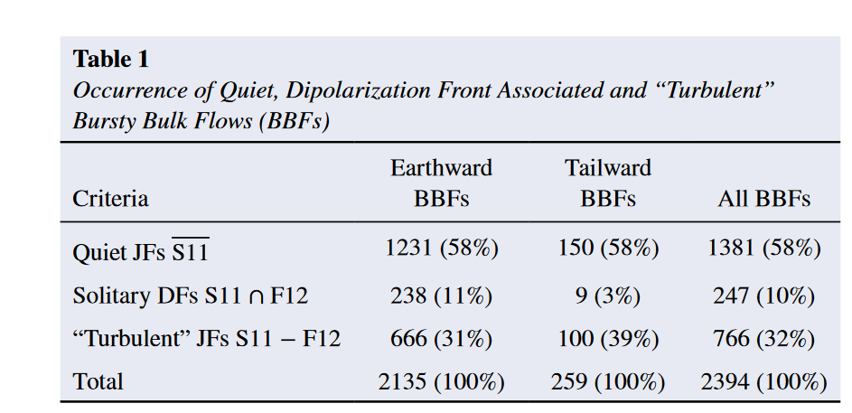
Some recent results – Observations (MMS)
Enhancements of vorticity is associated with the high-speed flow and high-energy ion flux (above 10 keV)
We find that only 10% are associated solitary sharp and strong dipolarization of the magnetic field
Zhang et al. (2019) | GRL
https://zenodo.org/record/7009706
Richard et al. (2022) | GRL

Slide 40
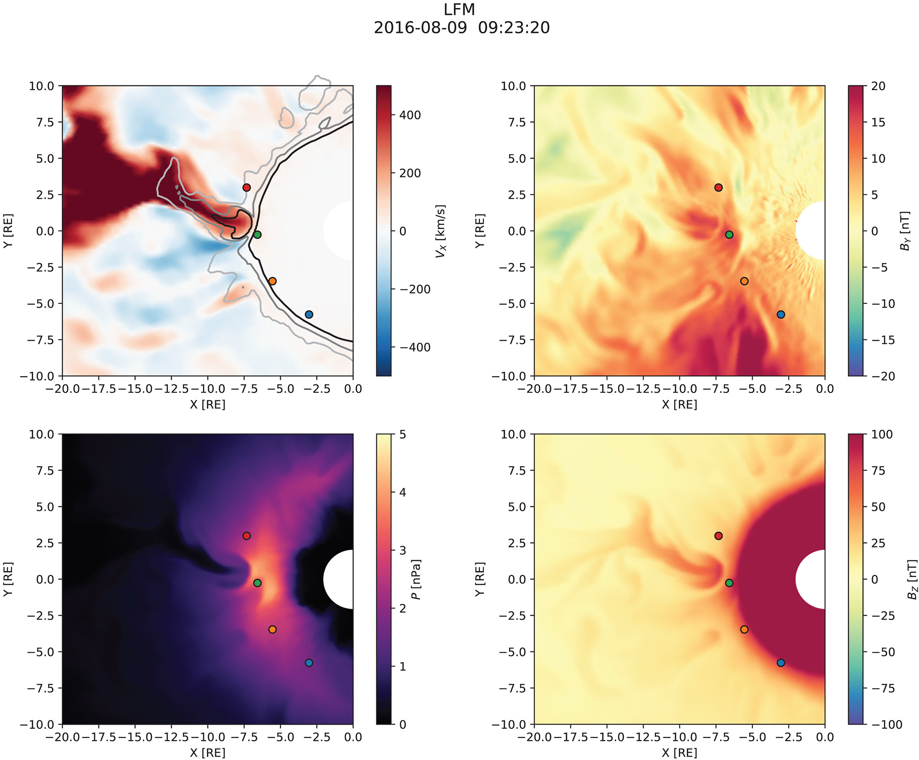
Conclusion
Thank you for listening ☺
Vuorinen et al. (2022)
Merkin et al. (2019)

Slide 41
Extras

Slide 42
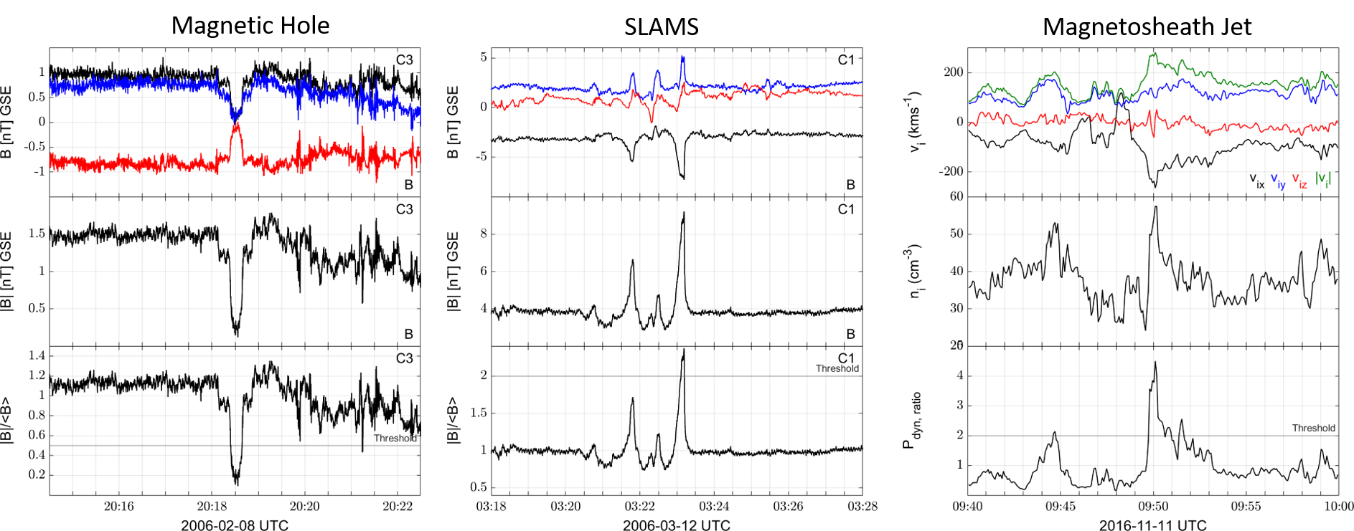
Dayside Transient Phenomena
(unpublished data – Ongoing work)

Slide 43
A lot of data are not fully used (conjunction example)
Currently, at ESA ESTEC working on conjunction lists for bow shock & MSH

Slide 44
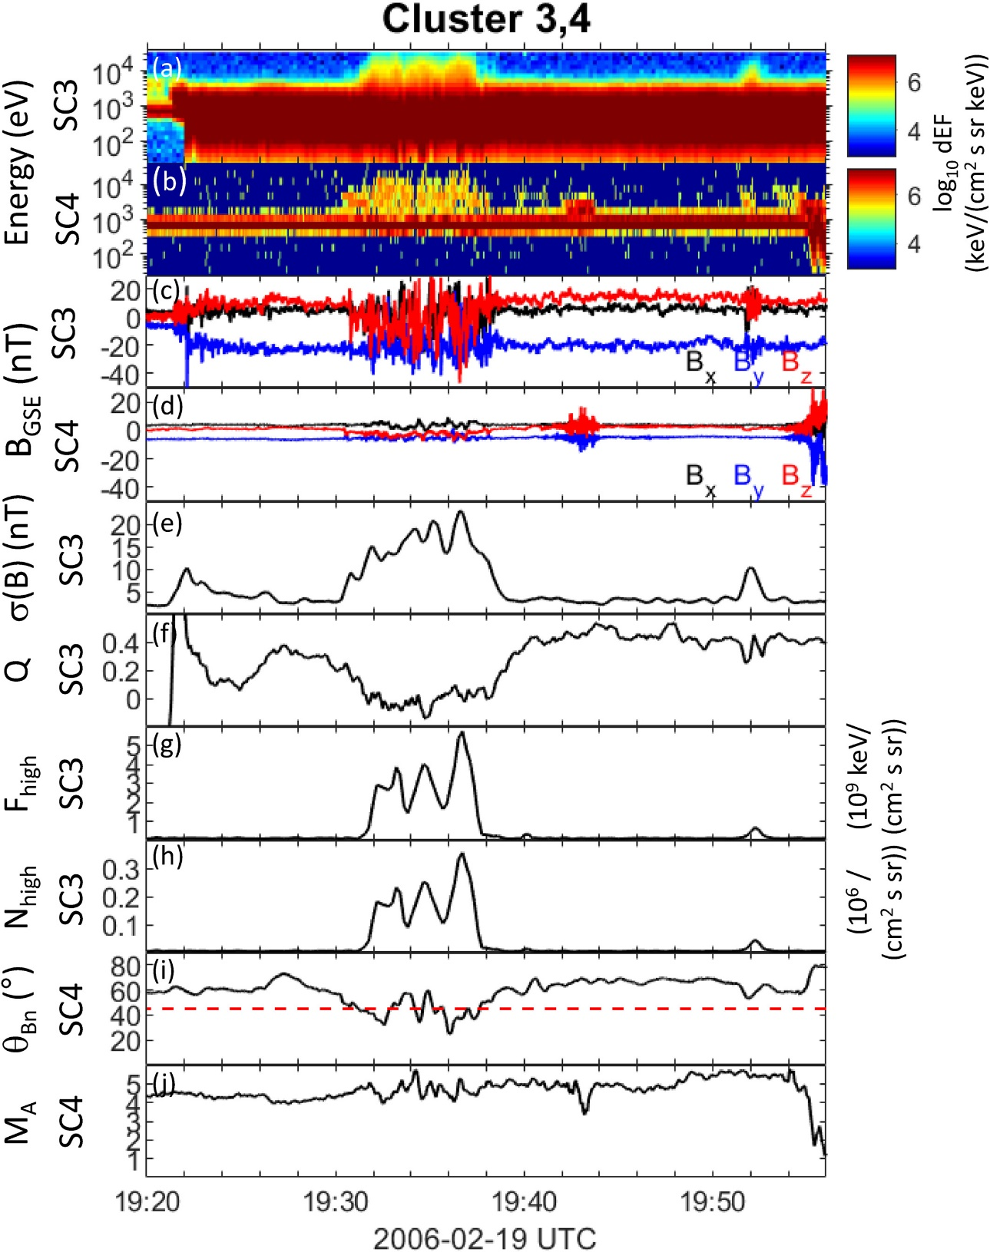
Classification Cluster
Karlsson T., Raptis S., et al. (2021) | JGR

Slide 45
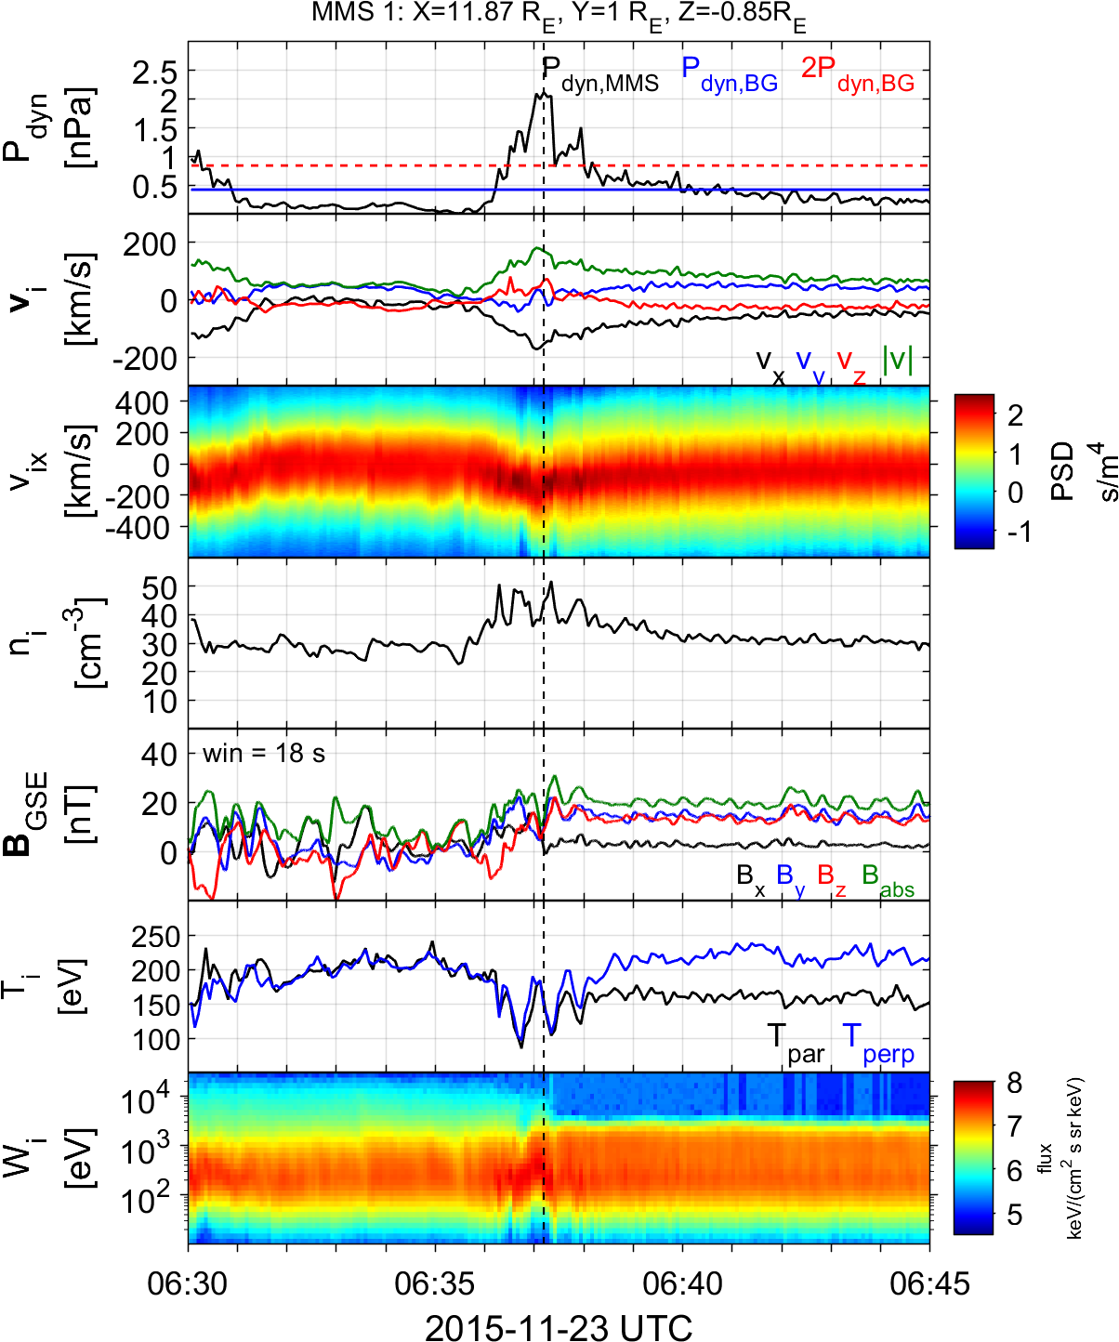
Summarized properties – Boundary
Hard to estimate their occurrence rate
Quite energetic and long duration
Similar properties to Qpar jets
Maybe associated to pressure pulses of SW [Archer et al. 2012]
Boundary Jet
Jets found in the boundary between $Q_{∥}$ and $Q_{⊥}$ MSH
Raptis S., Karlsson T., et al. (2020) | JGR

Slide 46
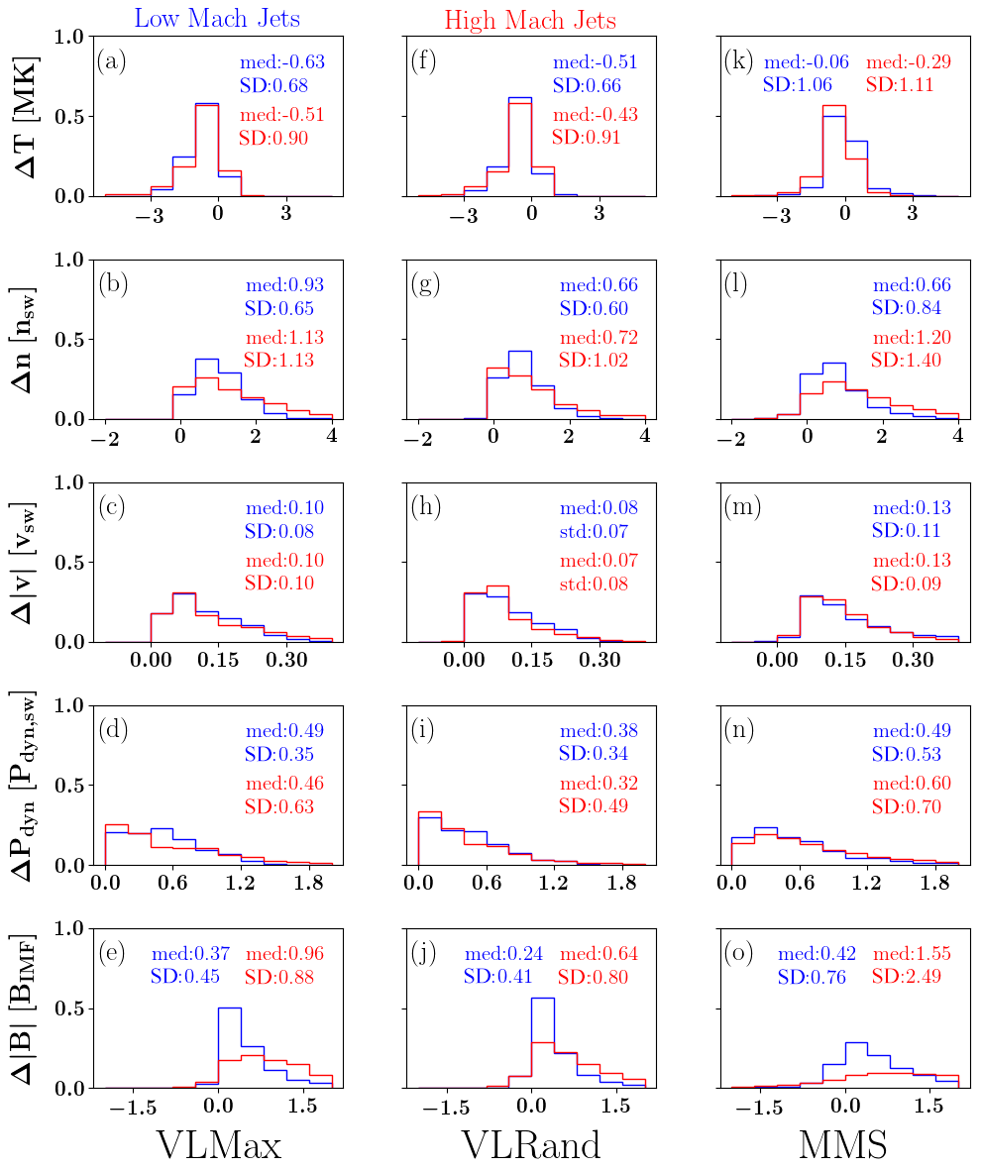
Comparison MMS & Vlasiator
Palmroth M., Raptis S., et al. (2021) | Annales

Slide 47
Global Shock Reformation Picture
Raptis S., et al. (2022a) | Nat. Commun.

Slide 48
Upstream whistlers paper V

Slide 49
Local & Global Shock properties
Local Measurements (e.g., MMS4)
$θ_{Bn}≈65−80°$ (large variations)
Global (OMNI) + BS model (e.g., Farris et al.)
$$θ_{Bn}≈25°$$
Consistent with FCS (i.e., SLAMS) acting locally as Qperp shocks
Turner et al. 2021 (HFA):
38.5 (global)
80.3 (local)

Slide 50
Scale comparison (e.g., Turner et al. 2021)
Hot Flow Anomaly (HFA) self-reformation
SLAMS self-reformation
n = [- 0.540, 0.379, 0.737]
$$v_{SH}=−62.1\frac{km}{s}$$
MC: [0.9026, 0.0987, -0.4191]
MVA: [-0.97, 0.16, -0.19]
$$v_{SH}=\sim 60\frac{km}{s}$$
New Shock ramp ~5 sec
New Shock ramp ~3-5 sec
New ramp ~150km ~2 $L_{i}$
∼1Li and then growing to ∼2Li
$$L_{e} = \sim 2 km$$
$$L_{i} = \sim 90 km$$
$$L_{d} = \sim 13 m$$
$$L_{e} = \sim 2 km$$
$$L_{i} = \sim 80 km$$
$$L_{d} = \sim 10 m$$
“very” rough comparison
Notes:
$$r_{cp}\sim 50−700 km$$

Slide 51
Jet evolution in Qpar Magnetosheath
Raptis S, et al,. 2022b | GRL

Slide 52
Extras
Neural Networks

Slide 53
Evaluation Metrics (Classification)

Slide 54
Evaluation Metrics (Regression)
Source: https://gist.github.com/thomasnield

Slide 55
Neural Networks
*Video Courtesy: 3Blue1Brown (Check his YouTube page. It's great!)

Slide 56
Application on forescasting SEPs
Problem description
Modeling
Validation & Results
 | SEP predicted always YES | SEP predicted always NO
SEP occurred YES | 191/220 [86.81 %] | 19/220 [8.63%]
SEP occurred NO | [7.77 %] | [92.23%]
24 features
Occurrence of SEP based on X-rays of flares
Comparisons to other models recently published
Review of Solar Energetic Particle Models (Advances in Space Research)
Aminalragia-Giamini, Raptis et al. (2021) | J. Space Weather Space Clim
Notes:
Using GOES SXR data

Slide 57
What exactly is a PINN then ?
$$loss=data fit+PDE residual+ICs fit+BCs fit$$
Idea = If output is a differentiable quantity with respect to an input = can compute PDEs = combined loss functions

Slide 58
Proposing a new model
*Where, standards = models, mechanisms etc.

