Slide 1
Evaluating the magnetic flux transport in the plasma sheet during geomagnetic storms using MMS + Geotail
Savvas Raptis¹, Slava Merkin¹, Shin Ohtani¹, Matina Gkioulidou¹
¹ APL/JHU, Laurel, MD, US
Supported by NASA DRIVE Science Center for Geospace Storms (CGS) - 80NSSC22M0163
savvas.raptis@jhuapl.edu
https://savvasraptis.github.io

Slide 2
Introduction & Motivation

Slide 3
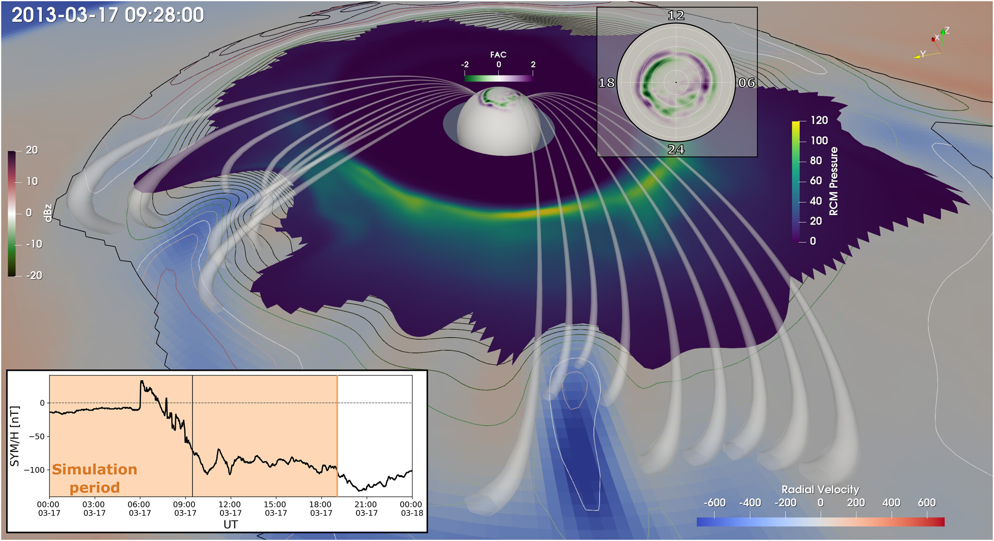
General Context - Motivation
One of CGS objectives:
The role of mesoscale plasma sheet transport in the ring current build-up
To tackle this we need to establish a clear understanding of the overall plasmasheet transport during quiet and storm times.
This presentation:
Focus on magnetic flux transport during storms
Building towards a holistic multi-spacecraft evaluation including mass and energy transport
50% of total energy flux transported into the inner magnetosphere by mesoscale structures
Sciola+ 2023
https://cgs.jhuapl.edu

Slide 4
Powering the magnetotail
~ 10 Re
~ -20-30 Re
Credits: ESA/ATG medialab

Slide 5
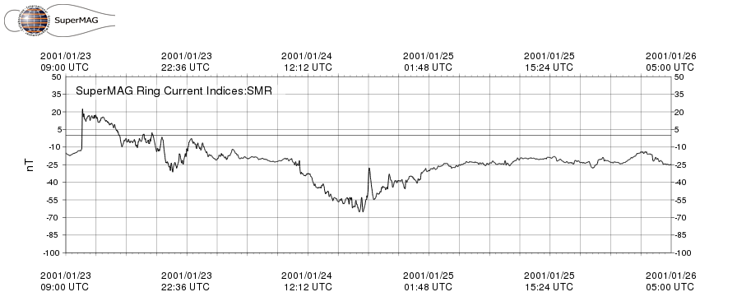
Data used
Ground
In-situ
Plasma moments from spectrometers
Magnetic field from fluxgate magnetometer
MMS* (2015 - now)
Geotail** (1992 – 2022)
THEMIS (2007 – Now) - TBD
SMR: Ring current index based on all ground magnetometers at geomagnetic latitudes (mlat) between -50 and +50 degrees;
Treated equivalently as DST and SYM-H indices traditionally used for geomagnetic storms (Note: differences exist)
*Currently showing HPCA (~10s) results not FPI (4.5s) (i.e., H+ not ions)
**Currently showing results of 12s resolution up to 2014
Gjerloev (2011, 2012), Newell and Gjerloev (2012)

Slide 6
Methods & Results
Classify plasmasheet observations
Analyze their properties
Gather storms & define their phases

Slide 7
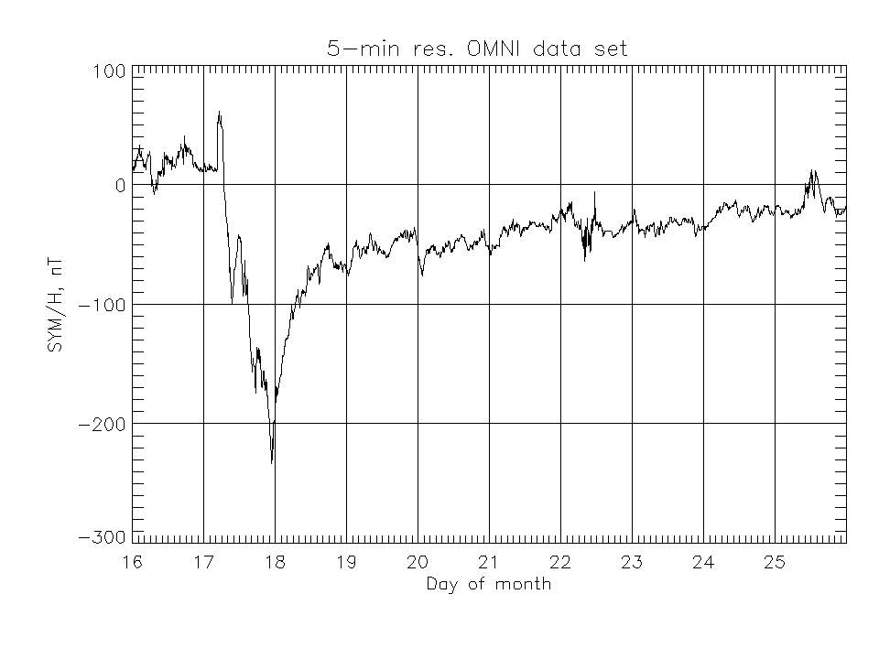
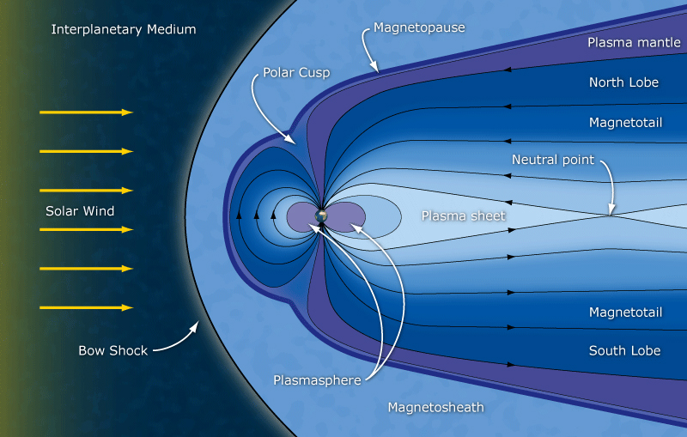
Definitions & Criteria used
Geomagnetic storms
Plasmasheet
Example Criteria to find CSP
$\left\lfloor Y_{GSM,4°}\right\rfloor <10$
$−5<X_{GSM,4°} <−30$
$β=\frac{P_{the}}{P_{mag}}>1$
$\left|Βz\right| >\sqrt{Bx^{2}+By^{2}}$
SSC
main
Recovery
SMR < -50 nT
Disclaimer: absolute numbers can be sensitive to criteria
See e.g., Ohtani 2021
See e.g., Ohtani+ 2008, Guild+ 2008, Roziers+ 2009, Vo+ 2023

Slide 8
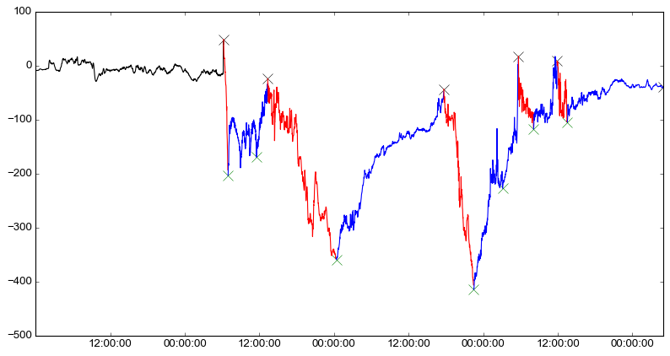
Storm phases automatic classification
2003 Halloween Storm
SMR
[nT]
Recovery | Main
Verified with methodology of Ohtani 2021

Slide 9
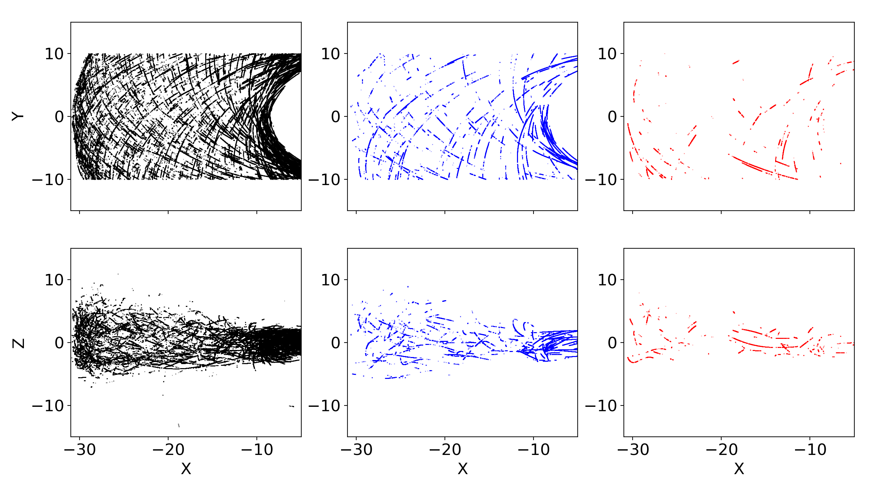
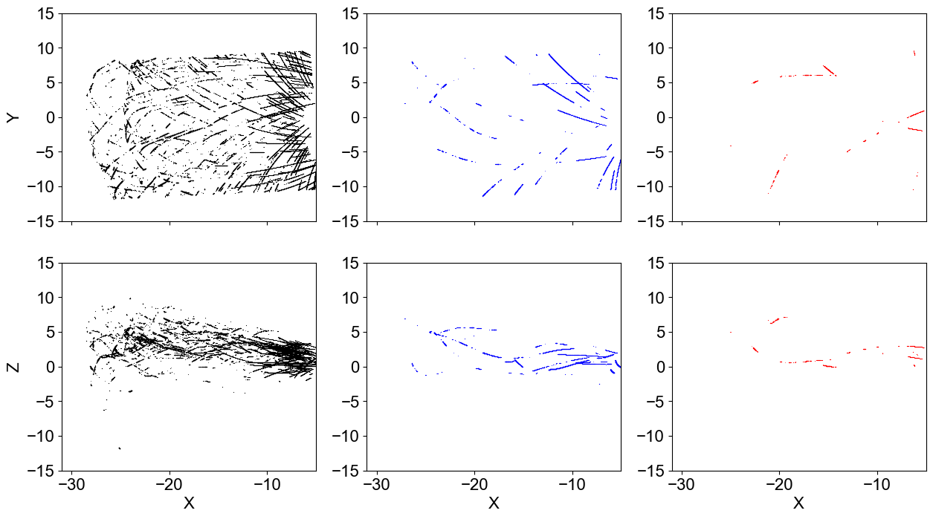
Plasmasheet Coverage per mission – Strict Criteria
Geotail ( 1994 – 2014)
MMS (2016 – 2024)
Quiet : 393,379 (85%)
Reco : 56,061 (12%)
Main : 11,546 (3%)
Quiet : 112,099 (88%)
Reco : 13,336 (10%)
Main : 2,205 (2%)

Slide 10
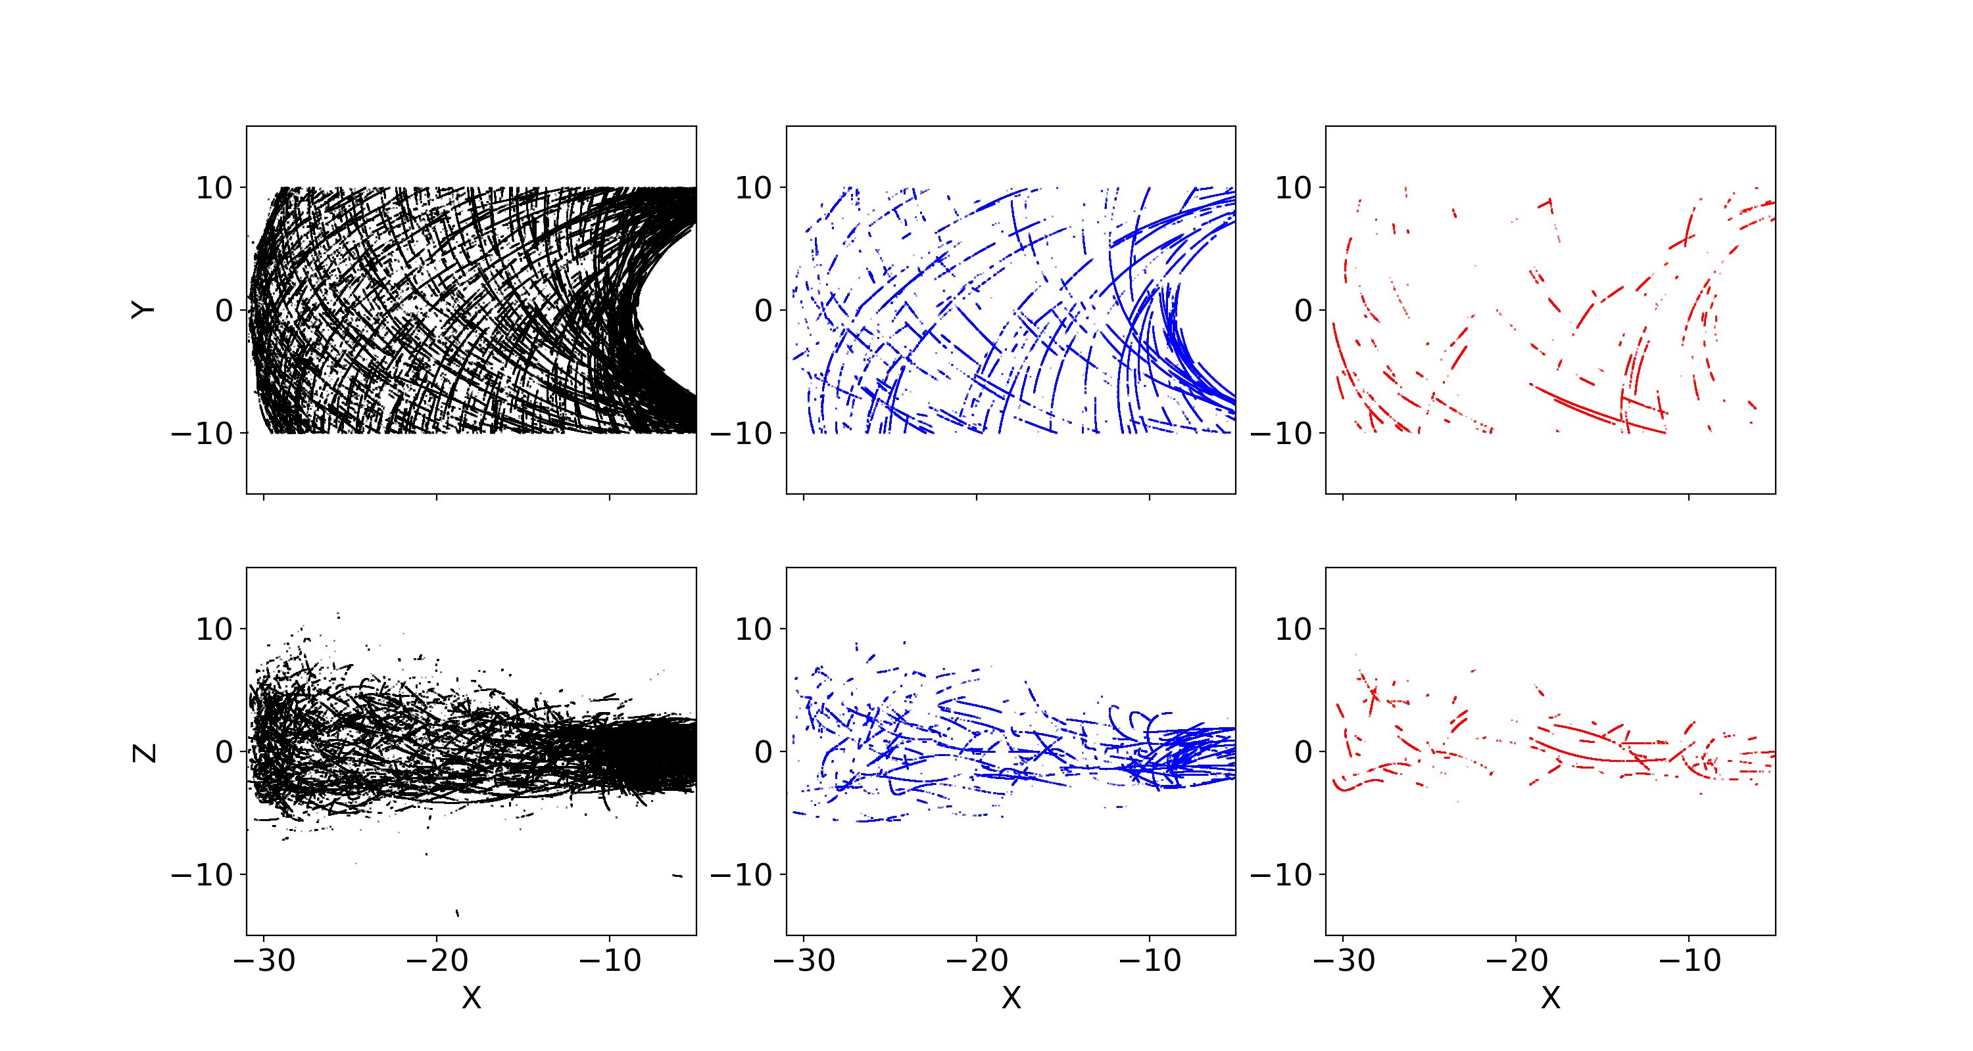
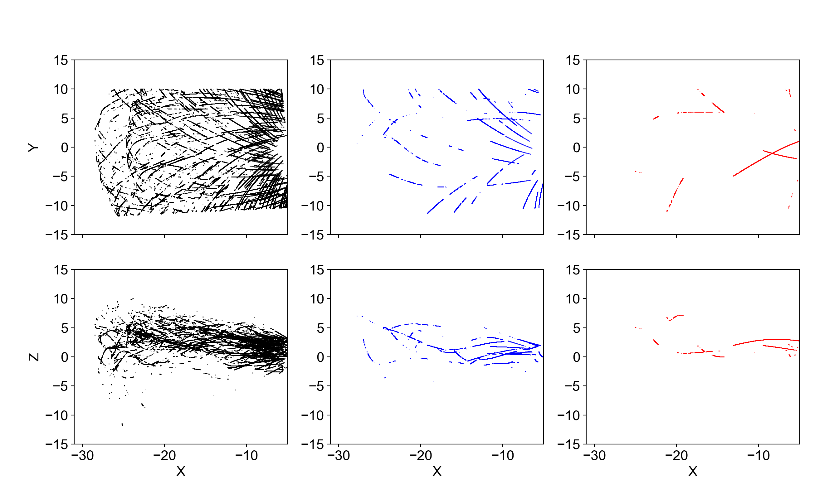
Plasmasheet Coverage per mission – Flexible* Criteria
Geotail ( 1994 – 2014)
MMS (2016 – 2024)
Quiet : 779,557 (+98%)
Reco : 10,6258 (+90)
Main : 22,797 (+99%)
Quiet : 250,749 (+124%)
Reco : 25,466 (+90%)
Main : 6,097 (+175%)
*Combine Ohtani 2008, Guild 2008, Roziers 2009, limit Y to 10 Re – changes in statistical properties: ~0 - 20%

Slide 11
Plasmasheet Coverage per mission – Flexible* Criteria
Geotail ( 1994 – 2014)
MMS (2016 – 2024)
Quiet : 779,557 (+98%)
Reco : 10,6258 (+90)
Main : 22,797 (+99%)
Quiet : 250,749 (+124%)
Reco : 25,466 (+90%)
Main : 6,097 (+175%)
*Combine Ohtani 2008, Guild 2008, Roziers 2009, limit Y to 10 Re – changes in statistical properties: ~0 - 20%

Slide 12
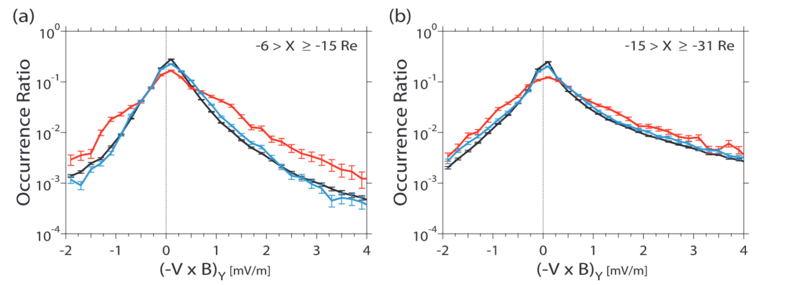
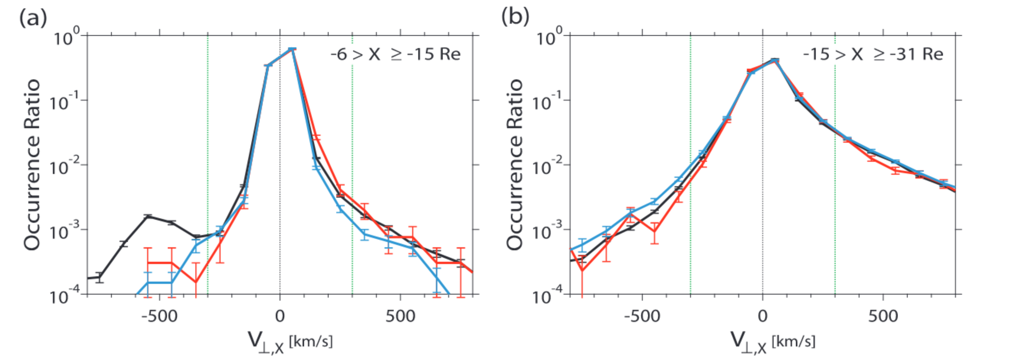
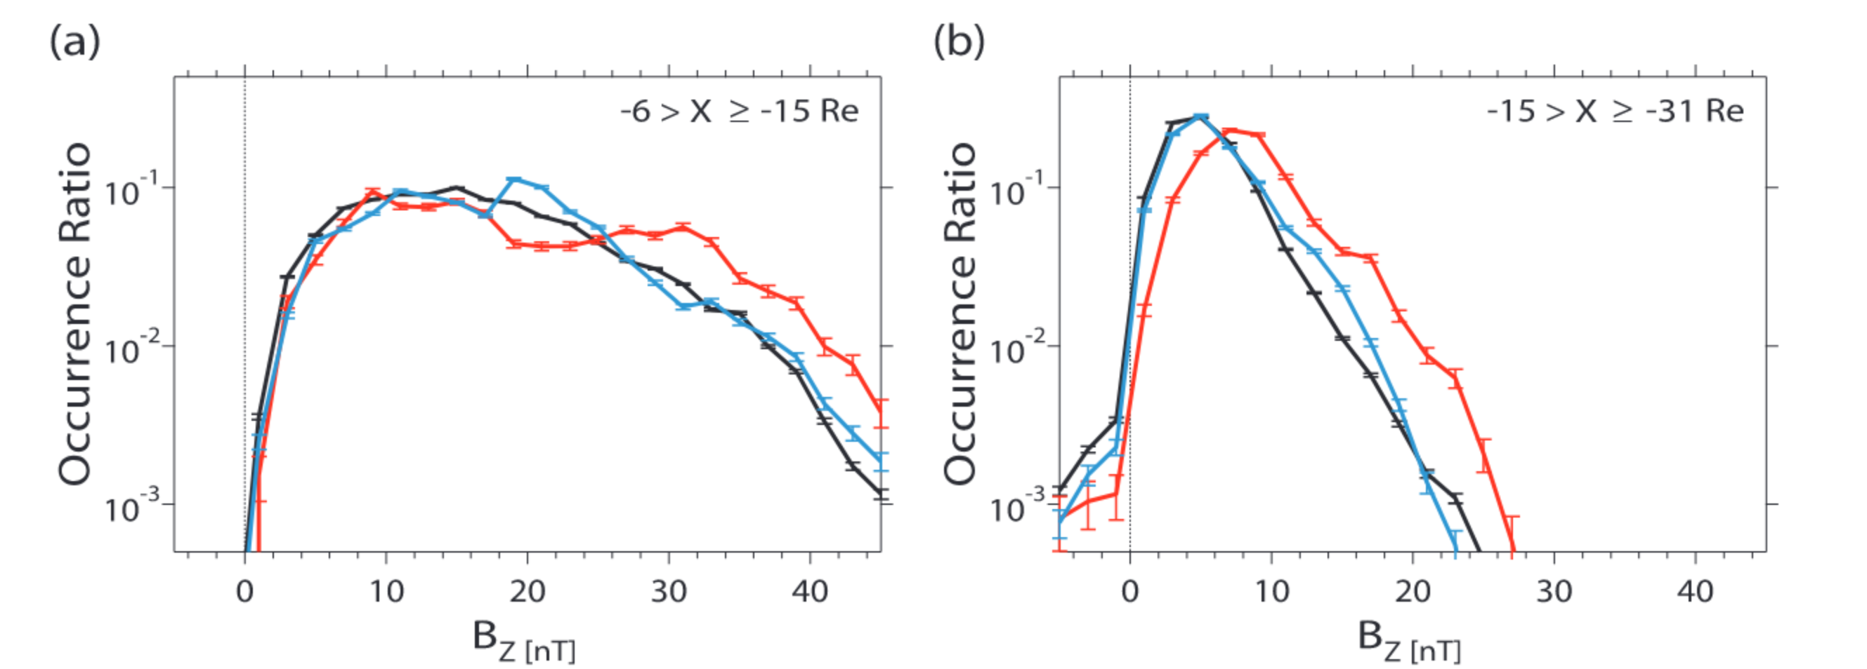
Confirmation of previous results
Geotail (1994 – 2006)
$$E_{y}$$
$$V_{⊥x}$$
$$B_{z}$$
Findings:
Ey increase during storm times
Increase realized through Bz enhancement rather than V⊥x
Reproduced with MMS (2015 – 2024)
Reproduced with Geotail (1994 – 2014)
Expand to distribution along X [GSM], and R
Investigate potential Dawn/Dusk asymmetries
Ohtani & Mukai 2008
Notes:
Increase in convection electric field.
Equatorial magnetic field is stronger during main phase

Slide 13
Take a step Further
Evaluate the distribution in X and radial distance

Slide 14
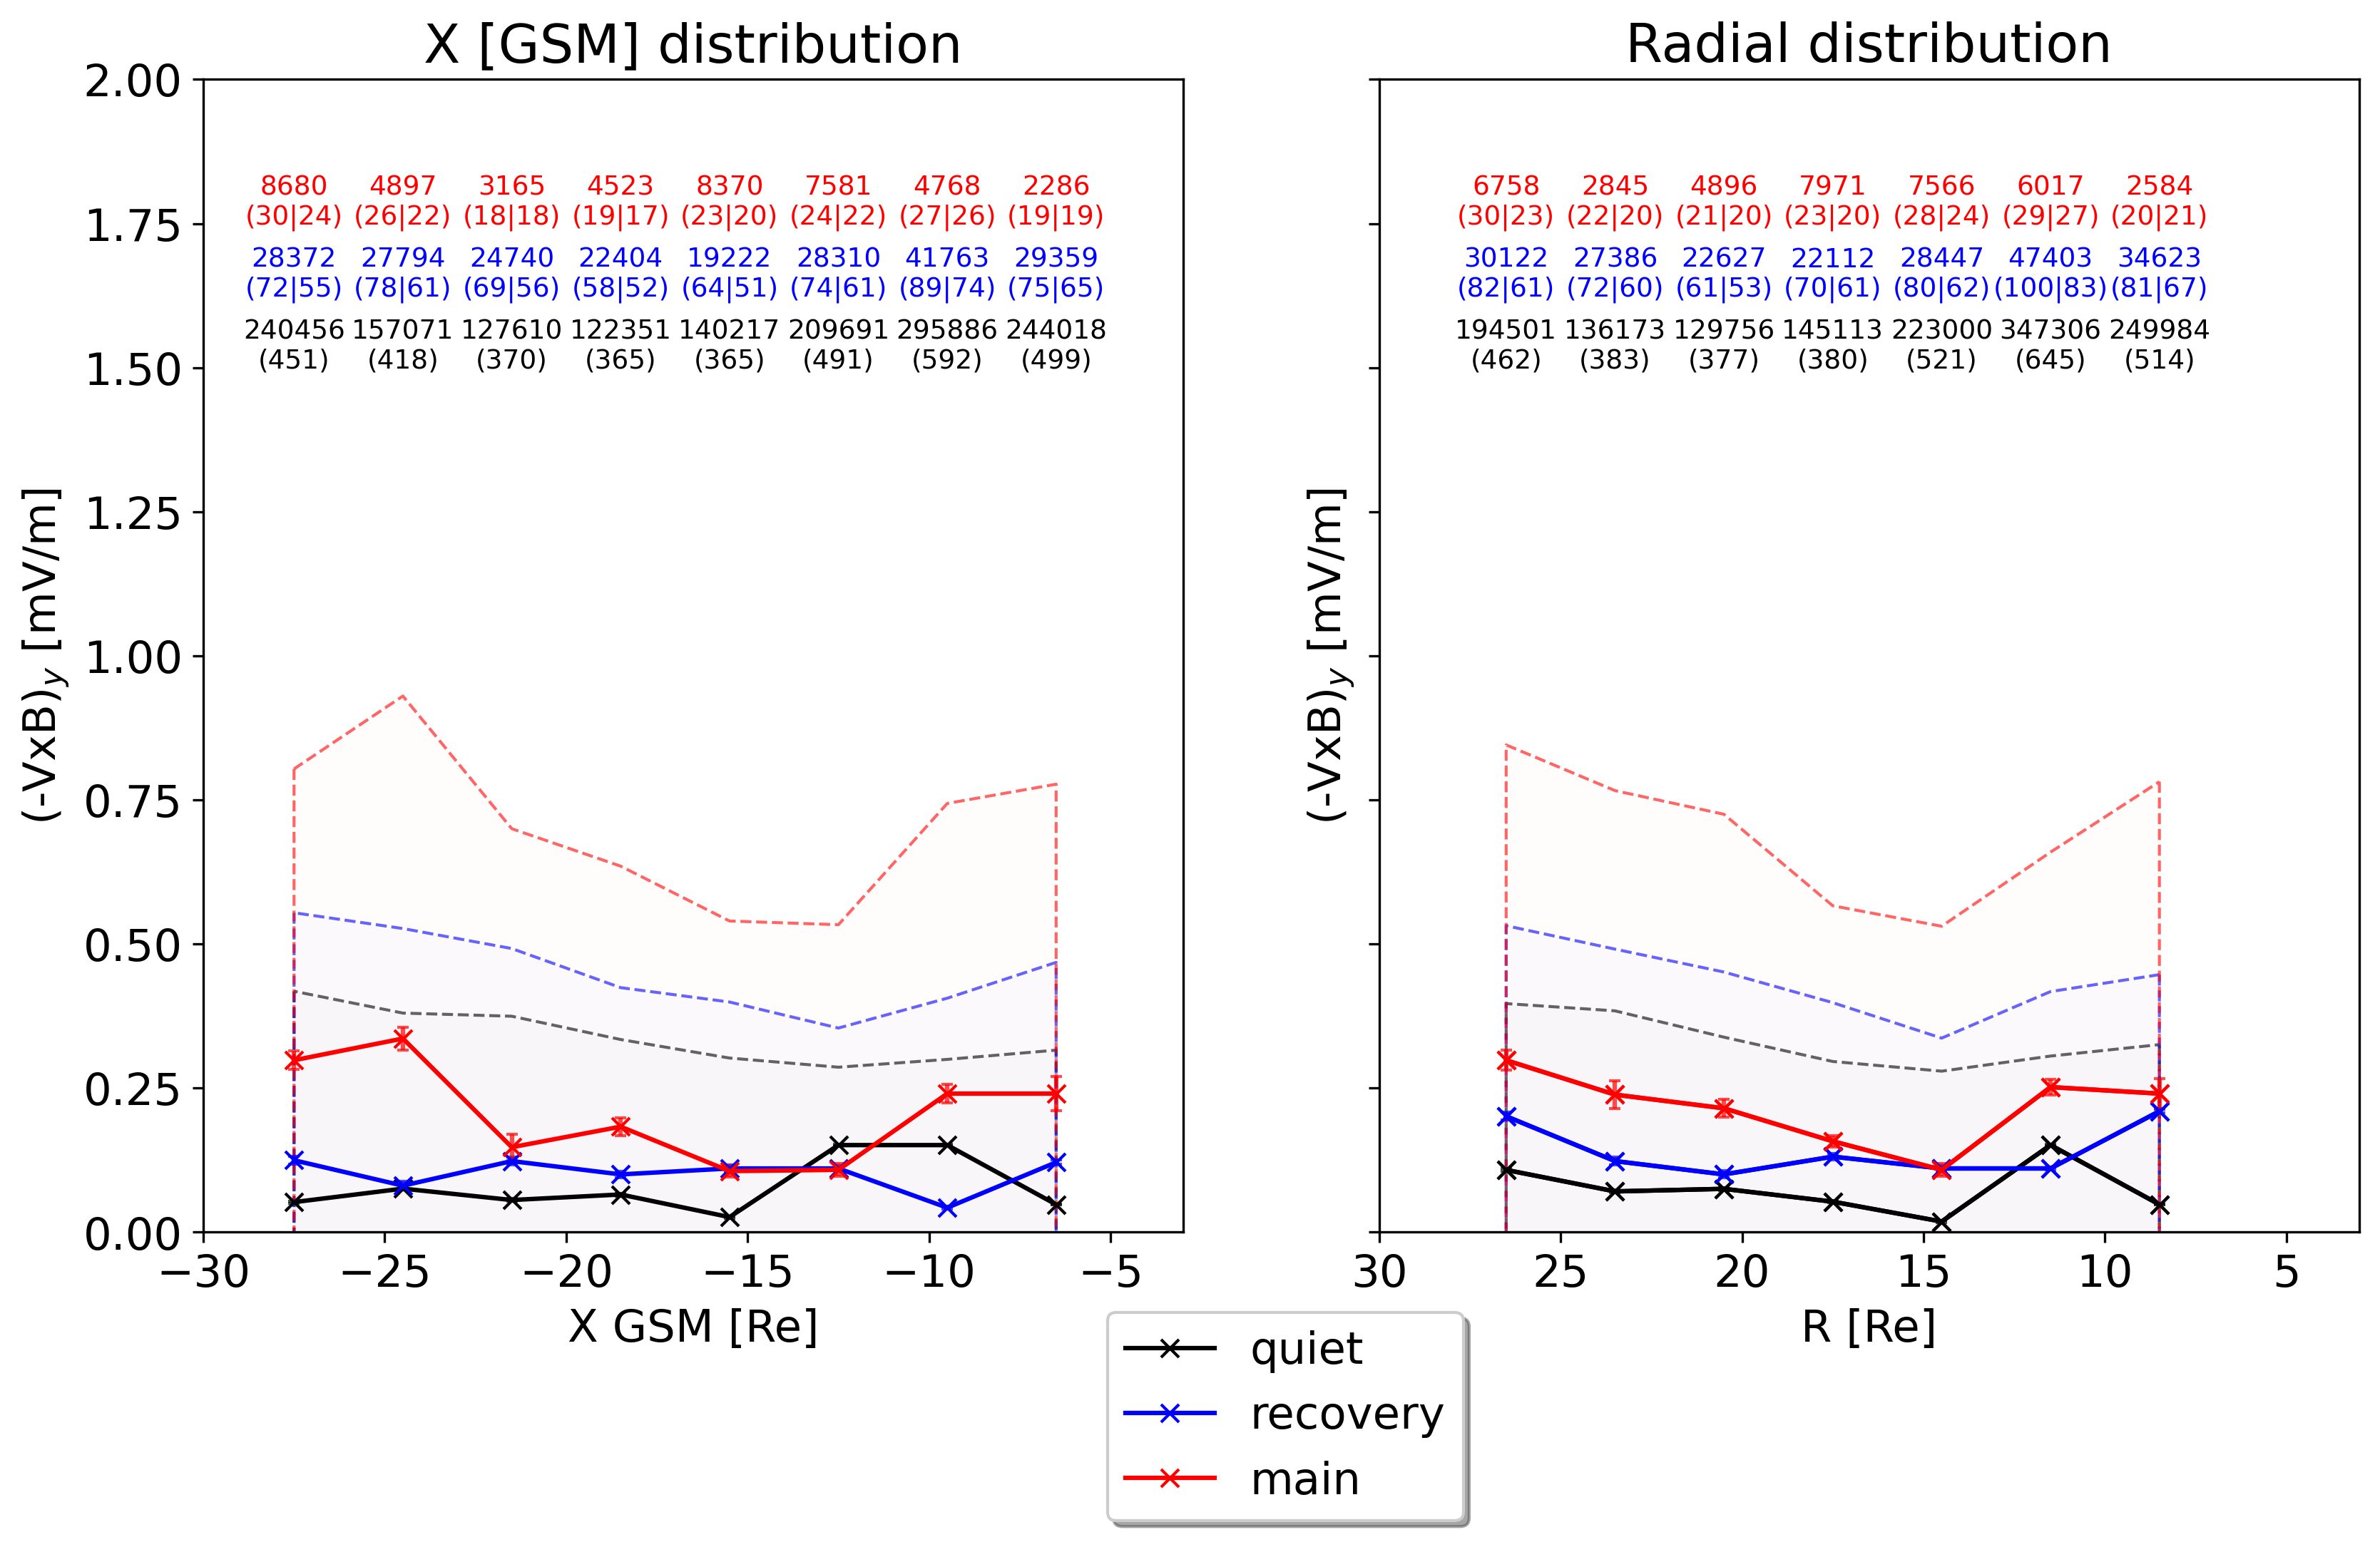
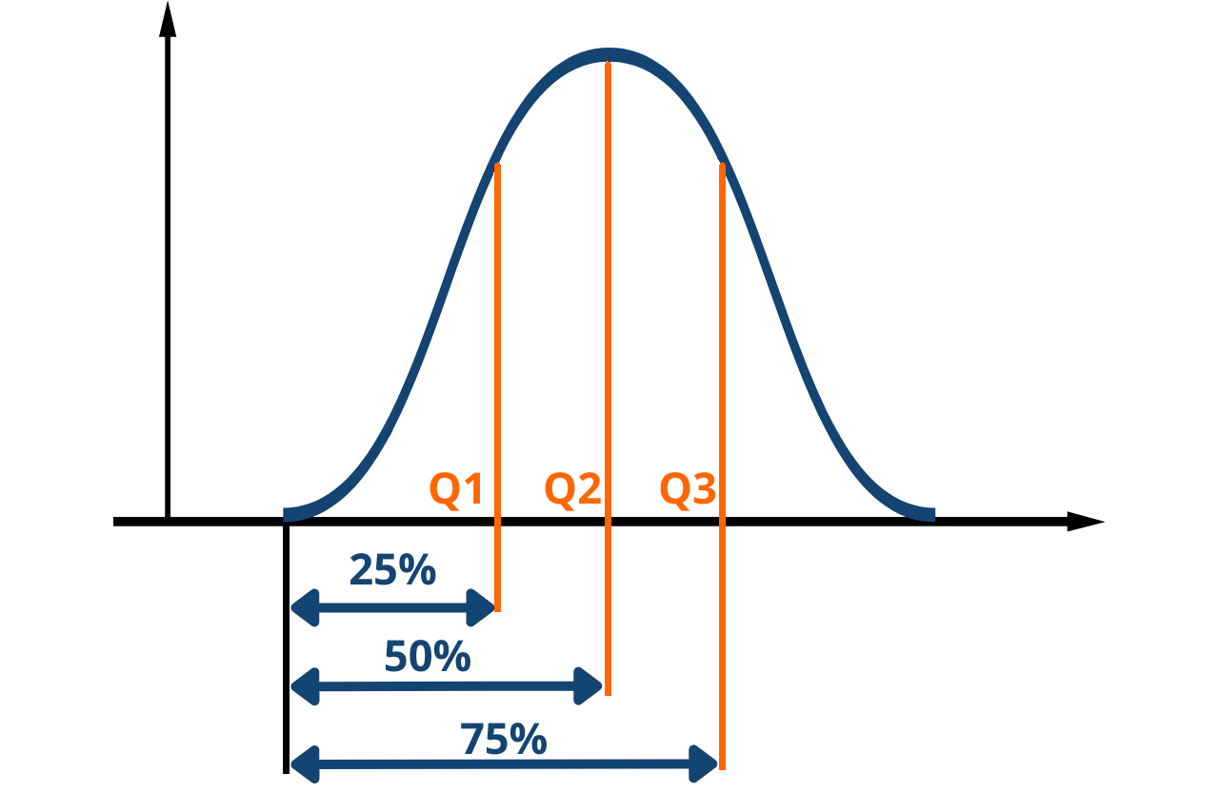
(-VxB)y– spatial distribution - Geotail
Outer
Inner
points
(days|storms)
Storm Ey $↑$
Solid: 50%
Dotted: 75%
Overlapping bins
width = 8 Re
step = 3 Re
Towards Earth

Slide 15
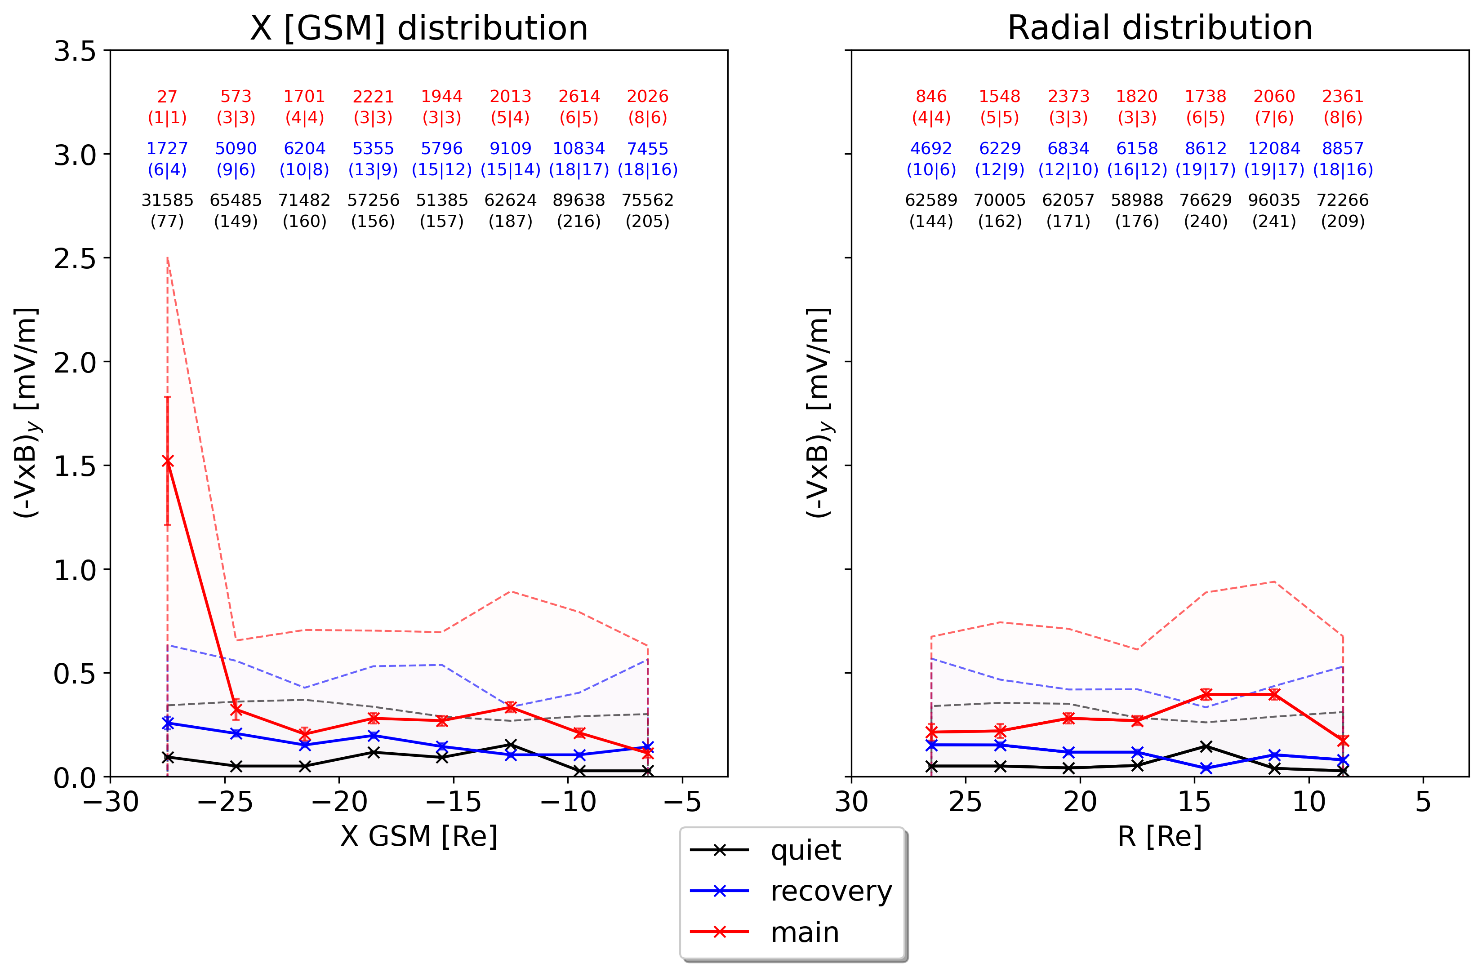
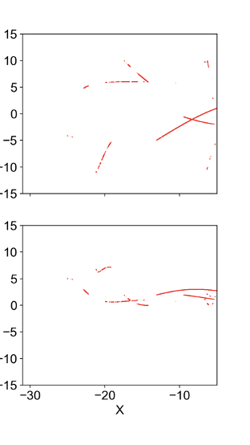
(-VxB)y – spatial distribution - MMS
XY plane
Storm times
MMS
Similar results
Less statistics
Reminder: main had 6097-10s points even when ”flexible” criteria

Slide 16
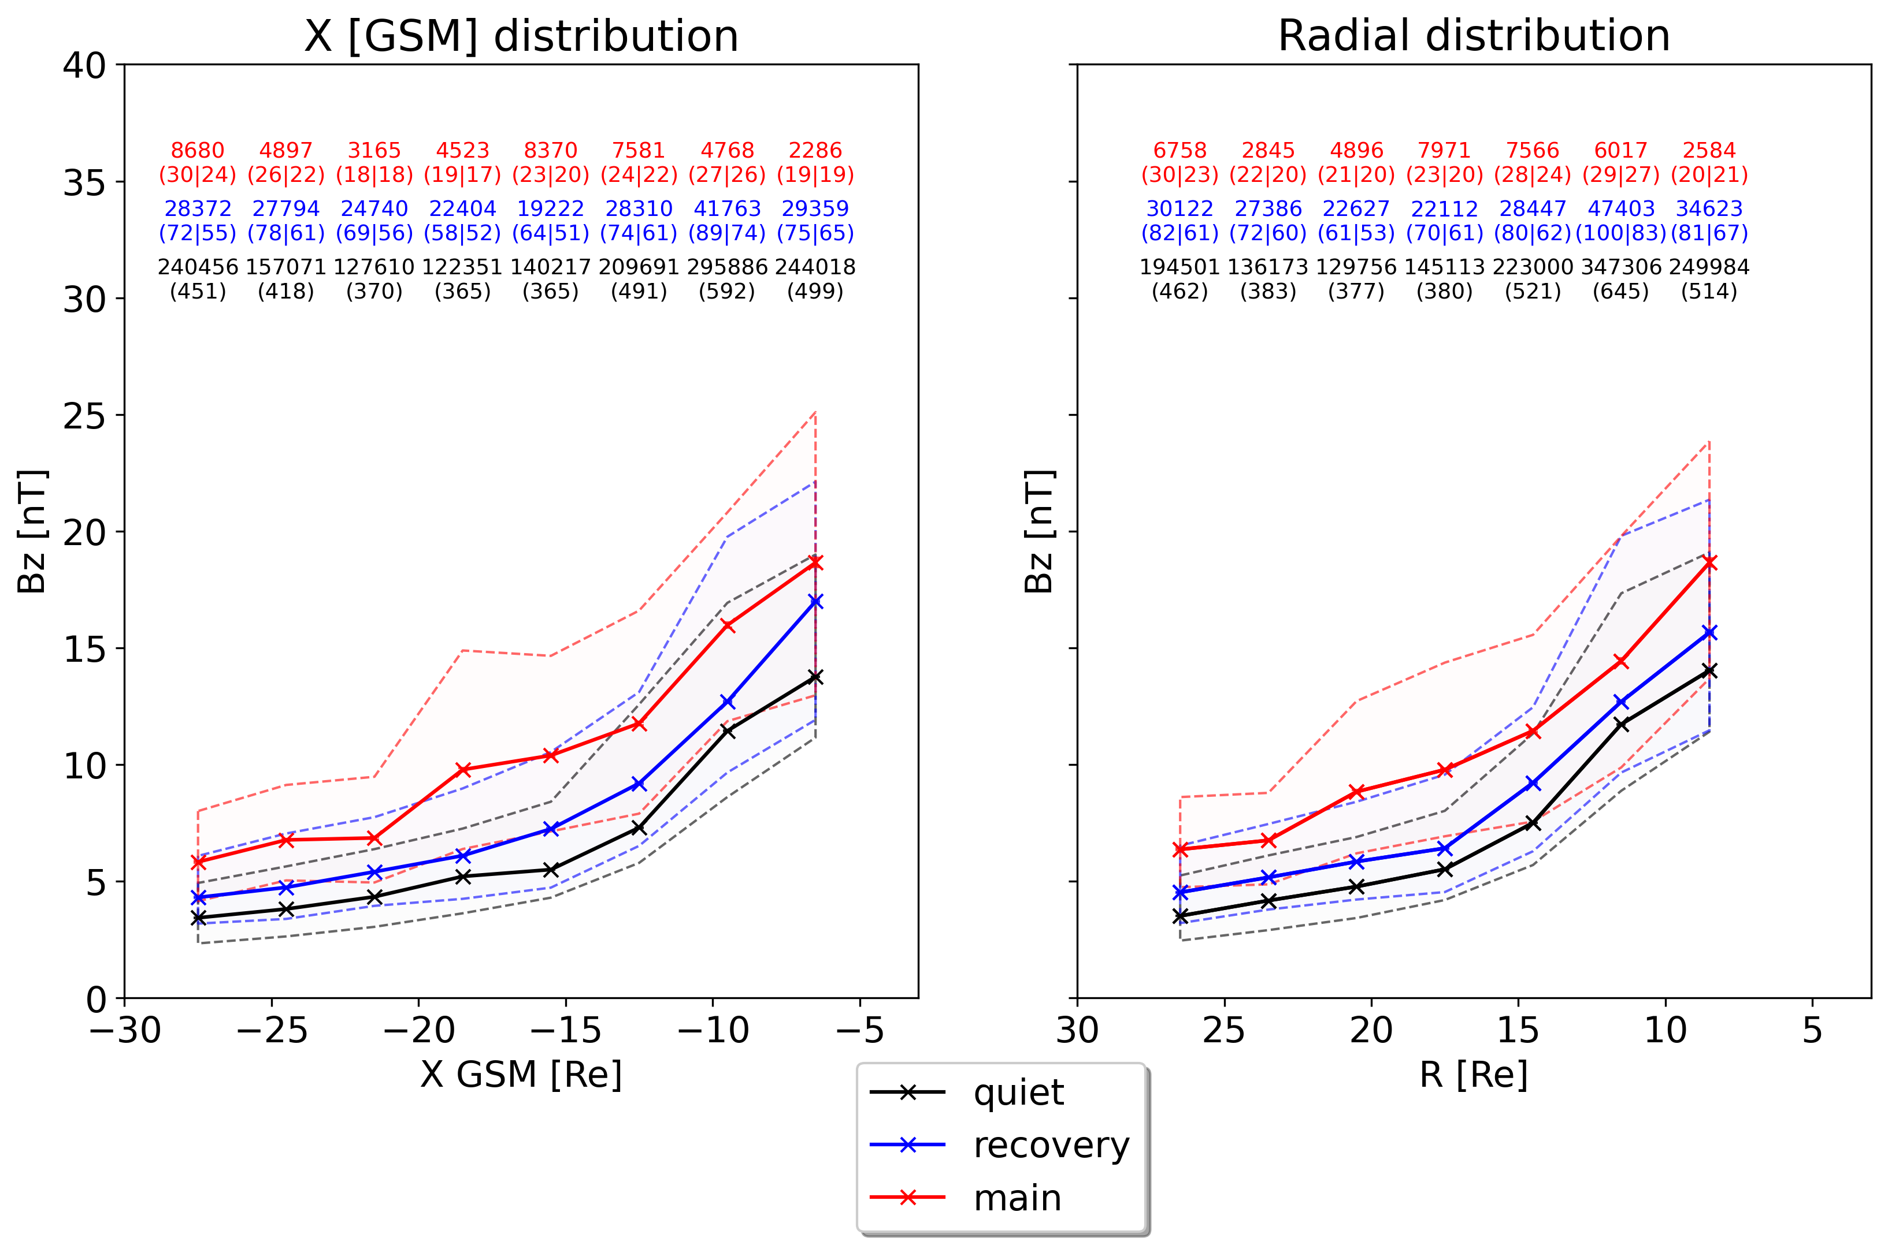
Bz – spatial distribution - Geotail
Outer
Inner
Storm Bz elevated throughout the tail

Slide 17
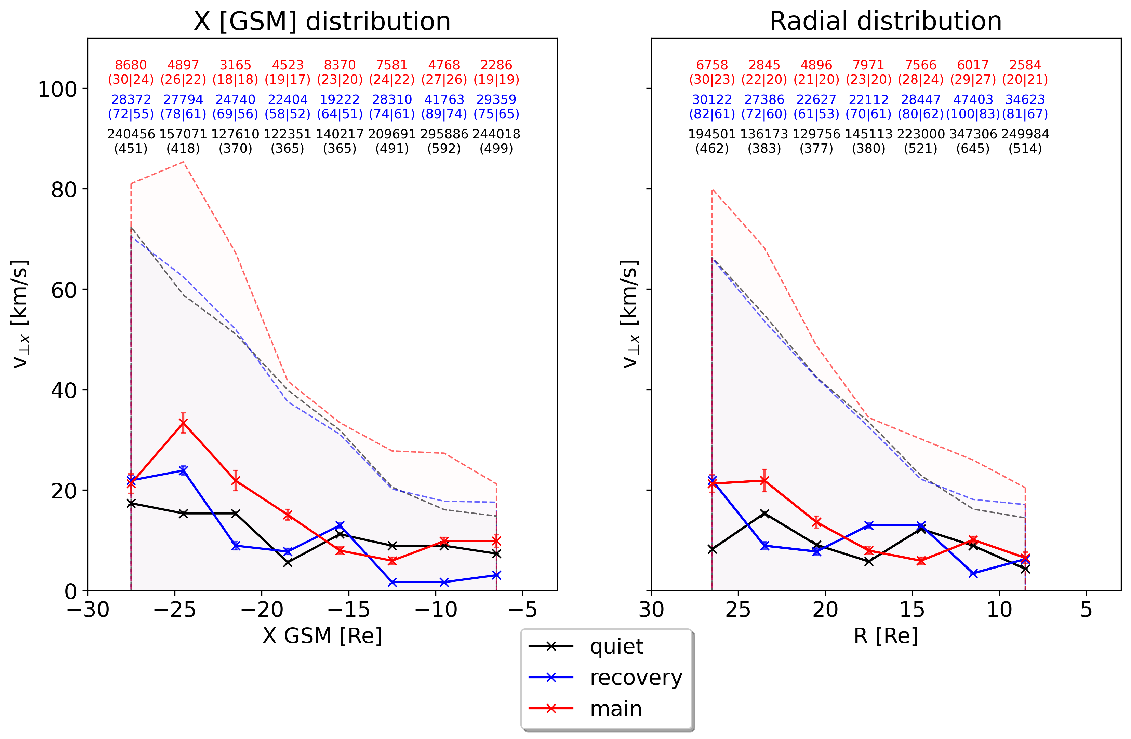
V⊥x – spatial distribution - Geotail
Outer
Inner
75%V⊥x slightly enhanced
Median V⊥x relatively constant

Slide 18
Take a step Further
Evaluate the distribution in X and radial distance
2) Investigate the 2D variability in XY GSM plane

Slide 19
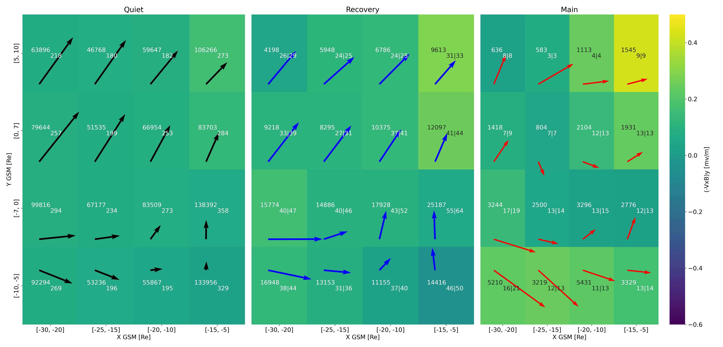
(-VxB)y & median flow - XY - Geotail
Ey $↑$
Arrows (→) showing median plasma flow
Dusk
Dawn
Outer
Inner
Ey $↑$
Median flows – Similar Quiet time to Nagai+ 2023

Slide 20
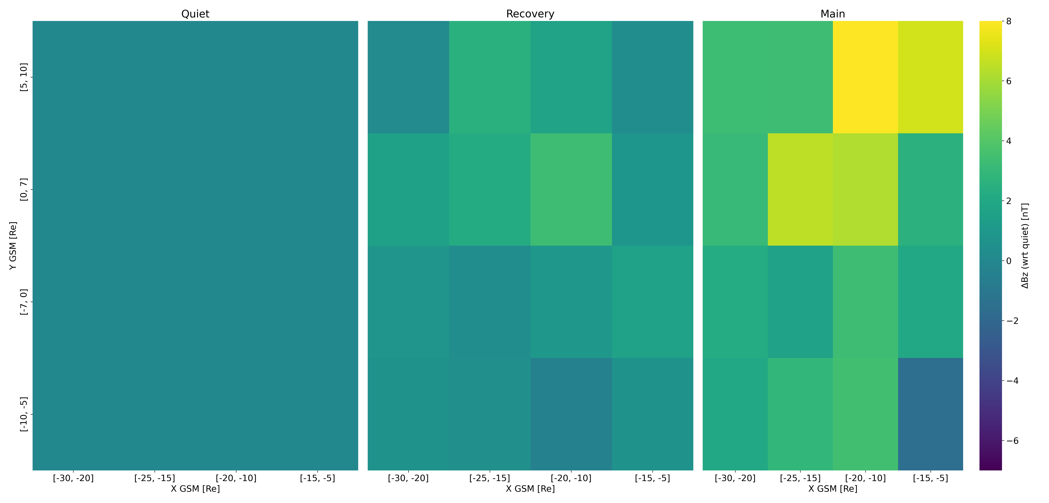
ΔBz (wrt quiet phase) - XY - Geotail
Bz $↑$
Dusk
Dawn
Outer
Inner

Slide 21
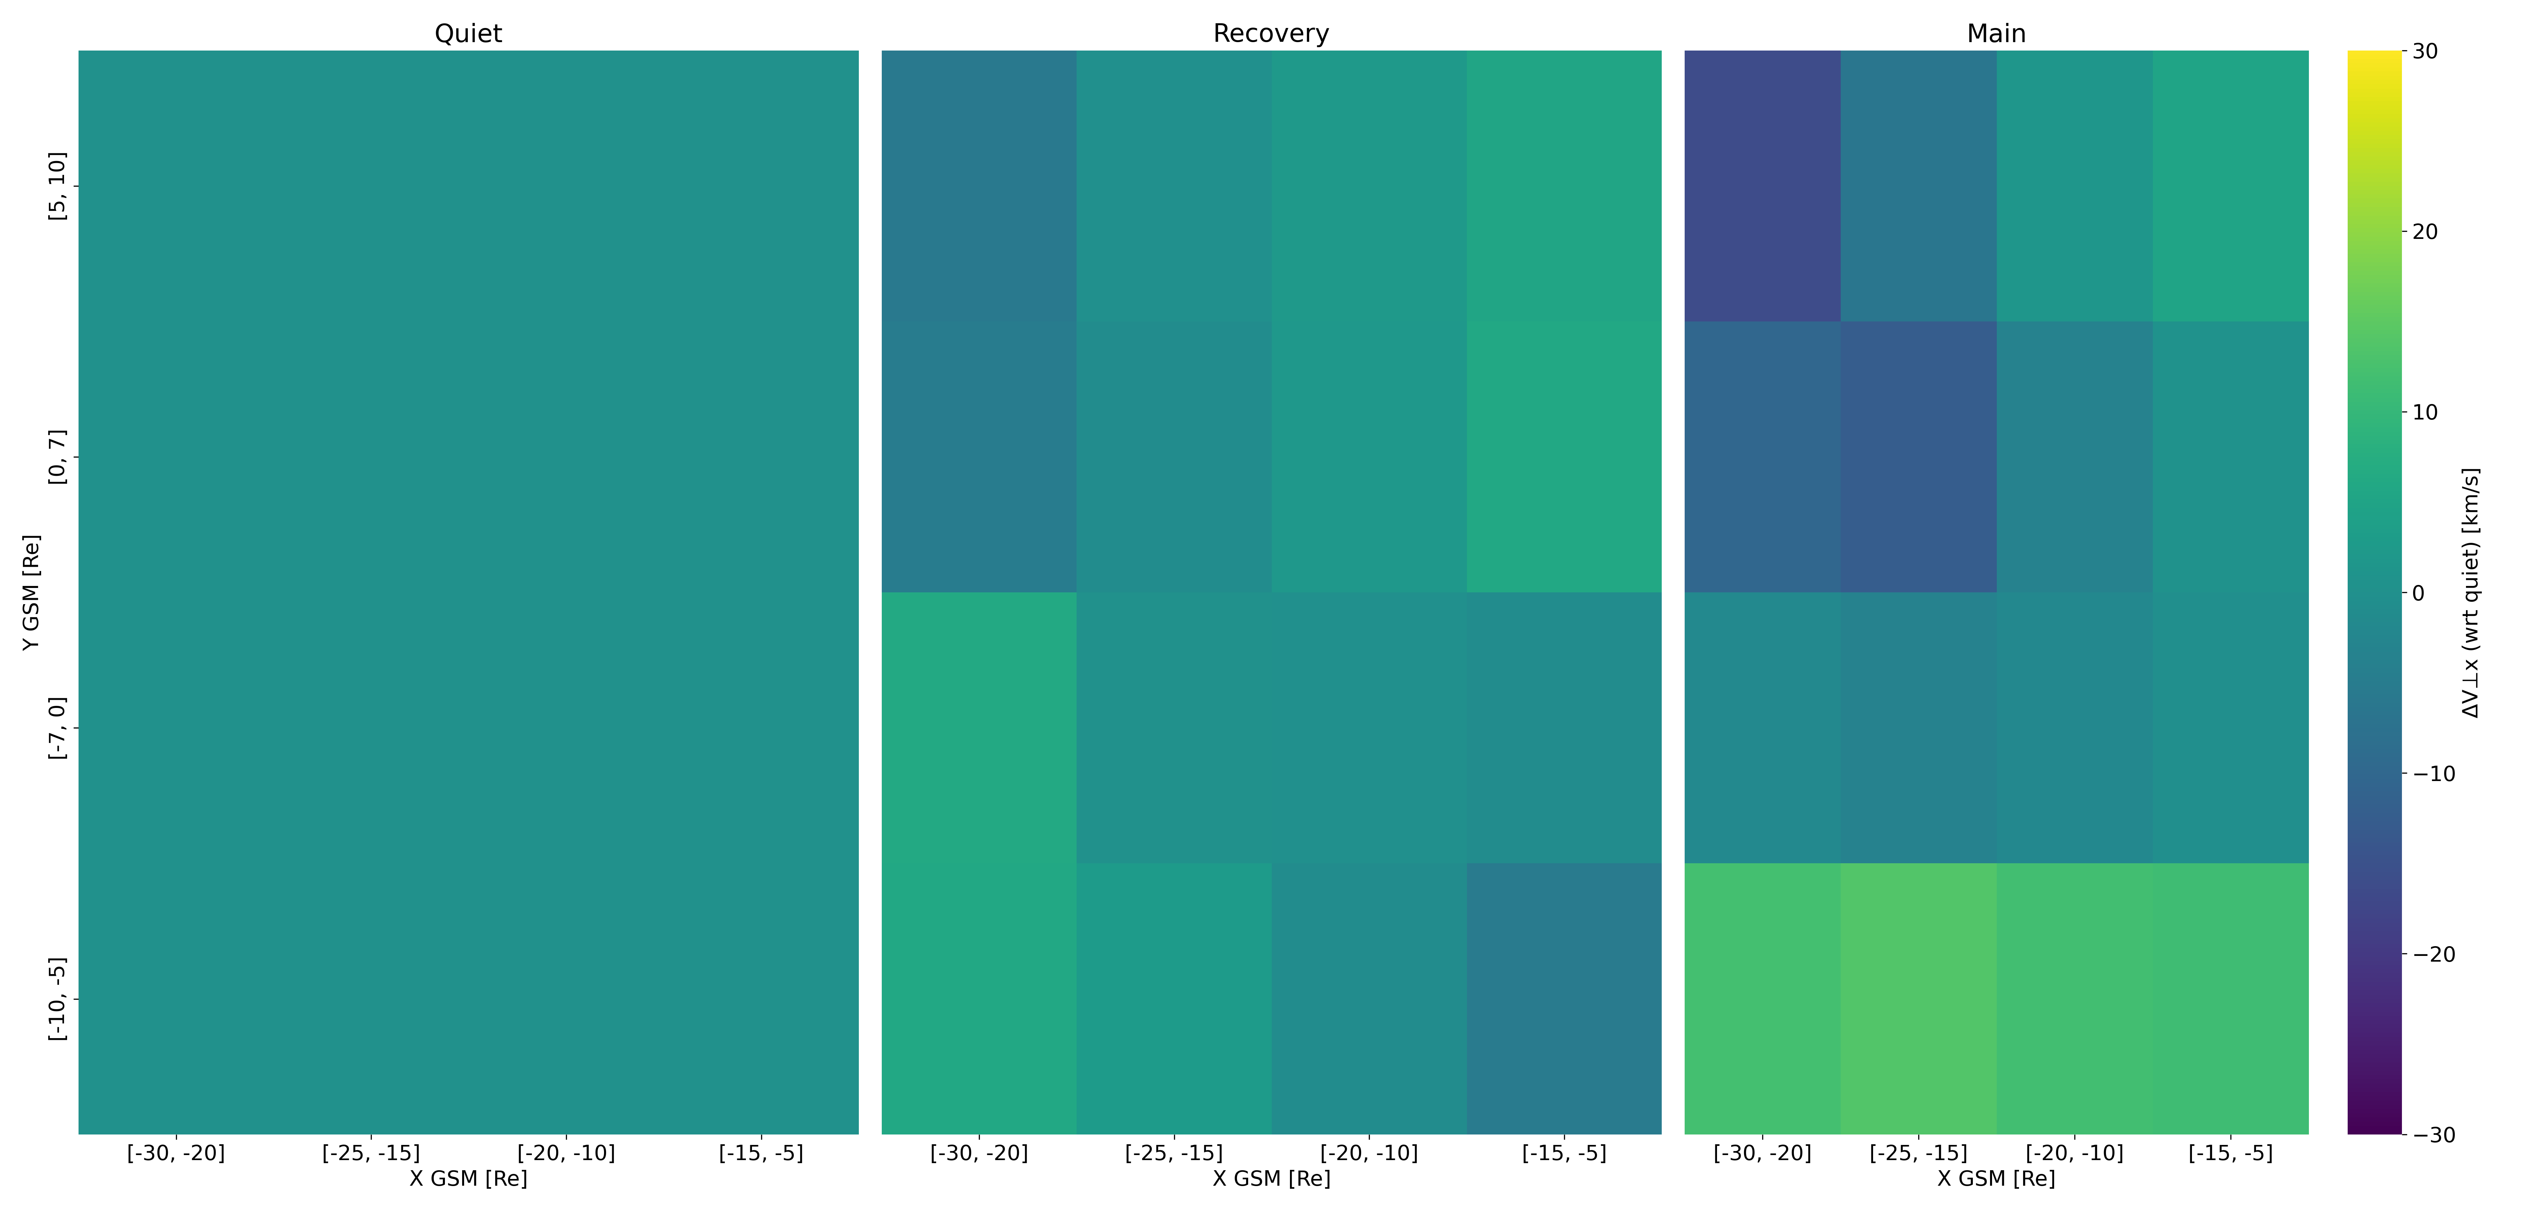
ΔV⊥x (wrt quiet phase) - XY - Geotail
Dusk
Dawn
V⊥x $↑$
Outer
Inner

Slide 22
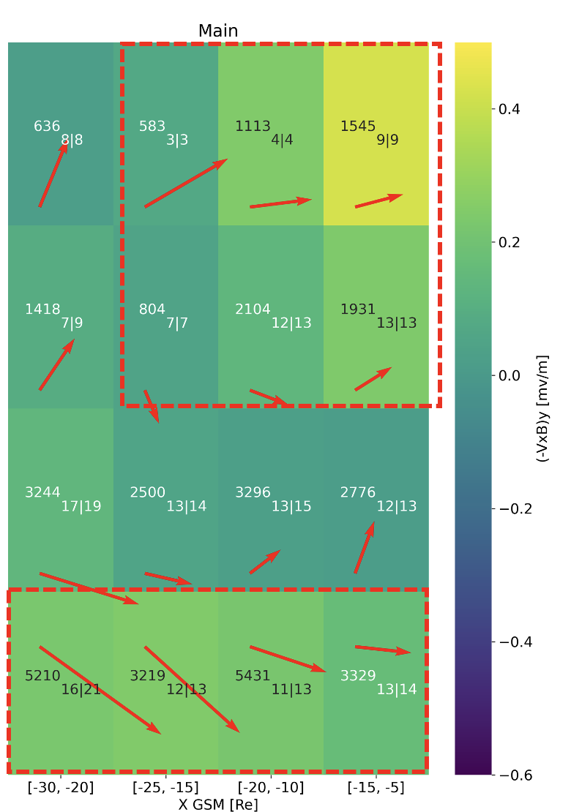
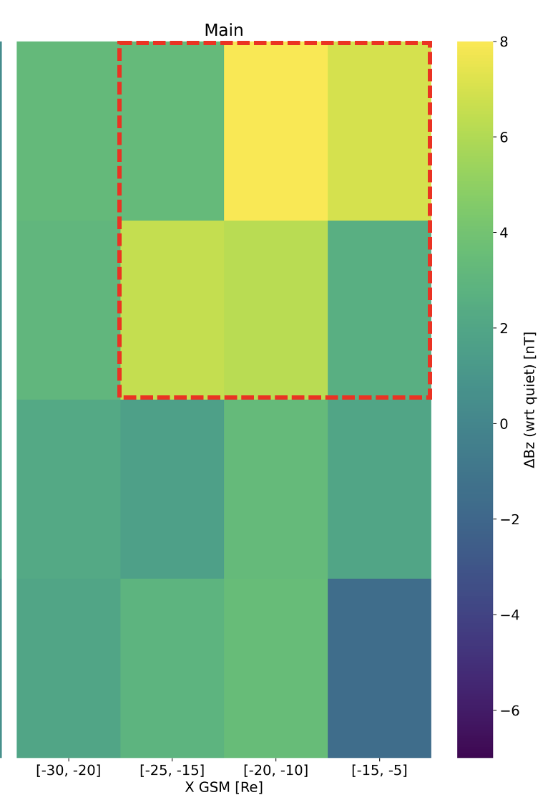
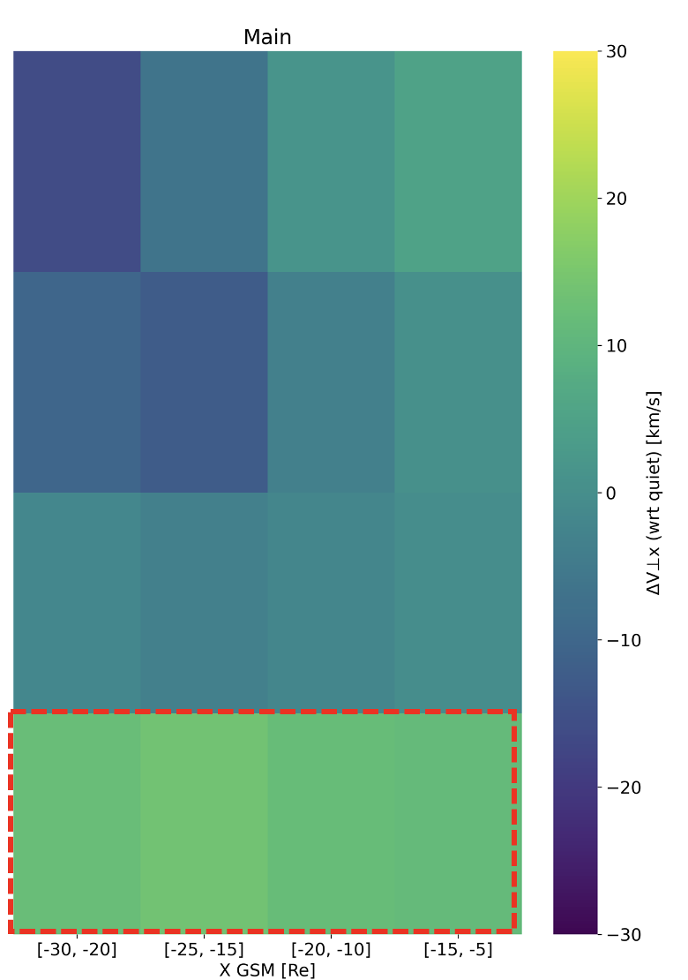
Storm - Main Phase Behavior
Ey $↑$
Bz $↑$
V⊥x $↓$
(1)
(1)
Dusk
Dawn
(2)
(2)
Outer
Ey
Inner
Bz
V⊥x $↑$
V⊥x

Slide 23
Discussion & Conclusion
Summary
During storm times:
Plasmasheet during storm times has eevated Ey associated with increased Bz, and limited enhancement of V⊥x throughout the whole magnetotail.
During Storm times:
Inner-Dusk observations showing more dipolar magnetic fields
Outer-Dawn are associated to relatively faster flows
Future Work
Validate results using FPI instrument (MMS)
Evaluate mass and energy flux transport
Validate findings with THEMIS mission & expand Geotail dataset to 2022
Quantify contribution of mesoscale transient phenomena across different missions
Please contact me with thoughts, feedback, and comments: savvas.raptis@jhuapledu
Supported by NASA DRIVE Science Center for Geospace Storms (CGS) - 80NSSC22M0163
Notes:
Ideas : If reconnection suppressed it could explain the enhanced flow of outer-dawn plasmasheet
However, for the tail of the distribution (75%) V⊥x appears to have a more significant effect.
Bz is increased across whole X and radial extend (differences between missions to be investigated)

Slide 24
Extras

Slide 25
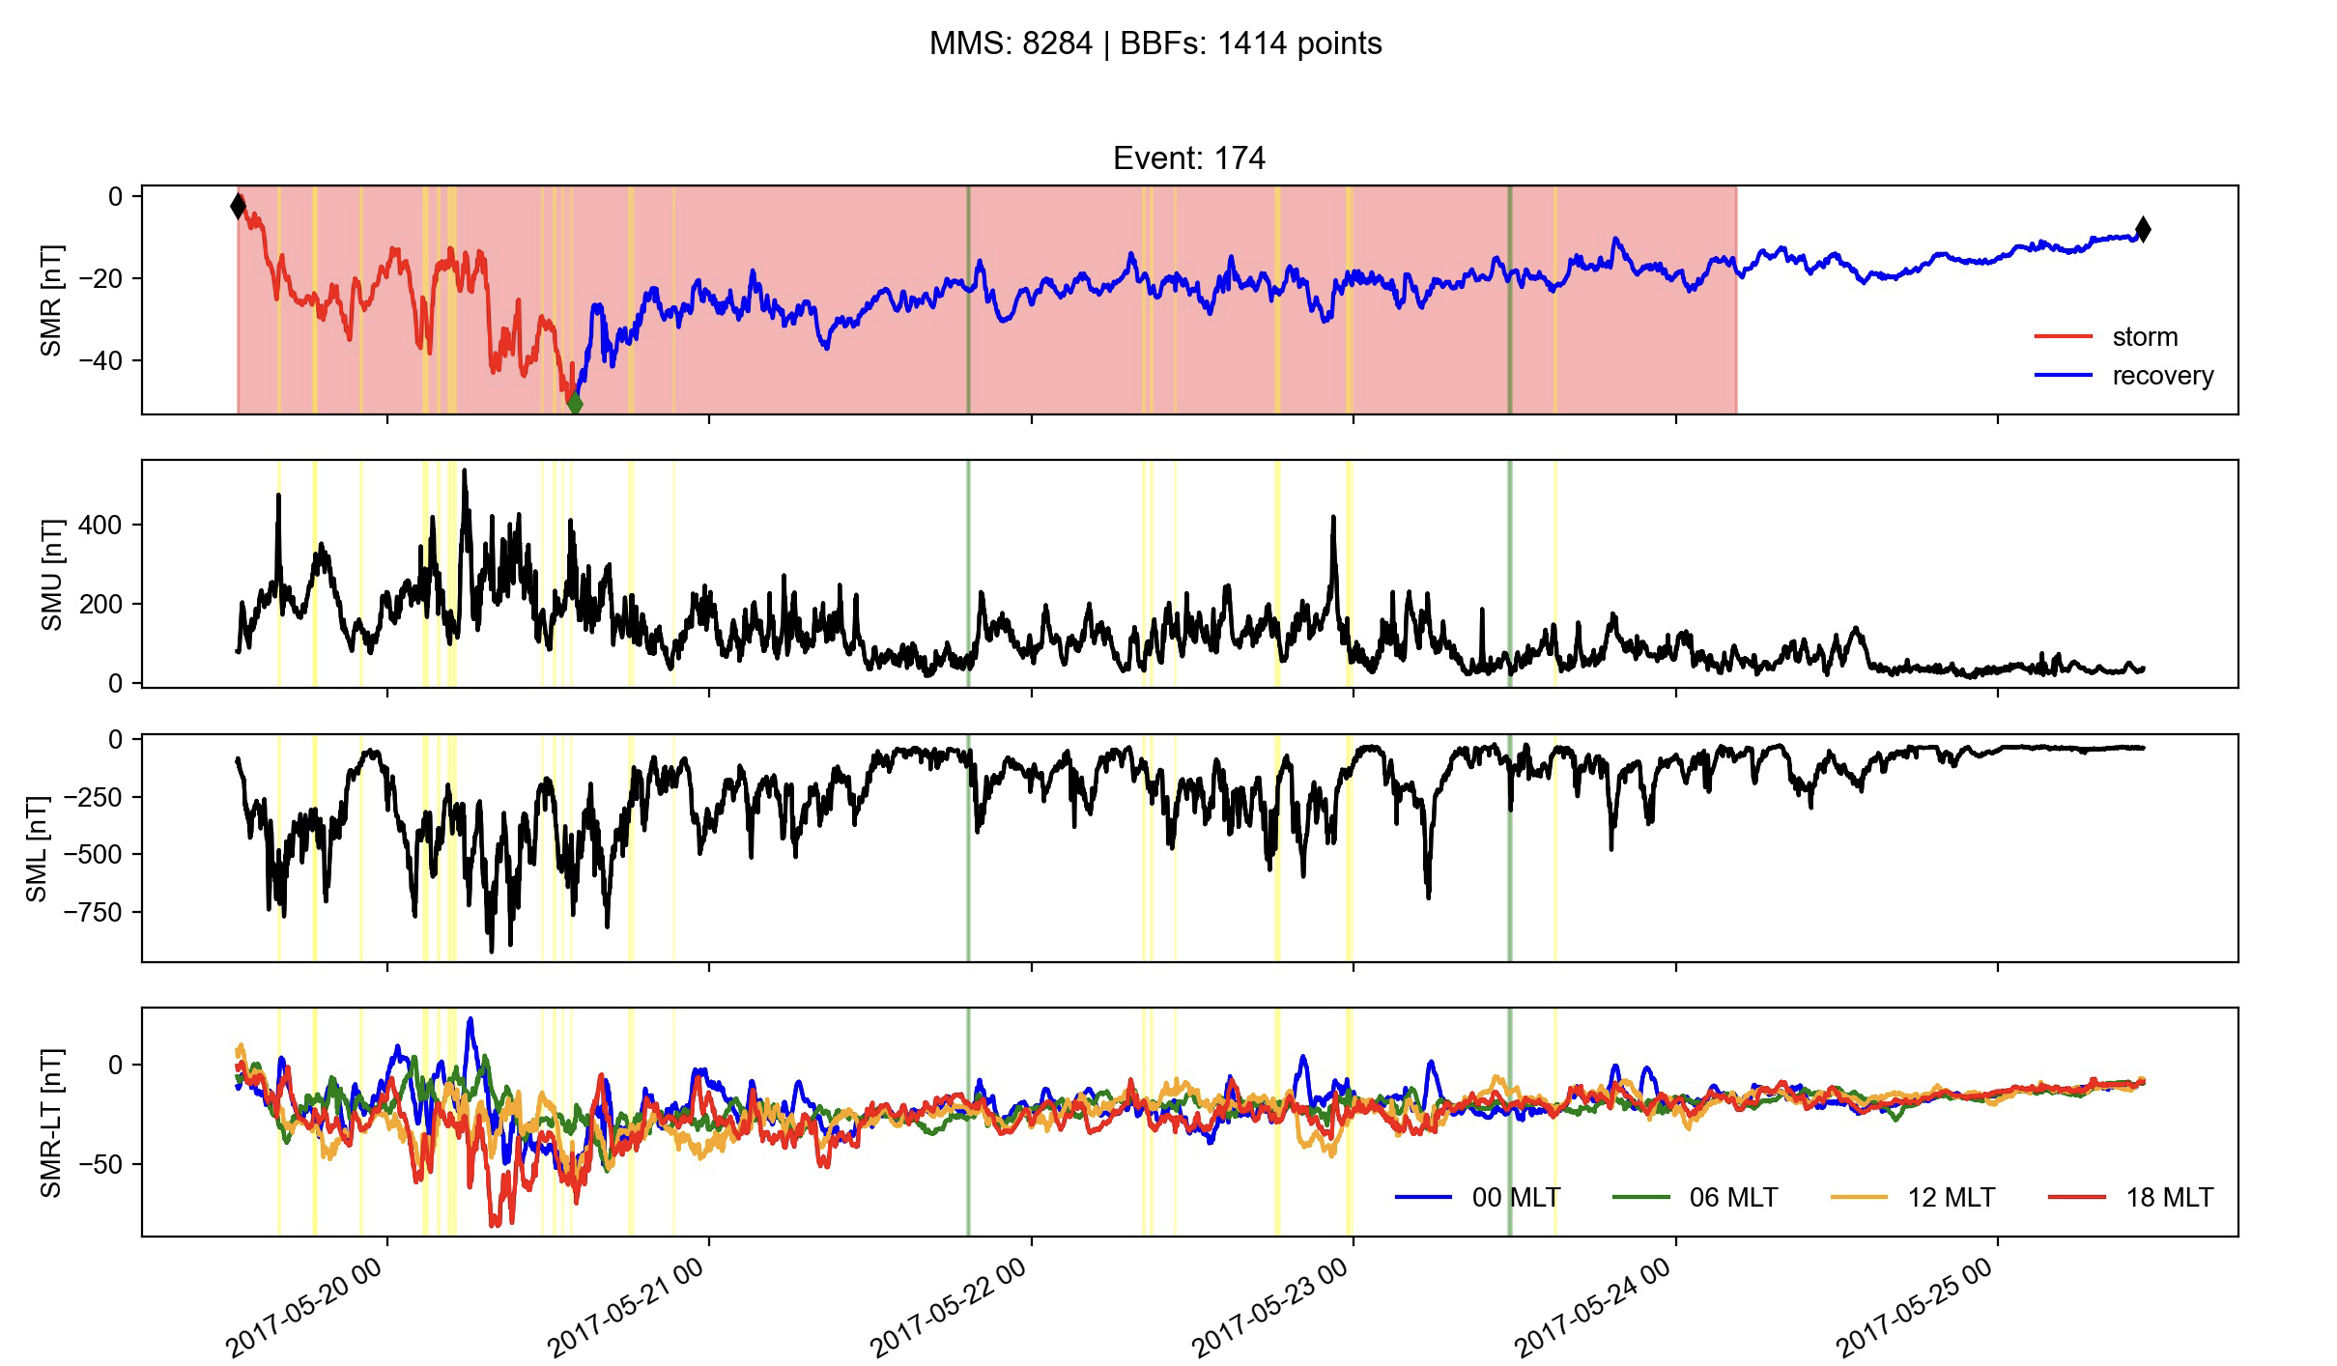
Future work: Connecting storms to SC coverage & to transients
Red = MMS coverage
Green = IP shocks
Yellow = BBFs

Slide 26
Dusk – Dawn Asymmetry Velocity
Quiet
Dusk
Recovery
Dawn
Main

Slide 27
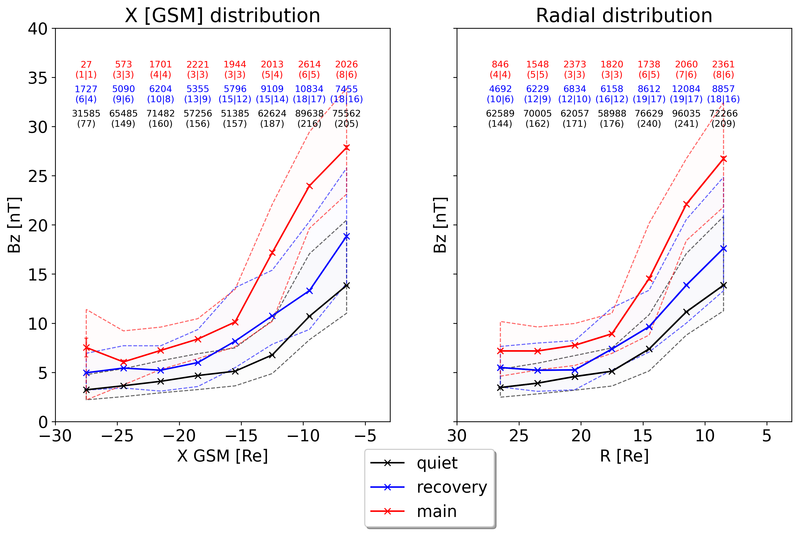
Bz – spatial distribution - MMS

Slide 28
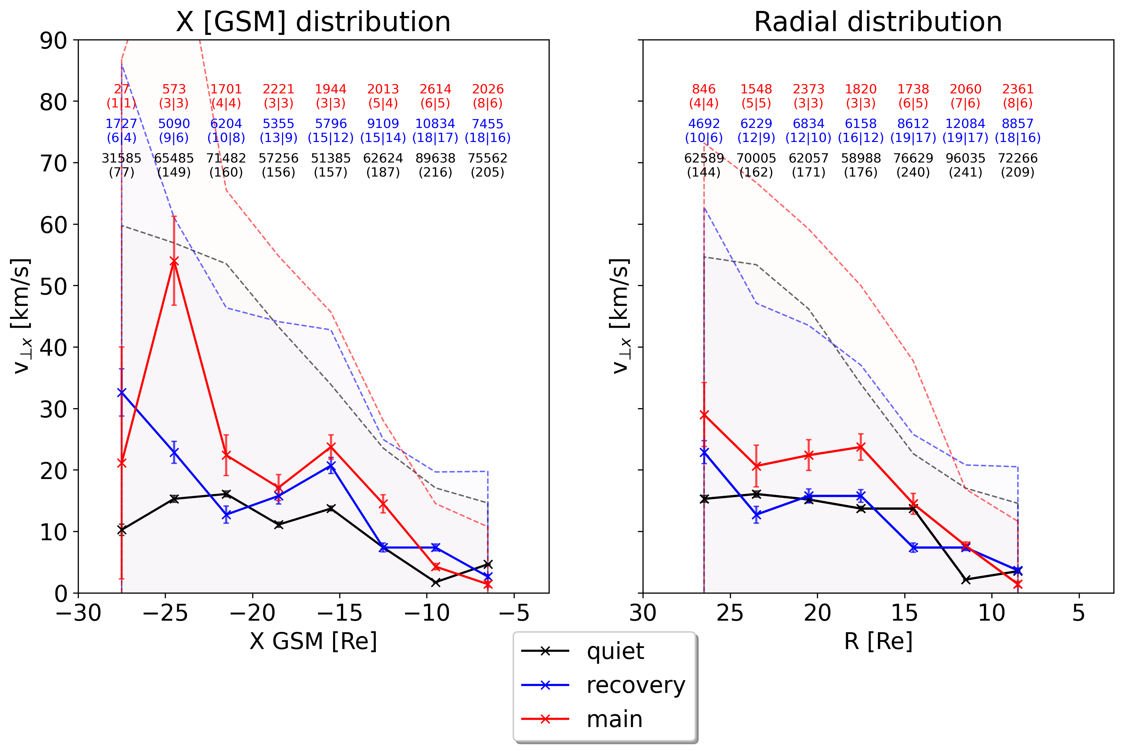
V⊥x – spatial distribution - MMS

