Slide 1
Heliophysics Education and Research using Cloud Computing
Savvas Raptis¹, Slava Merkin¹, Sandy Atunes¹, Brent Smith¹, Chris Jeschke¹, Eric Winter¹, Peter Shumate¹, Michael Wiltberger²
¹ APL/JHU, Laurel, MD, USA
² NCAR High Altitude Observatory, Boulder, CO, USA
Supported by NASA DRIVE Science Center for Geospace Storms (CGS) - 80NSSC22M0163
savvas.raptis@jhuapl.edu
https://savvasraptis.github.io

Slide 2
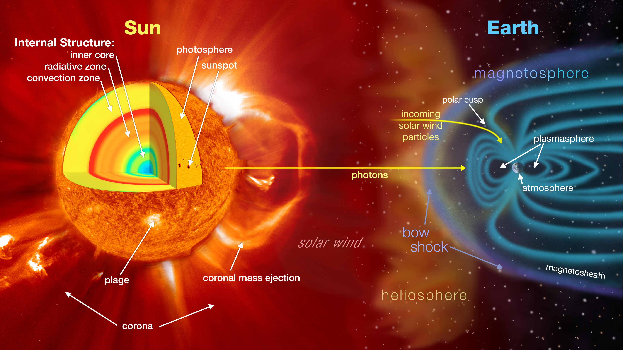
What is Heliophysics?
Heliophysics is the study of “the nature of the Sun and how it influences the very nature of space -and, in turn, the atmospheres of planets and the technology that exists there.”
[NASA Heliophysics Division Website]
Credits: NASA

Slide 3
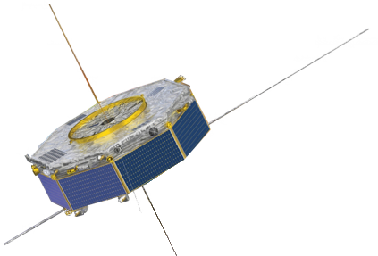
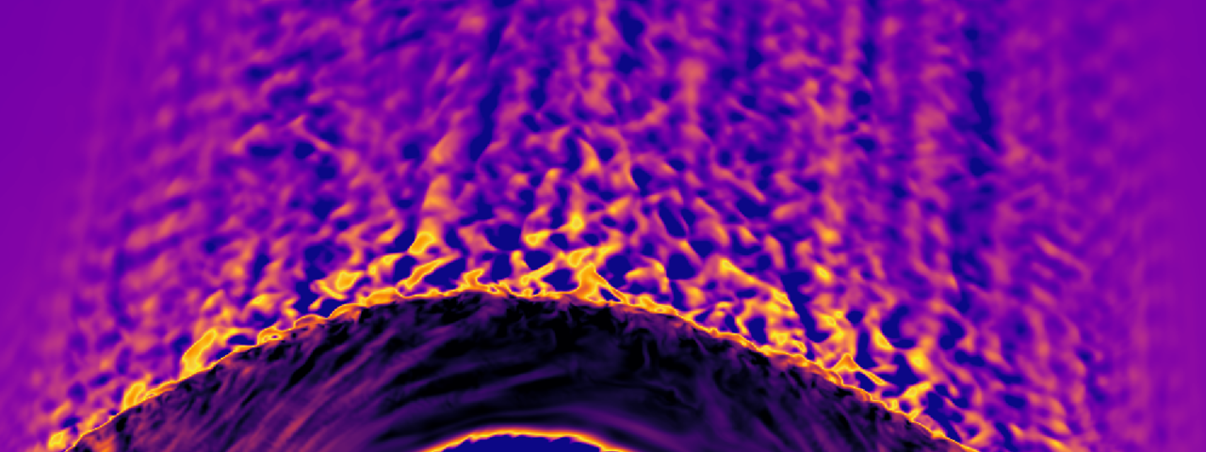
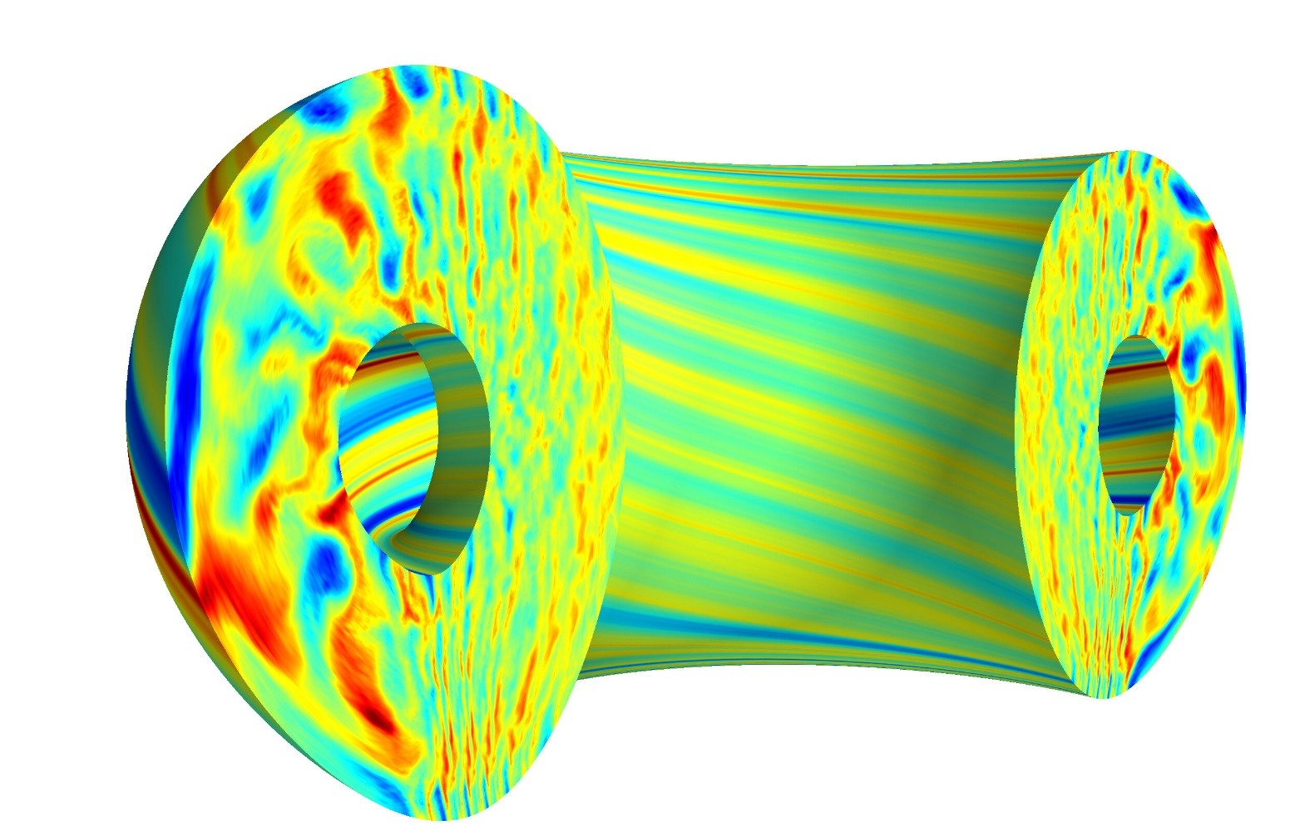
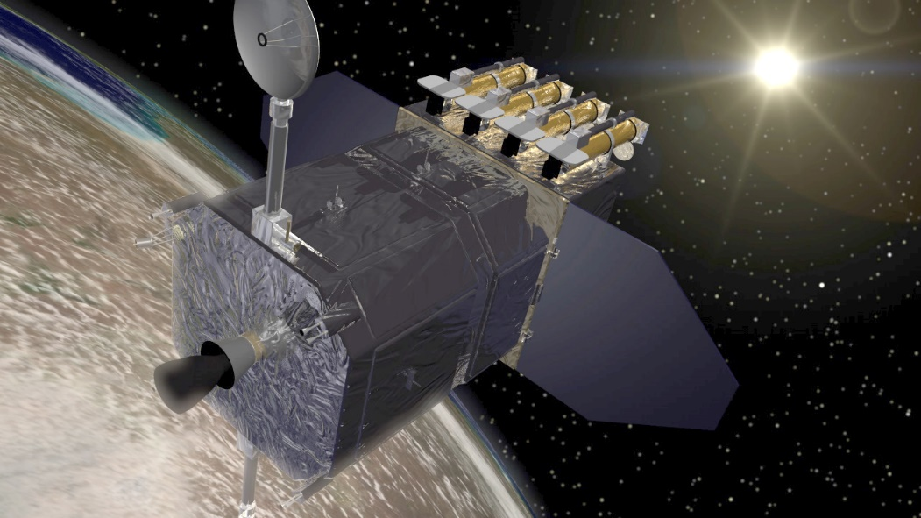
Research in Heliophysics
Observations
Simulations
In-situ
(examples)
Cluster
MMS
THEMIS
Arase
ACE
WIND
PSP
Fluid, Hybrid, PIC, Monte Carlo
Remote Sensing
(examples)
SOHO
SDO
Solar Orbiter
SMILE
[Top]: MMS/NASA
[Bottom]: SDO/NASA
[Top]: M. Palmroth, Vasiator
[Bottom]: Emily Belli, General Atomics

Slide 4
Typical Course in Heliophysics vs Research
Theory
Exercises
Analytical
Computational
Theory
Research
Analytical
Computational
A course in Heliophysics
A researcher’s day
70%
10%
15%
15%
10%
80%
Question: How do we prepare graduate students for a future within and outside of our field ?

Slide 5
Reality of graduate student education

Slide 6
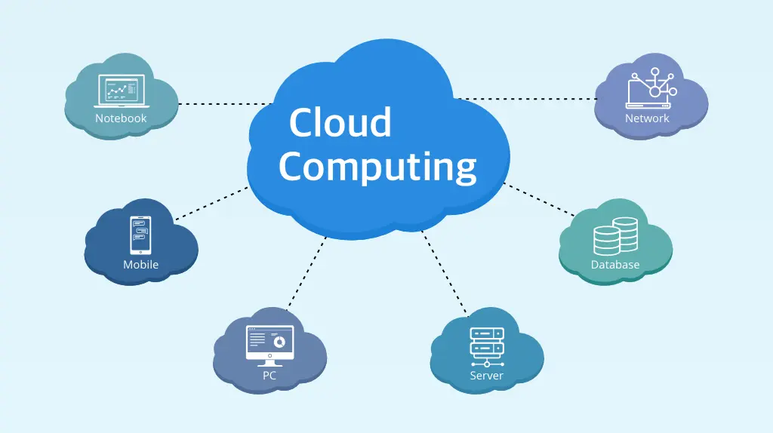
The code & data challenge
Things typically not addressed in courses:
State-of-the-art algorithmic solutions to problems
Community driven libraries & open science
Data/code management and scaling

Slide 7
What is cloud computing and how it is relevant?
Cloud computing is storing and accessing data and programs over the internet instead of your computer's hard drive.
Data storage and listing
Computing power on demand
Easy to share (essentially a website)
Easy to control (1 link = 1 project/exercise)
Easy to collaborate (many tools available)
We can bring all new tools, and all good practices in 1 place
Notes:
The Helio Cloud is sponsored and organized by the NASA Heliophysics Digital Resources Library (HDRL)

Slide 8
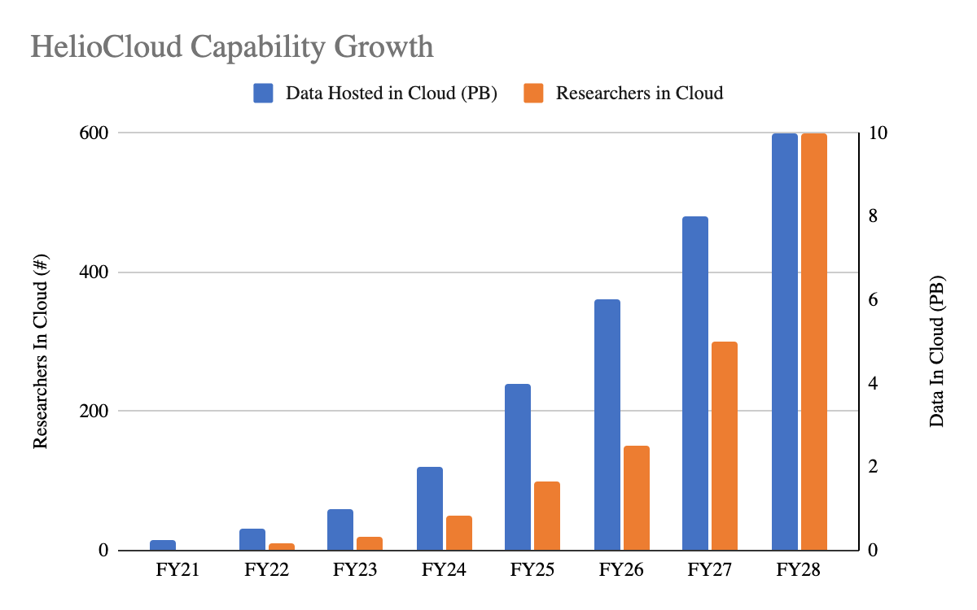
Heliophysics Cloud solutions
https://datalabs.esa.int
Brian Thomas/HDRL
https://heliocloud.org
Notes:
The Helio Cloud is sponsored and organized by the NASA Heliophysics Digital Resources Library (HDRL)

Slide 9
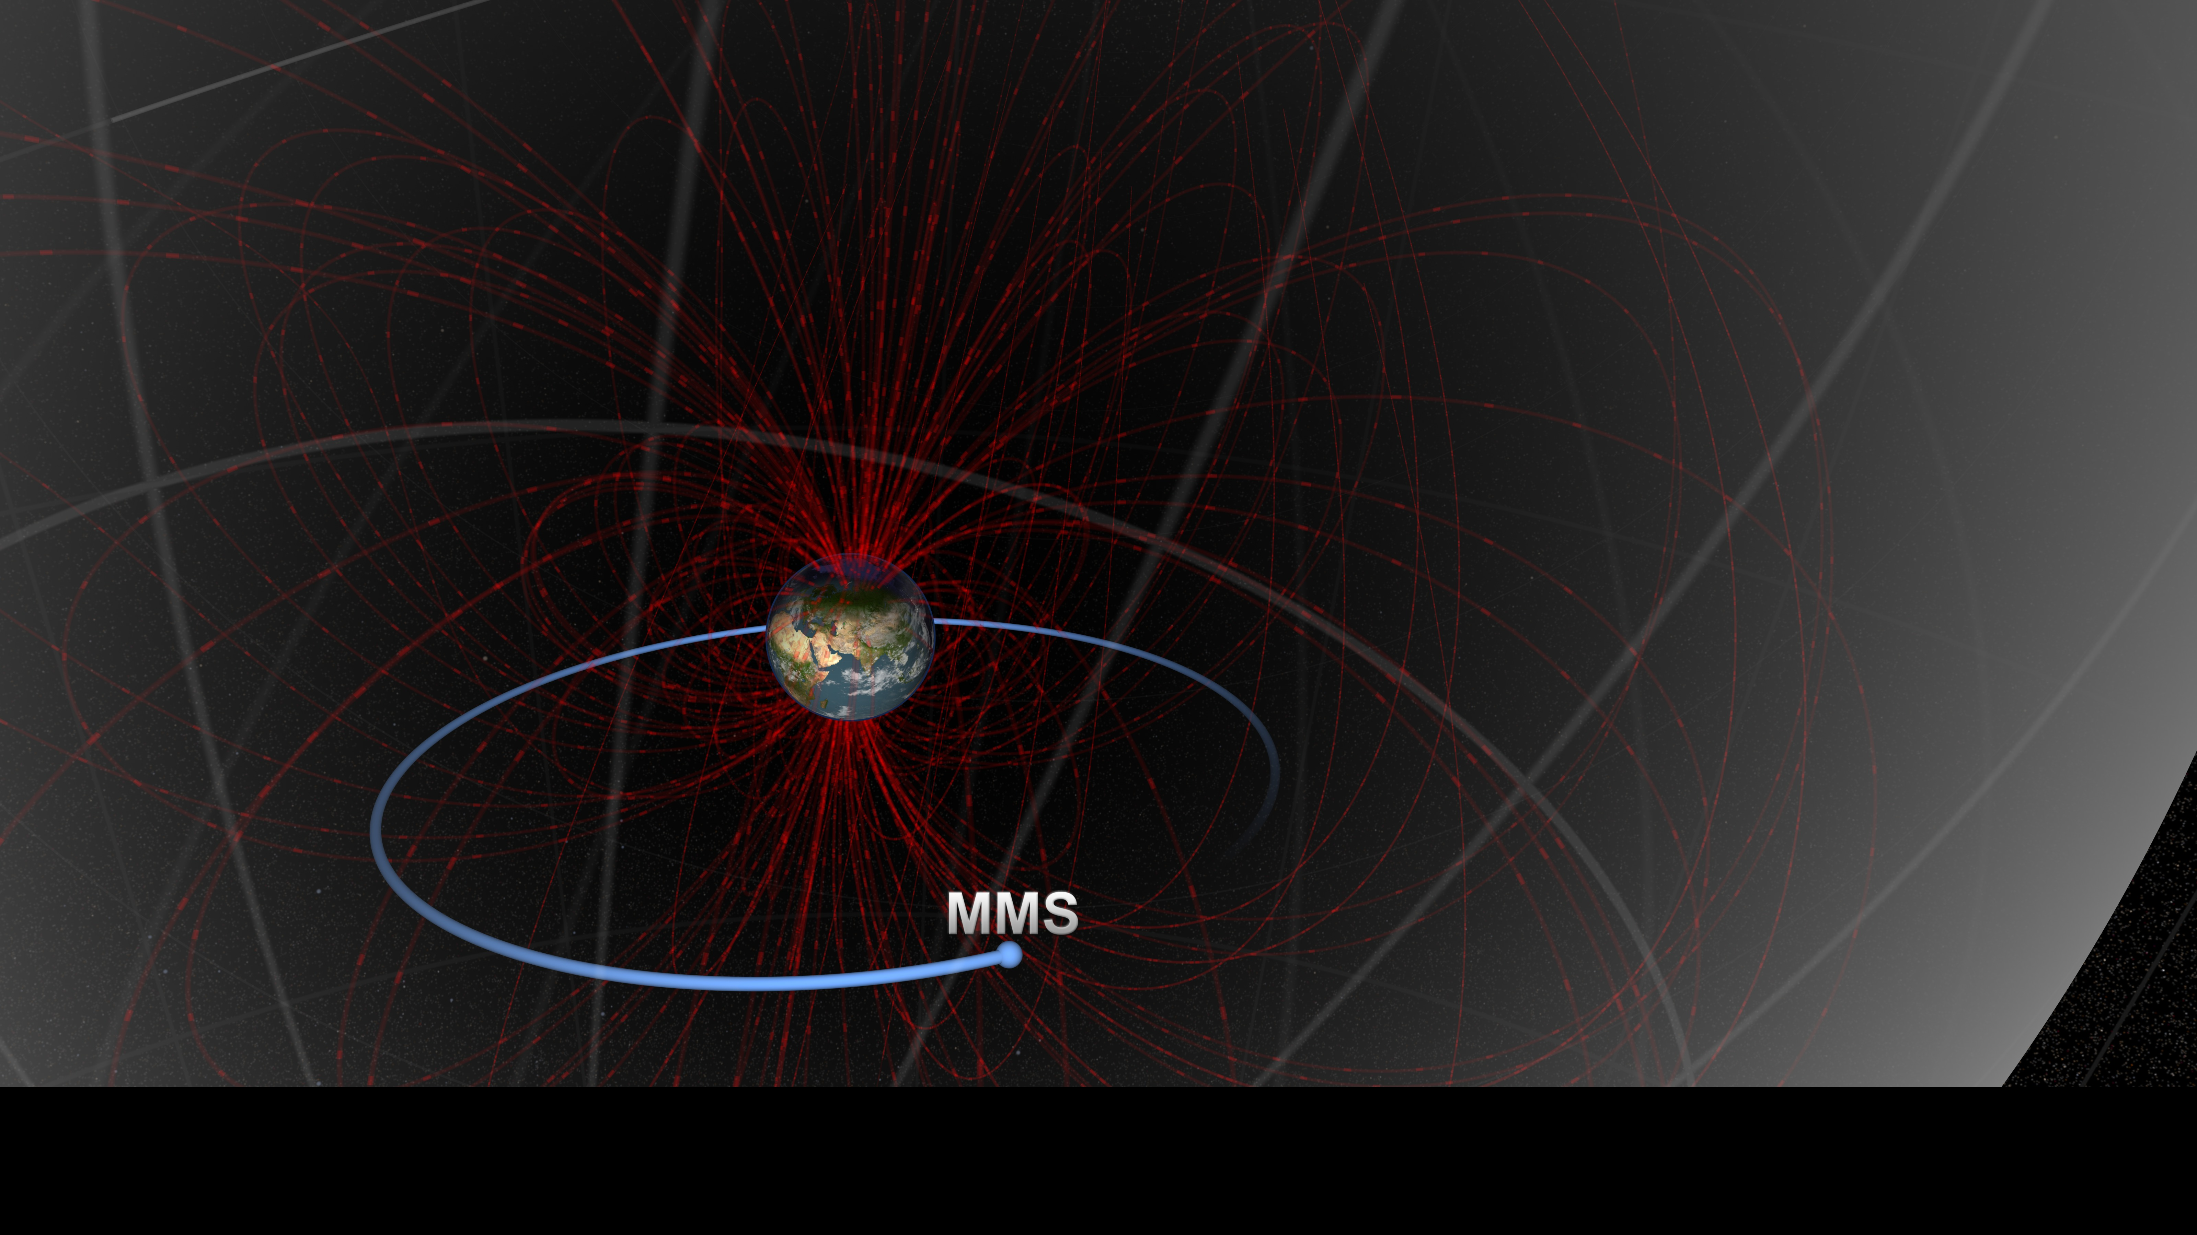
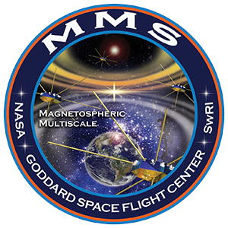
Example – Observations problem
Download and pre-process data
Write scripts to load and analyze data
Results and Interpretation
1
2
3
Task: Plot the magnetic field of MMS mission on 2019-09-14T07:54:00.000

Slide 10
The (old) usual approach
https://lasp.colorado.edu/mms/sdc/public/ → Find .cdf file(s) → download
Write a script to open .cdf files
Post process data (cleaning spikes, outliers, background noise etc.)
Organize dataset in an easy to transfer and to plot format
Pick a language to analyze and visualize results (python, MATLAB, R etc.)
Make the plot
Hard to reproduce
Hard to collaborate
Tedious and time consuming
Suspectable to package version changes
Fine for an exercise in class, not so fine when you work on a project as a researcher or in industry

Slide 11
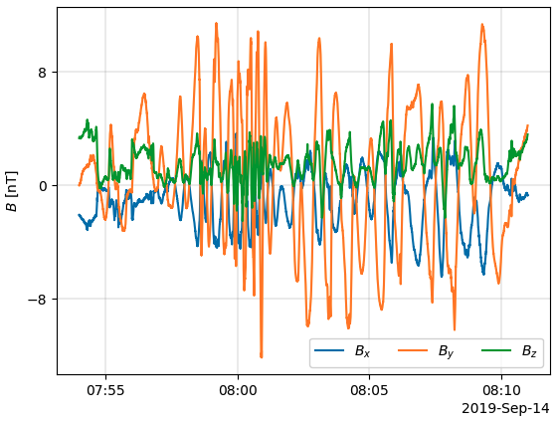
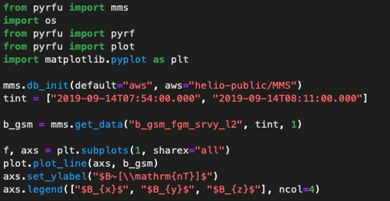
The cloud approach
Download and pre-process data
Write scripts to load and analyze data
Results and Interpretation
1
2
3
mms.db_init(default="aws", aws="helio-public/MMS")
plot.plot_line(b_gsm)
https://pyrfu.readthedocs.io/en/latest/

Slide 12
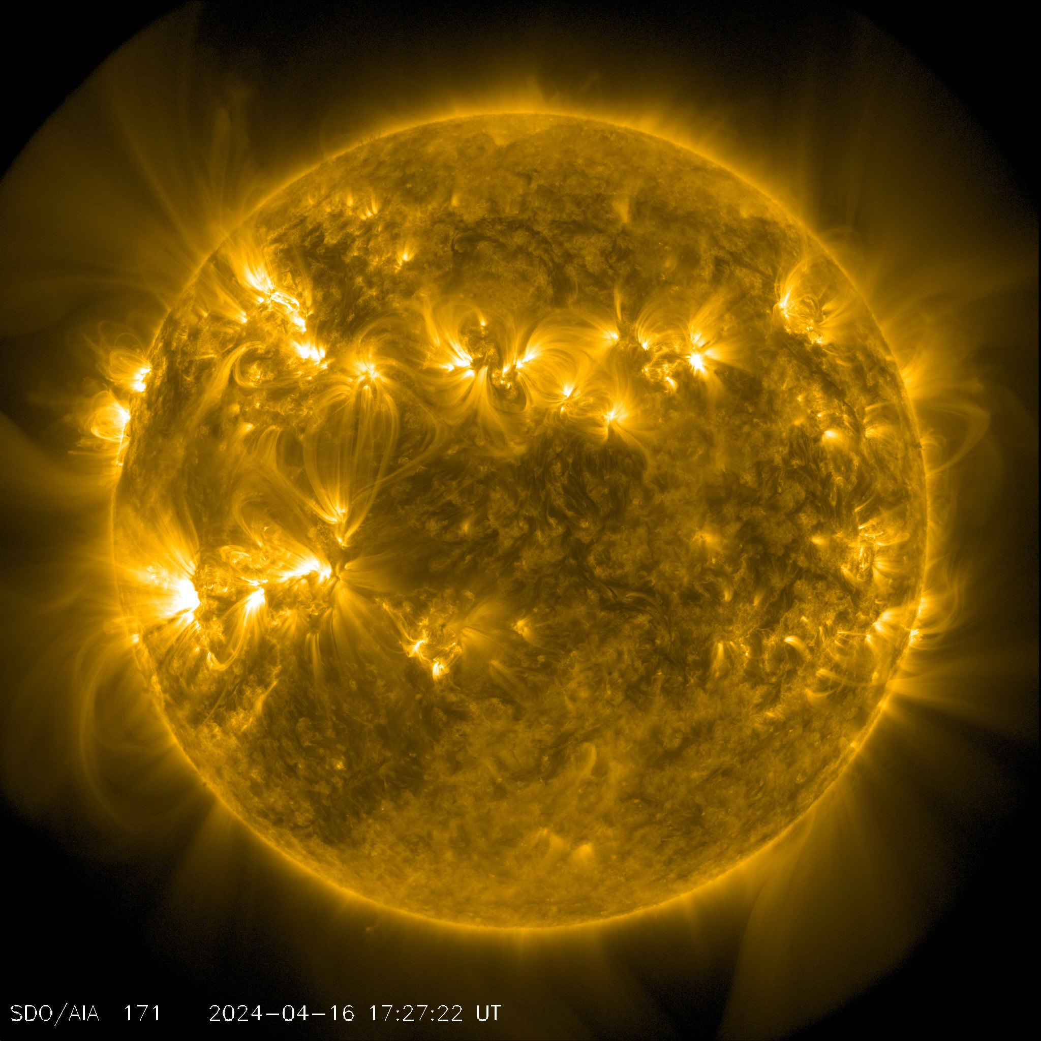
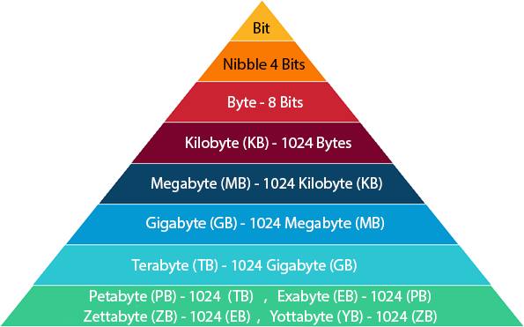
Using solar images with heliocloud
1 year - 2TB of SDO data
Typical laptop ~ 27 hours
Heliocloud ~ 25 minutes
Solar Irradiance over 1 year
Case studies
Toy examples
Statistics
Simulations
Machine learning
Example from: Alexander (Sandy) Antunes (APL)
see: https://github.com/heliocloud-data/science-tutorials

Slide 13
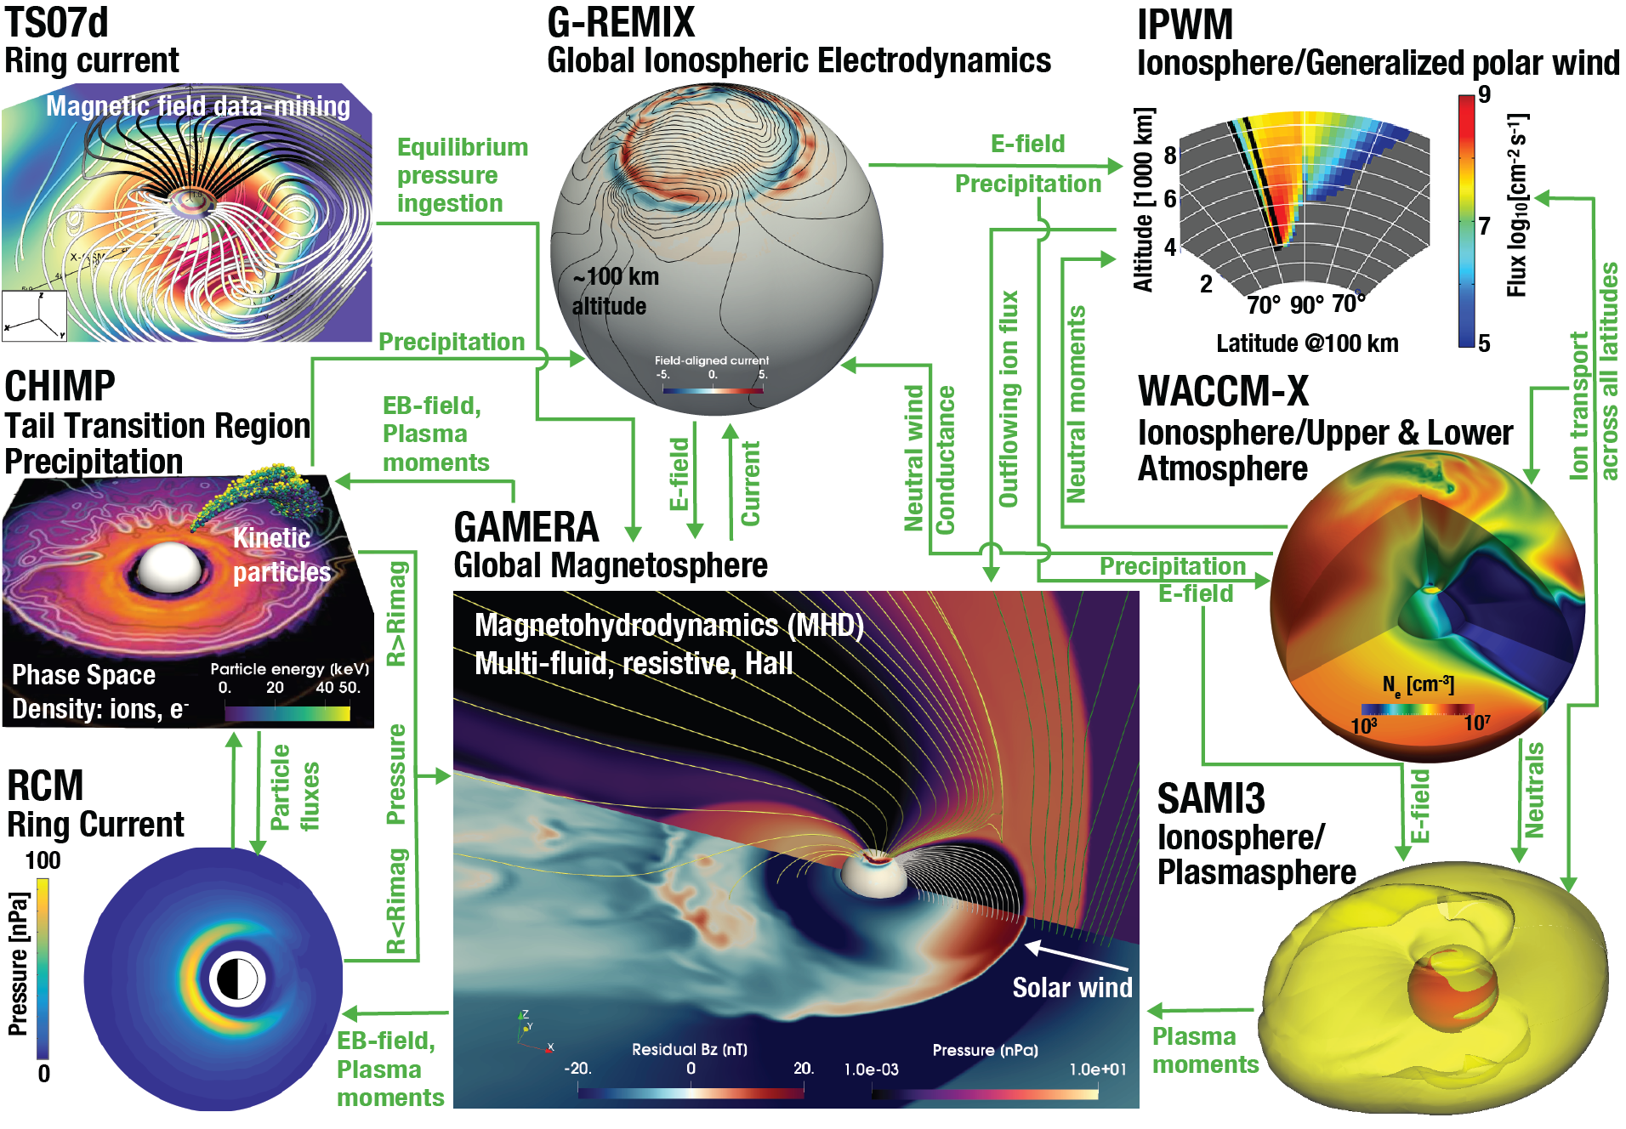
Center for Geospace Storms (CGS) – MAGE
MAGE (Multiscale Atmosphere Geospace Environment Model)
Complicated model allowing us to understand Earth’s geospace!
High data size
High computing power

Slide 14
Example – Simulation problem
https://cgs.jhuapl.edu
Run simulations & load data
Write scripts to open and analyze
Results and Interpretation
1
2
3
Case studies
Toy examples
Task:
Plot simulated Earth’s magnetosphere in XY plane showing fast flows (velocity) as colorbar
Statistics
Simulations
Machine learning

Slide 15
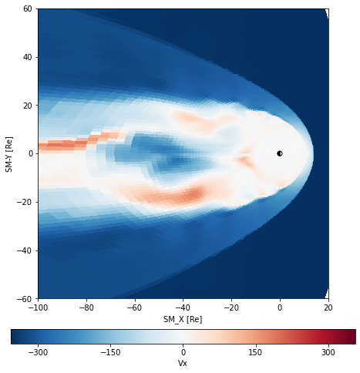
Quicker Approach
https://cgs.jhuapl.edu
Run simulations & load data
Write scripts to open and analyze
Results and Interpretation
1
2
3
https://ccmc.gsfc.nasa.gov
https://pypi.org/project/kaipy/
[Future cloud adaptation] CGS/CCMC efforts
fdir ='/Gamera-test/’
ftag = 'msphere’
gsph = msph.GamsphPipe(fdir,ftag,doFast=False) nstep = gsph.sFin
xyBds = [-100,20,-60,60]
See more on this link: https://github.com/wiltbemj/CGS-Tools

Slide 16
Summary
Cloud computing allow us to combine the following components:
Modern algorithmic tools
Sharing between collaborators / students
Version control and reproducibility of results
Tackle problems that require significant computing power or data size without huge expertise/facilities
Including exercise and projects with the use of these tools will benefit students greatly since they:
(a) have more time to understand the results topic
(b) learn advanced tools that people use
(c) facilitate collaborative spirit since sharing and code accessibility becomes very easy

Slide 17
Python in Heliophysics – More Opportunities
What: PyHC package intros with focus on active student involvement and more!
Why: Educate on and integrate students and early career scientists in PyHC software
Where: At LASP (Boulder, CO, USA) and online everywhere on Zoom
When: Monday, May 20th - Friday, May 24th 2024
Who: undergraduate and graduate students, early career scientists, etc.!
Cost: the event is FREE!
Important dates
Registration (required): due by April 29th
NSF travel support applications: due by April 29th
Hotel block: prior to cut off date of April 19th
Poster submission: due by May 6th (11:59 PM MT)
pyhc.org/summer-school-24 ​

Slide 18
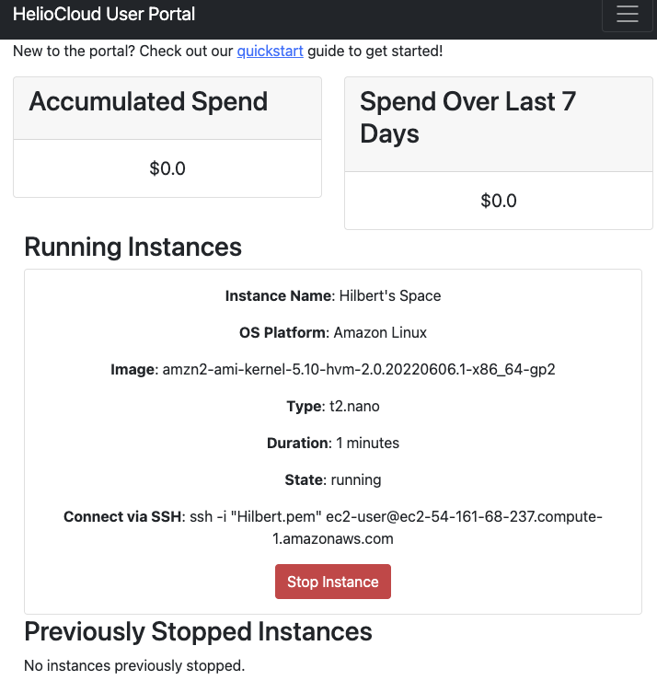
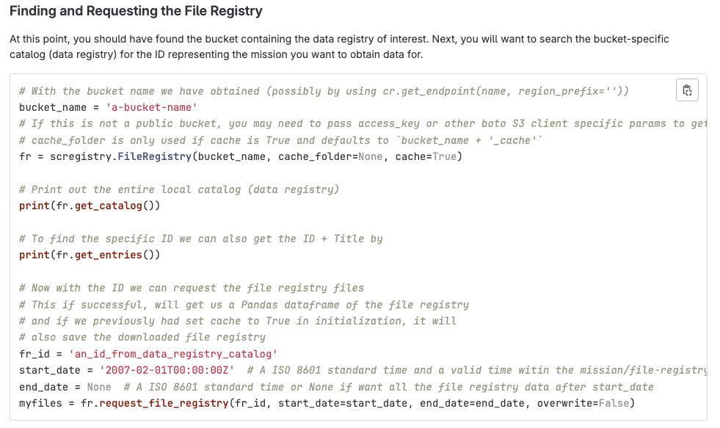
Heliocloud usage & roadmap
Next year plans:
Website/ documentation update
Improved login experience
Jupyter notebook computational cost tracking
JupyterBook integration
Workshop support
Cloud agnostic investigation: AWS, Azure, GCP
HelioCloud is a time-saving tool for Heliophysics researchers to rapidly access and analyze high-volume datasets from a web browser via an open science collaboration framework.
Datasets
HelioCloud
Jupyterhub with Python, MATLAB, IDL kernels and libraries
AWS EC2 dashboard
Registry, data storing and sharing
Big data on demand with high-performance computing
https://heliocloud.org

