Slide 1
Magnetic flux transport in the plasma sheet during geomagnetic storms using MMS + Geotail
Savvas Raptis¹, Slava Merkin¹, Shin Ohtani¹, Matina Gkioulidou¹
¹ APL/JHU, Laurel, MD, US
Supported by NASA DRIVE Science Center for Geospace Storms (CGS) - 80NSSC22M0163
savvas.raptis@jhuapl.edu
https://savvasraptis.github.io

Slide 2
Introduction & Motivation

Slide 3
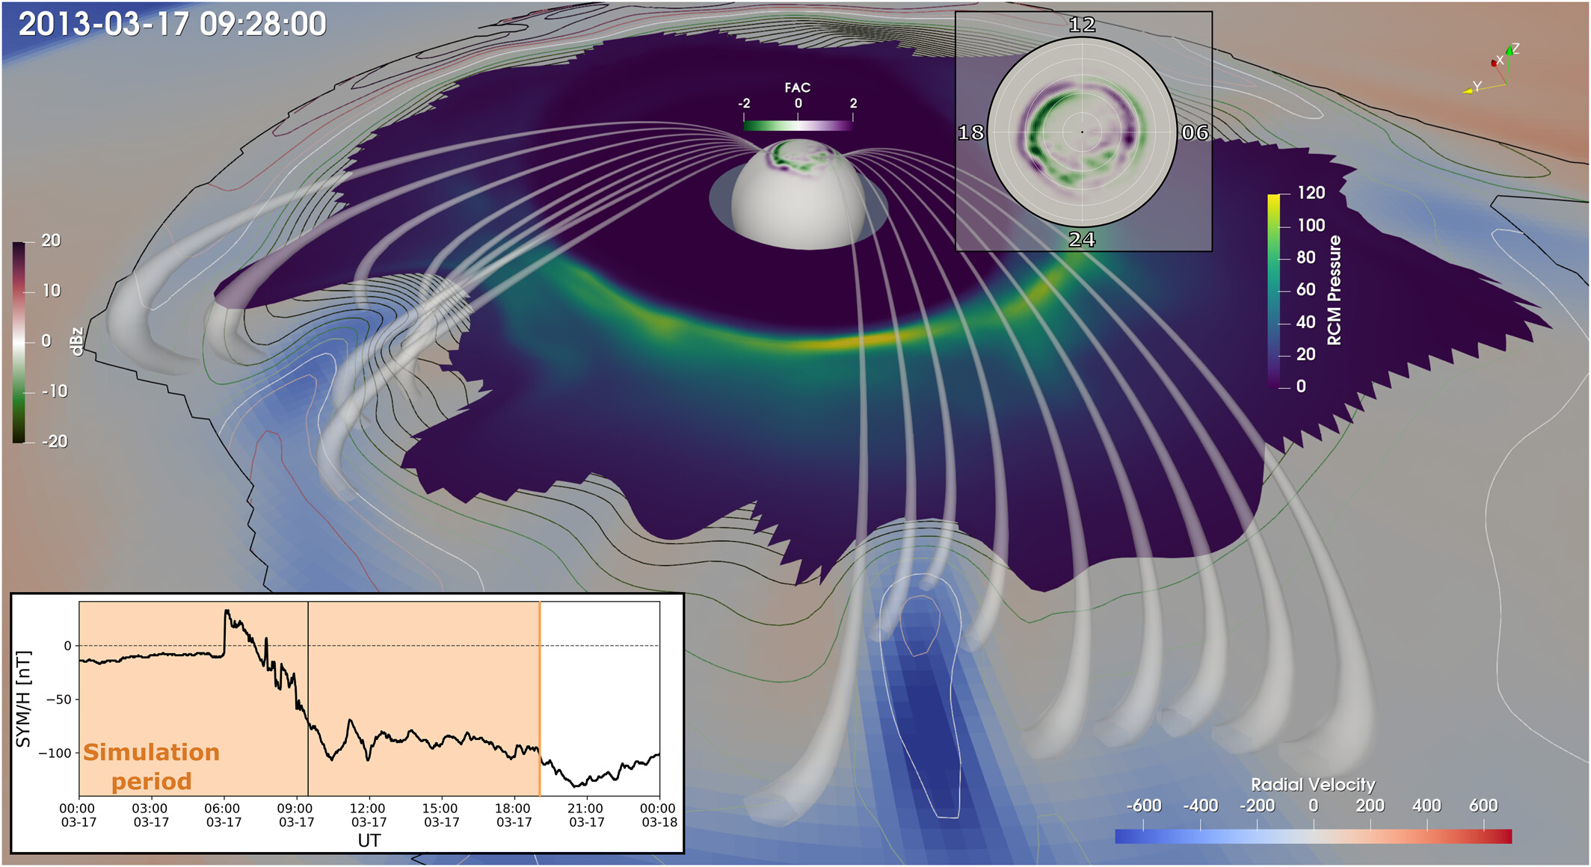
General Context - Motivation
One of CGS objectives:
The role of mesoscale plasma sheet transport in the ring current build-up
To tackle this we need to establish a clear understanding of the overall plasmasheet transport during quiet and storm times.
This presentation:
Focus on magnetic flux transport during storms
Building towards a holistic multi-spacecraft evaluation including mass and energy transport
50% of total energy flux transported into the inner magnetosphere by mesoscale structures
Sciola+ 2023
Notes:
Overall this work is part of CGS, a NASA drive sience center which ultimate goal is to understand the stormtime geospace
One specific objective of this is to quantify the effect of mesoscale transport in the ring current. In understand to fully comprehend this from an observational point of view we need to be able to have a clear understanding of the global scale convection and how different this is during quiet time and storm times.
For this presentation we focus on magnetic flux transport and we are essentially building..

Slide 4
Powering the magnetotail
~ 10 Re
~ -20-30 Re
Credits: ESA/ATG medialab
Notes:
Reconnection dayside = Open flux → loads tail inflates, polar cap expands → at some point Magnetotail reconnection → magnetic flux transport towards the Earth and the dayside
While it is still unclear if the main driver is reconnection on a specific location or some kind of current instability etc. The important aspect here is that somehow you have to move the flux that has pilled up in the tail.
Generally this drives geomagnetic phenomena such as substorms when we have southward IMF.

Slide 5
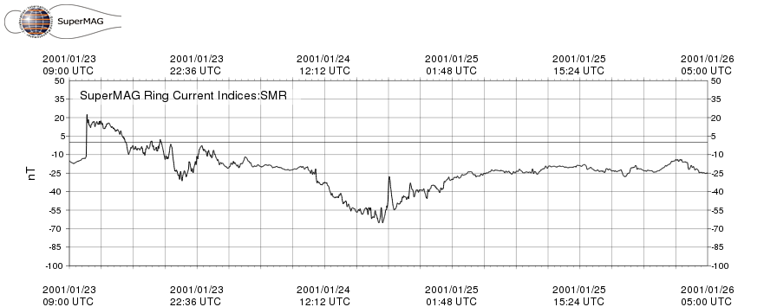
Data used
Ground
In-situ
Plasma moments from spectrometers
Magnetic field from fluxgate magnetometer
MMS* (2015 - now)
Geotail** (1992 – 2022)
THEMIS (2007 – Now) - TBD
SMR: Ring current index based on all ground magnetometers at geomagnetic latitudes (mlat) between -50 and +50 degrees;
Treated equivalently as DST and SYM-H indices traditionally used for geomagnetic storms (Note: differences exist)
*Currently showing HPCA (~10s) results not FPI (4.5s) (i.e., H+ not ions)
**Currently showing results of 12s resolution up to 2014
Gjerloev (2011, 2012), Newell and Gjerloev (2012)
Notes:
HPCA during its typical resolution gives us 10 second resolution measurements

Slide 6
Methods & Results
Classify plasmasheet observations
Analyze their properties
Gather storms & define their phases

Slide 7
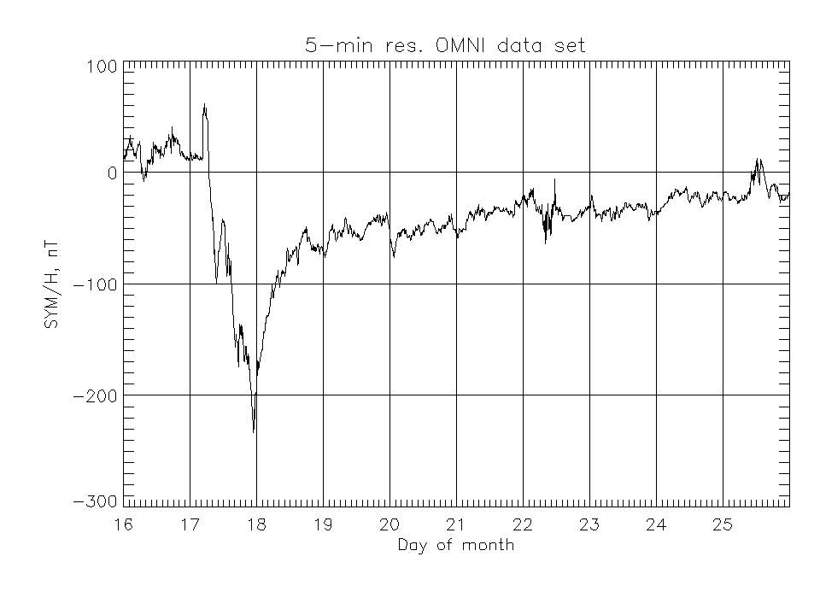
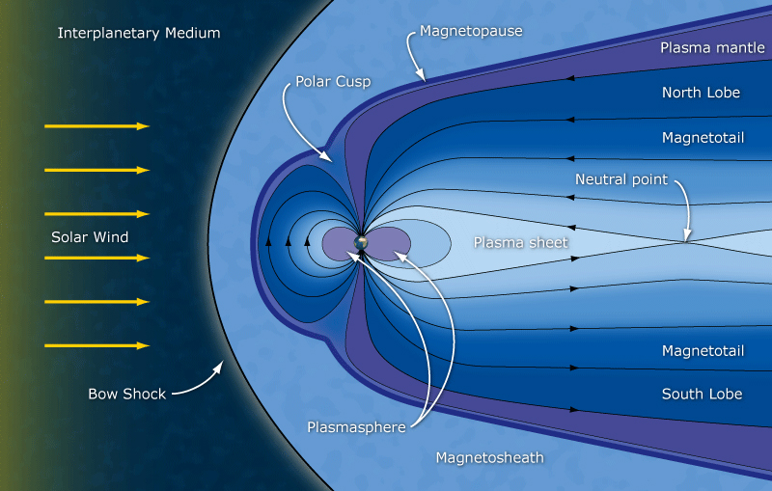
Definitions & Criteria used
Geomagnetic storms
Plasmasheet
Example Criteria to find CSP
$\left\lfloor Y_{GSM,4°}\right\rfloor <10$
$−5<X_{GSM,4°} <−30$
$β=\frac{P_{the}}{P_{mag}}>1$
$\left|Βz\right| >\sqrt{Bx^{2}+By^{2}}$
SSC
main
Recovery
SMR < -50 nT
Disclaimer: absolute numbers can be sensitive to criteria
See e.g., Ohtani 2021
See e.g., Ohtani+ 2008, Guild+ 2008, Roziers+ 2009, Vo+ 2023
Notes:
Long-lasting interplanetary convection electric field leads, through a substantial energization in the magnetosphere-ionosphere system, to an intensified ring current
Plasma sheet is the region of closed field lines in the equatorial magnetotail

Slide 8
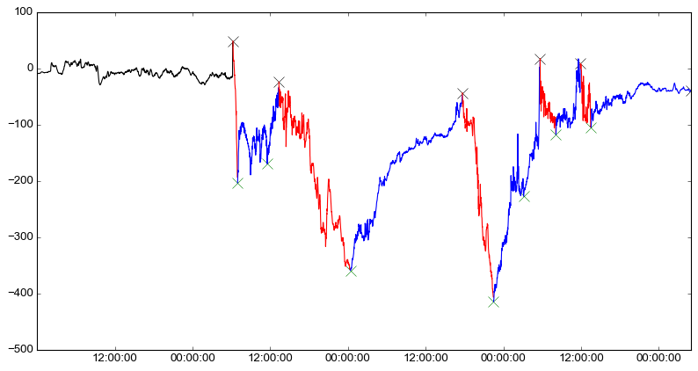
Storm phases automatic classification
2003 Halloween Storm
SMR
[nT]
Recovery | Main
Verified with methodology of Ohtani 2021

Slide 9
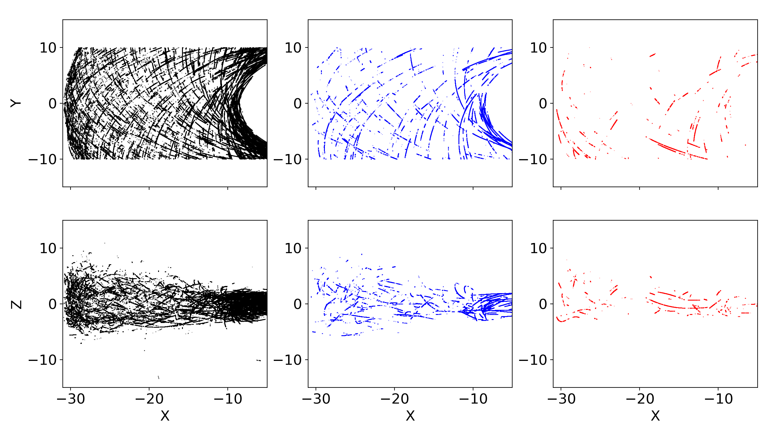
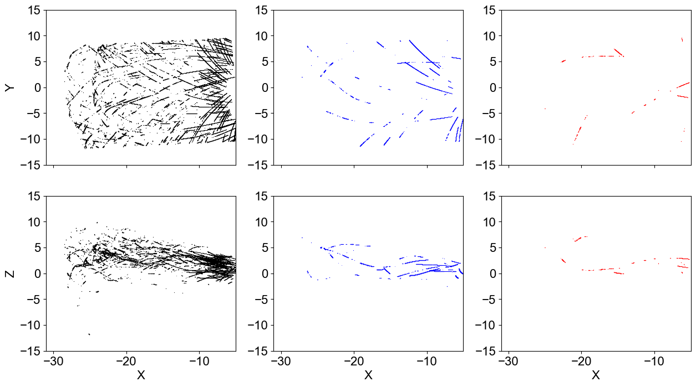
Plasmasheet Coverage per mission – Strict Criteria
Geotail ( 1994 – 2014)
MMS (2016 – 2024)
Quiet : 393,379 (85%)
Reco : 56,061 (12%)
Main : 11,546 (3%)
Quiet : 112,099 (88%)
Reco : 13,336 (10%)
Main : 2,205 (2%)

Slide 10
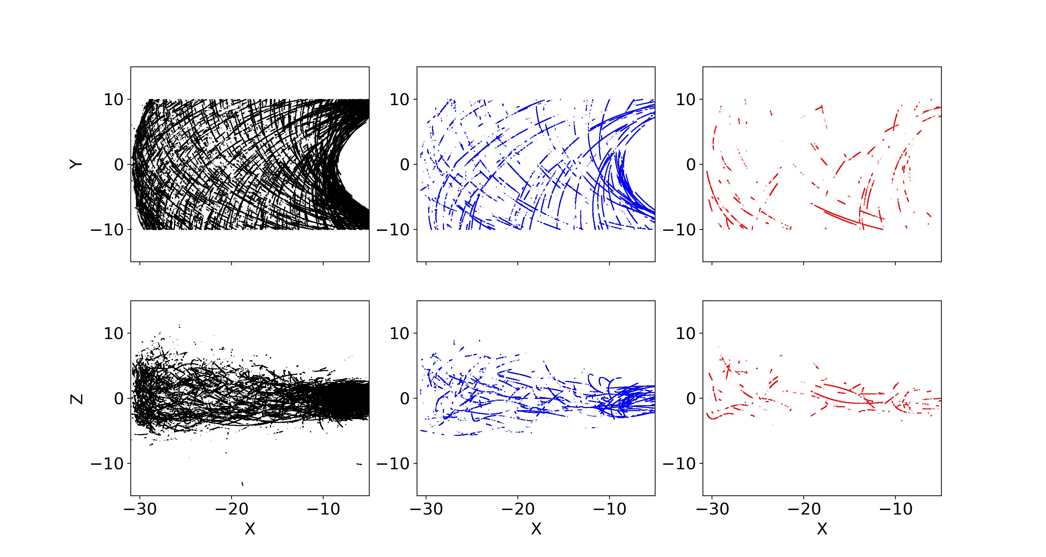
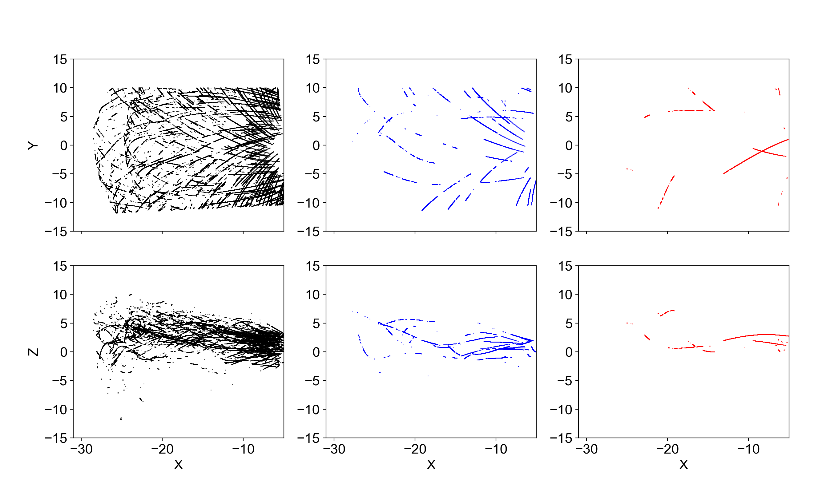
Plasmasheet Coverage per mission – Flexible* Criteria
Geotail ( 1994 – 2014)
MMS (2016 – 2024)
Quiet : 779,557 (+98%)
Reco : 10,6258 (+90)
Main : 22,797 (+99%)
Quiet : 250,749 (+124%)
Reco : 25,466 (+90%)
Main : 6,097 (+175%)
*Combine Ohtani 2008, Guild 2008, Roziers 2009, limit Y to 10 Re – changes in statistical properties: ~0 - 20%

Slide 11
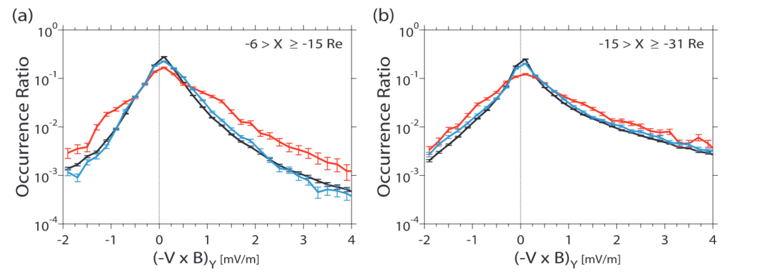
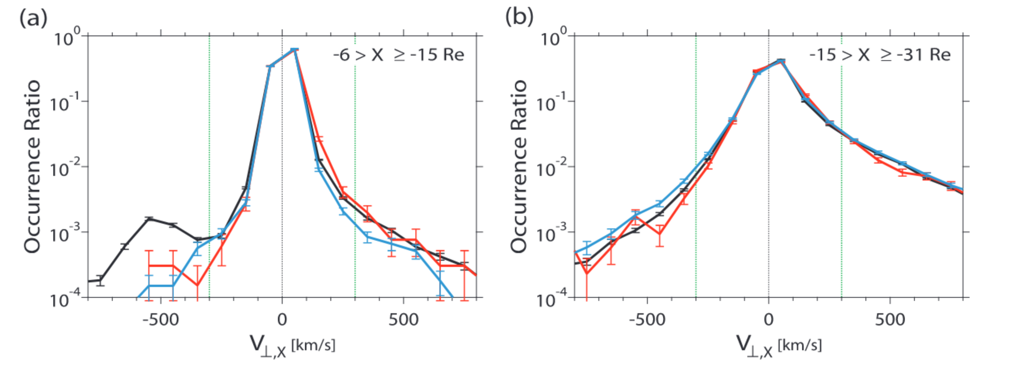
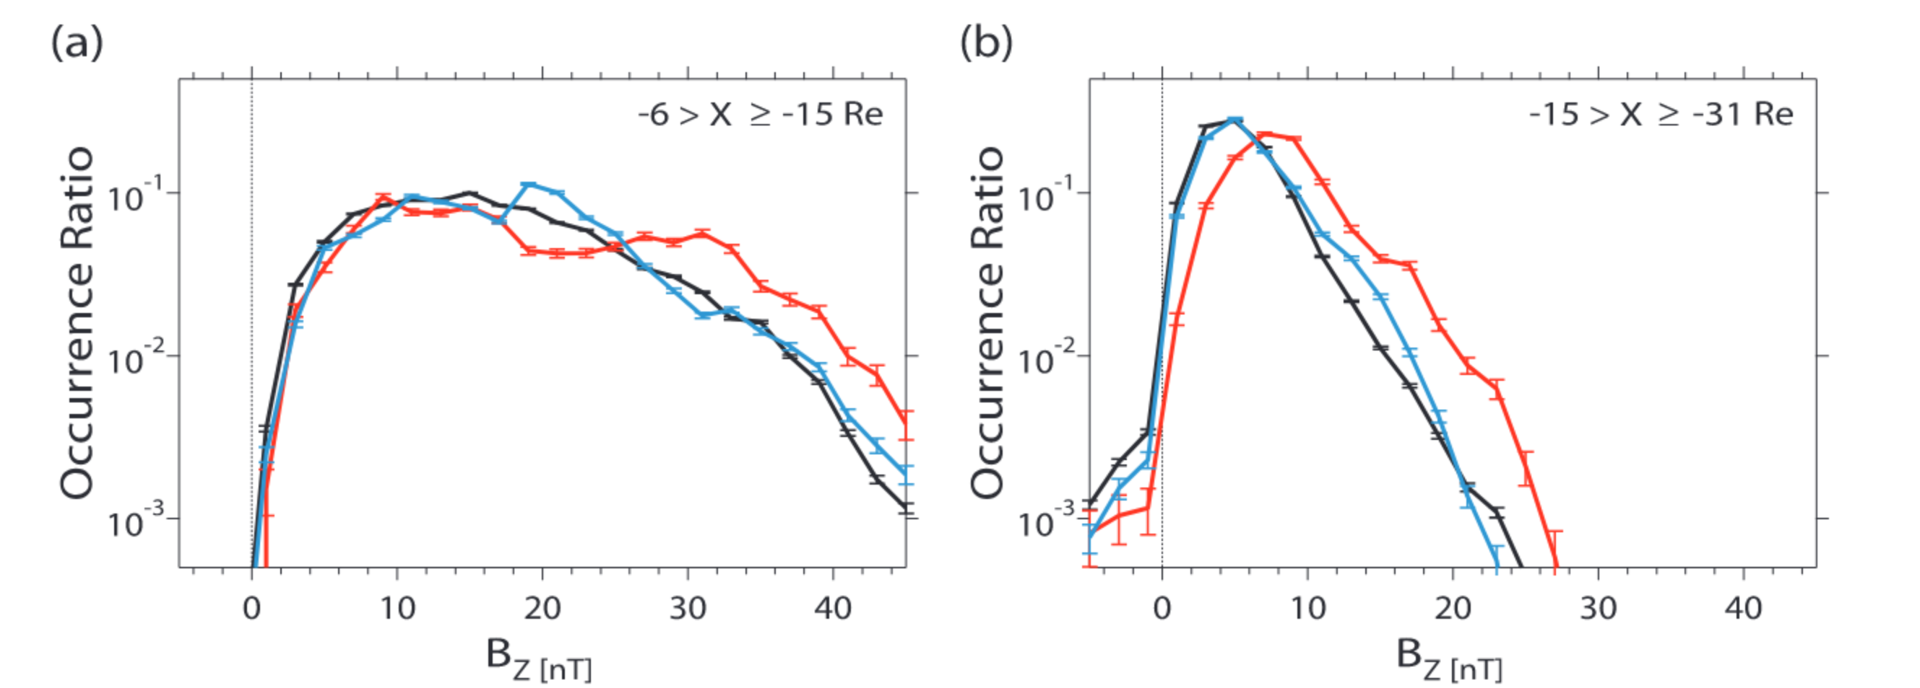
Confirmation of previous results
Geotail (1994 – 2006)
$$E_{y}$$
$$V_{⊥x}$$
$$B_{z}$$
Findings:
Ey increase during storm times
Increase realized through Bz enhancement
Reproduced with MMS (2015 – 2024)
Reproduced with Geotail (1994 – 2014)
Expand to distribution along X [GSM], and R
Investigate potential Dawn/Dusk asymmetries
Ohtani & Mukai 2008
Notes:
Increase in convection electric field.
Equatorial magnetic field is stronger during main phase

Slide 12
Take a step Further
Evaluate the distribution in X and radial distance

Slide 13
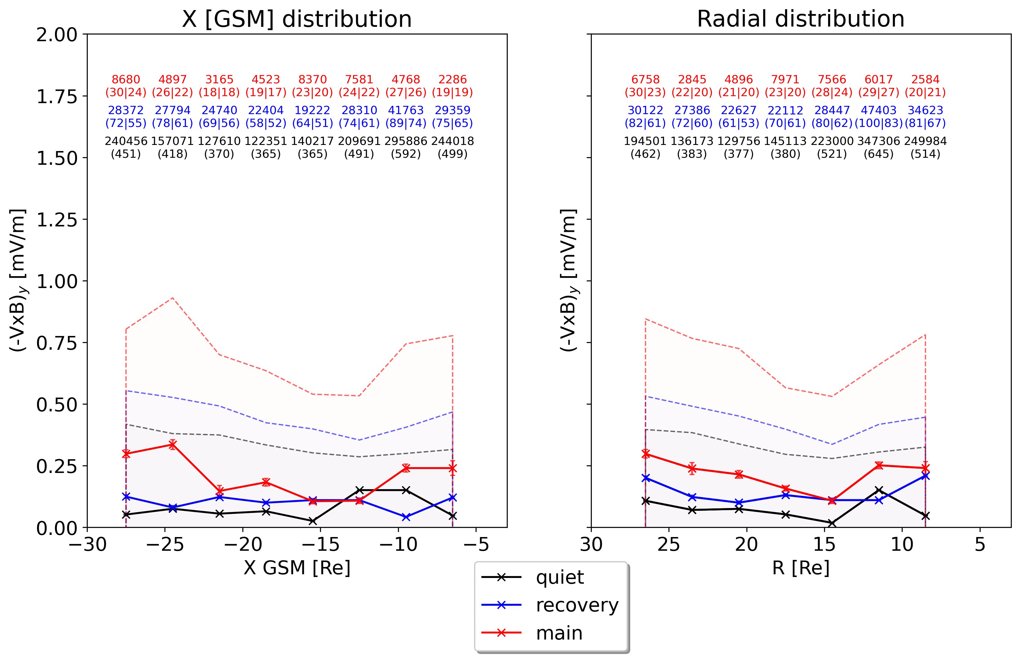
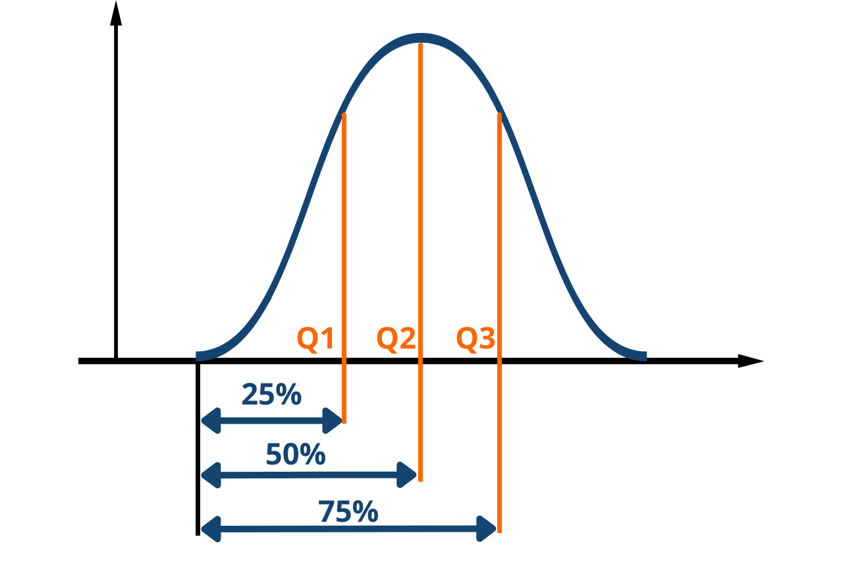
(-VxB)y– spatial distribution - Geotail
Outer
Inner
points
(days|storms)
Storm Ey $↑$
Solid: 50%
Dotted: 75%
Overlapping bins
width = 8 Re
step = 3 Re
Towards Earth

Slide 14
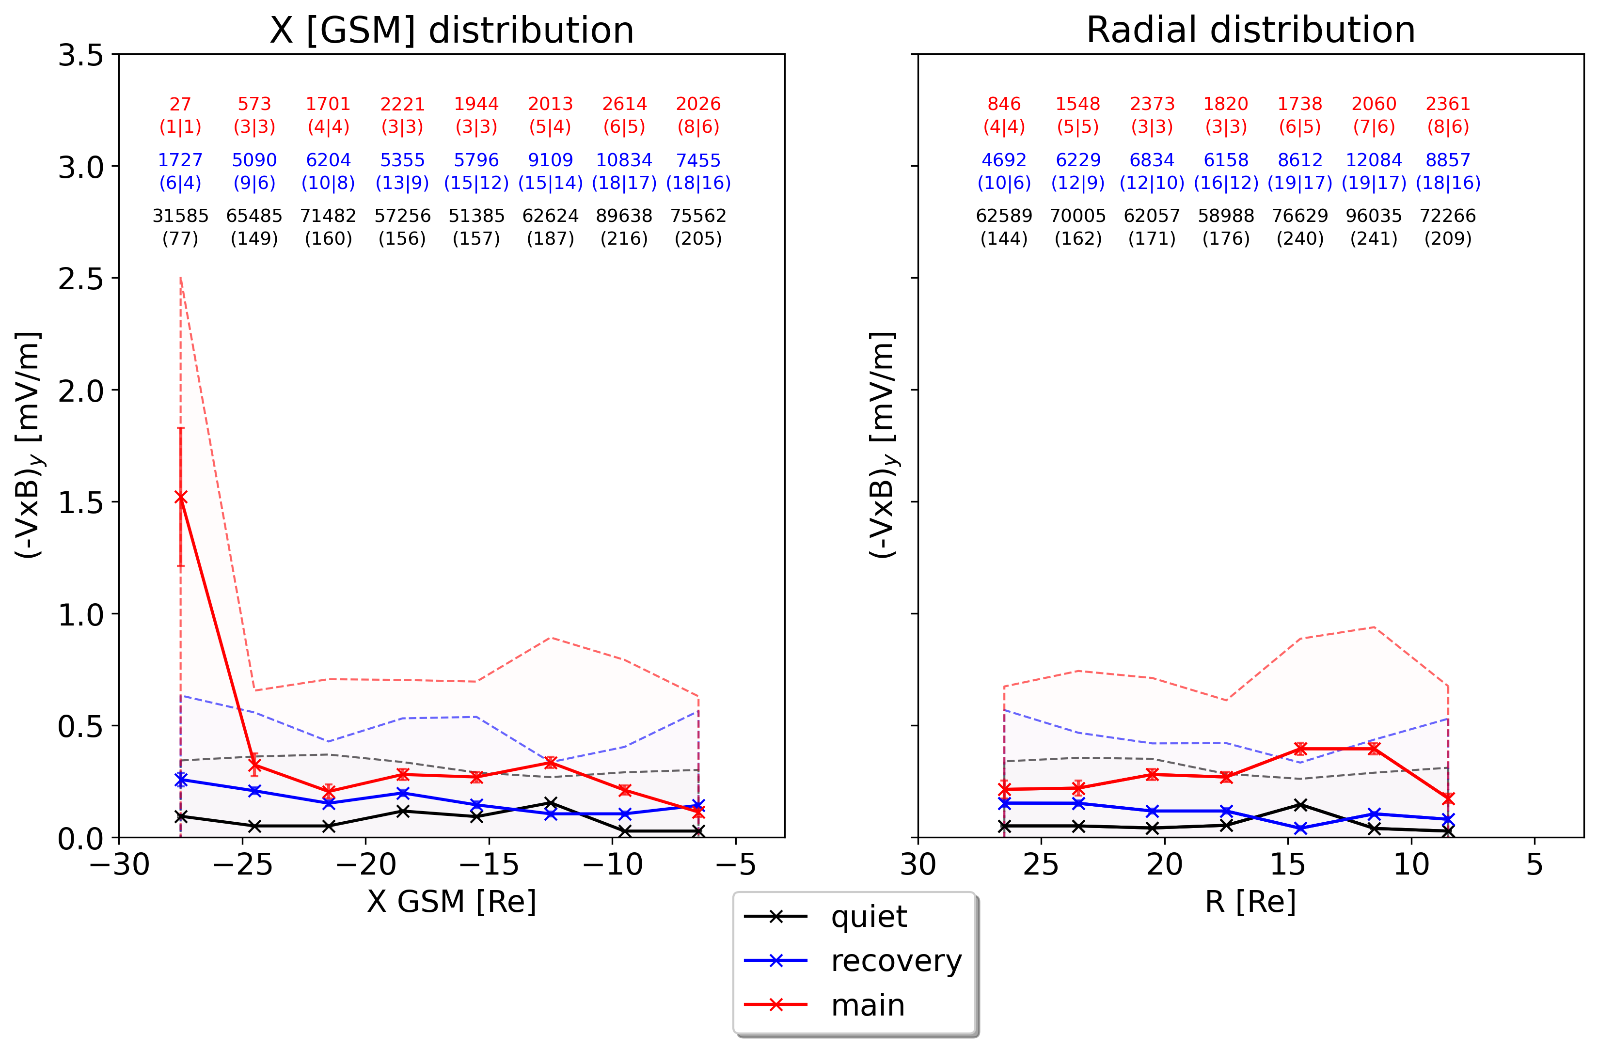
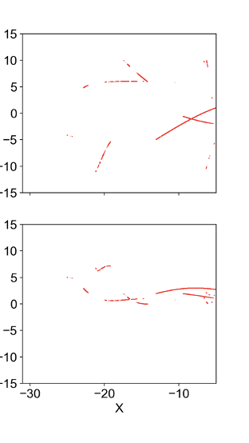
(-VxB)y – spatial distribution - MMS
XY plane
Storm times
Reminder: main had 6097-10s points even when ”flexible” criteria

Slide 15
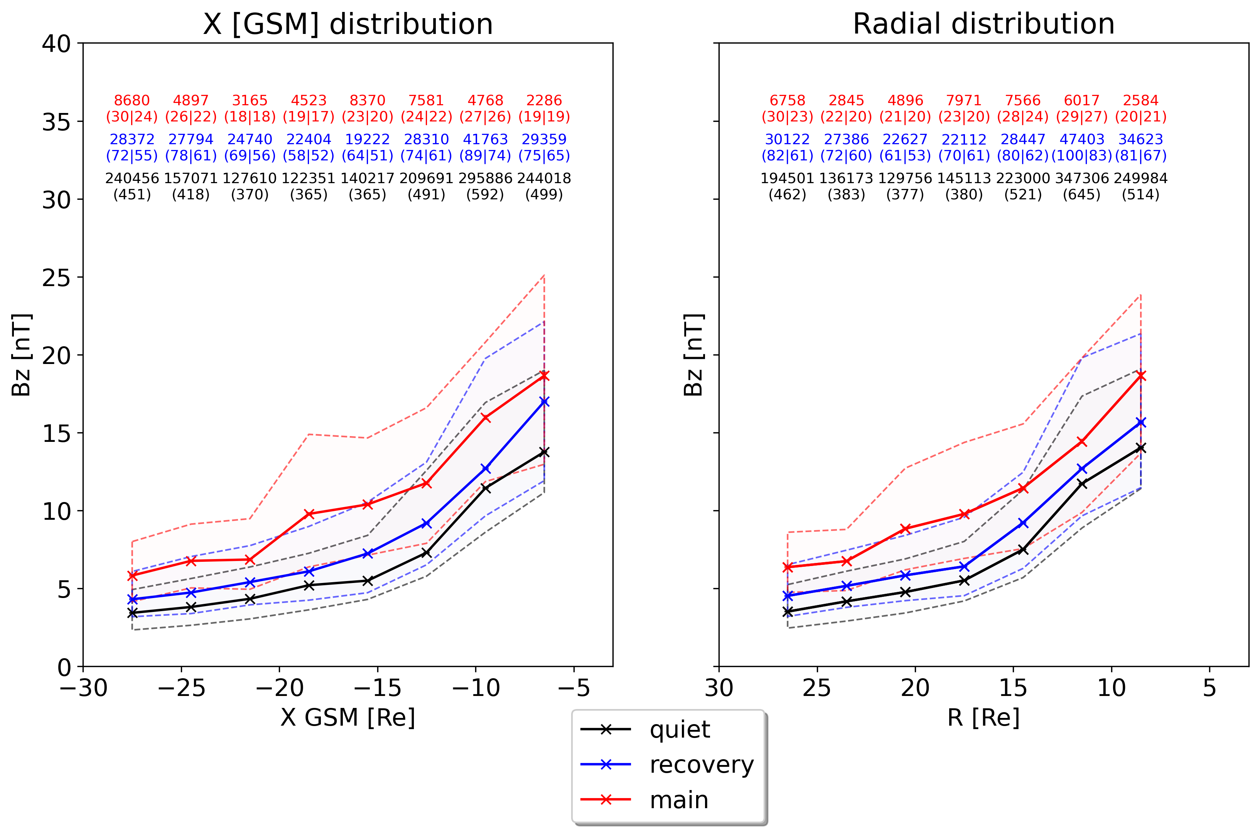
Bz – spatial distribution - Geotail
Outer
Inner
Storm Bz elevated throughout the tail

Slide 16
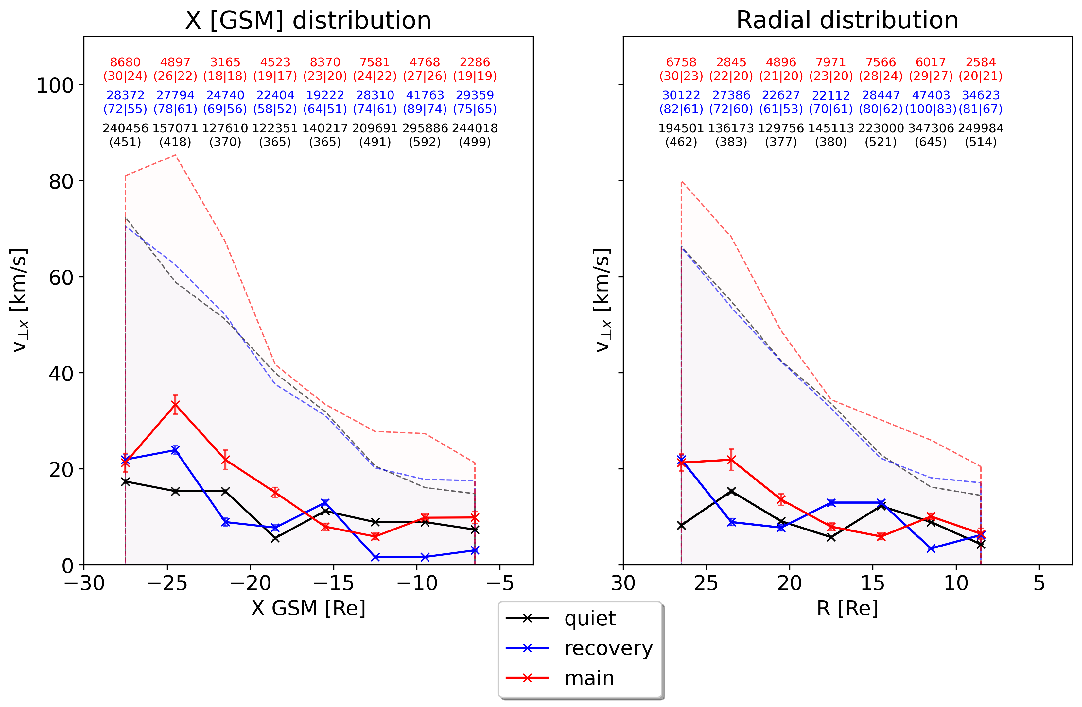
V⊥x – spatial distribution - Geotail
Outer
Inner
75%V⊥x slightly enhanced
Median V⊥x relatively constant

Slide 17
Take a step Further
Evaluate the distribution in X and radial distance
2) Investigate the 2D variability in XY GSM plane

Slide 18
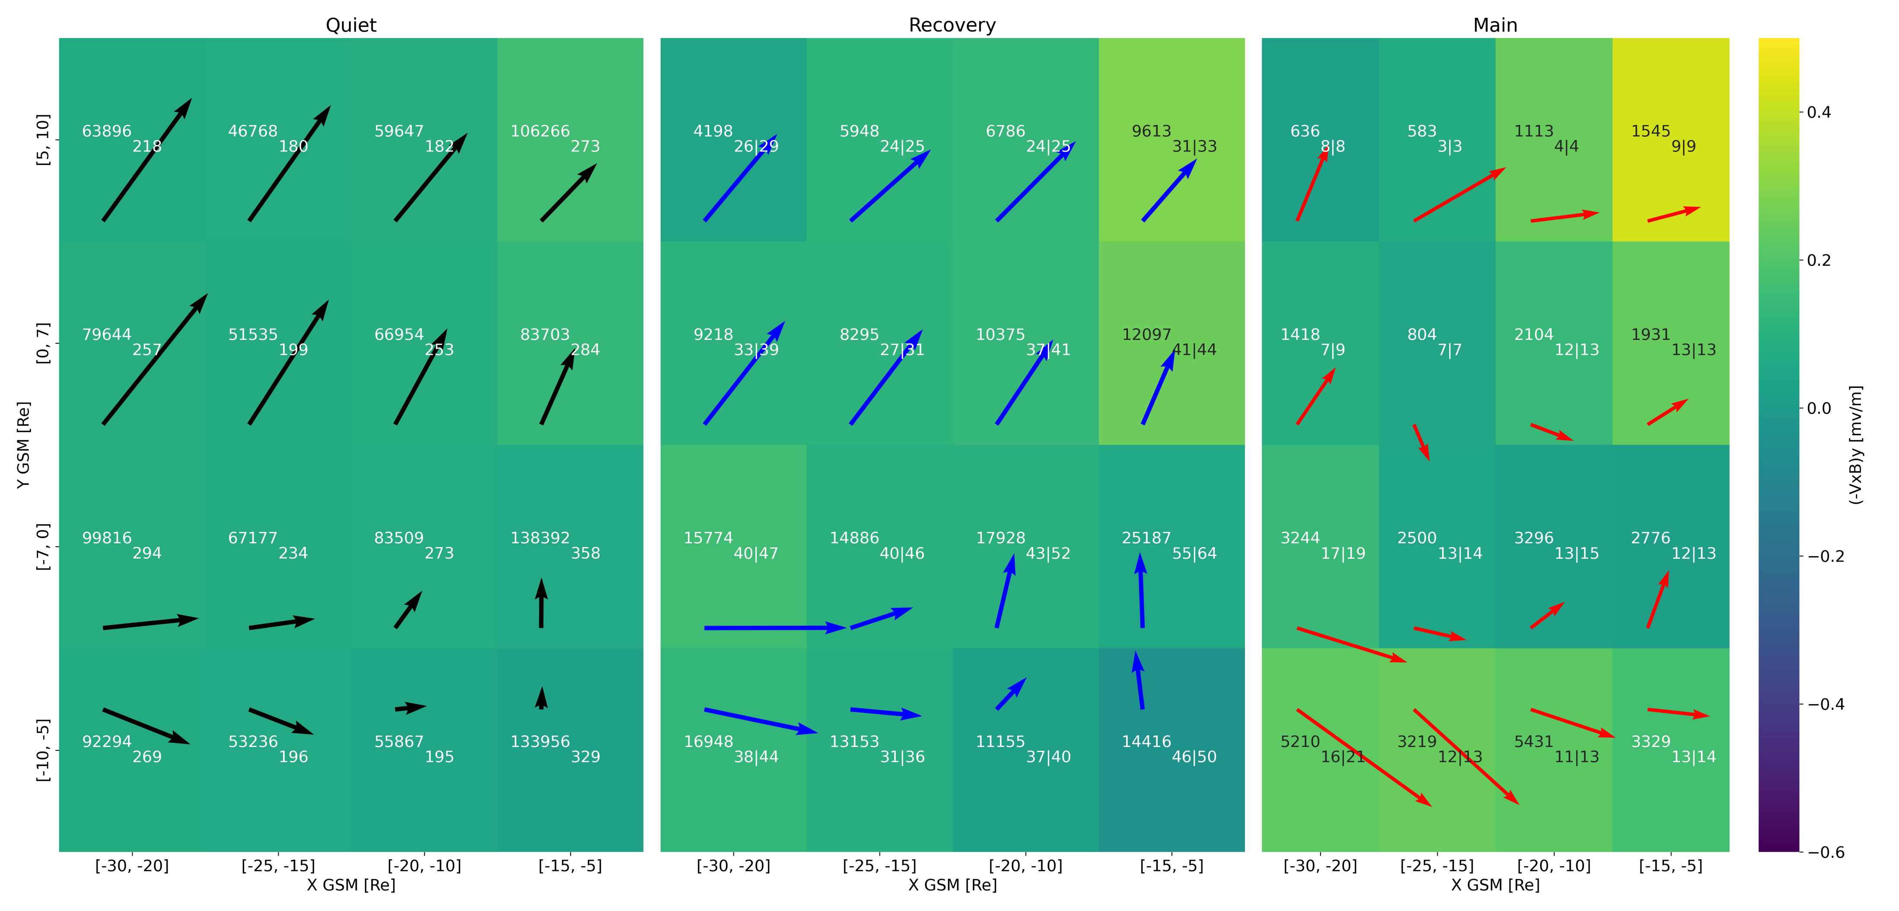
(-VxB)y & median flow - XY - Geotail
Arrows (→) showing median plasma flow
Dusk
Dawn
Outer
Inner
Median flows – Similar Quiet time to Nagai+ 2023

Slide 19
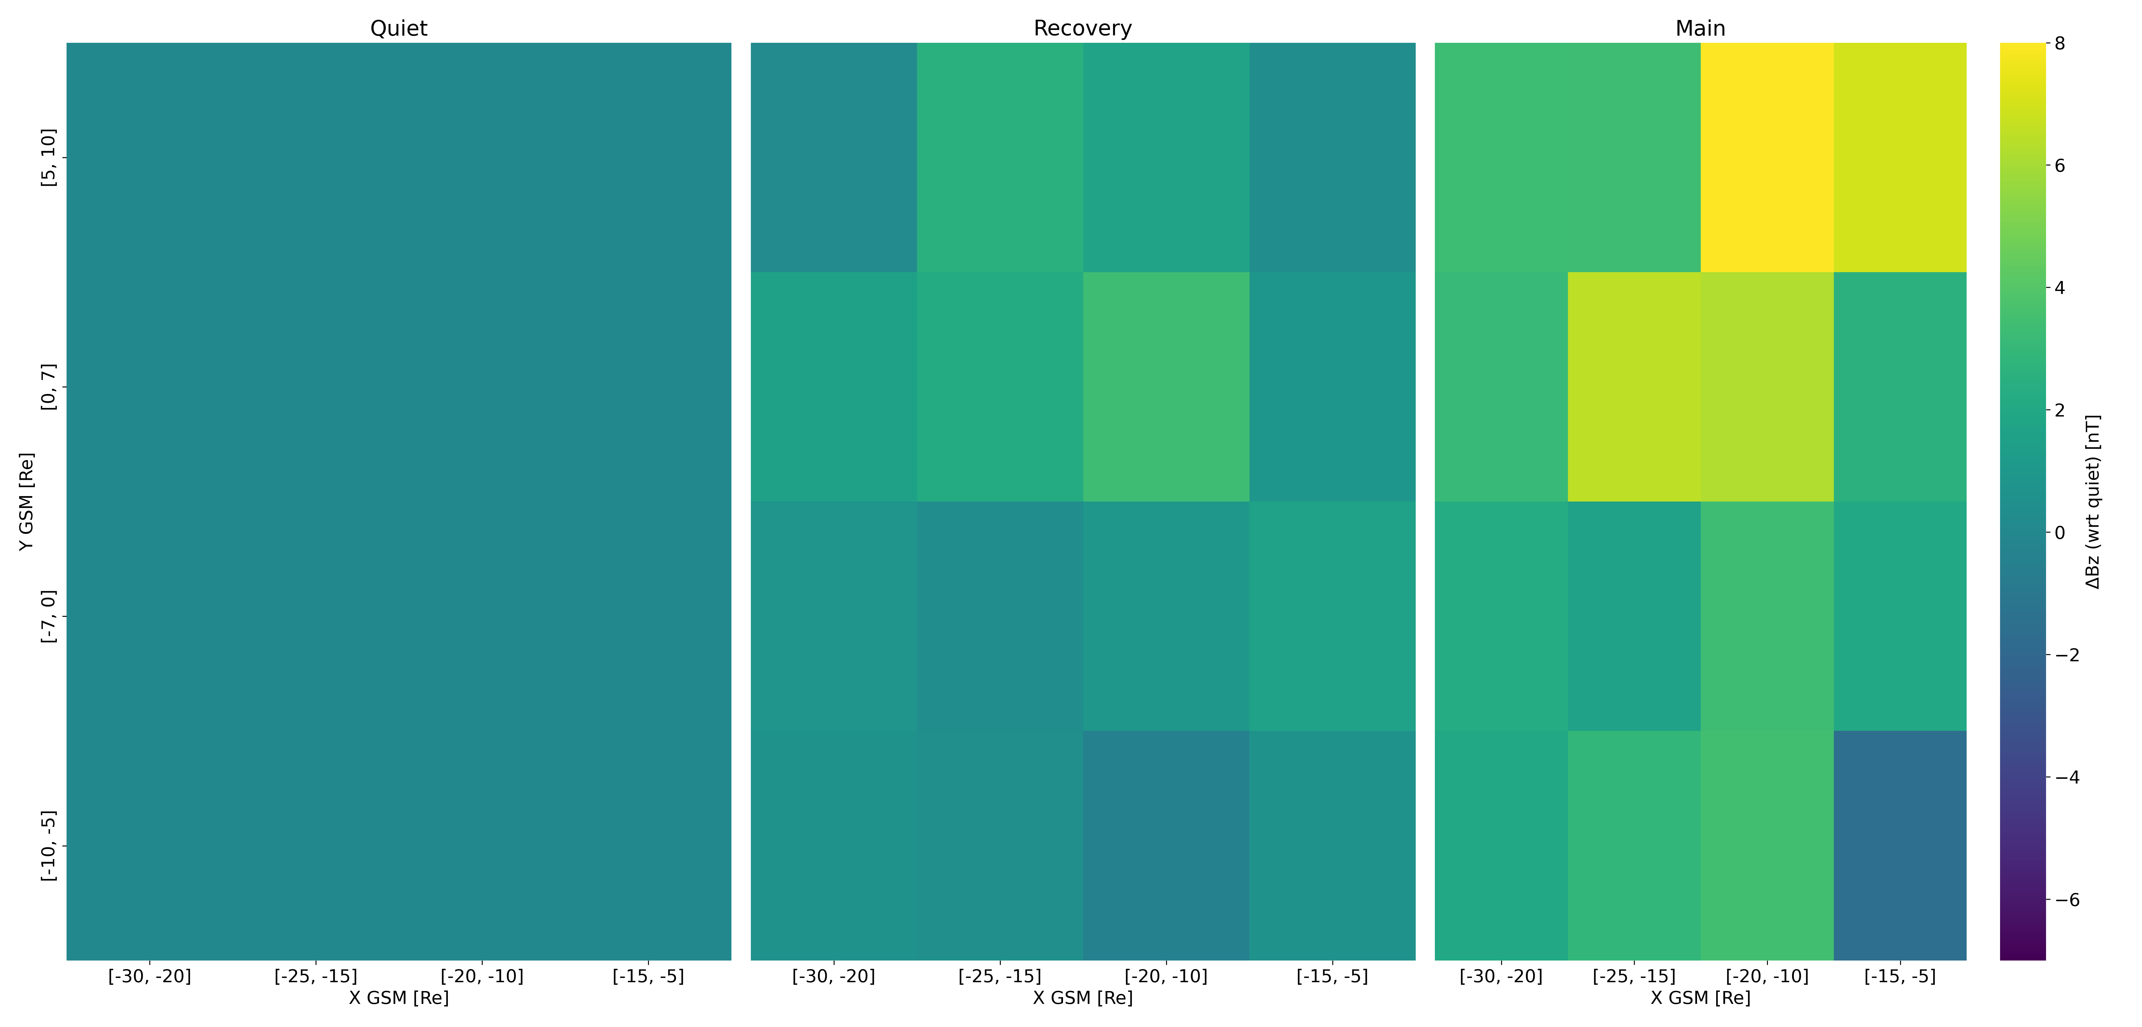
ΔBz - XY - Geotail
Dusk
Dawn
Outer
Inner

Slide 20
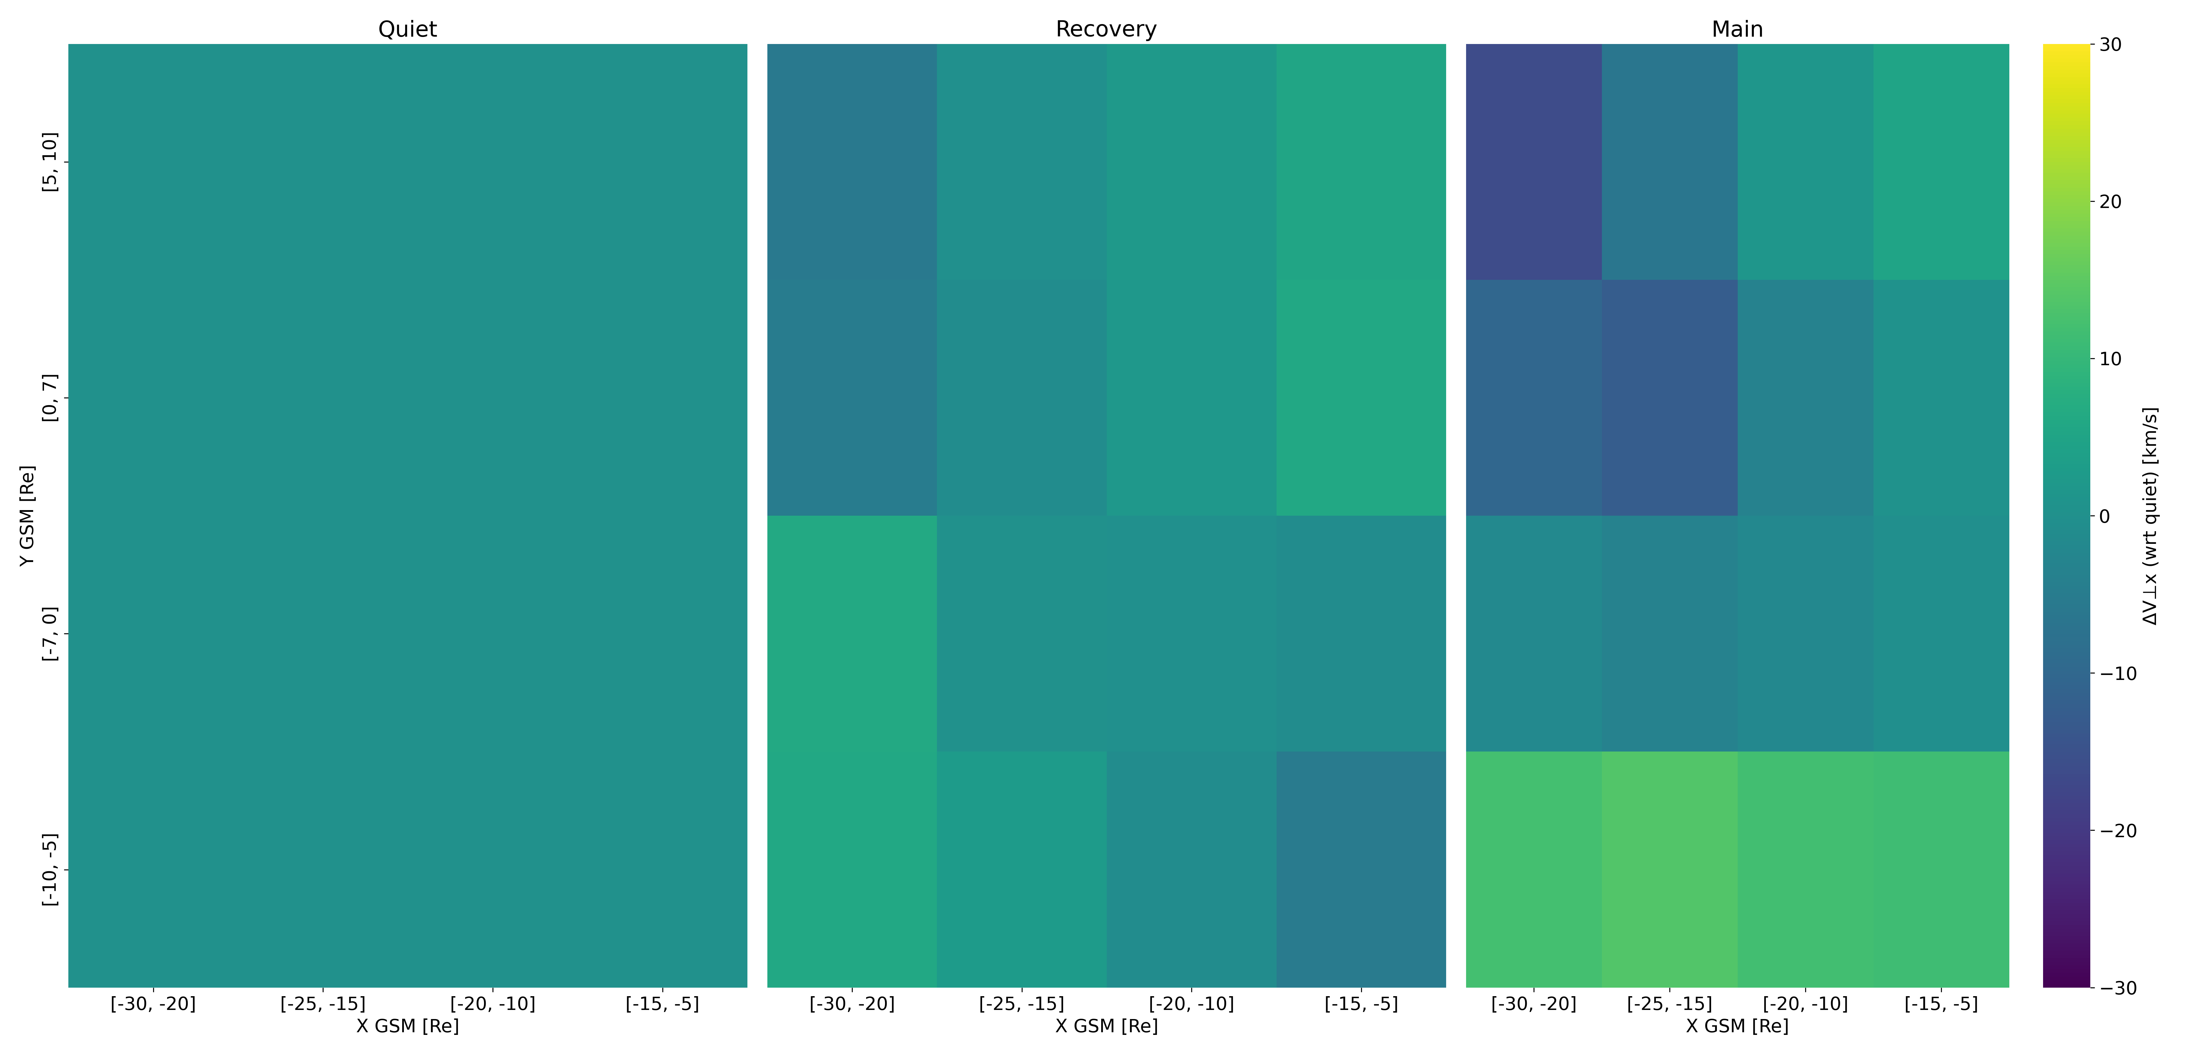
ΔV⊥x - XY - Geotail
Dusk
Dawn
Outer
Inner

Slide 21
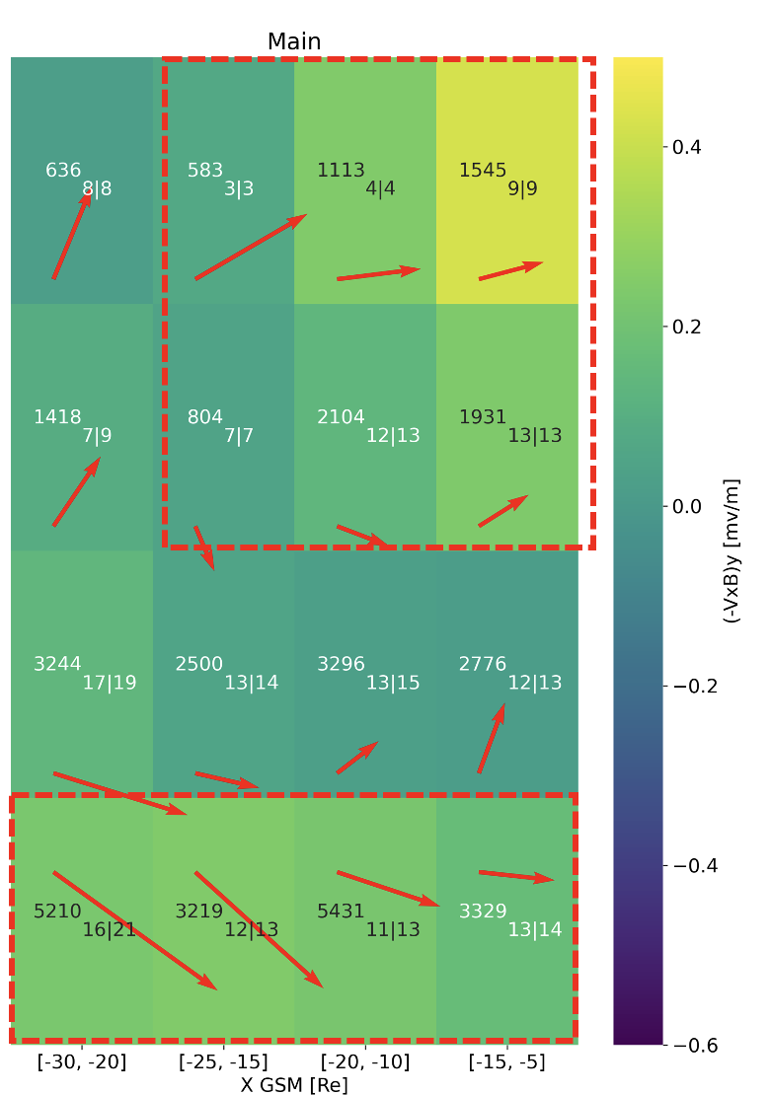
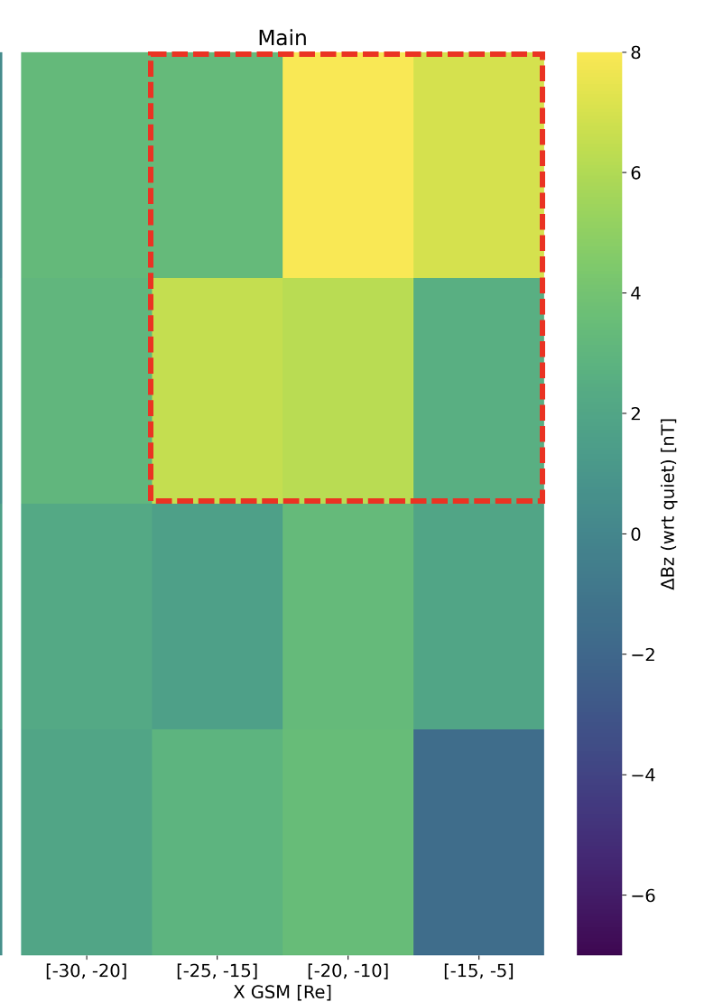
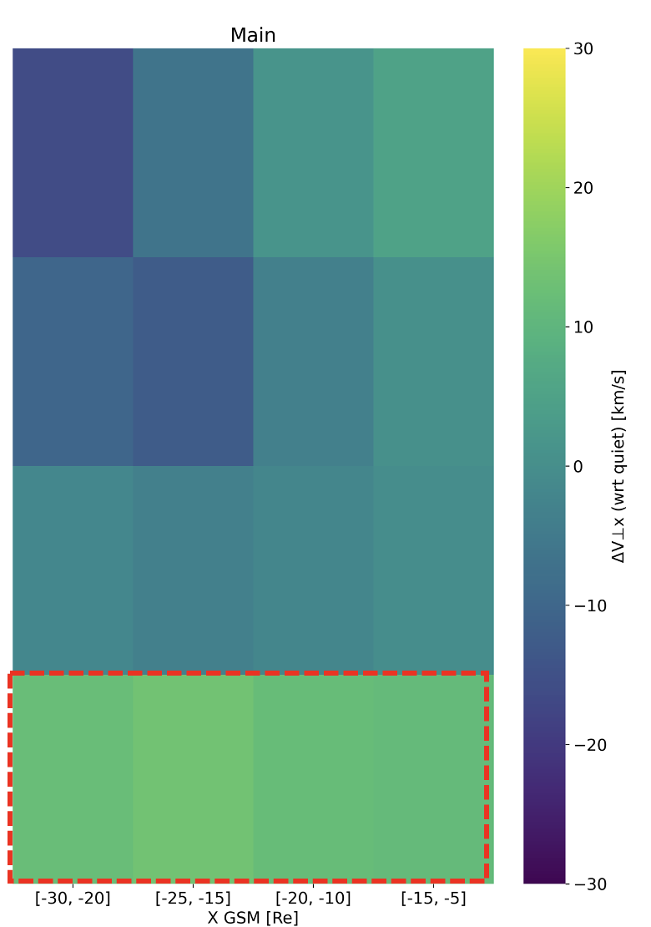
Storm - Main Phase Behavior
Ey $↑$
Bz $↑$
V⊥x $↓$
(1)
(1)
Dusk
Dawn
(2)
(2)
Outer
Ey
Inner
Bz
V⊥x $↑$
V⊥x

Slide 22
Future work & conclusion

Slide 23
Discussion & Conclusion
Summary
During storm times:
Elevated Ey occurs with increased Bz, and limited enhancement of V⊥x. This remains throughout the whole magnetotail
Inner-Dusk observations showing more dipolar signatures, while Outer-Dawn indicated relatively faster flows
Future Work
Validate results using FPI instrument (MMS)
Evaluate mass and energy flux transport
Validate findings with THEMIS mission & expand Geotail dataset to 2022
Quantify contribution of mesoscale transient phenomena across different missions
Supported by NASA DRIVE Science Center for Geospace Storms (CGS) - 80NSSC22M0163
Notes:
Ideas : If reconnection suppressed it could explain the enhanced flow of outer-dawn plasmasheet
However, for the tail of the distribution (75%) V⊥x appears to have a more significant effect.
Bz is increased across whole X and radial extend (differences between missions to be investigated)

Slide 24
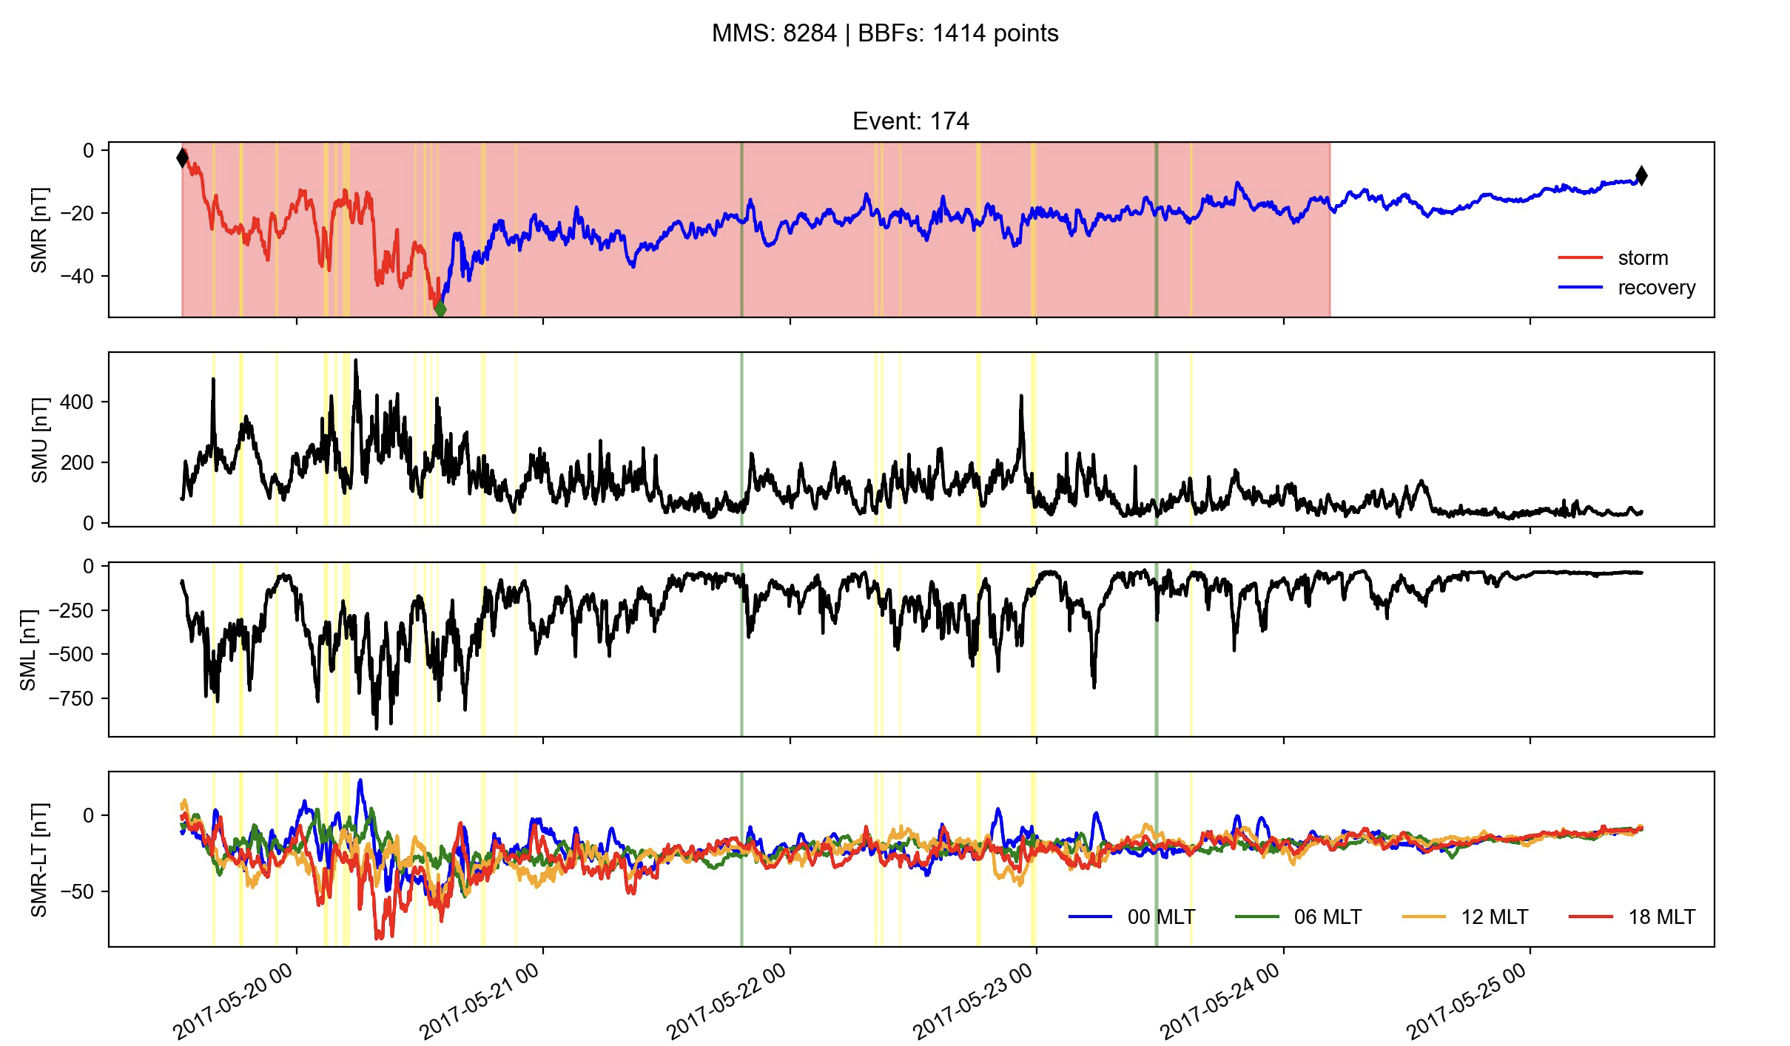
Future work: Connecting storms to SC coverage & to transients
Red = MMS coverage
Green = IP shocks
Yellow = BBFs

Slide 25
Extras

Slide 26
Dusk – Dawn Asymmetry Velocity
Quiet
Dusk
Recovery
Dawn
Main

Slide 27
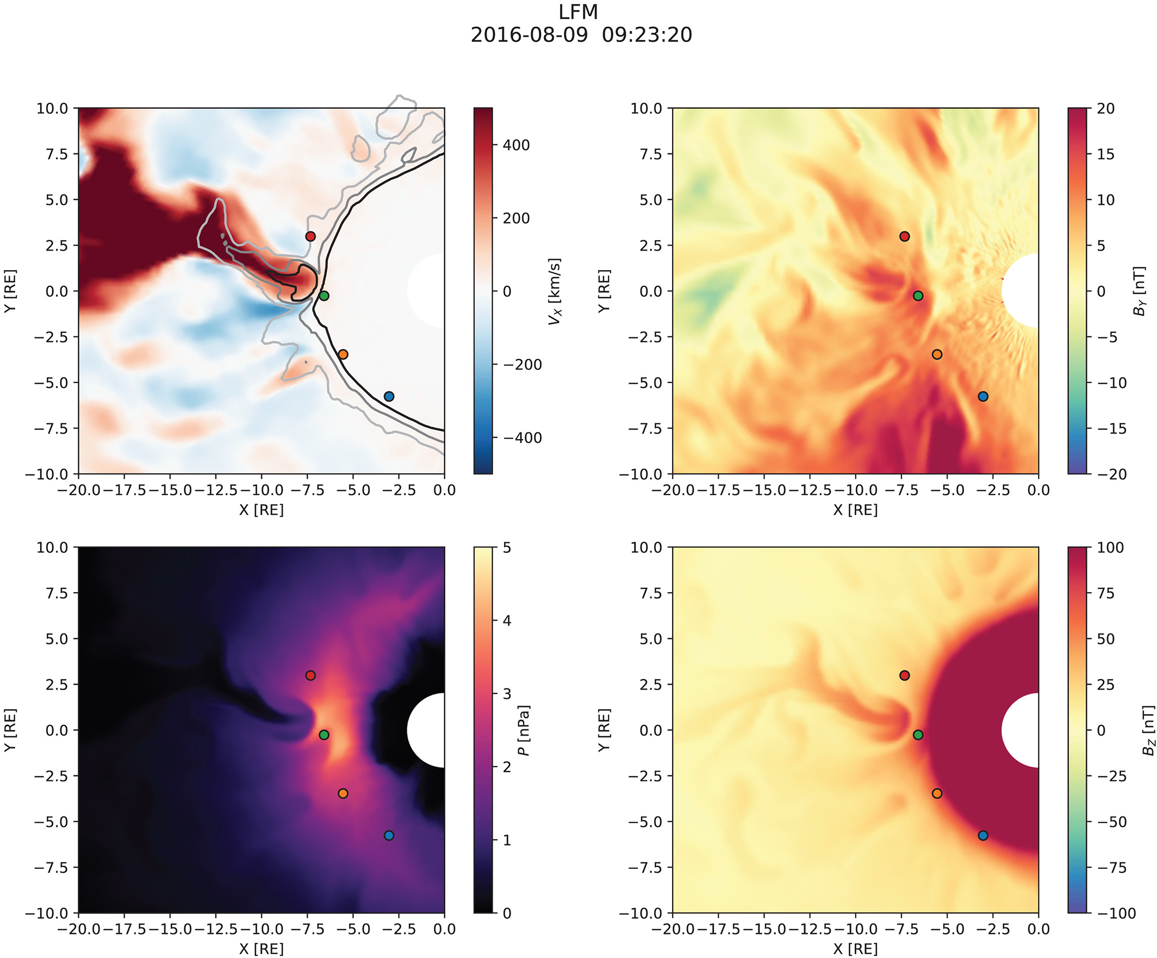
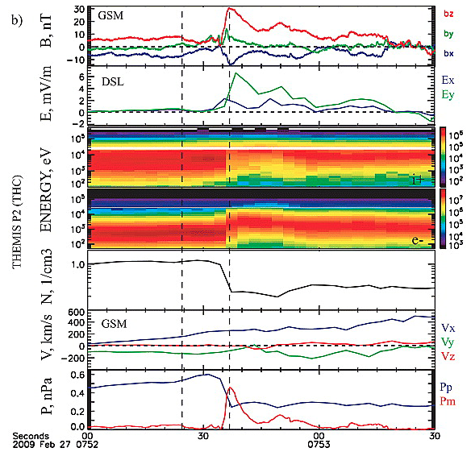
Transport and mesoscale structures
Runov+ 2009
Merkin+ 2019

Slide 28
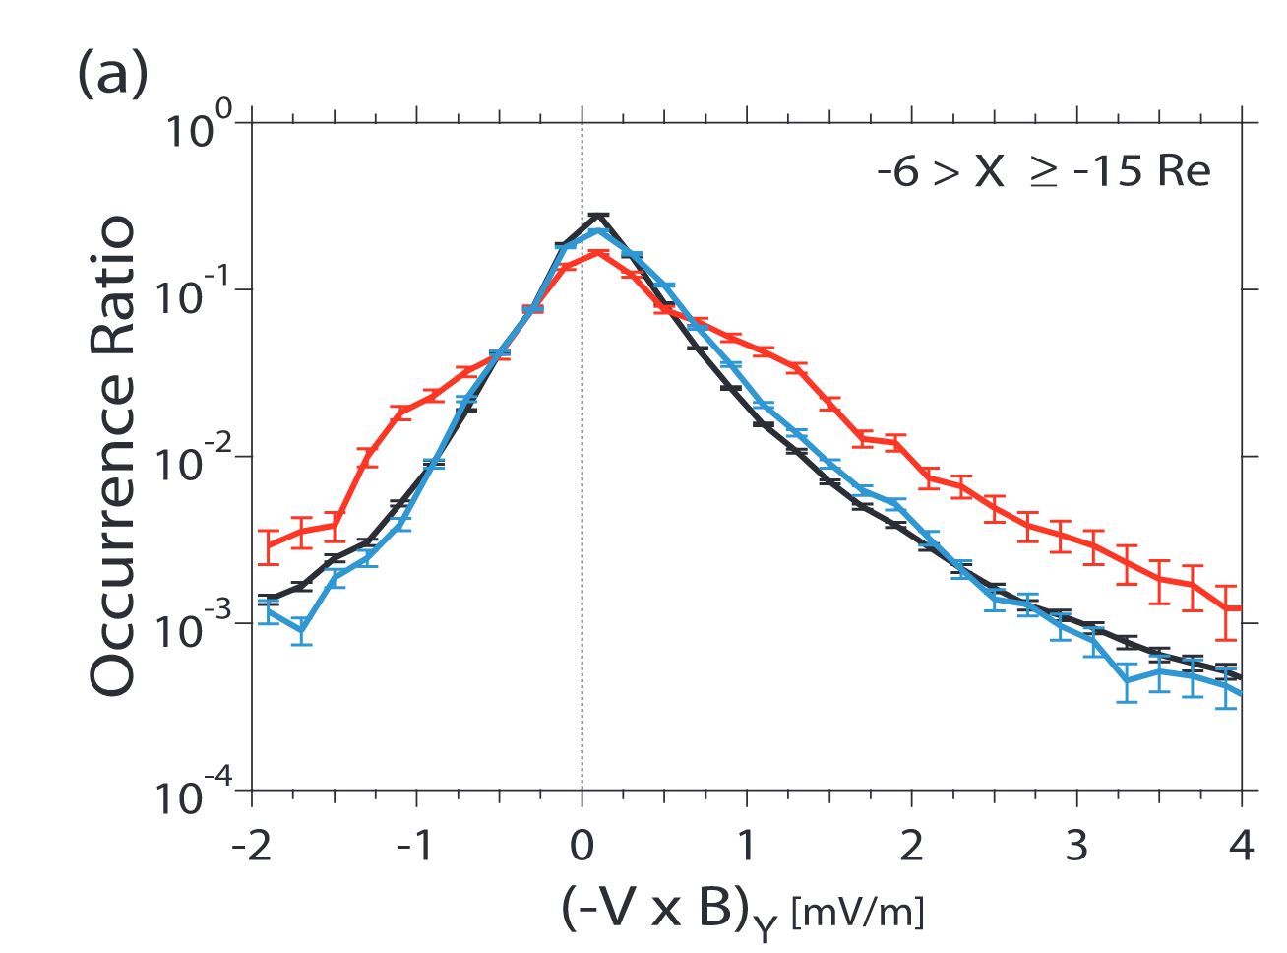
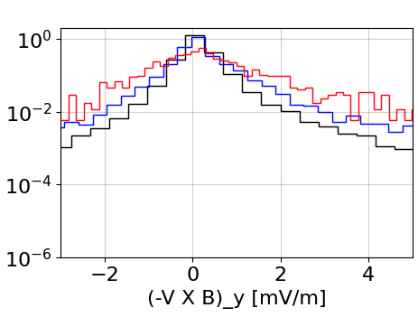
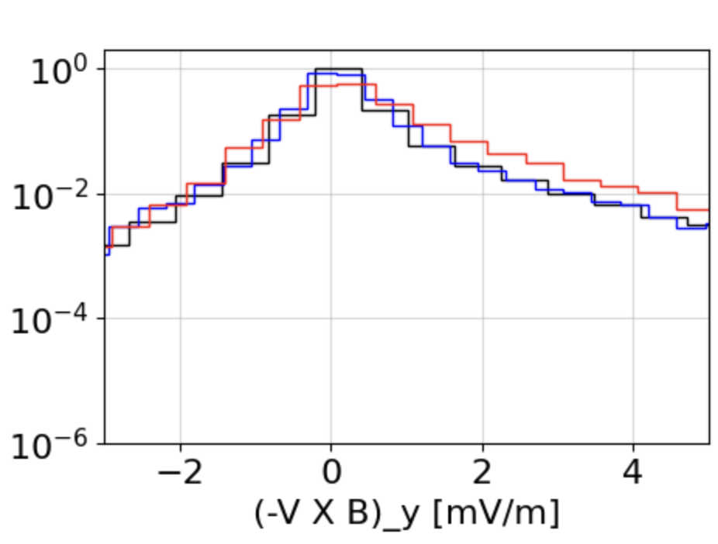
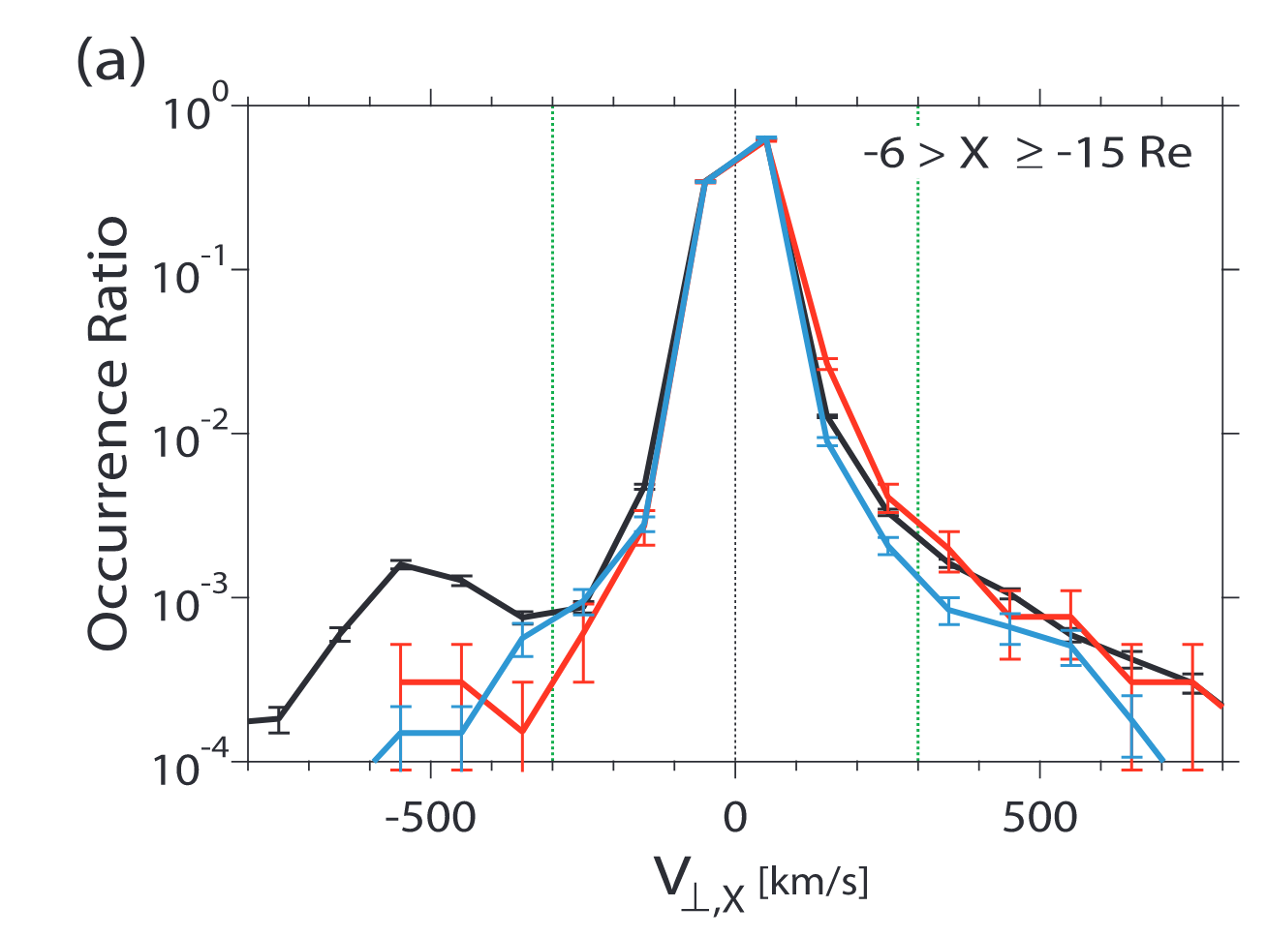
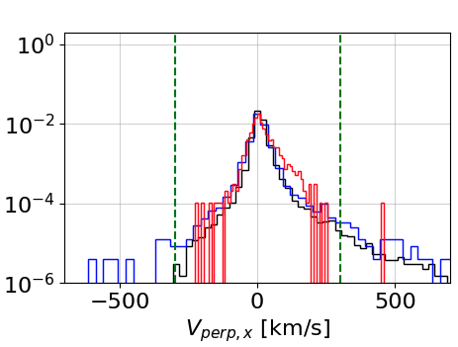
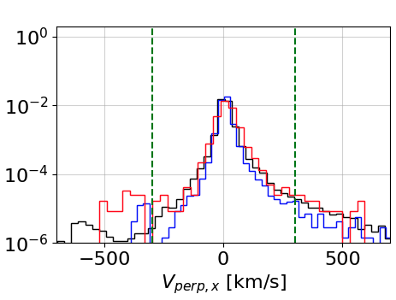
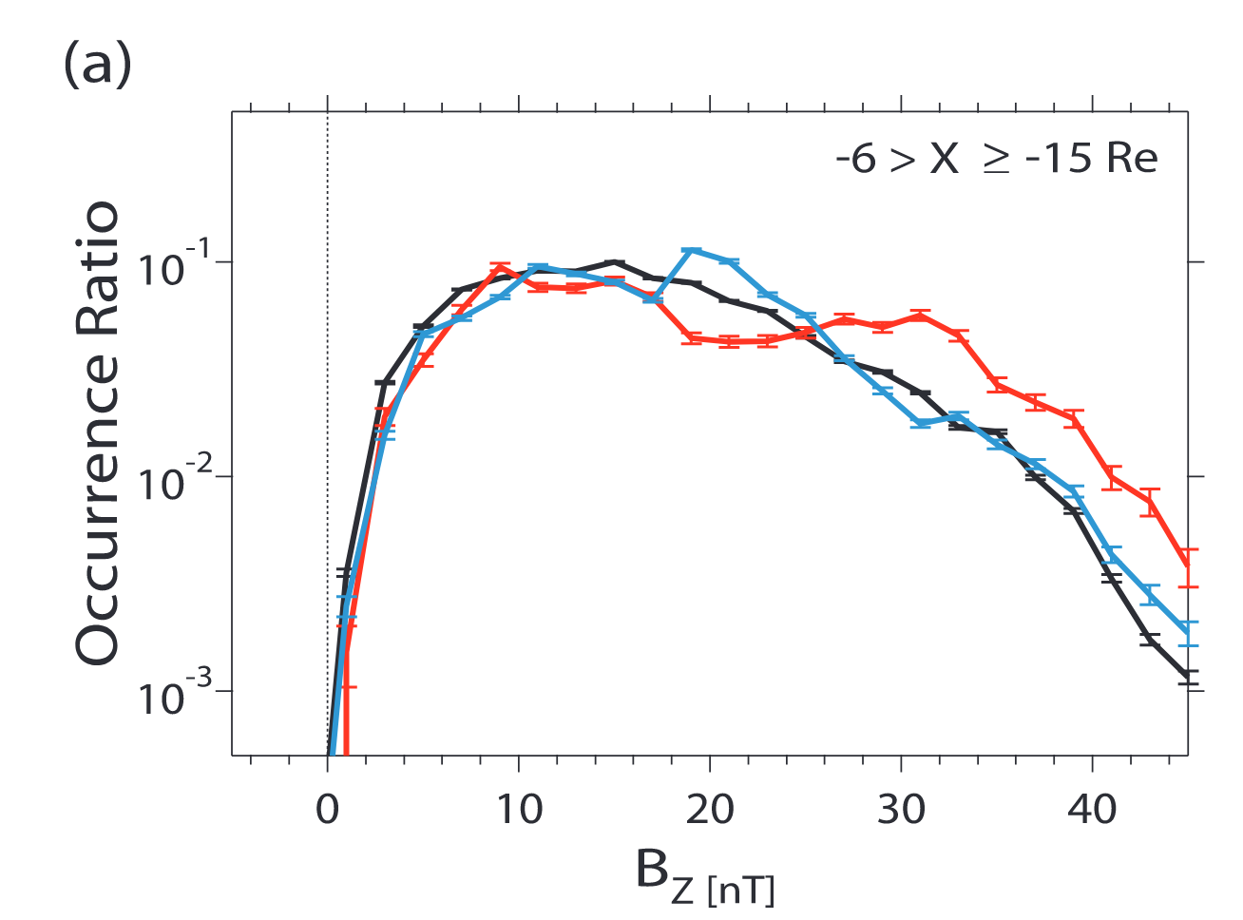
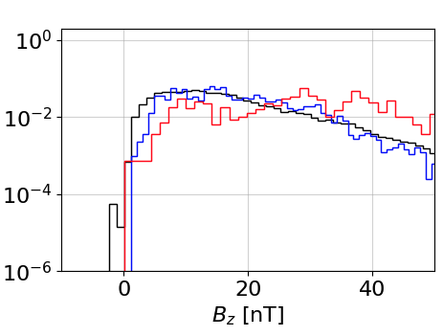
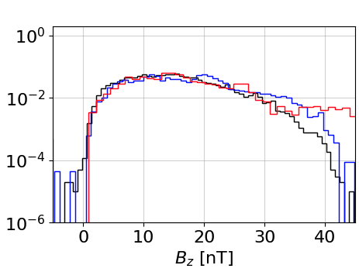
Confirmation of previous results
Geotail (1994 – 2006)
MMS (2015 - 2024)
Geotail (1994 - 2014)
Inner Magnetosphere:
$$−6<X_{GSM}<15 {[R}_{E}]$$
$$E_{y}$$
$$V_{⊥x}$$
$$B_{z}$$
Findings:
Ey increase during storm times
Ohtani & Mukai 2008

Slide 29
Confirmation of previous results
Geotail (1994 – 2006)
MMS (2015 - 2024)
Geotail (1994 - 2014)
Inner Magnetosphere:
$$−6<X_{GSM}<15 {[R}_{E}]$$
$$E_{y}$$
$$V_{⊥x}$$
$$B_{z}$$
Findings:
Ey increase during storm times
Findings:
Ey increase during storm times
Increase realized through Bz enhancement
Ohtani & Mukai 2008
Notes:
As we are close to Earth here, a current increase as expected in storm times can cause an increa

Slide 30
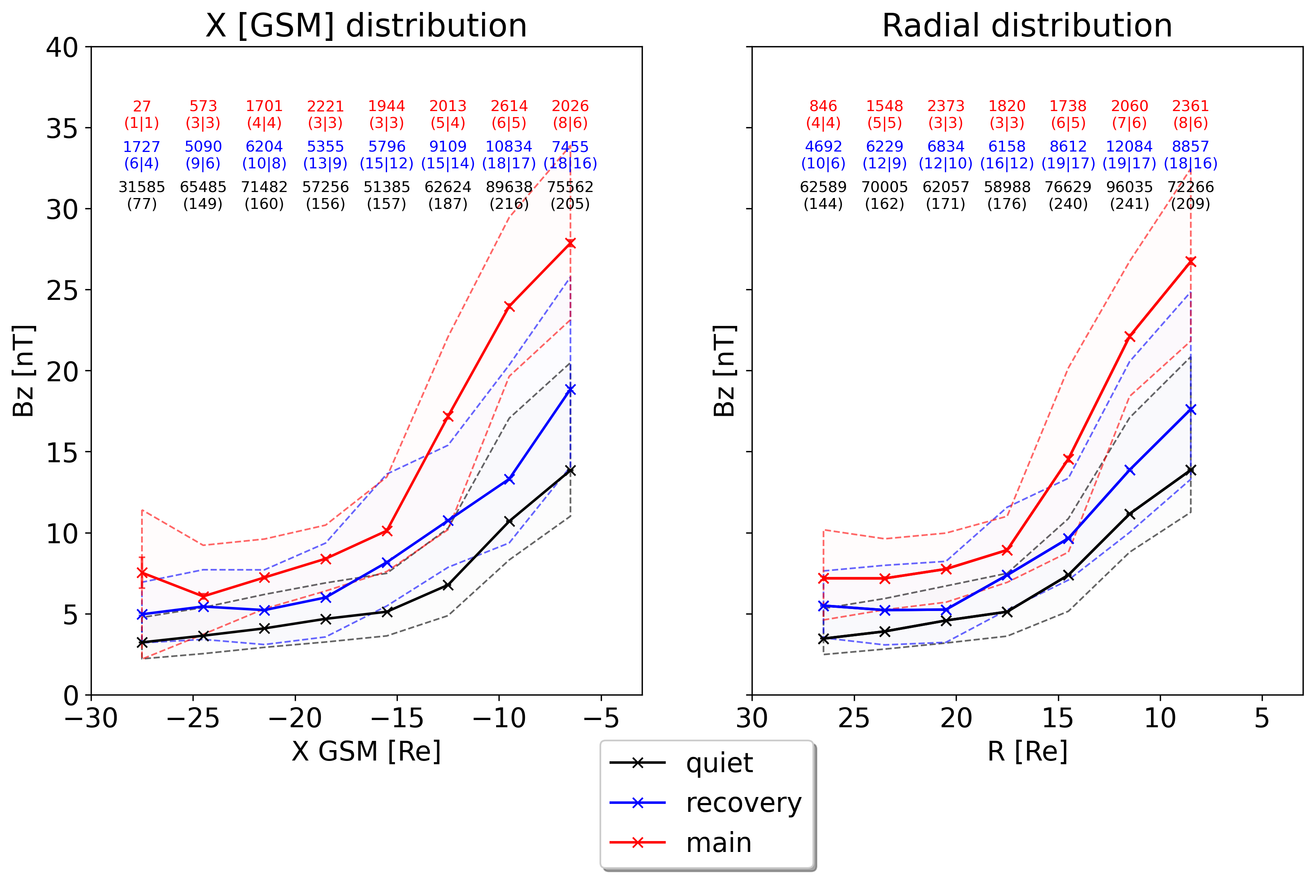
Bz – spatial distribution - MMS

Slide 31
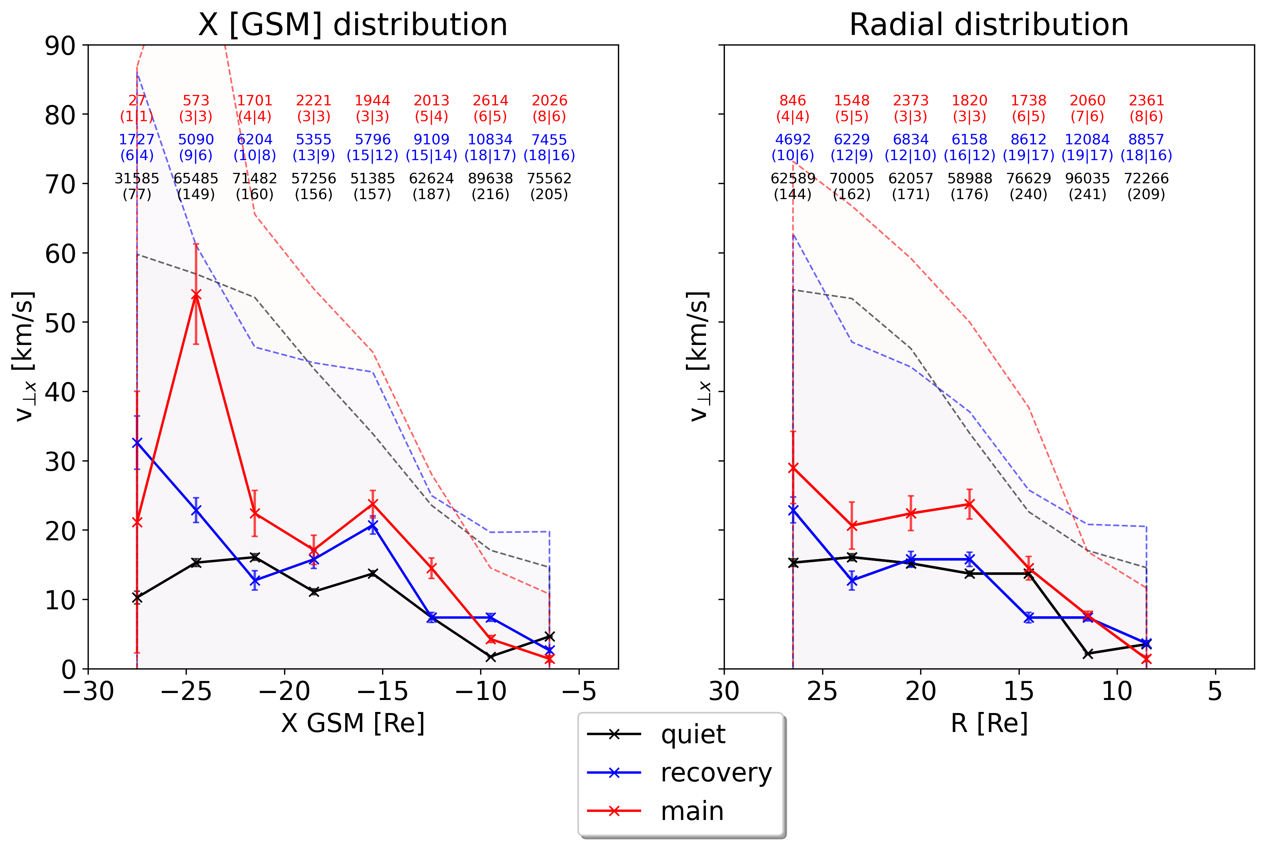
V⊥x – spatial distribution - MMS

Slide 32
ΔBz - XY – Geotail - Extra
Dusk
Dawn
Outer
Inner

Slide 33
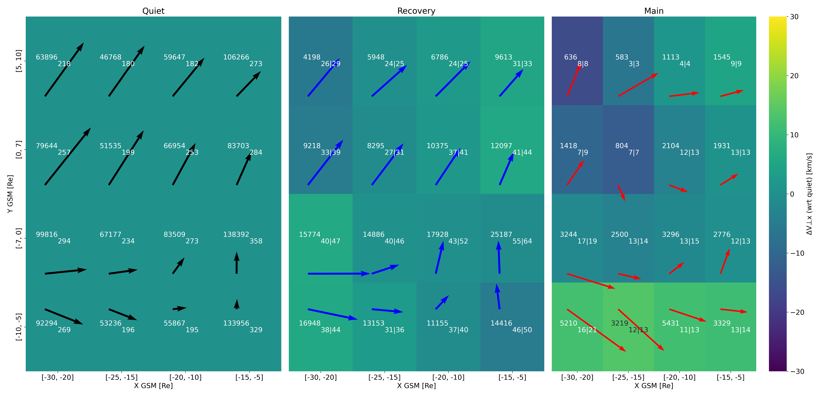
ΔV⊥x - XY – Geotail - Extra
Dusk
Dawn
Outer
Inner

