Slide 1

Modeling Earth’s Plasma Sheet using Machine Learning
Savvas Raptis¹, Connor O’ Brien^{1,2}, Kareem Sorathia¹, Viancheslav Merkin¹, Shinichi Ohtani¹, Louis Richard³, Simon Wing¹
¹ APL/JHU, Laurel, MD, US
² Center for Space Physics, Boston University, Boston, MA, USA
³ Swedish Institute of Space Physics, Uppsala, Sweden
Supported by John Hopkins University Applied Physics Laboratory independent R&D fund and NASA Drive Center CGS
savvas.raptis@jhuapl.edu
https://savvasraptis.github.io

Slide 2
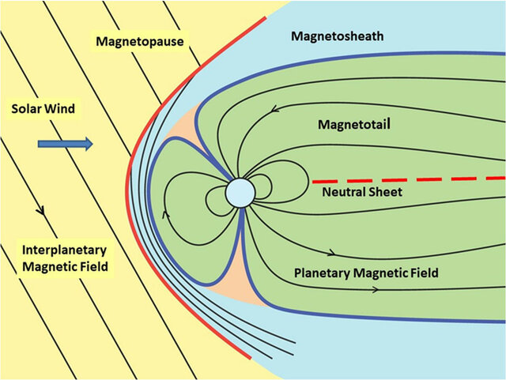
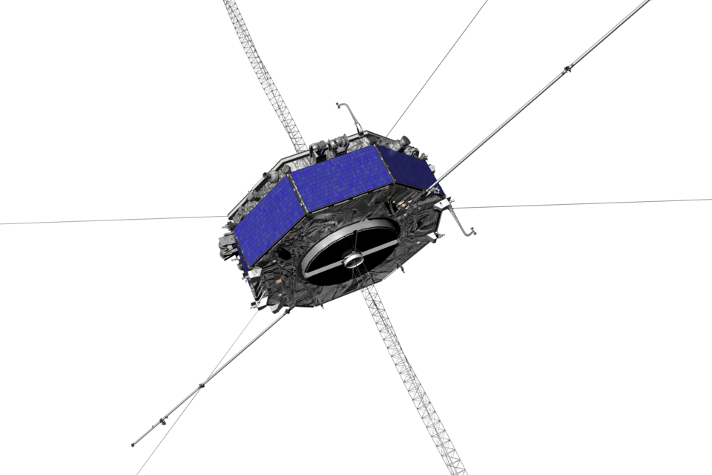
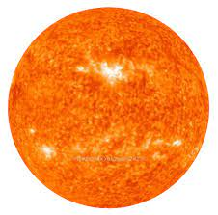


2
Where are we & what are we doing?
Input:
+Geomagnetic
ACE/WIND/DSCVR
(L1)
200$R_{E}$
Output: In-situ properties from: MMS, Geotail, THEMIS
Goal: Model Plasmasheet properties based on driving (SW) and geomagnetic conditions
$$R_{E}=6371.2 \left[km\right]$$

Slide 3
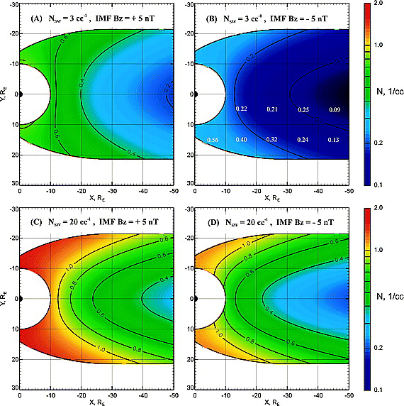
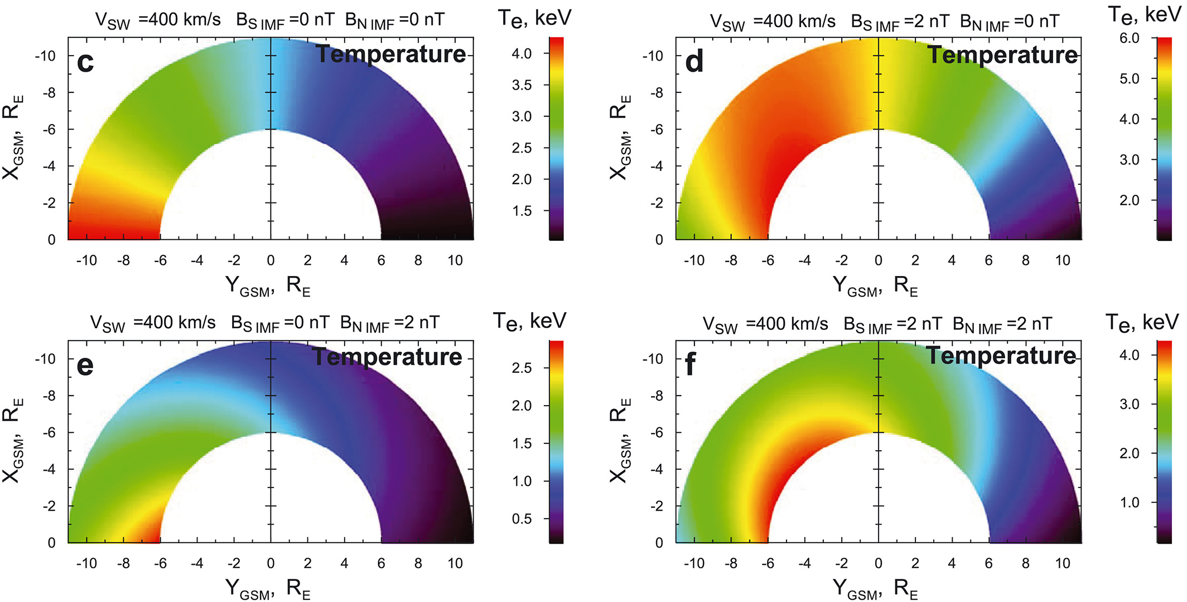
Baseline empirical models
Modelled with Geotail
Modelled with THEMIS
Dubyagin+ 2016
Why keep working on this?
More Data
No MMS Model
These models don’t include time history
New methods can utilize non-linear relationship of input space
We can learn more now based on feature evaluation
Tsyganenko & Mukai 2003

Slide 4
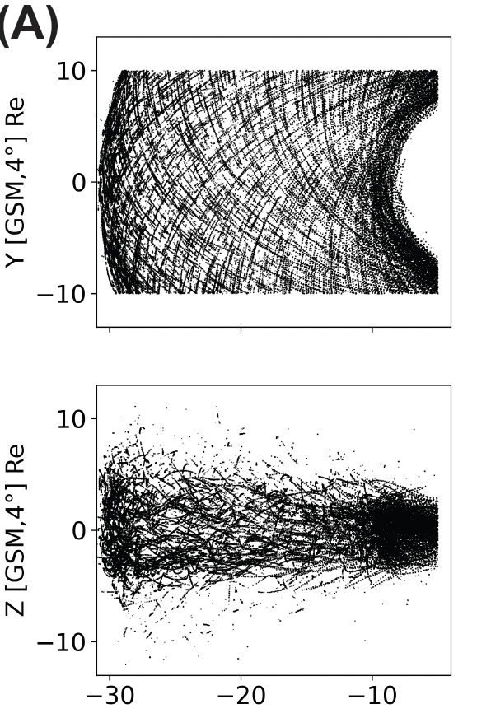
The dataset (output – Central Plasma Sheet)
Geotail (1994 - 2022)
>1 million points (~12s res)
(B) MMS (2015 – 2024)
~ 250k points (~12s res)
Output:
Anything locally measured
(In this example plasma moments)
Raptis+ 2024 (GRL)

Slide 5
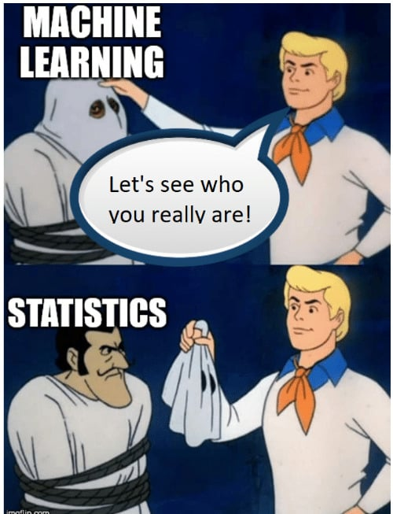
Metrics & Results

Slide 6
Methodologies & input space
PRIME Advantages: Embedded uncertainty quantification and propagation from L1
Time History | Type of Input | Architectures
1-6h | Wind (L1) | Linear Reg
 | OMNIweb | Gradient Boosting
 |  | Neural Network
 |  | RNN/LSTM/GRU (PRIME-PS)
O’Brien et al. 2023,2024
Answering hypothetical questions:
Also tried different error functions, optimizers, hyperparameters etc.
And different imbalanced learning techniques
Key Takeaway:
To quantify our method's impact, we tested multiple variations of the problem.
Raptis, O’Brien et al., 2026 (under prep.)

Slide 7
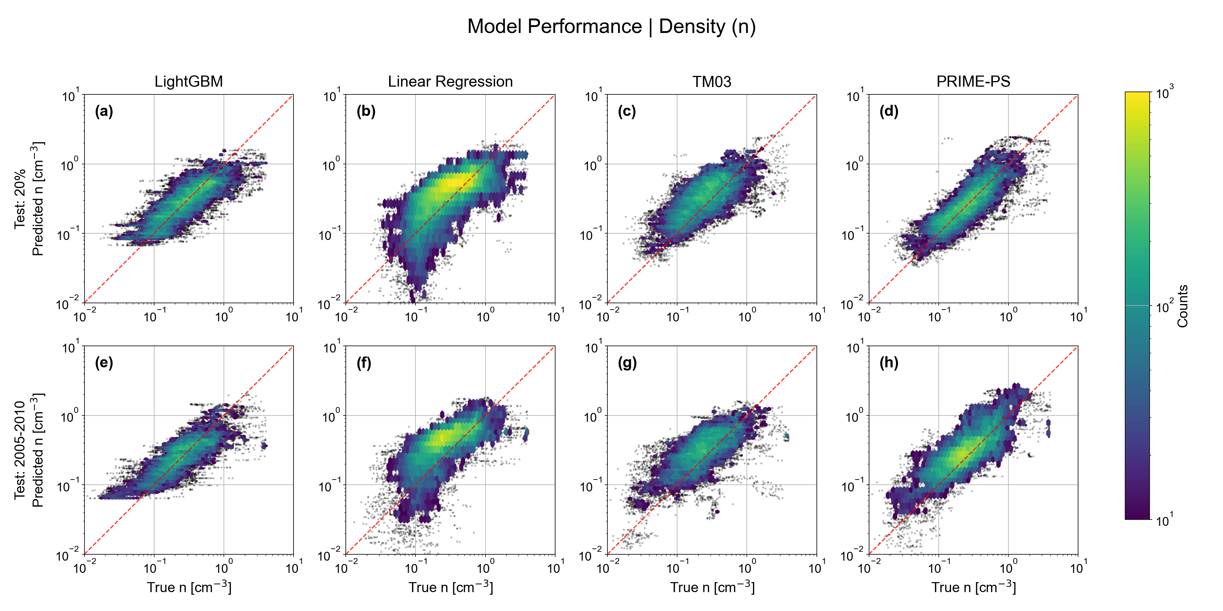

Modeling Density | Predictions vs Observations
Key Message: $PRIME/GB >Baseline ≈ TM03$
Offsets
Raptis, O’Brien et al., 2026 (under prep.)
Reminder: Close to x=y → good

Slide 8
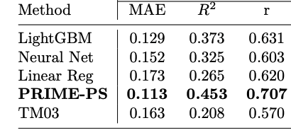
Metrics using Test set (20% of data)
Key Results:
PRIME-PS demonstrates a performance edge (~30% MAE from TM03 and ~15% from other ML approaches).
This advantage can get relatively low (other train/test splits & crossvalidation).
Different input, method, time-history, and hyperparameter tuning etc. had overall a statistically marginal effect. Why?
Since PRIME-PS was statistically better, and Gradient boosting can’t be used for modeling, we only keep this for next parts of analysis.
Raptis, O’Brien et al., 2026 (under prep.)

Slide 9
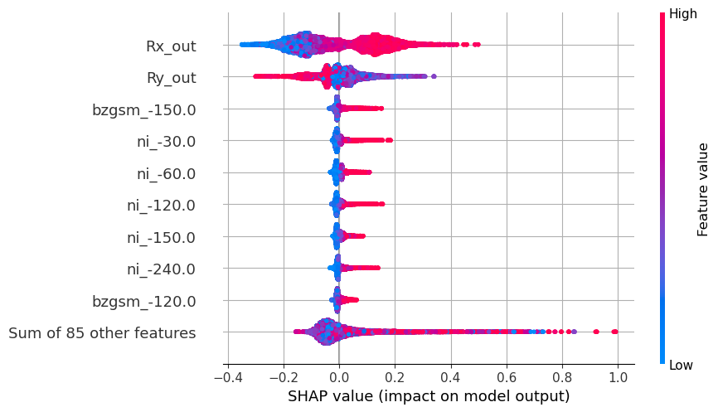
Feature Importance Analysis
Higher density close to earth and at dawn
X GSM
Y GSM
Answer: In most cases (statistically):
Model is predominantly driven by spacecraft location
Solar wind input has lower effect, although cumulative history is still important
Blue/Red: Input value
Left/Right: Output value
SHAP Values explain why a model made a specific prediction, by showing each feature's impact.

Slide 10
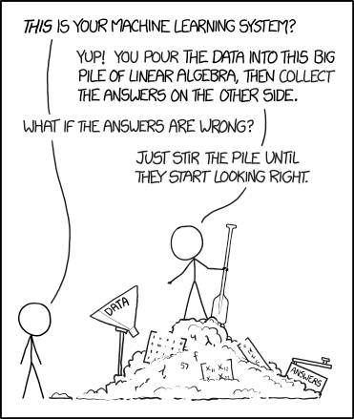
Modeling Efforts
Seriously, we did exactly that.

Slide 11
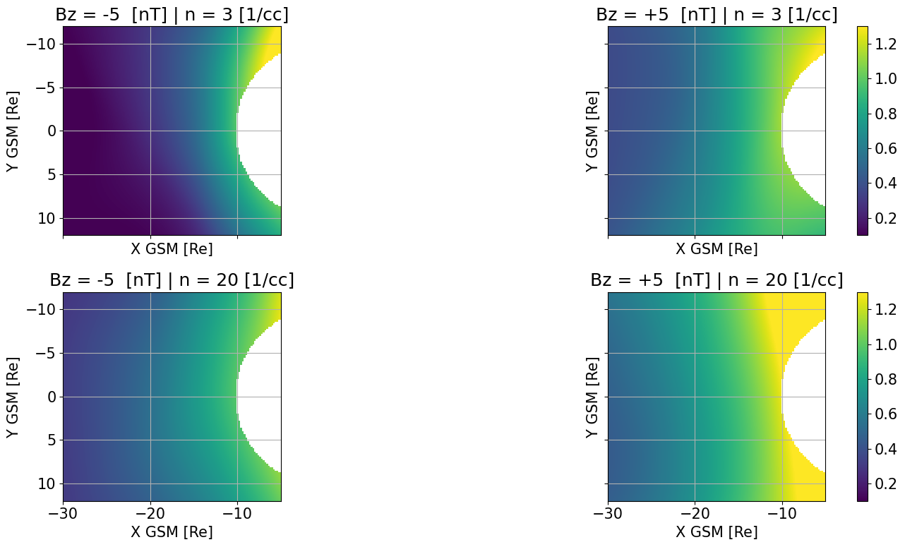
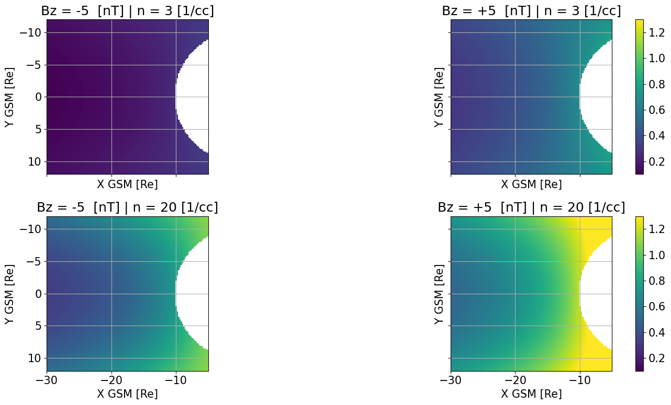
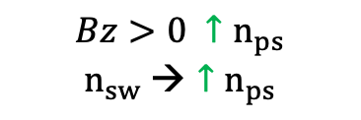
Modeling Density | 2D Maps (Synthetic input)
Assymetries Introduced
N [1/cc]
N [1/cc]
$$Bz>0 {↑n}_{ps}$$
$$n_{sw} →{↑n}_{ps}$$
Neural Networks modeling
Empirical modeling (TM03)
Raptis, O’Brien et al., 2026 (under prep.)
Notes:
Bz <0 KH and lobe reconnection resulting in slower convection that in southward Bz
Dawn = preferential deflection towards dawn , as ion drift duskward they get heated

Slide 12
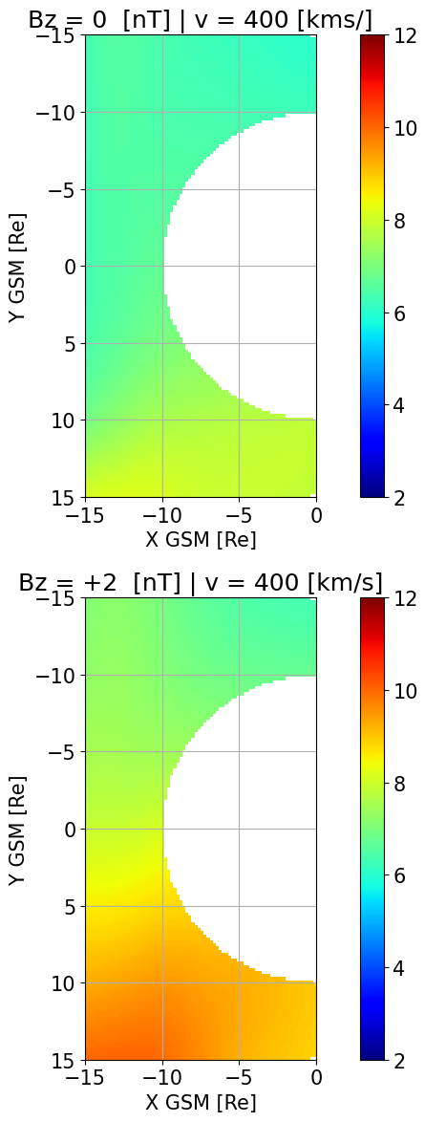
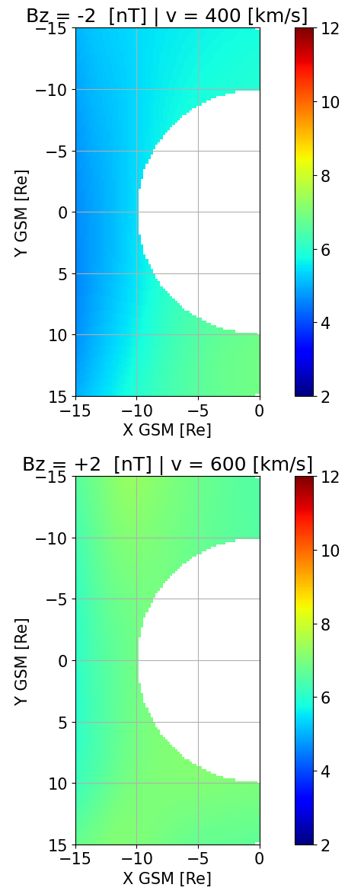
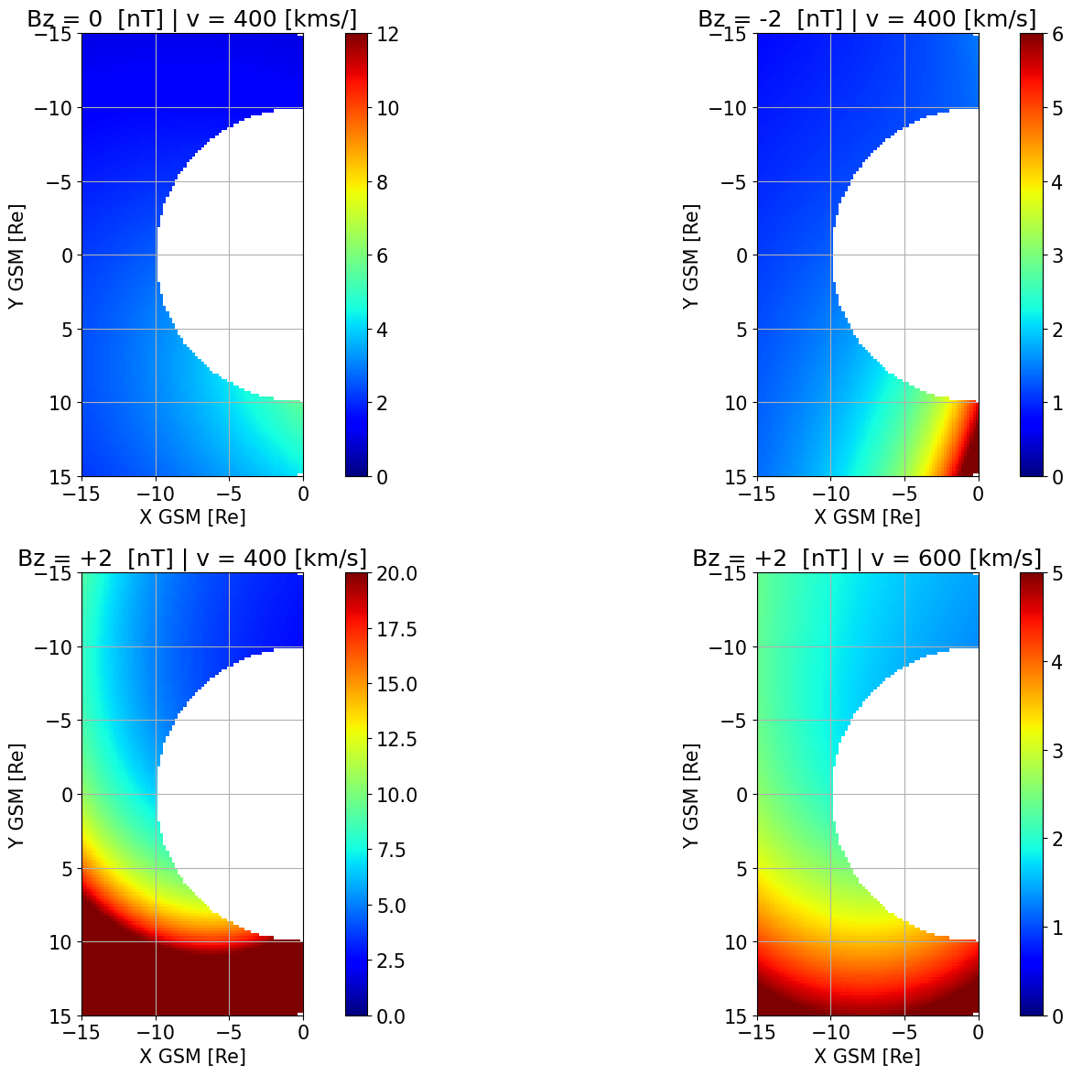
Modeling Temperature Ratios with MMS | 2D Maps
Note: Agreement Wang et al., 2010 with dusk Ti/Te higher than dawn (Using THEMIS)
Pros:
+No extreme values
+Asymmetries shown
+ Coherent physical picture
Cons:
- No analytical form
Neural Networks modeling
Empirical modeling (TM03/DSGR16)

Slide 13
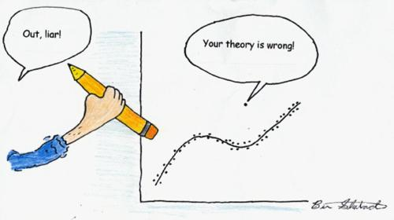
Storm Time Behavior and Importance of Outliers

Slide 14
Test case of a storm (05 Nov 2023)
Process:
High: Includes manually picked high-density intervals from Geotail
Strict: Normal threshold-based classification of plasma sheet
Test:
THEMIS observations
Results
ML model (high dens): 0.7 [1/cc]
ML model (normal): 0.94 [1/cc]
TM03: 1.48 [1/cc]
Key Message: >50% improvement
Note: values <1 cm⁻³, are boundary layer transitions, gray shaded linear interpolation

Slide 15
Summary & Discussion
Results
✅ Significant Gains: PRIME-PS and ML models outperform analytical methods & show asymmetries.
❌ Mediocre Storm Predictability: We mainly capture "boring" conditions, not the critical rare events.
🧠 A Core Problem: Our training data is biased. Extreme events, are not always captured by simple thresholds, are very rare, and including them is methodologically challenging
Future Work
Understand the output: Focus on feature importance under different conditions.
Hybrid Modeling: Use simulations to generate extreme events we lack in data? (Need to be careful here).
Discussion Points/Opinions
A model with R² ~0 can have a correlation of 0.7 and very low MAE depending on the problem.
“Unique and extreme” events with parameter distribution can be more important than typical metrics.
Work is ongoing feedback is very welcome!

Slide 16
Extras

Slide 17
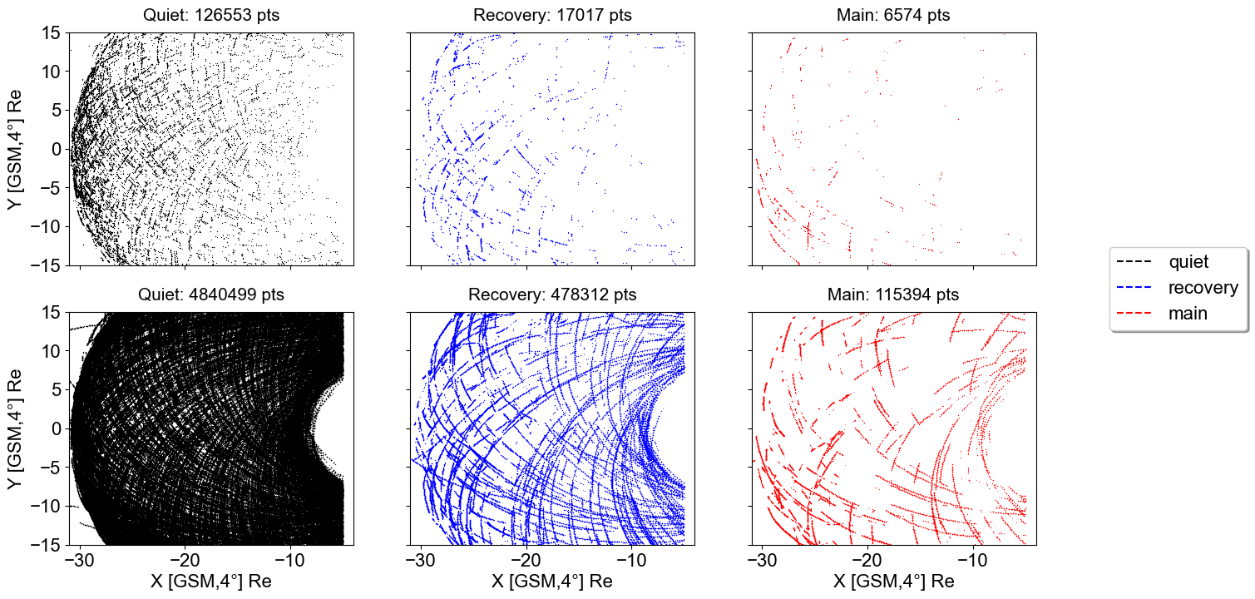
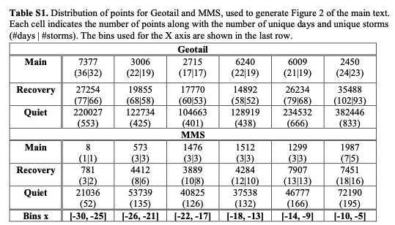
Community Reminder: Data Sparsity During Extreme Events
Geotail data (1994 – 2022), time resolution: 12 seconds
(#of unique days, # unique storms)
Keypoint: Number of data points can be misleading

Slide 18
Test case of a storm (05 Nov 2023)
Process:
PRIME: Directly predicted
Calc: Calculated
Test:
THEMIS observations 2 years after the Geotail data stopped operating

Slide 19
Feature Importance Analysis

Slide 20



Data Scientist POV (i.e., Input, output & regression)
Input
SW properties + Geo conditions
Output
Plasma Sheet
Quantity
Dense Neural Network
Regression
$$\begin{matrix}x_{+5} \\ ⋮ \\ \begin{aligned}x_{−365} \\ r_{x},r_{y},r_{z}\end{aligned}\end{matrix}$$
$$…$$
$$y_{0}$$
Input:
x: Different solar wind features (e.g., n, B, etc.) + geomagnetic indices including time history up to 6h
r: Location of SC measuring output
Output:
y: Different quantities at plasma sheet (e.g., n, B, T etc.)
SW Input tried: Wind (1min res) – OMNIweb (1/5 min res)
Results here shown for 1min averaged quantities for output

Slide 21
Temperature and Ti/Te MMS output
Note: Not showing analytical model, but essentially it does not agree with observations since DGSR16 and TM03 are trained on different domains, spatial distances, and from different missions

Slide 22
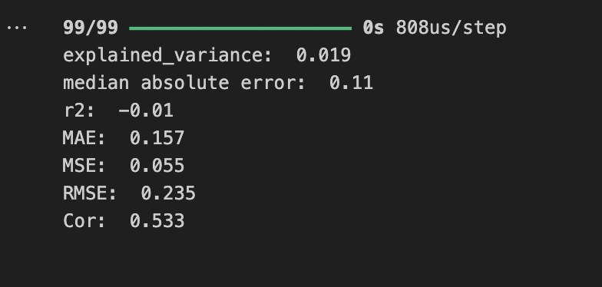
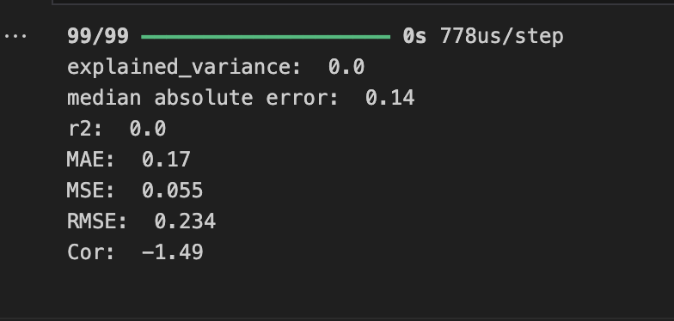

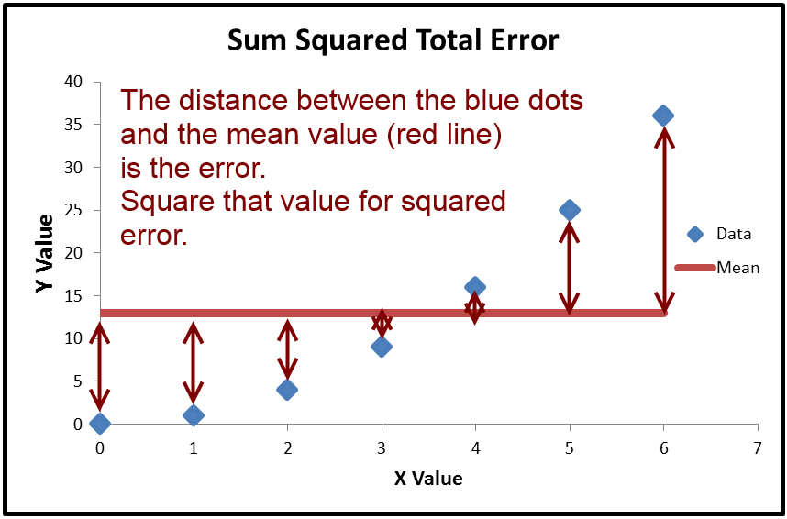
What are the metrics we need to use
A complex and intriguing model
np.mean()
When 𝑅2<0, the horizontal line explains the data better than your model (i.e., mean of observed).
Notes:
R2 measures how much of the variance in the dependent variable is explained by the model.

Slide 23
Modeling Temperature | Predictions vs Observations
Key Message: $PRIME−PS/GB >Baseline≥ TM03$
Raptis, O’Brien et al., 2026 (under prep.)

Slide 24

Is all this data needed? (Discussion point – Imbalanced learning)
Identify Outliers:
Find Outliers: Detected using Isolation Forest (unusual feature patterns)
2. Build a Diverse Core (Farthest Point Sampling):
Selects a core subset where points are maximally distant
Ensures broad coverage and high diversity of the original data
3. Balance with Rare Samples (Kernel Density Estimation):
Adds points from under-represented regions
Reduced by 1-2 order of magnitudes.
Almost Identical performance on test set.

Slide 25
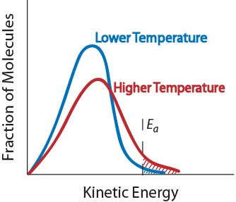
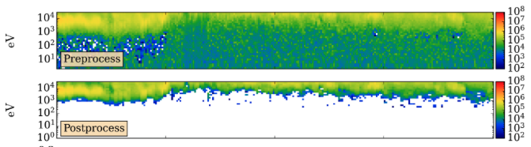
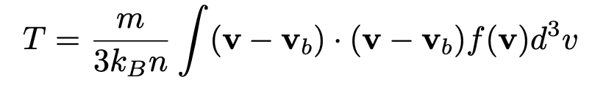
Community Reminder on Temperature
Temperature is the 2nd plasma moment
The higher the moment, the more uncertain because you rely more on the poorly sampled tails of the distribution.
So, 0 and 1st moment (Density and Velocity) are usually ok, but Temperature, we got to be careful
Ion Penetrating Radiation
Figure credits: Tien Vo
The temperature here was completely incorrect, and the velocity increased from about 200 km/s to over 1500 km/s.

Slide 26
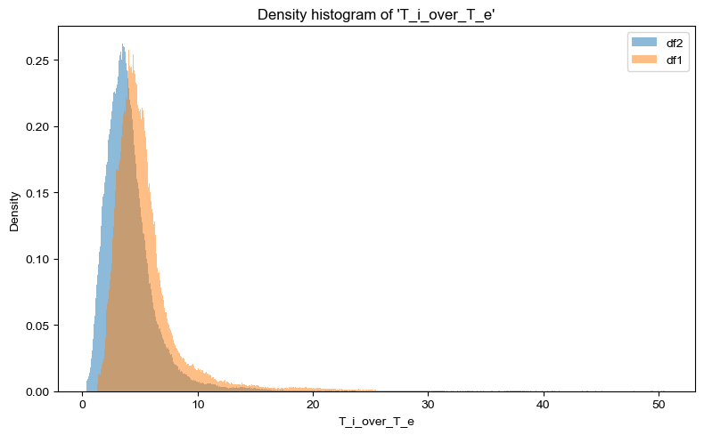
MMS Ti/Te plasmasheet ratio example (Full vs Partial moments)
mean df1 (full distribution moments): 5.5513
mean df2 (partial distribution moments): 4.0797
DF2 effectively removes the contribution from the penetrating radiation (Gershman+ 2019)
Key Message1: The mean differenced changed by 1.5 (>30%) simply by recalculating moments
Key Message2: A model with +30% is exciting, but we need to know if “ground truth” vary by the same magnitude

Slide 27
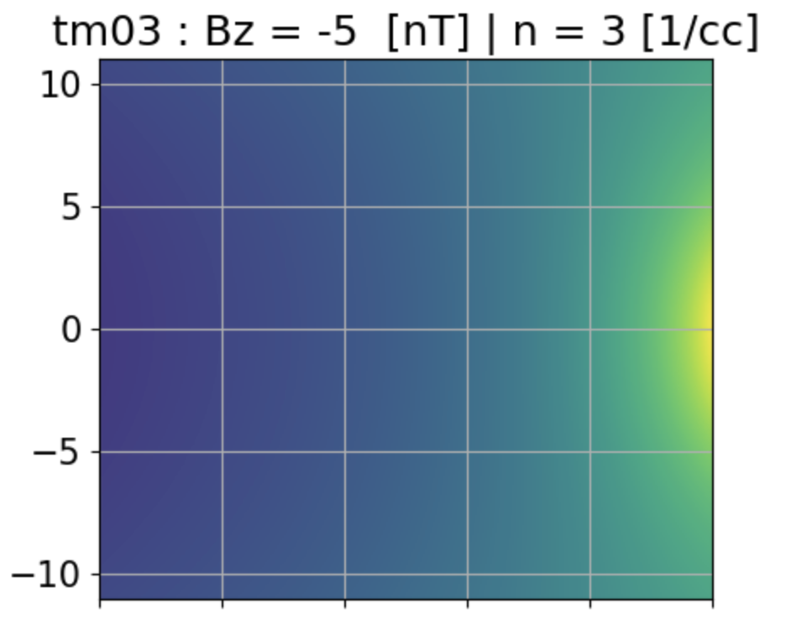
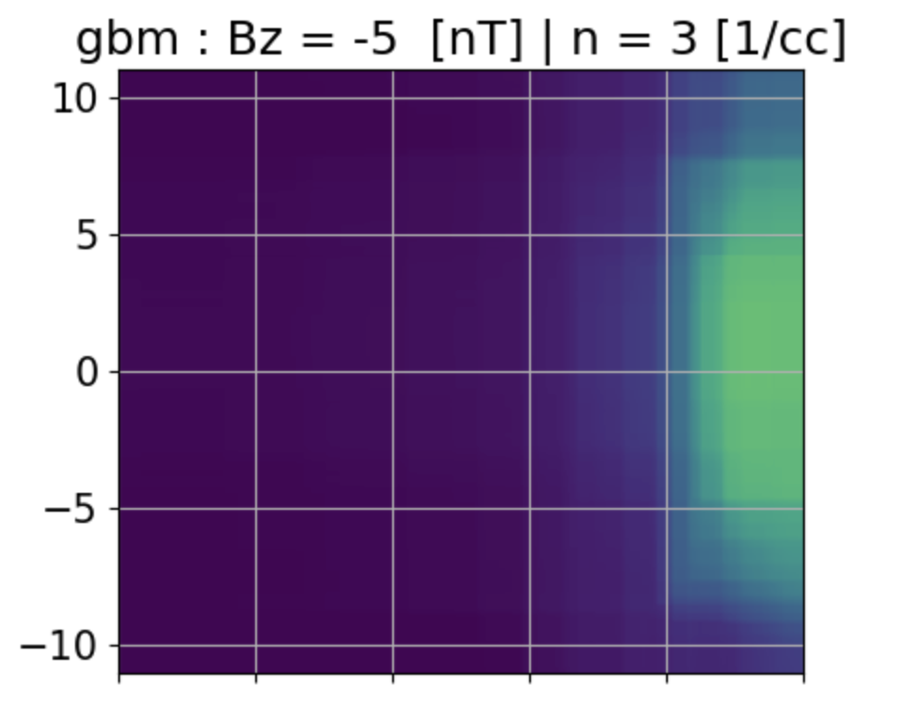
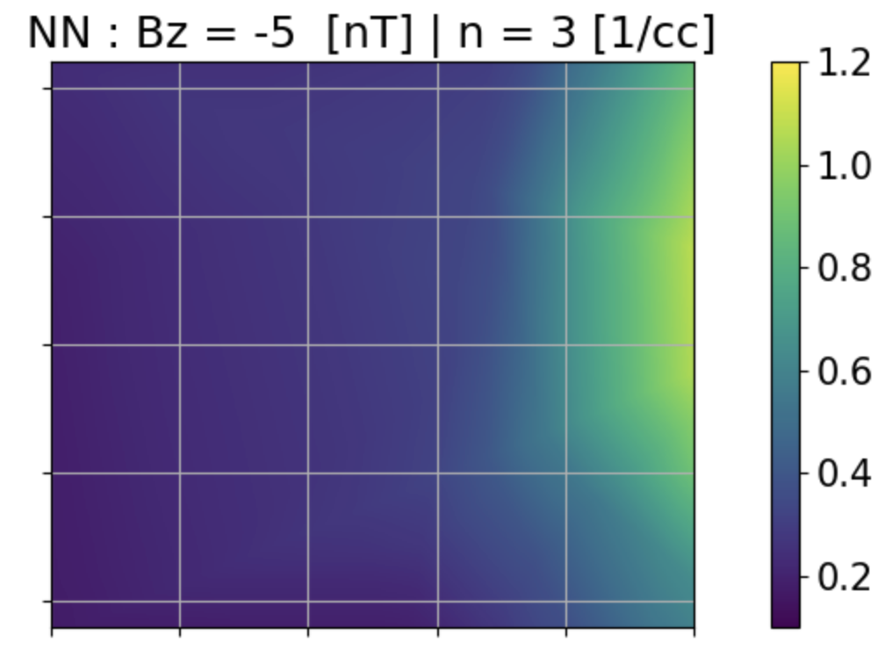
Community Reminder via Modeling Bz
Gradient boosting is powerful, but it’s a poor extrapolator.
Since it’s built on decision trees, it predicts from nearby data rather than extending patterns like a neural network.

Slide 28
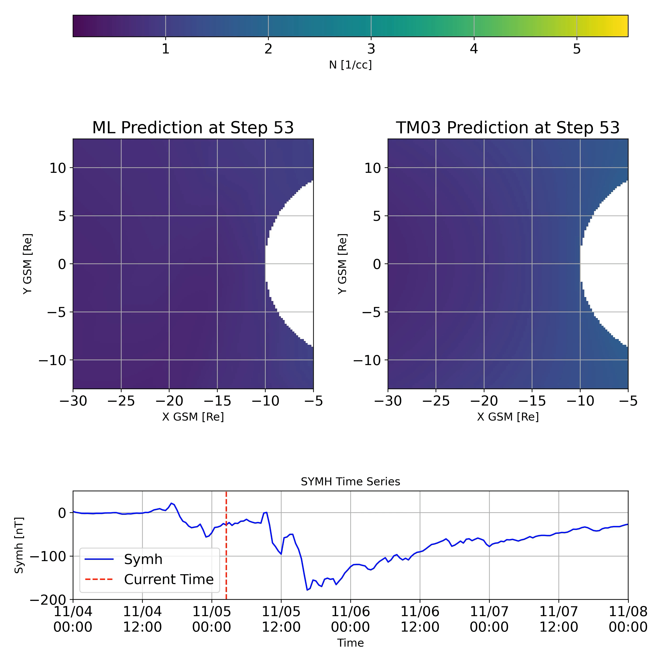
ML storm time density modeling

Slide 29
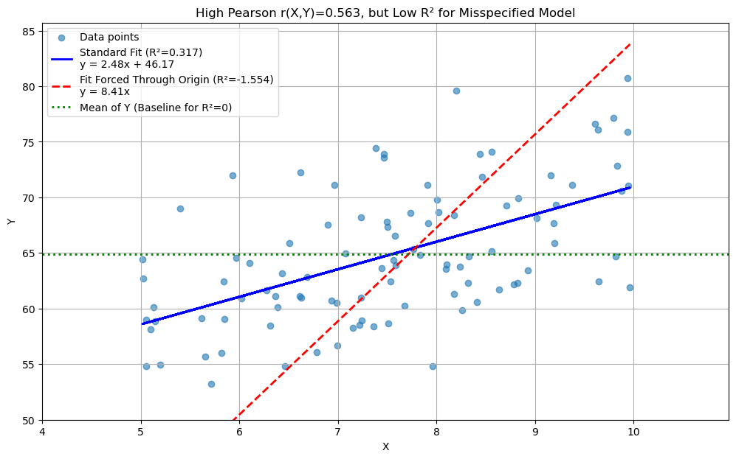
Correlation and Rsquared difference

Slide 30
Goal of Presentation
Spark a discussion on problems we have with data-driven modeling.
🔹 Evaluating Models What do our typical metrics really tell us about predictive power?
🔹 Outliers & Sampling How should we treat rare events? Can we expand or restrict our dataset meaningfully?
🔹 Ground Truth in Space How do we use in-situ data, and what counts as “truth” relative to model performance?
🔹 Model Architectures Do architectures always drive performance? or do data and physics matter more?
All these questions will be discussed through the challenge of predicting Earth’s plasma sheet properties from solar wind and geomagnetic conditions

Slide 31
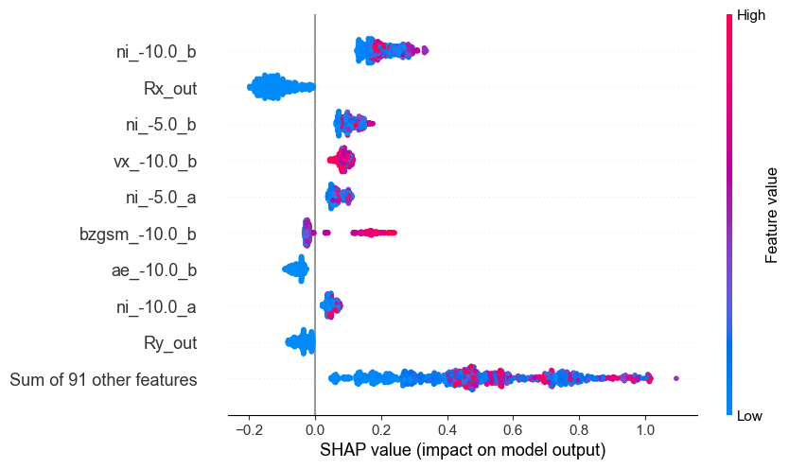
Model Feature importance storm vs quiet
In other words, the increased upstream density (-1h) had a greater impact during the storm than the SC location.
X_test_storm
X_test_total

Slide 32
Classifying plasma sheet is not trivial
Note Vo+2023, had a multi-step process based on interval, this is just using the point-by-point classification

Slide 33
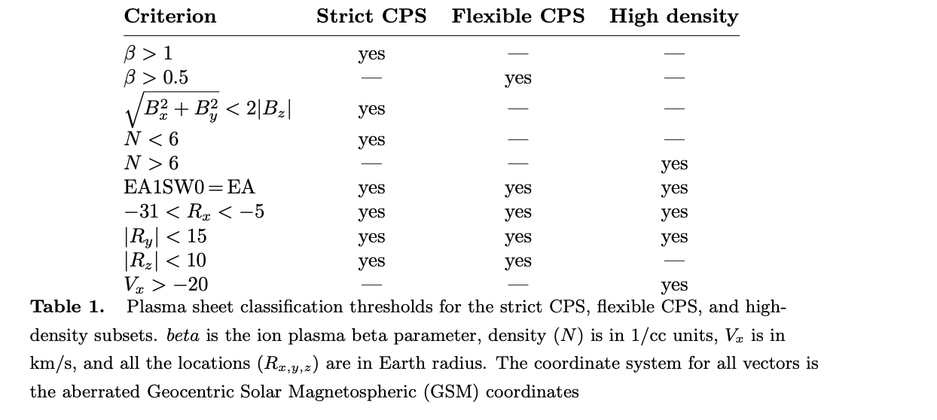
Storm Time Behavior and Importance of Outliers
The Problem: We use static thresholds for dynamic environents.
The Risk: Therefore we can mistakenly remove the crucial "stormtime plasmasheet.”
The "Solution": Manually find the missing data and add it to the dataset.
Strict CPS (e.g., Ohtani et al., 2008 Raptis et al., 2024) & Flexible CPS (e.g., Richard et al., 2022)

Slide 34

Next step: 2D modeling
Input
SW properties + Geo conditions
Output
Plasma Sheet
Quantity
Dense Neural Network
Regression
grid in x,y
To get 2D maps
Output across 2D
$$\begin{matrix}x_{+5} \\ ⋮ \\ \begin{aligned}x_{−365} \\ r_{x},r_{y},r_{z}\end{aligned}\end{matrix}$$
$$…$$
$$y_{0}$$
Input:
x: Different solar wind features (e.g., n, B, etc.) + geomagnetic indices including time history up to 6h
r: Location of SC measuring output
Output:
y: Different quantities at plasma sheet (e.g., n, B, T etc.)
SW Input tried: Wind (1min res) – OMNIweb (1/5 min res)
Results here shown for 1min averaged quantities for output

Slide 35
Data number & storms
if you don't bin the measurements and you predict point by point with their formula, the R^2 drops to zero
Raptis+2024
Error bar is
non existent!
What does it mean to have 1500 data points if they originate from 3 storms/3days?
Key Message: #of unique days, # unique storms, and distribution of upstream conditions is more important than SE

Slide 36
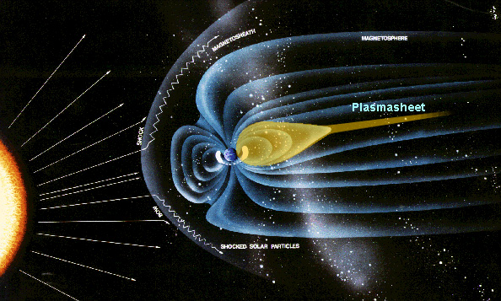
Earth’s plasma sheet
Magnetotail reconnection
Bursty Bulk Flows (BBFs)
Global Convection Patterns
Ring current
Modeling PS is useful for:
Understanding storm/substorm dynamics
Explain ring current configuration
Facilitate space weather modeling
Understand inner magnetosphere
Source for radiation belts
Credits: NASA

