Slide 1
The Role of Shock-Generated Transients in Particle Acceleration at Planetary Bow Shocks
Savvas Raptis
APL/JHU, Laurel, MD, USA
Acknowledgments:
MMS Early Career Grant and APL R&D program
ISSI Team: P. Kajdič - Foreshocks Across The Heliosphere: System Specific Or Universal Physical Processes?
GEM Focus group: Multiscale Dayside Transients (MDT) and their Effect on Earth’s Magnetosphere
APL R&D program
Thanks to co-authors and collaborators: Ahmad Lalti, Drew Turner, Terry Liu, Martin Lindberg, Damiano Caprioli, Lynn Wilson III, Yufei Zhou, David Sibeck, Primoz Kajdic, Adnane Osmane, Ian Cohen, Philippe Escoubet, Jim Burch, George Clark, Jamey Szalay ++ many more
savvas.raptis@jhuapl.edu / https://savvasraptis.github.io

Slide 2
Shocks & Transient Phenomena
Shocks & Transient Phenomena
Particle Acceleration
Notes:
2 minutes

Slide 3
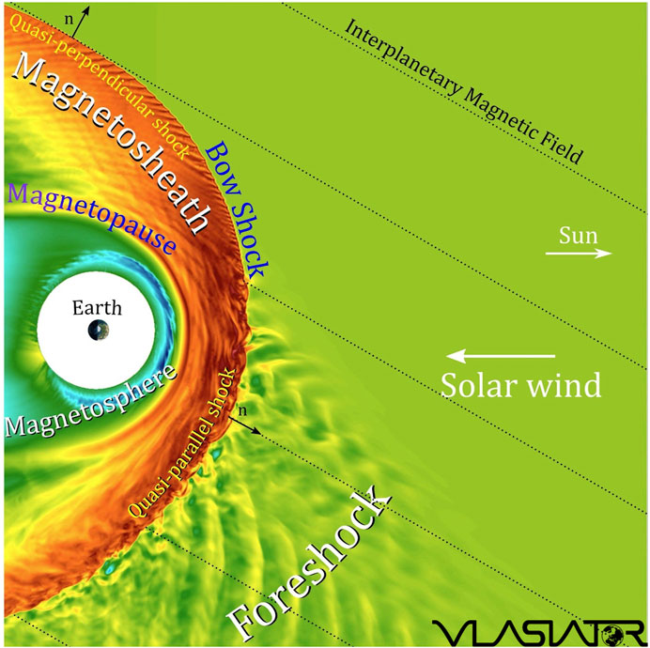
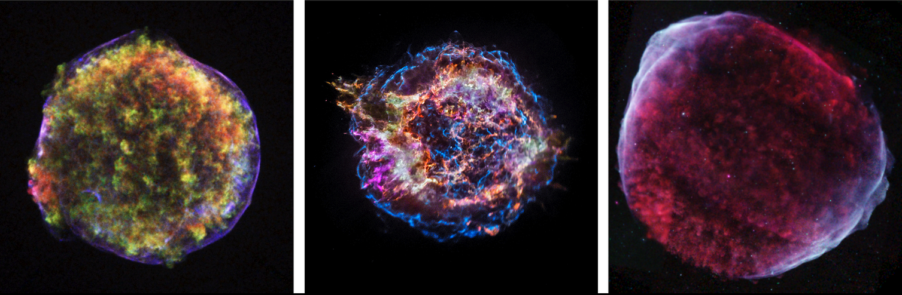
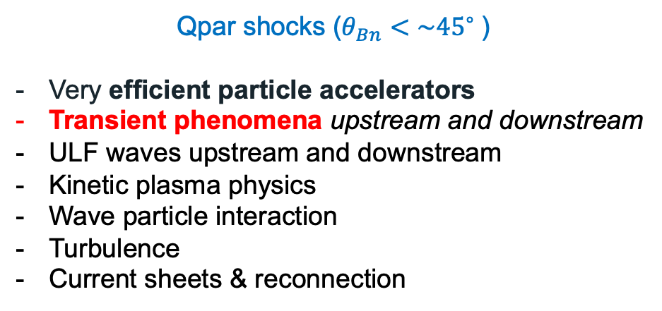
Earth’s Qpar bow shock and foreshock
Qpar shocks ($θ_{Bn}<\sim {45}^{∘}⁡$)
Very efficient particle accelerators
Transient phenomena upstream and downstream
ULF waves upstream and downstream
Kinetic plasma physics
Wave particle interaction
Turbulence
Current sheets & reconnection
*Astro references on Qpar importance: Caprioli+2014, Giuffrida+2022, Vink+2024

Slide 4

What is a Dayside Transient?
Transient phenomena are events that disrupt the steady-state plasma conditions, occurring temporarily and introducing dynamic changes to the physical system
←New review paper about high-speed jets!
Global (Solar):
Coronal Mass Ejection (CME)
High-Speed Stream (HSS)
Pressure Pulse / IP Shocks
Fluid scale:
Flux Transfer Event (FTE)
Magnetopause (bursty) Reconnection
Mesoscale:
Hot Flow Anomalies (HFAs)
Foreshock Bubbles (FBs)
Magnetosheath High Speed Jets (HSJs)
Kinetic:
ULF waves
Shocklets
SLAMS
Figure adapted from Krämer et al., 2025, Credits: Florian Koller
NOTE: Transients can be intrinsic (e.g., ULF waves, SLAMS) or driven (e.g., HFAs)
GEM FG: Multiscale Dayside Transients and their Effect on Earth's Magnetosphere
(2025 - 2029; Savvas Raptis, Ivan Vasko, Imogen Gingell, Terry Z. Liu, Ying Zou)
Notes:
Mesoscale → Foreshock ions referring 1000th of kilometers. Relative to solar wind ions they can be still considered fluid scales
Absolute scale of HFA/FB ~ FTEs reconnection

Slide 5
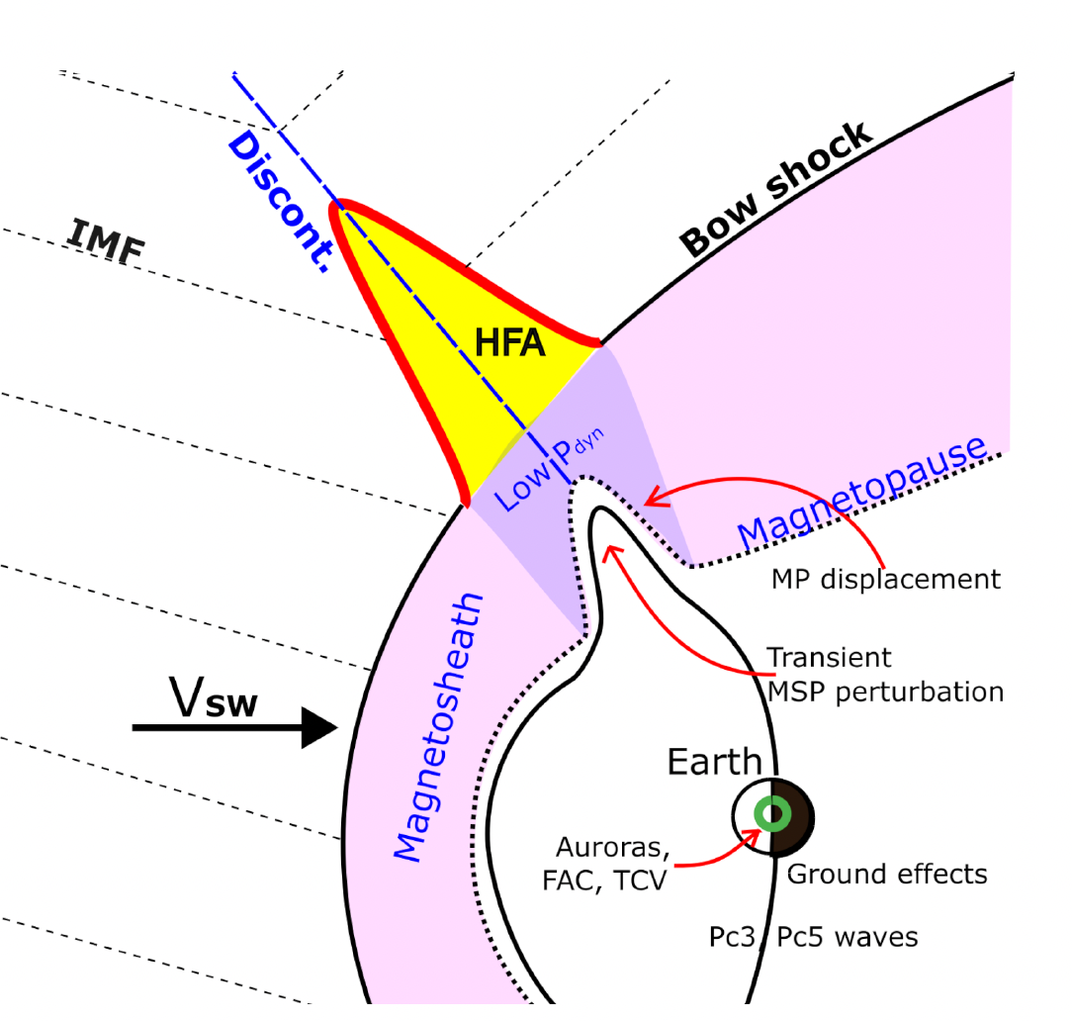
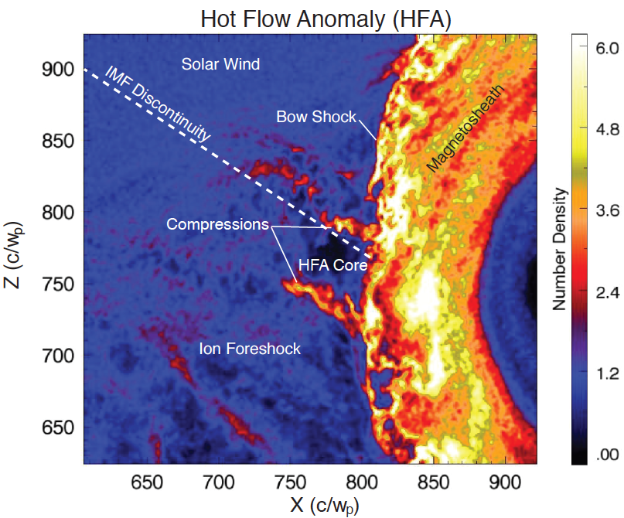
The anatomy of an HFA
Effect on Magnetosphere e.g.,: Shen+2018, Wang+ 2021, Yang+2023, Guo+ 2023, Xu+ 2024, Sibeck+2025
How many: ~several per day!
How big: ~up to 10s of Re
Crater-like B-field and IMF discontinuity
Upstream
shock
Solar wind beam disrupted
Density compressions and cavity
Upstream
shock
Strong plasma flow
deflections in core
Hot Flow Anomalies (HFA)
Figure by Nick Omidi
Kajdič+ (2024)
Superheated core plasma
How they form?
Discontinuity intersects the bow shock and the convection electric field
(−V X B) points towards the sheet on at least one side.
Figure by Drew Turner

Slide 6
Particle Acceleration Recent Results*
Shocks & Transient Phenomena
Particle Acceleration
*See also: Wilson III L. et al. 2016; Turner et al. 2018; Liu et al. 2019; Shi et al. 2023,2025 ; Tonoian et al. 2023; Kamaletdinov et al. 2024; Li et al. 2025

Slide 7
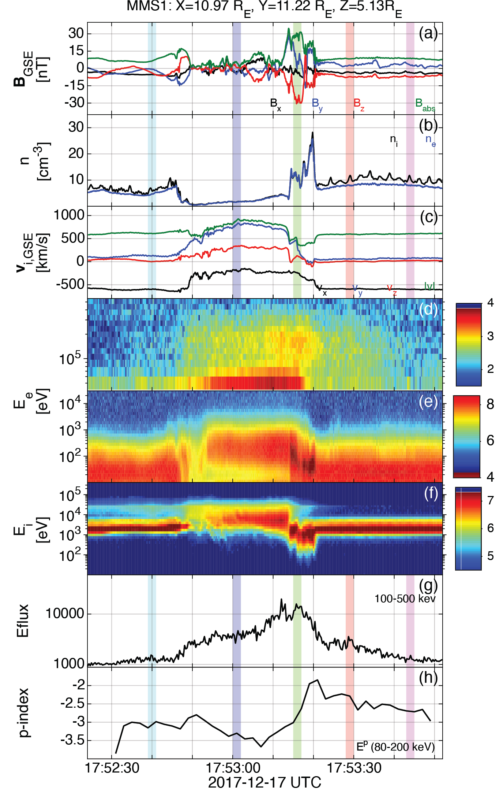
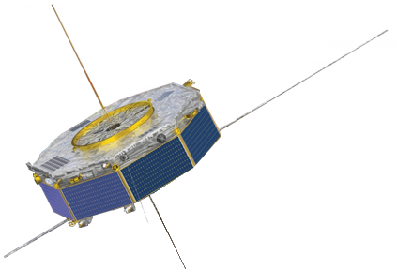

Relativistic Electrons with MMS
Typical properties of transient:
- Depleted Core (low B, n)
- Mature HFA (ΔΒ/B0 ~ 1-4)
- SW beam disrupted
- Strong density and magnetic field compressive boundaries
- Formation of a Qperp “shock”
- Flow anomaly (velocity decreasing)
Unique property
>500 keV electrons throughout the core and shock region
New plot, much easier to understand!
Compressive edges
Core
With respect to SW/FS:
Electron fluxes (>50 keV) up to x6
Ion fluxes (>50 keV) up to x15
Foreshock transient
Bow shock
Raptis et al.2025 NatComm

Slide 8
Reinforced Shock Acceleration of Relativistic Electrons
Electron acceleration at Foreshock Transient
Shock Acceleration
Wave particle interactions
Ratio = $\frac{F_{100−500 KeV}}{{\left\langle F_{100−500 KeV}\right\rangle }_{BG}}$
“Seeding”
Seed from
CH plasma
(1-5 keV)
+
Max flux ratio
Efficient through PA scattering & confinement:
- Whistler waves (Shock Transition)
- Wavefield of HFA’s core (ΔB>>B)
- ”Magnetic bottle” between HFA’s edges and bow shock (trapping & Fermi)
- Betatron (elec. temperature anisotropy)
Note: Other framework is consistent with all other studies (e.g., Wilson+2016, Liu+2019, Shi+2025)
Key-point:
Seed + Foreshock’s Shock + Waves + Efficiency factors = ~MeV electrons before reaching the bow shock.
Raptis et al.2025 NatComm

Slide 9
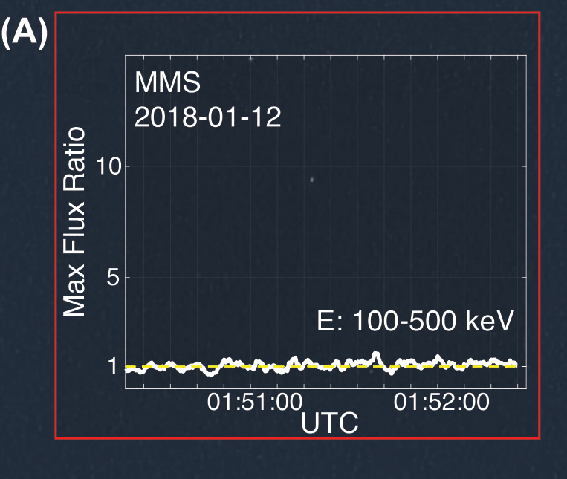
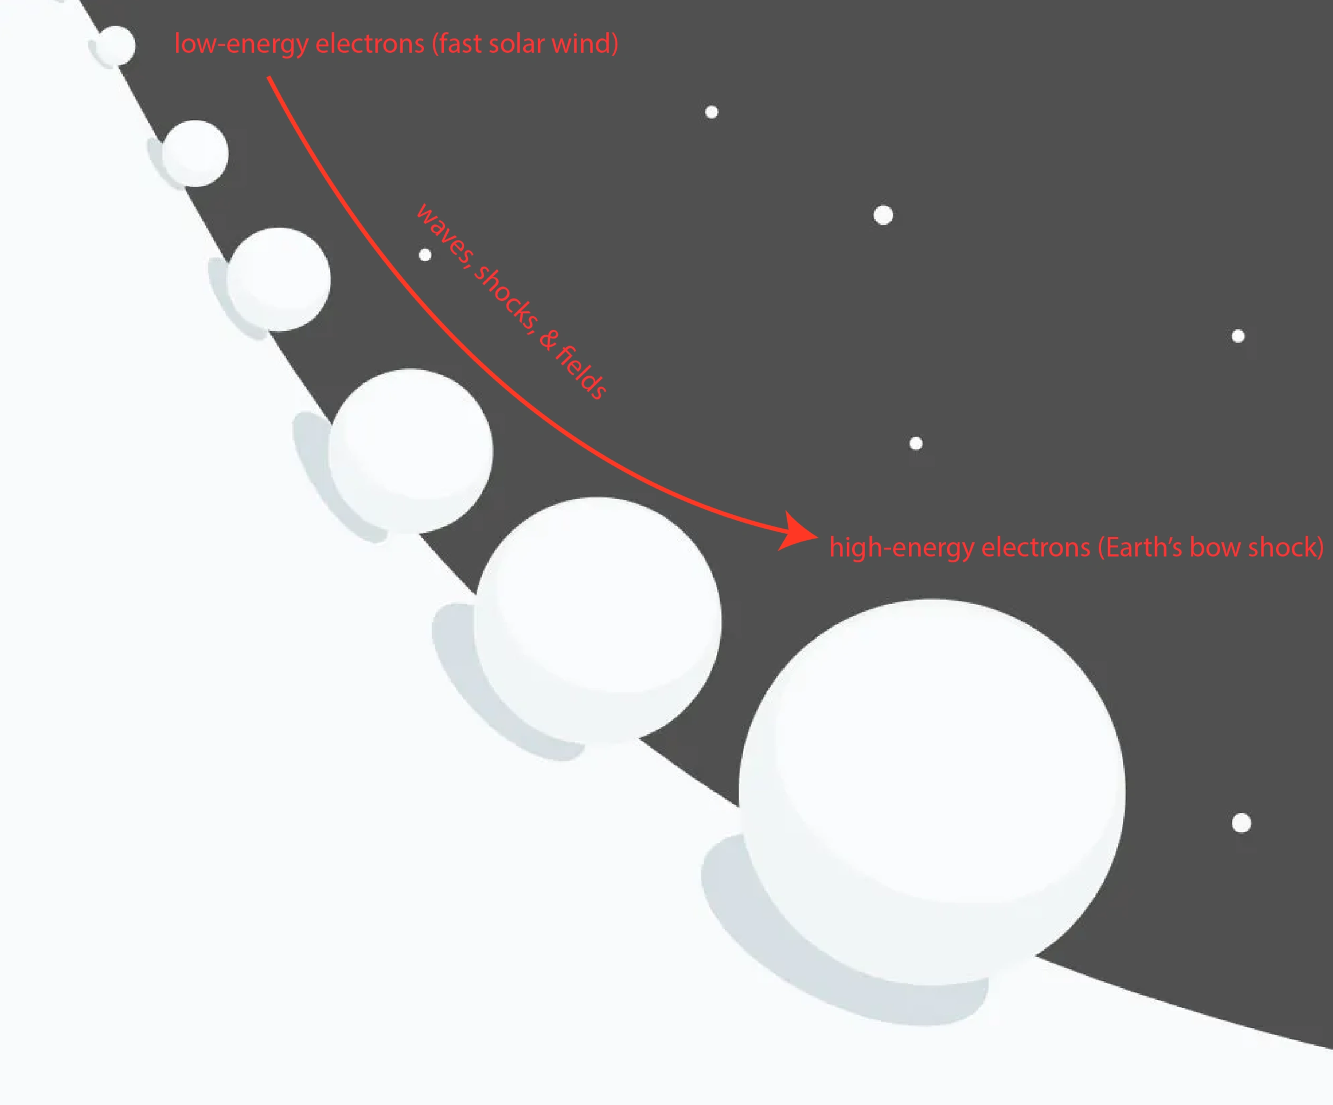
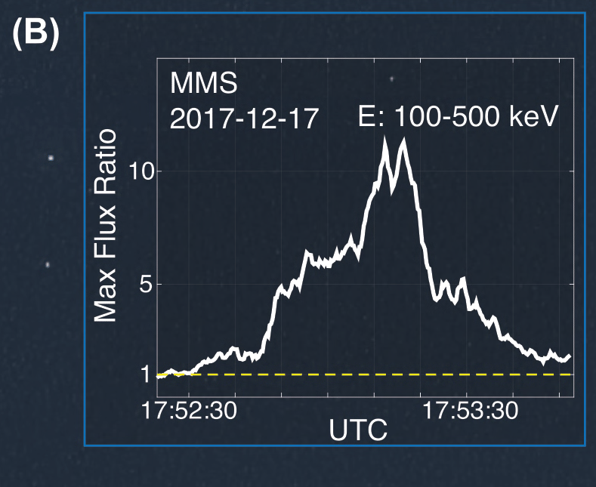
Simple Simplistic Picture to remember
❌
✓
How do relativistic electrons form at shocks? “Behind The paper” https://communities.springernature.com/posts/shocks-acceleration-electrons-from-sun-to-earth

Slide 10
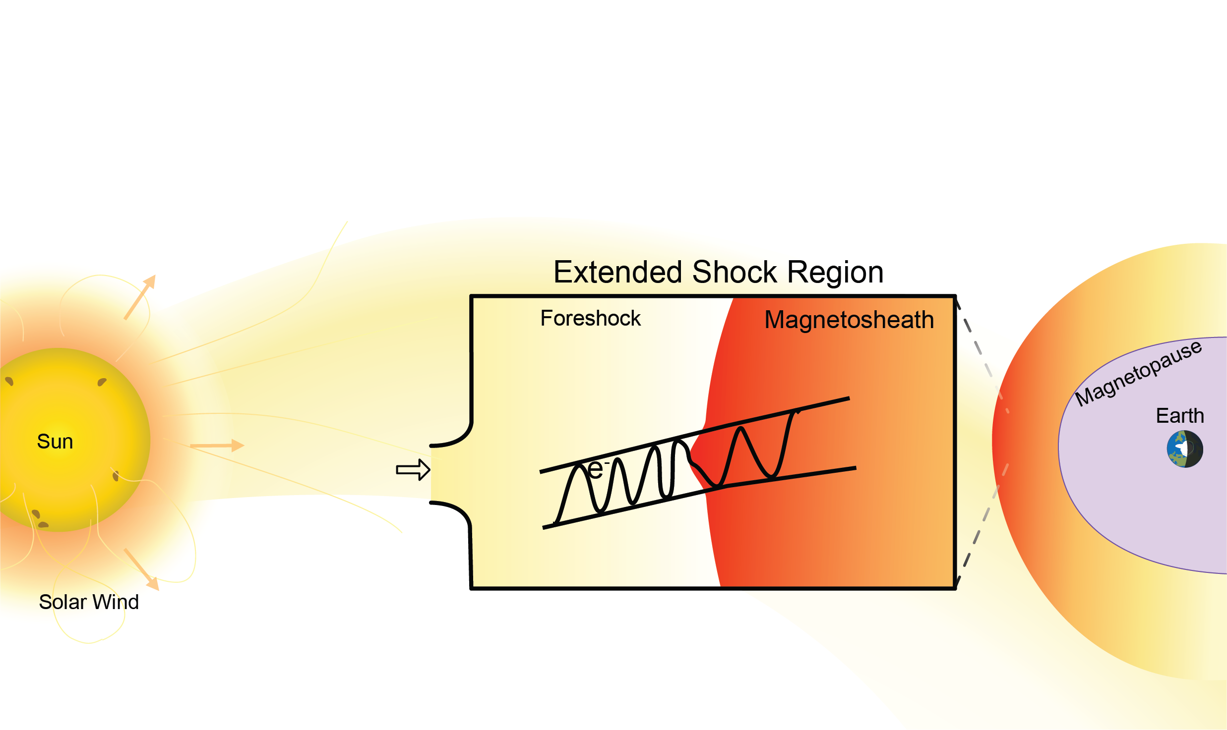
But let’s ask one more question
What do we expect to see when these transient appear downstream?
HFA
Sketch by Florian Koller

Slide 11
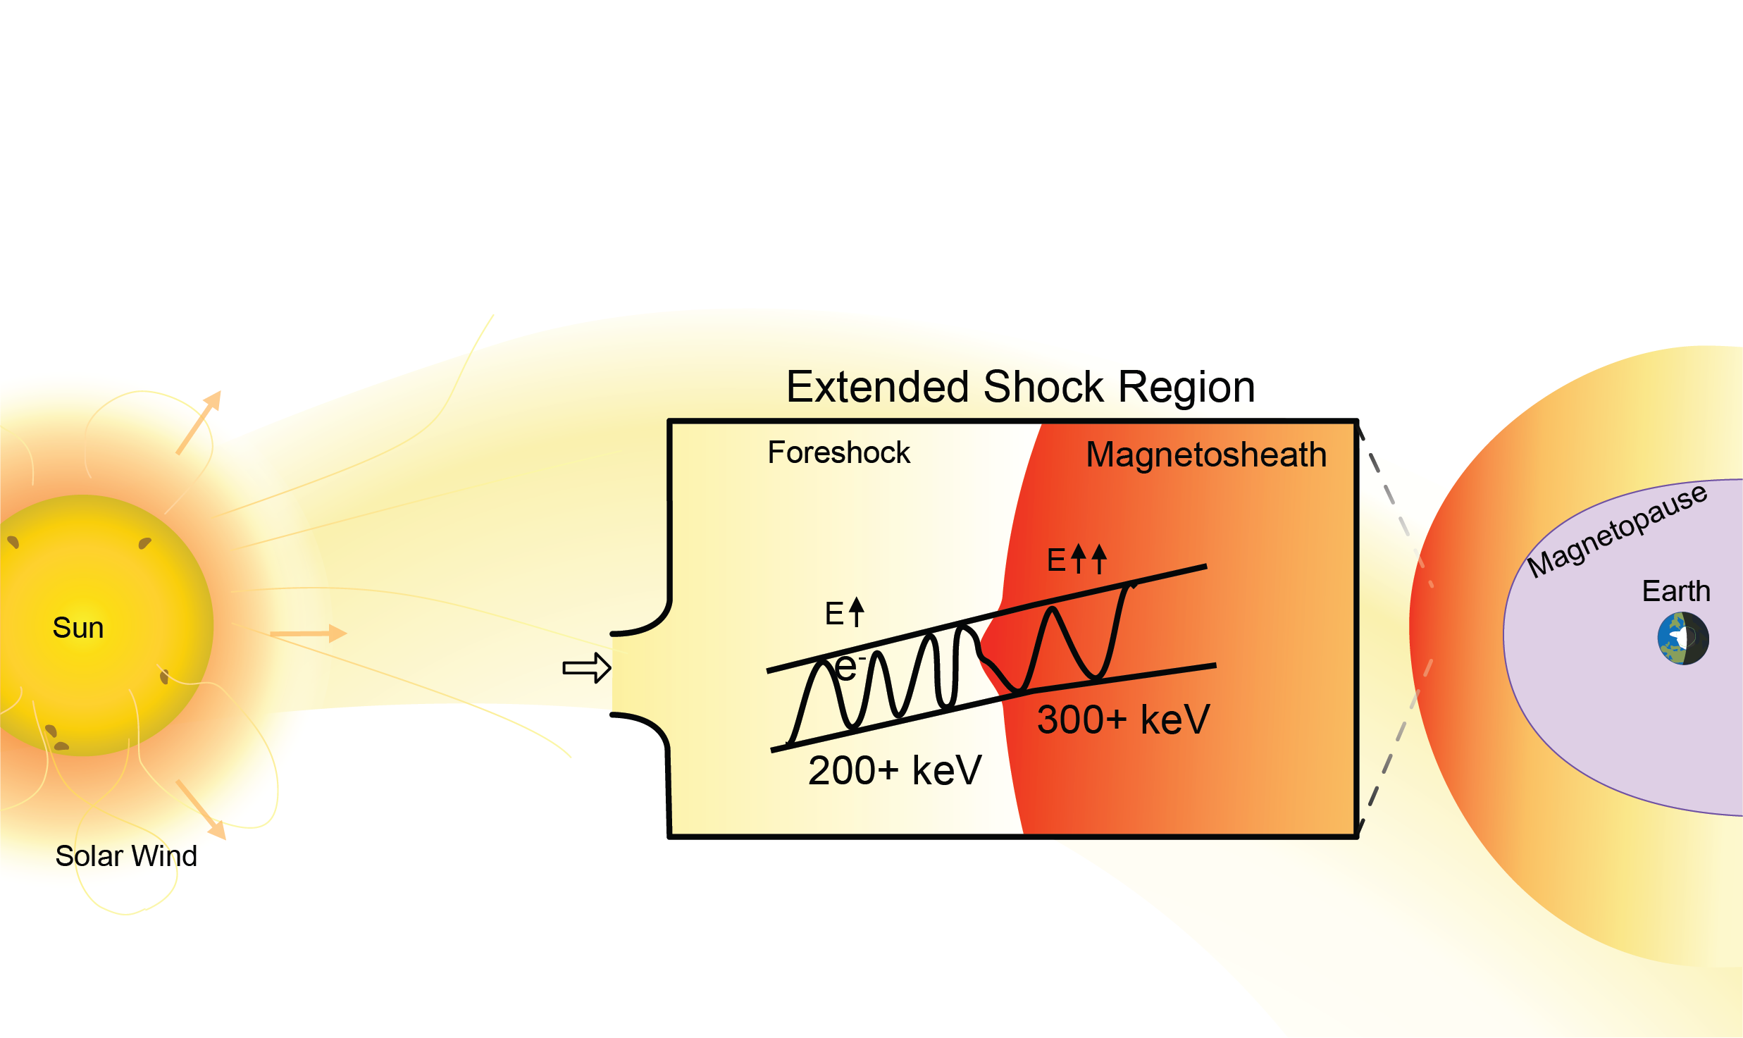
But let’s ask one more question
What do we expect to see when these transient appear downstream?
Cluster
MMS
HFA
Indeed, energy increases more
(+ We get localized jets; not shown)
Sketch by Florian Koller

Slide 12
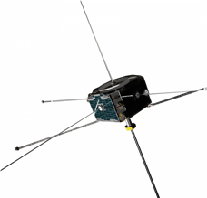
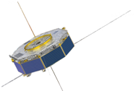





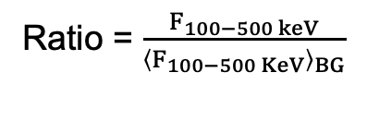
Reinforced Shock Acceleration: From Sun to Earth
(A)
?
Discontinuity (SW) ARTEMIS
Transient (FS) MMS
(B)
Transient (FS) Cluster
Transient (MSH) MMS
Coronal Hole SW
V> 400 km/s
X → X+100 keV
~1 keV
>100-500 keV
Ratio = $\frac{F_{100−500 keV}}{{\left\langle F_{100−500 KeV}\right\rangle }_{BG}}$
Ratio = $\frac{F_{1−5 keV}}{{\left\langle F_{1−5 KeV}\right\rangle }_{BG}}$
Max flux ratio
Max flux ratio
SW – ARTEMIS/THEMIS
Foreshock - MMS
Magnetosheath – CL/MMS
Fast SW seeding ~low keV particles
: Raptis+ 2025 (NatComm) - Revealing an Unexpectedly Low Electron Injection Threshold via Reinforced Shock Acceleration
: Raptis+ 2025 (ApJL) - Multi-Mission Observations of Relativistic Electrons and High-Speed Jets Linked to Shock Generated Transients

Slide 13
Very fresh results!

Slide 14
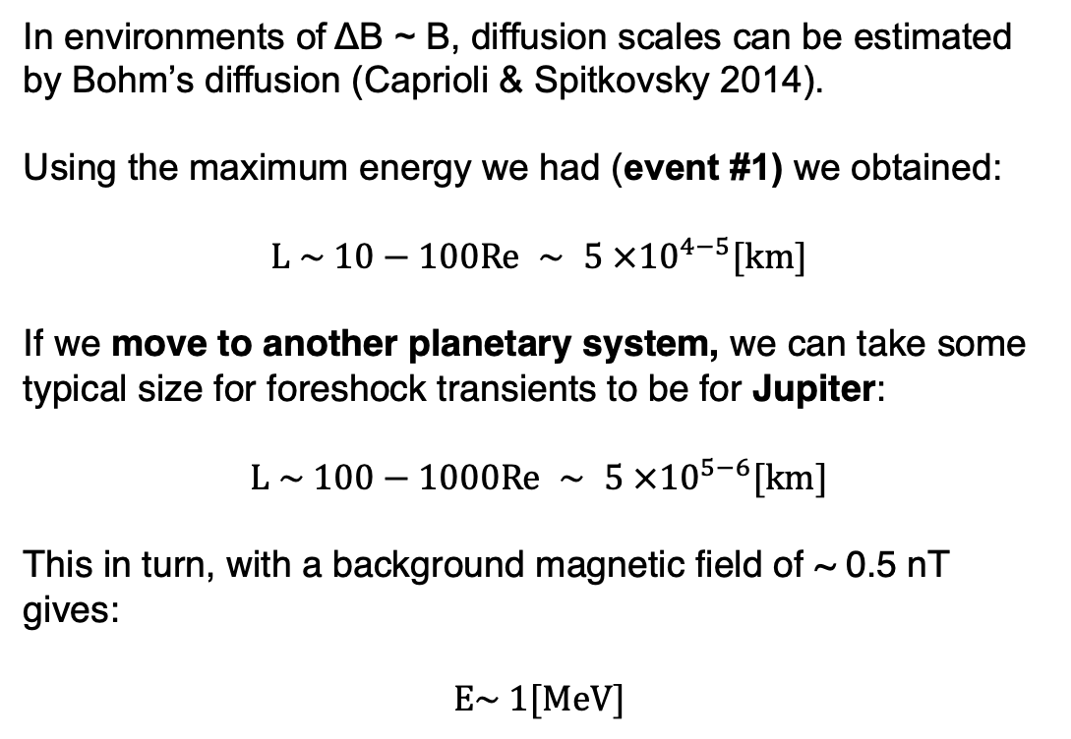
Electron Acceleration in other planets
Adapted from Valek + 2017
In environments of ΔB ~ B, diffusion scales can be estimated by Bohm’s diffusion (Caprioli & Spitkovsky 2014).
Using the maximum energy we had (event #1) we obtained:
$$L \sim 10−100Re ∼ 5 ×{10}^{4−5}[km]$$
If we move to another planetary system, we can take some typical size for foreshock transients to be for Jupiter:
$$L \sim 100−1000Re ∼ 5 ×{10}^{5−6}[km]$$
This in turn, with a background magnetic field of ~ 0.5 nT gives:
$$E\sim 1[MeV]$$
Raptis et al.2025 NatComm
Essentially what is called the Hillas limit (Hillas 1984), See recent paper relevant to our field by Oka+ 2025)

Slide 15
Juno Observations – Jovian Bow Shock Crossing
Foreshock Transient (HFA):
High energy electrons up to 1 MeV (agreement with Raptis+2025a,b)
Disrupted solar wind beam
Localized depletion of n and B
Solar wind (SW):
Typical SW:~ 1-2/cc, 2.5 nT
No energetic electrons
Bow shock (BS):
Typical compression of ~2 for B and n
suprathermal electrons present but minimal energetic electrons only up to 10ish KeV
Ion spectrum
Ion density
Electron
Spectra
JADE + JEDI
Magnetic
field
Raptis+ 2026 (Under Review)

Slide 16
Reinforced Shock Acceleration at Jupiter
DSA (rel) ~2
DSA (non-rel) ~1.5
Raptis+ 2026 (Under Review)
This “DSA-like” acceleration happens at the transient, bow shock only up to <10 keV

Slide 17



Concluding Words
Foreshock Transients at Quasi-Parallel shocks are amazing! Relativistic particles, localized compressive edges/shocks on multiple temporal and spatial scales, forming high-speed jets, all interacting with each other.
Recent results:
Seeding and Max Energy: Identified a systematic suprathermal seeding (~1–5 keV) intrinsic to fast solar wind. Localized transients act as the primary driver to boost these these electrons to high energies (100s of keV). (Raptis et al., 2025a)
A Two-Step Mechanism: Particles get energized when larger transients (i.e., HFAs/FBs) cross the bow shock. For energetic particles, additional acceleration can be modeled by adiabatic compression (betatron) and strong scattering. (Raptis et al., 2025b)
Broader Implications: We expanded this model to test its universality at other planetary boundaries (e.g., Jupiter – 1 MeV electrons) and fundamental astrophysical shocks. This model predicts up to 100 TeV particles in in supernova shocks (e.g., SN 1006) in agreement with cosmic ray observations. (Raptis et al., 2026, under review)
Retino+ 2021 | Ex. Astro.
Goodrich+ 2023
GEM FG: (MDT) Multiscale Dayside Transients and their Effect on Earth's Magnetosphere (2025 – 2029)
Savvas Raptis, Ivan Vasko, Imogen Gingell, Terry Z. Liu, Ying Zou, Runyi Liu, David Tonoian

Slide 18
Appendix

Slide 19
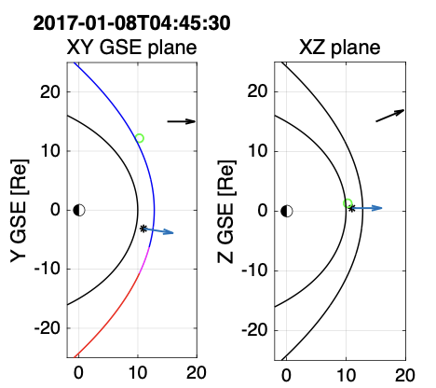
Cluster: Upstream showing HFAs
700 km/s Solar Wind!
Fast coronal hole plasma consistent with our previous work ✓
Hot Flow Anomalies
Disturbed SW beam
~200 keV electrons
Typical properties:
Compressive edges ✓
Flow anomaly ✓
Hot core ✓
Particle energization ✓
Raptis et al.2025 ApJL

Slide 20

MMS: Downstream HFAs and jets
High speed jets!
$$|V|↑$$
$$V_{x}↑$$
$$n↑$$
$$T↓$$
Zoom-in
Hot Flow Anomalies
Localized compressions
~300 keV electrons
20+min interval
Raptis et al.2025 ApJL

Slide 21
But let’s ask one more question
What do we expect to see when these transient appear downstream?
HFA
Sketch by Florian Koller

Slide 22
Adapted Hillas Limit to Transient Structures
Raptis+ 2026 (Under Review)

Slide 23
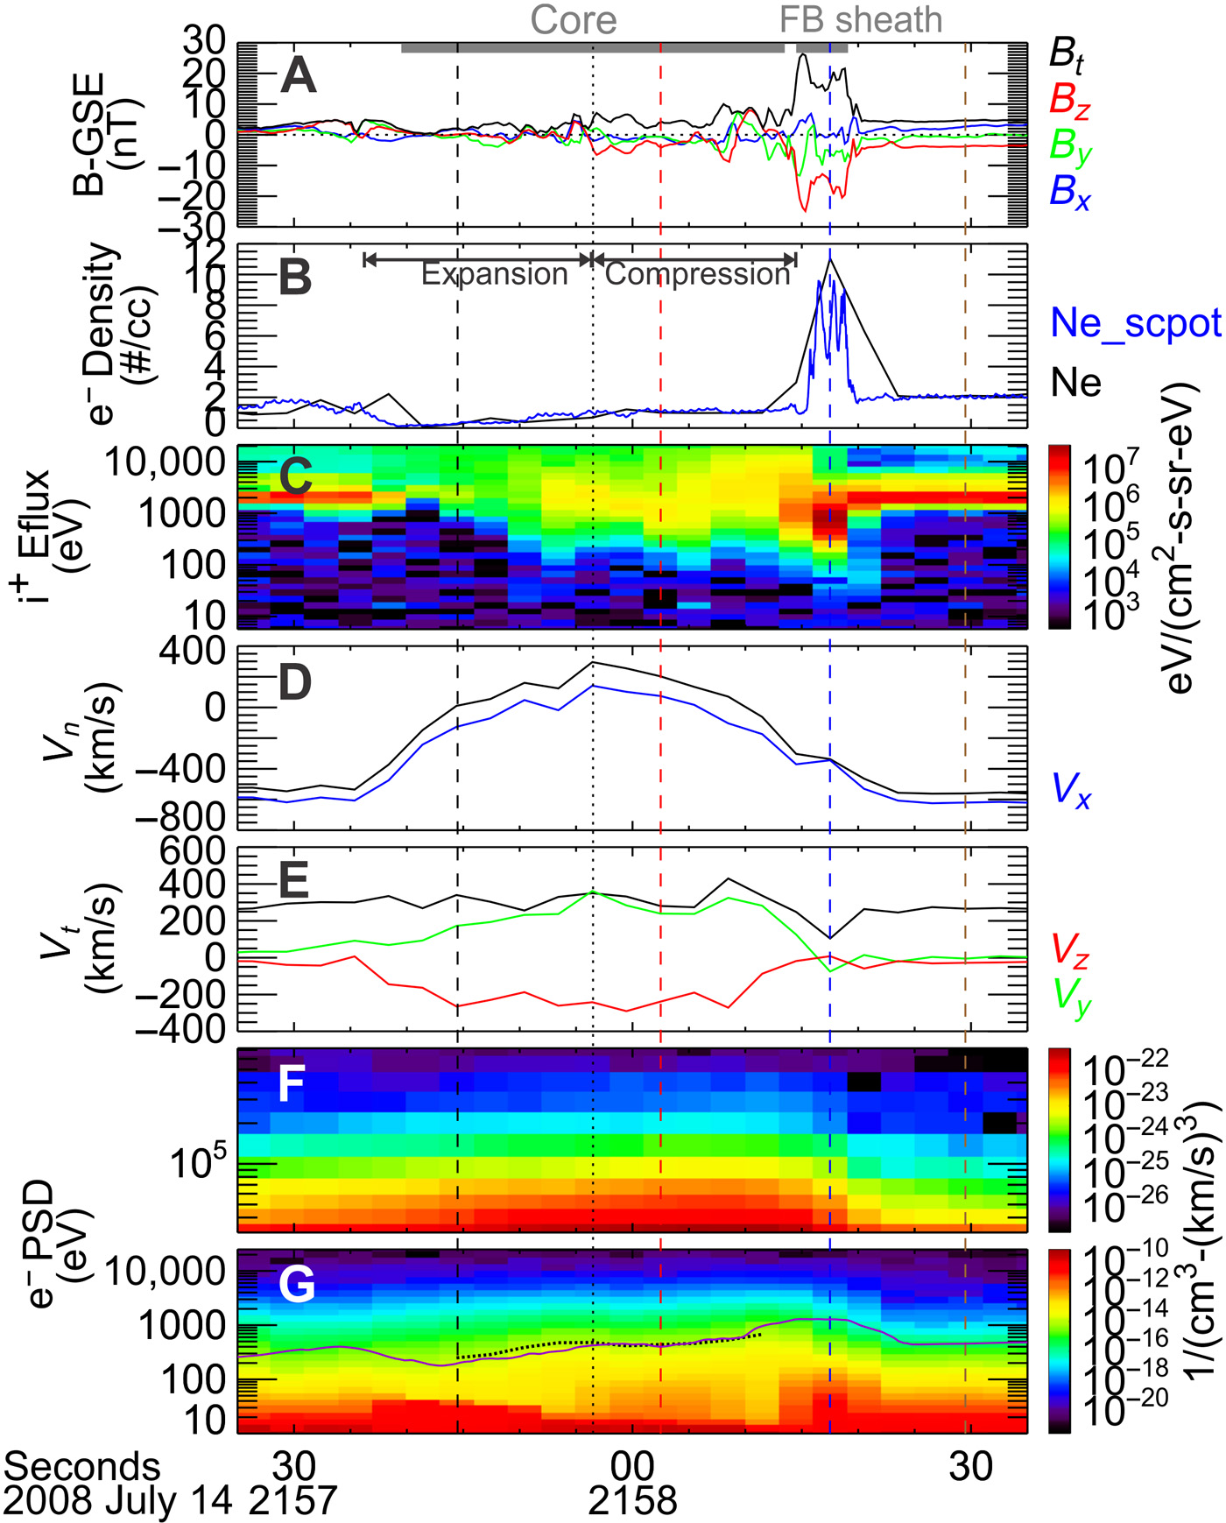
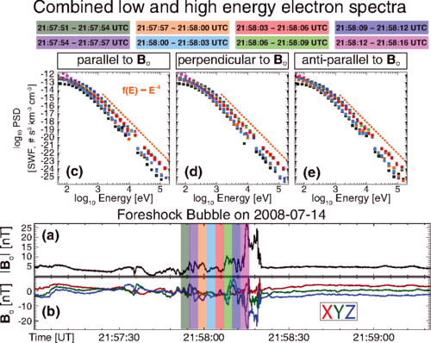
Foreshock Transients & Electron acceleration
See also: Turner et al. 2018; Liu et al. 2019; Shi et al. 2023,2025 ; Tonoian et al. 2023; Kamaletdinov et al. 2024; Li et al. 2025; Oka et al. 2025
~300 KeV electrons
Wilson III L. et al. 2016 | PRL
~200 KeV electrons
Liu T. et al. 2019 | Science Adv.
Notes:
Lynn Wilsson: Shock Drift Acceleration up to 300 KeV, non local acceleration that can then get even further accelerated at the shock
Terry Liu : Betatron acceleration on Foreshock transients = Making Qpar shock more effective in accelerating particles

Slide 24
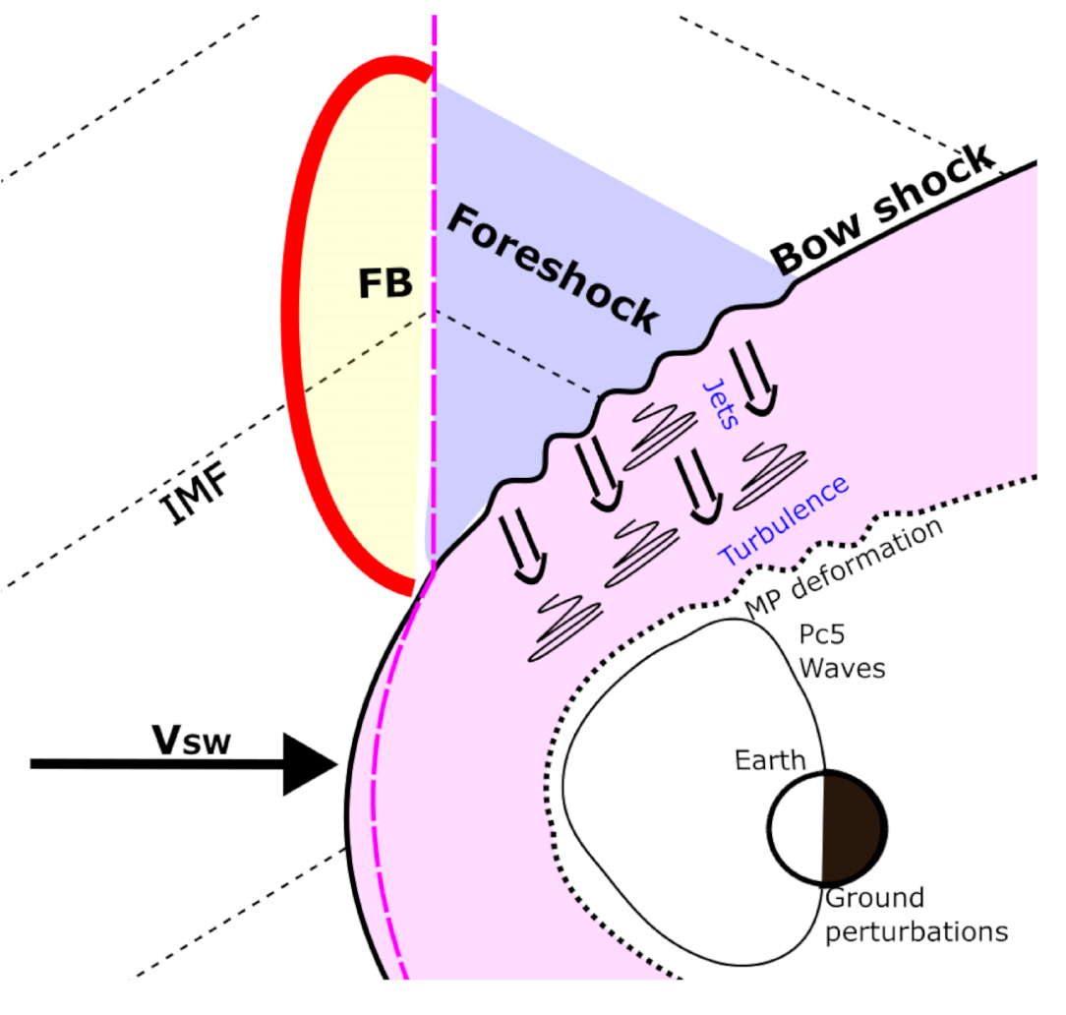
Transients with most notable impact
How many: ~several per day!
How big: up to ~10s of Re
HFAs
Discontinuities intersects BS and E (-V X B) points towards the sheet, ions pile up and thermalized
FBs
Discontinuity & foreshock backstream ions concentrate and create a bubble that expands into the SW
Zhang et al., (2022)
Hot Flow Anomalies (HFAs)
Foreshock Bubbles(FBs)
Primož K. et al. (2024)
TUMS (Transient Upstream Mesoscale Structures)
Notes:
Hot Flow Anomalies : when an IMF directional discontinuity intersects the bow shock and the convection electric field (−V X B) points towards the sheet on at least one side
Foreshock Bubbles: form due to the interaction of IMF rotational discontinuities with the back streaming ions in the foreshock region. If the convection electric field on the upstream of the rotational discontinuity has a larger earthward component than the electric field on its downstream side, foreshock ions become concentrated on the upstream side.

Slide 25
Foreshock Transients & Electron acceleration
See also: Turner et al. 2018; Liu et al. 2019; Shi et al. 2023,2025 ; Tonoian et al. 2023; Kamaletdinov et al. 2024; Li et al. 2025
~300 KeV electrons
Wilson III L. et al. 2016 | PRL
~200 KeV electrons
Liu T. et al. 2019 | Science Adv.
Notes:
Lynn Wilsson: Shock Drift Acceleration up to 300 KeV, non local acceleration that can then get even further accelerated at the shock
Terry Liu : Betatron acceleration on Foreshock transients = Making Qpar shock more effective in accelerating particles

Slide 26
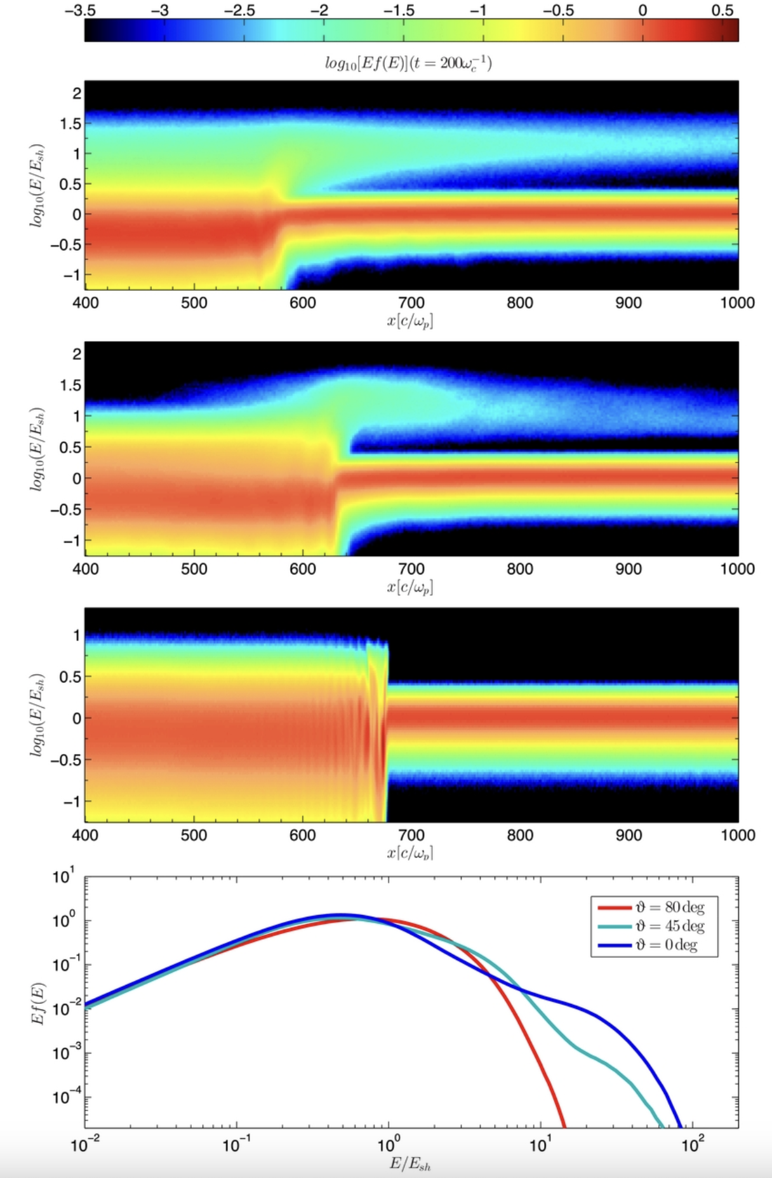
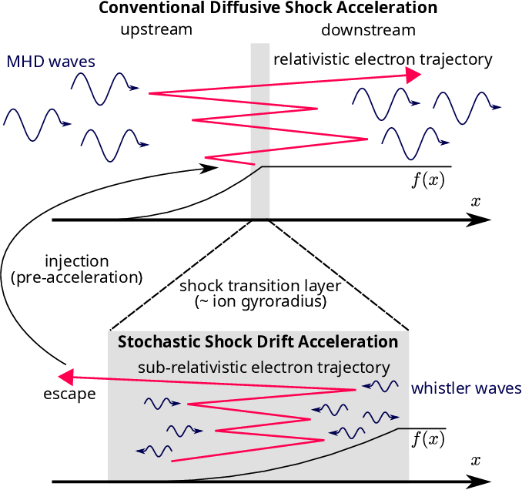
Acceleration at Qpar and Qperp shocks
Qpar shock (DSA)
Oblique shock
Qperp shock
(SDA/SSDA)
ions
Caprioli and Spitkovsky 2014
Amano et al. 2020 | PRL
Notes:
Shock Drift Acceleration = Not enough to get relativistic
Diffusive Shock Acceleration = Good, but requires injection.
SSDA tried to solve this by introducing whistler activity

Slide 27
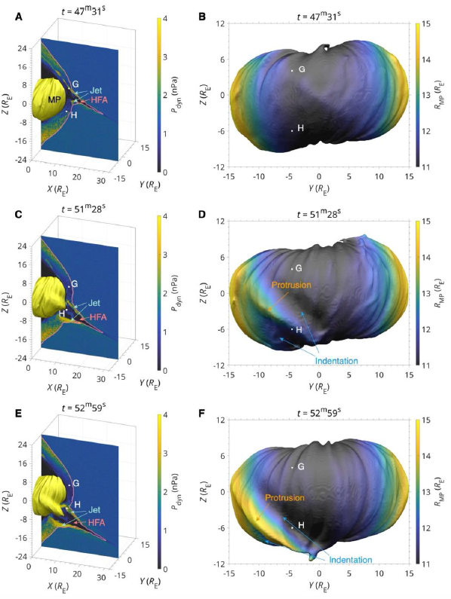
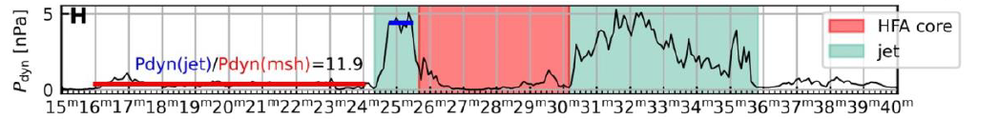
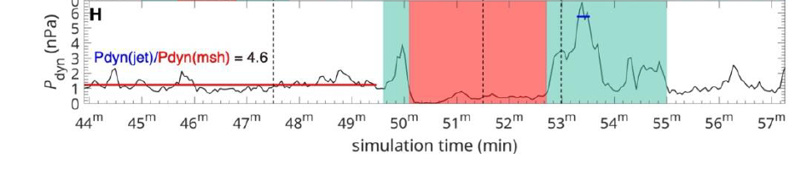
HFAs effect on Magnetosphere
See also: Shen+2018, Wang+ 2021, Yang+2023, Guo+ 2023, Xu+ 2024, Sibeck+2025
Localized dynamic enhancements (jets) at the edges
(stuff move inwards)
Core density depletion effects
(stuff move outwards)
Leads to magnetosheath restructuring
Spatial extent: ~10s of Re
Duration: ~10s of minutes
MMS
3D Hybrid Simulations
HFAs associated to jets (Archer+2014, Zhou+ 2023, Raptis+ 2025)
Zhou Y, et al., 2025 (Under Review)

Slide 28
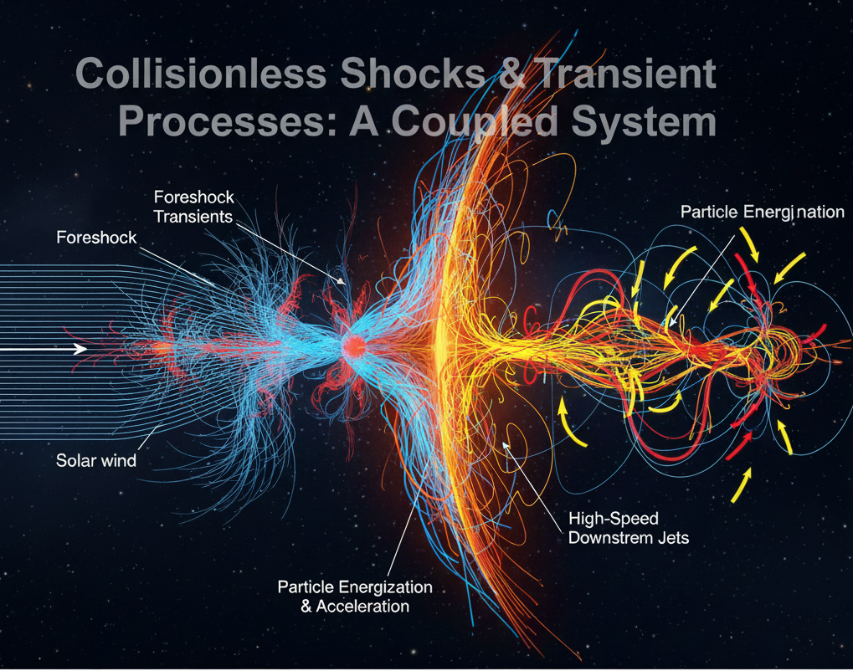
Shocks and upstream/downstream environments
Studying transients as individual components can be problematic.
The bow shock decide what the foreshock and magnetosheath are doing.
Whether we see transients or not is also controlled by the shock.
Transients both upstream and downstream are connected
Gemini trying to illustrate this.
Credits: Google’s Gemini (Still not as good as Florian’s sketch…)
Notes:
5minutes

Slide 29
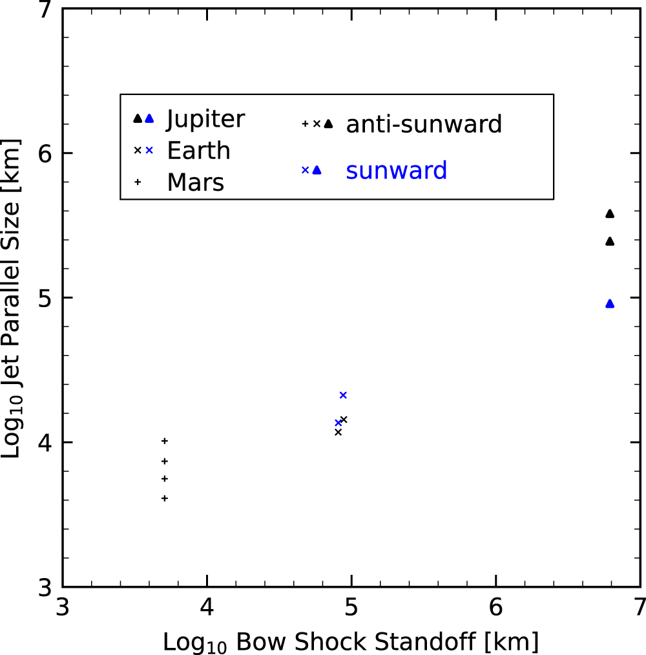
Transients Scaling Across Different Systems
HFA Scaling
Jet Scaling
Zhou, et al. 2024
Adapted form Valek et al. (2017) | JGR
Important point

