Slide 1
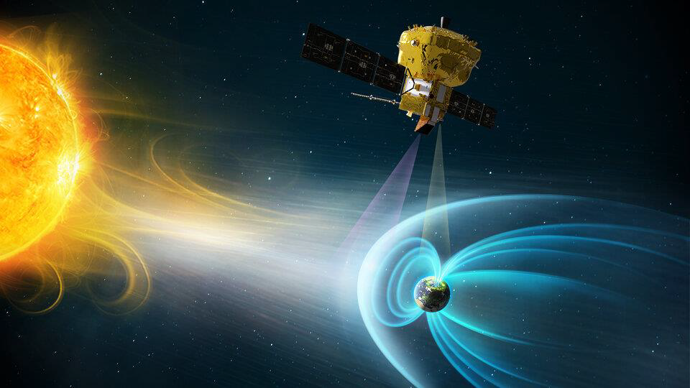
Dayside Transients and Their Effect on the Magnetosphere
Savvas Raptis
Johns Hopkins University Applied Physics Laboratory (JHU/APL), Laurel, MD, USA
Thanks to friends and collaborators: Ahmad Lalti, Yufei Zhou, Drew Turner, Terry Liu, Martin Lindberg, Damiano Caprioli, Imogen Gingell, Ying Zou, Ivan Vansko, David Sibeck, Primoz Kajdic, Adnane Osmane, Ian Cohen, Philippe Escoubet ++ more
Credits: ESA

Slide 2
High Level Intro

Slide 3
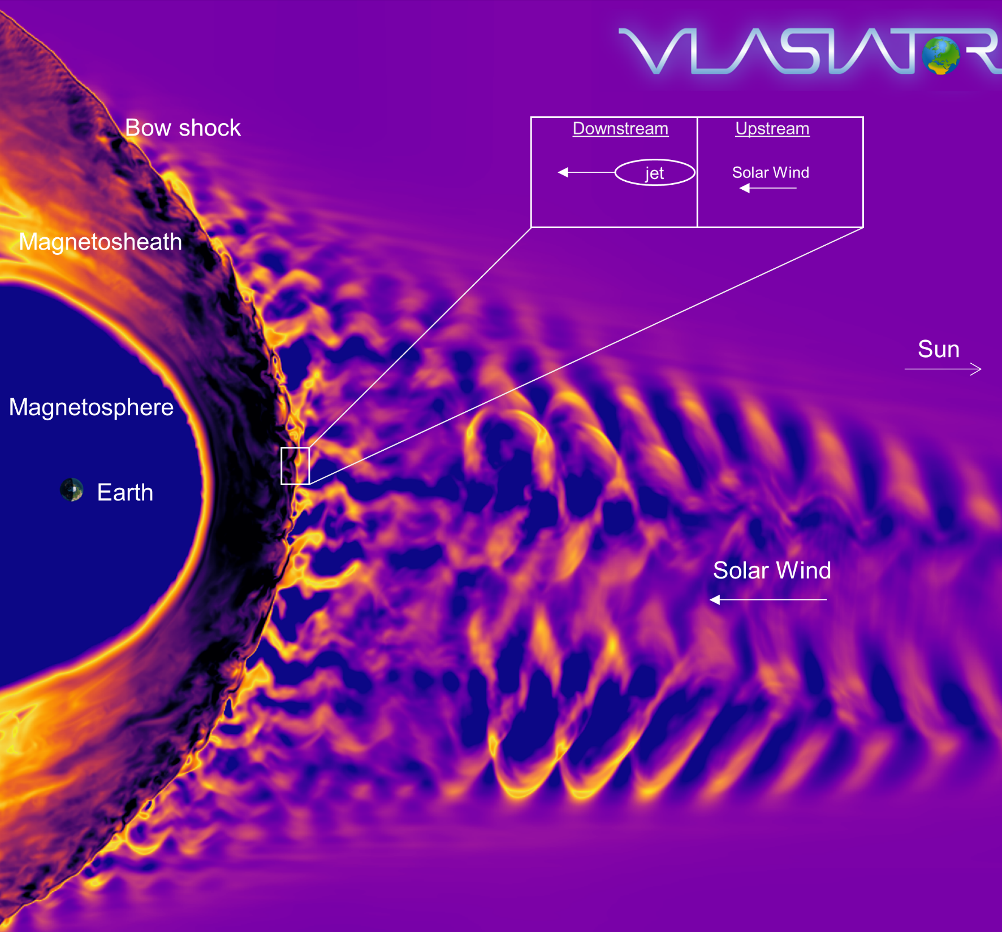
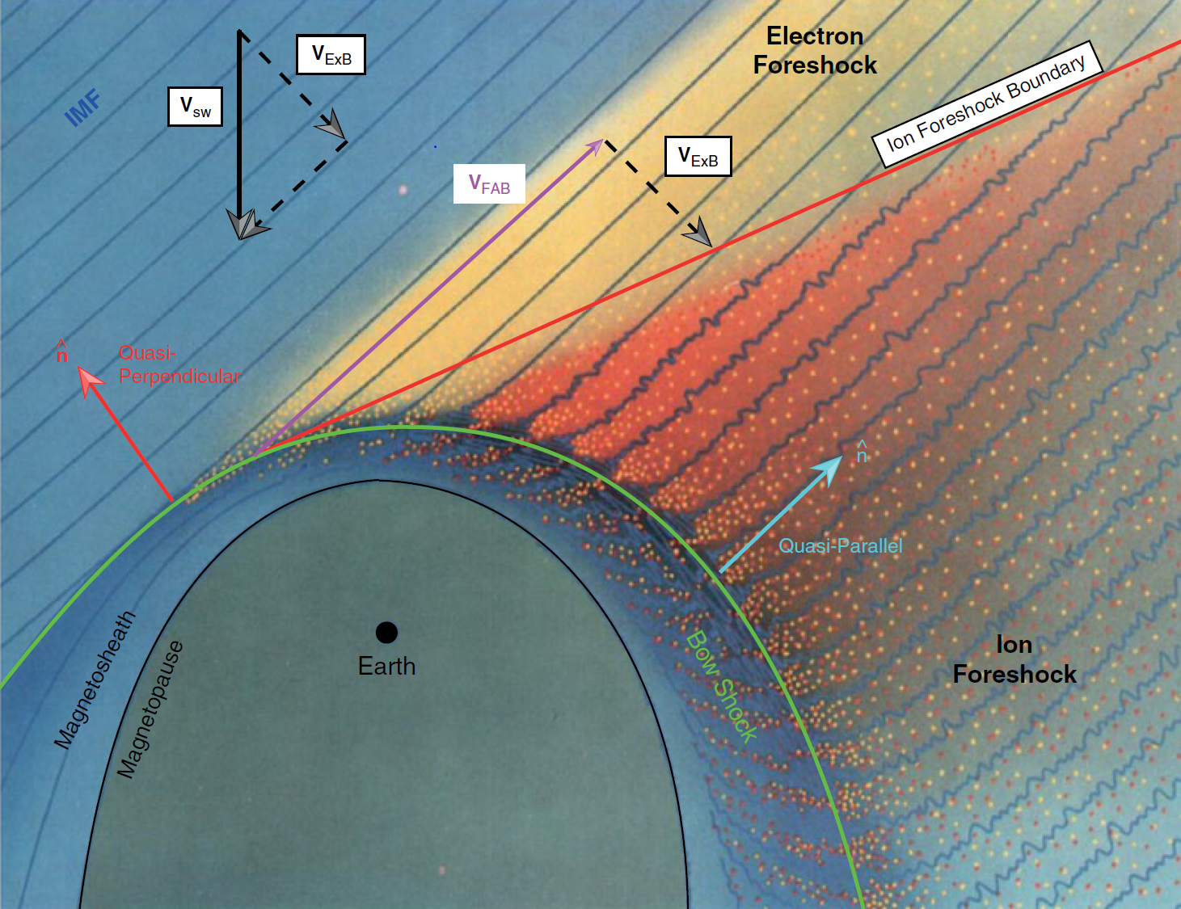
Earth’s magnetosphere & shock environment
Courtesy of M. Palmroth, U Helsinki
L. B. Wilson (2016)

Slide 4
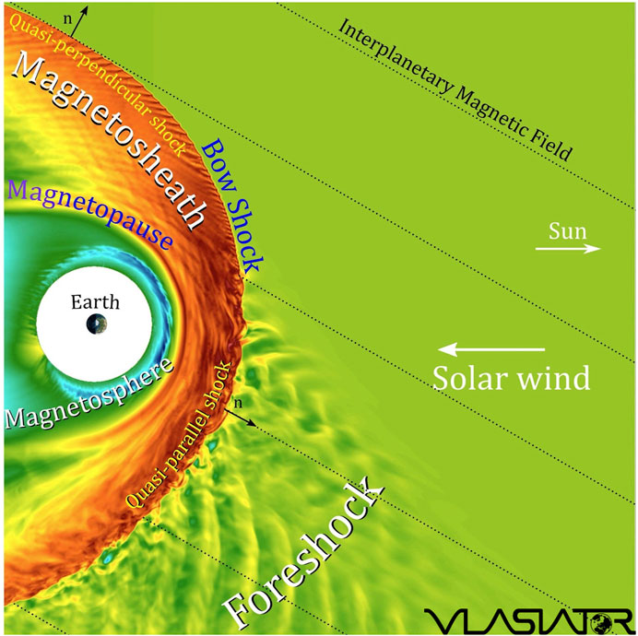
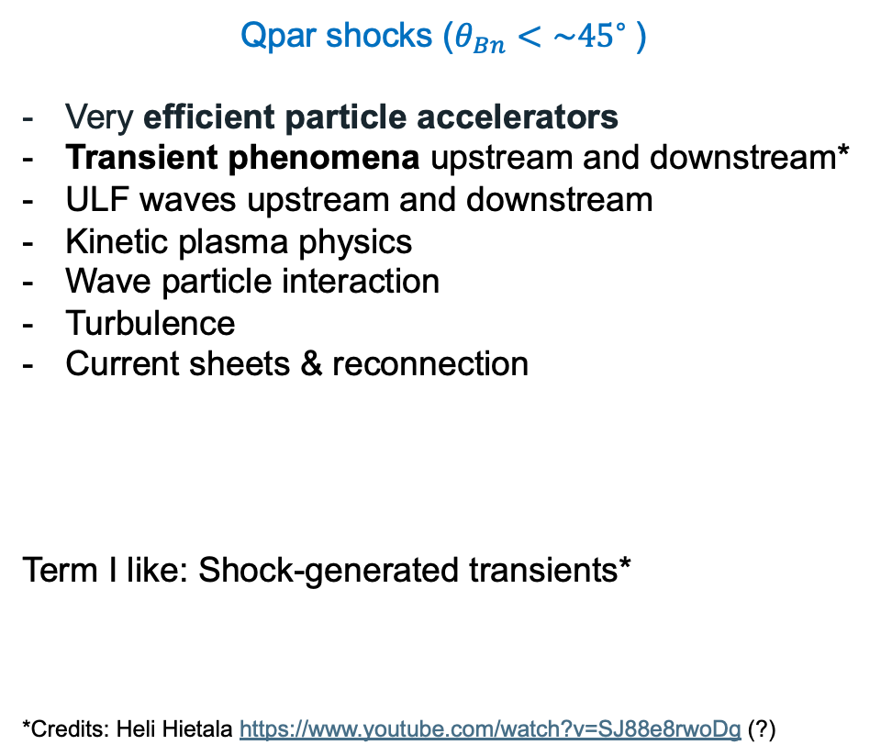
Earth’s Qpar bow shock and foreshock
Qpar shocks ($θ_{Bn}<\sim {45}^{∘}⁡$)
Very efficient particle accelerators
Transient phenomena upstream and downstream*
ULF waves upstream and downstream
Kinetic plasma physics
Wave particle interaction
Turbulence
Current sheets & reconnection
Term I like: Shock-generated transients*
*Credits: Heli Hietala https://www.youtube.com/watch?v=SJ88e8rwoDg (?)

Slide 5
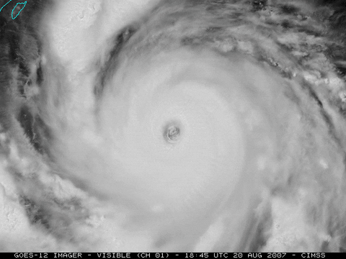


Transient events – weather
Hurricanes
Rain
Snowstorms

Slide 6
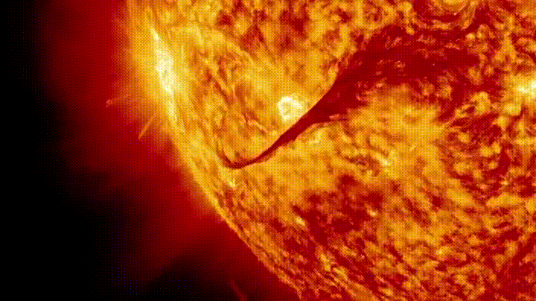
Transient events – weather
CMEs
Rain
Snowstorms

Slide 7
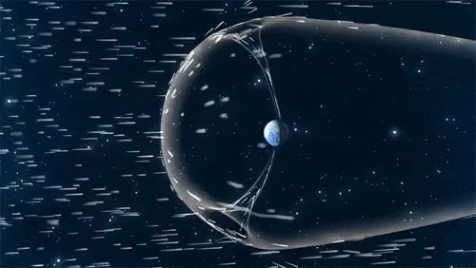
Transient events – weather
CMEs
Rain
High speed streams, discontinuities
Credits : NASA

Slide 8
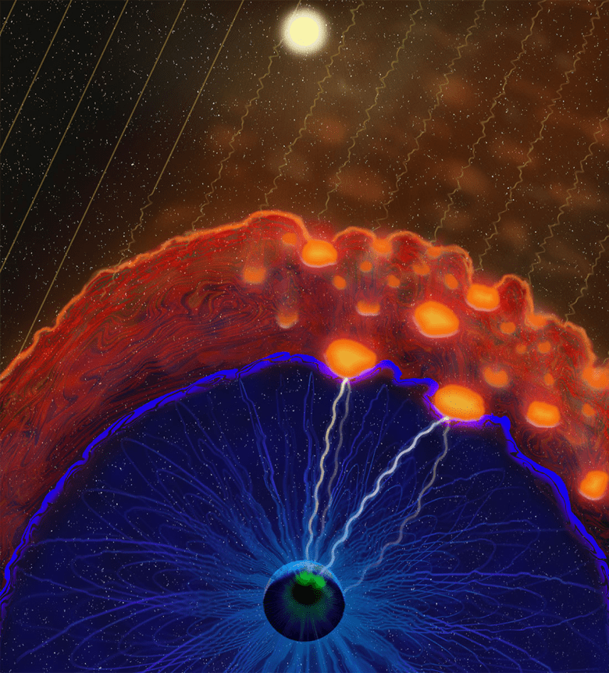
Transient events – space weather
CMEs
Foreshock transients & plasma jets
High speed streams, discontinuities
Credits : NASA
Credits: Vuorinen et al. (2022) https://eos.org/features/space-raindrops-splashing-on-earths-magnetic-umbrella

Slide 9
Transients and their effects

Slide 10

What is a Dayside Transient?
Transient phenomena are events that disrupt the steady-state plasma conditions, occurring temporarily and introducing dynamic changes to the physical system
Global (Solar):
Coronal Mass Ejection (CME)
High-Speed Stream (HSS)
Pressure Pulse
Fluid scale:
Flux Transfer Event (FTE)
Magnetopause (bursty) Reconnection
Mesoscale:
Hot Flow Anomalies (HFAs)
Foreshock Bubbles (FBs)
Magnetosheath High Speed Jets (HSJs)
Kinetic:
ULF waves
Shocklets
SLAMS
Figure adapted from Krämer et al., 2025, Credits: Florian Koller
←New review paper about high-speed jets!

Slide 11
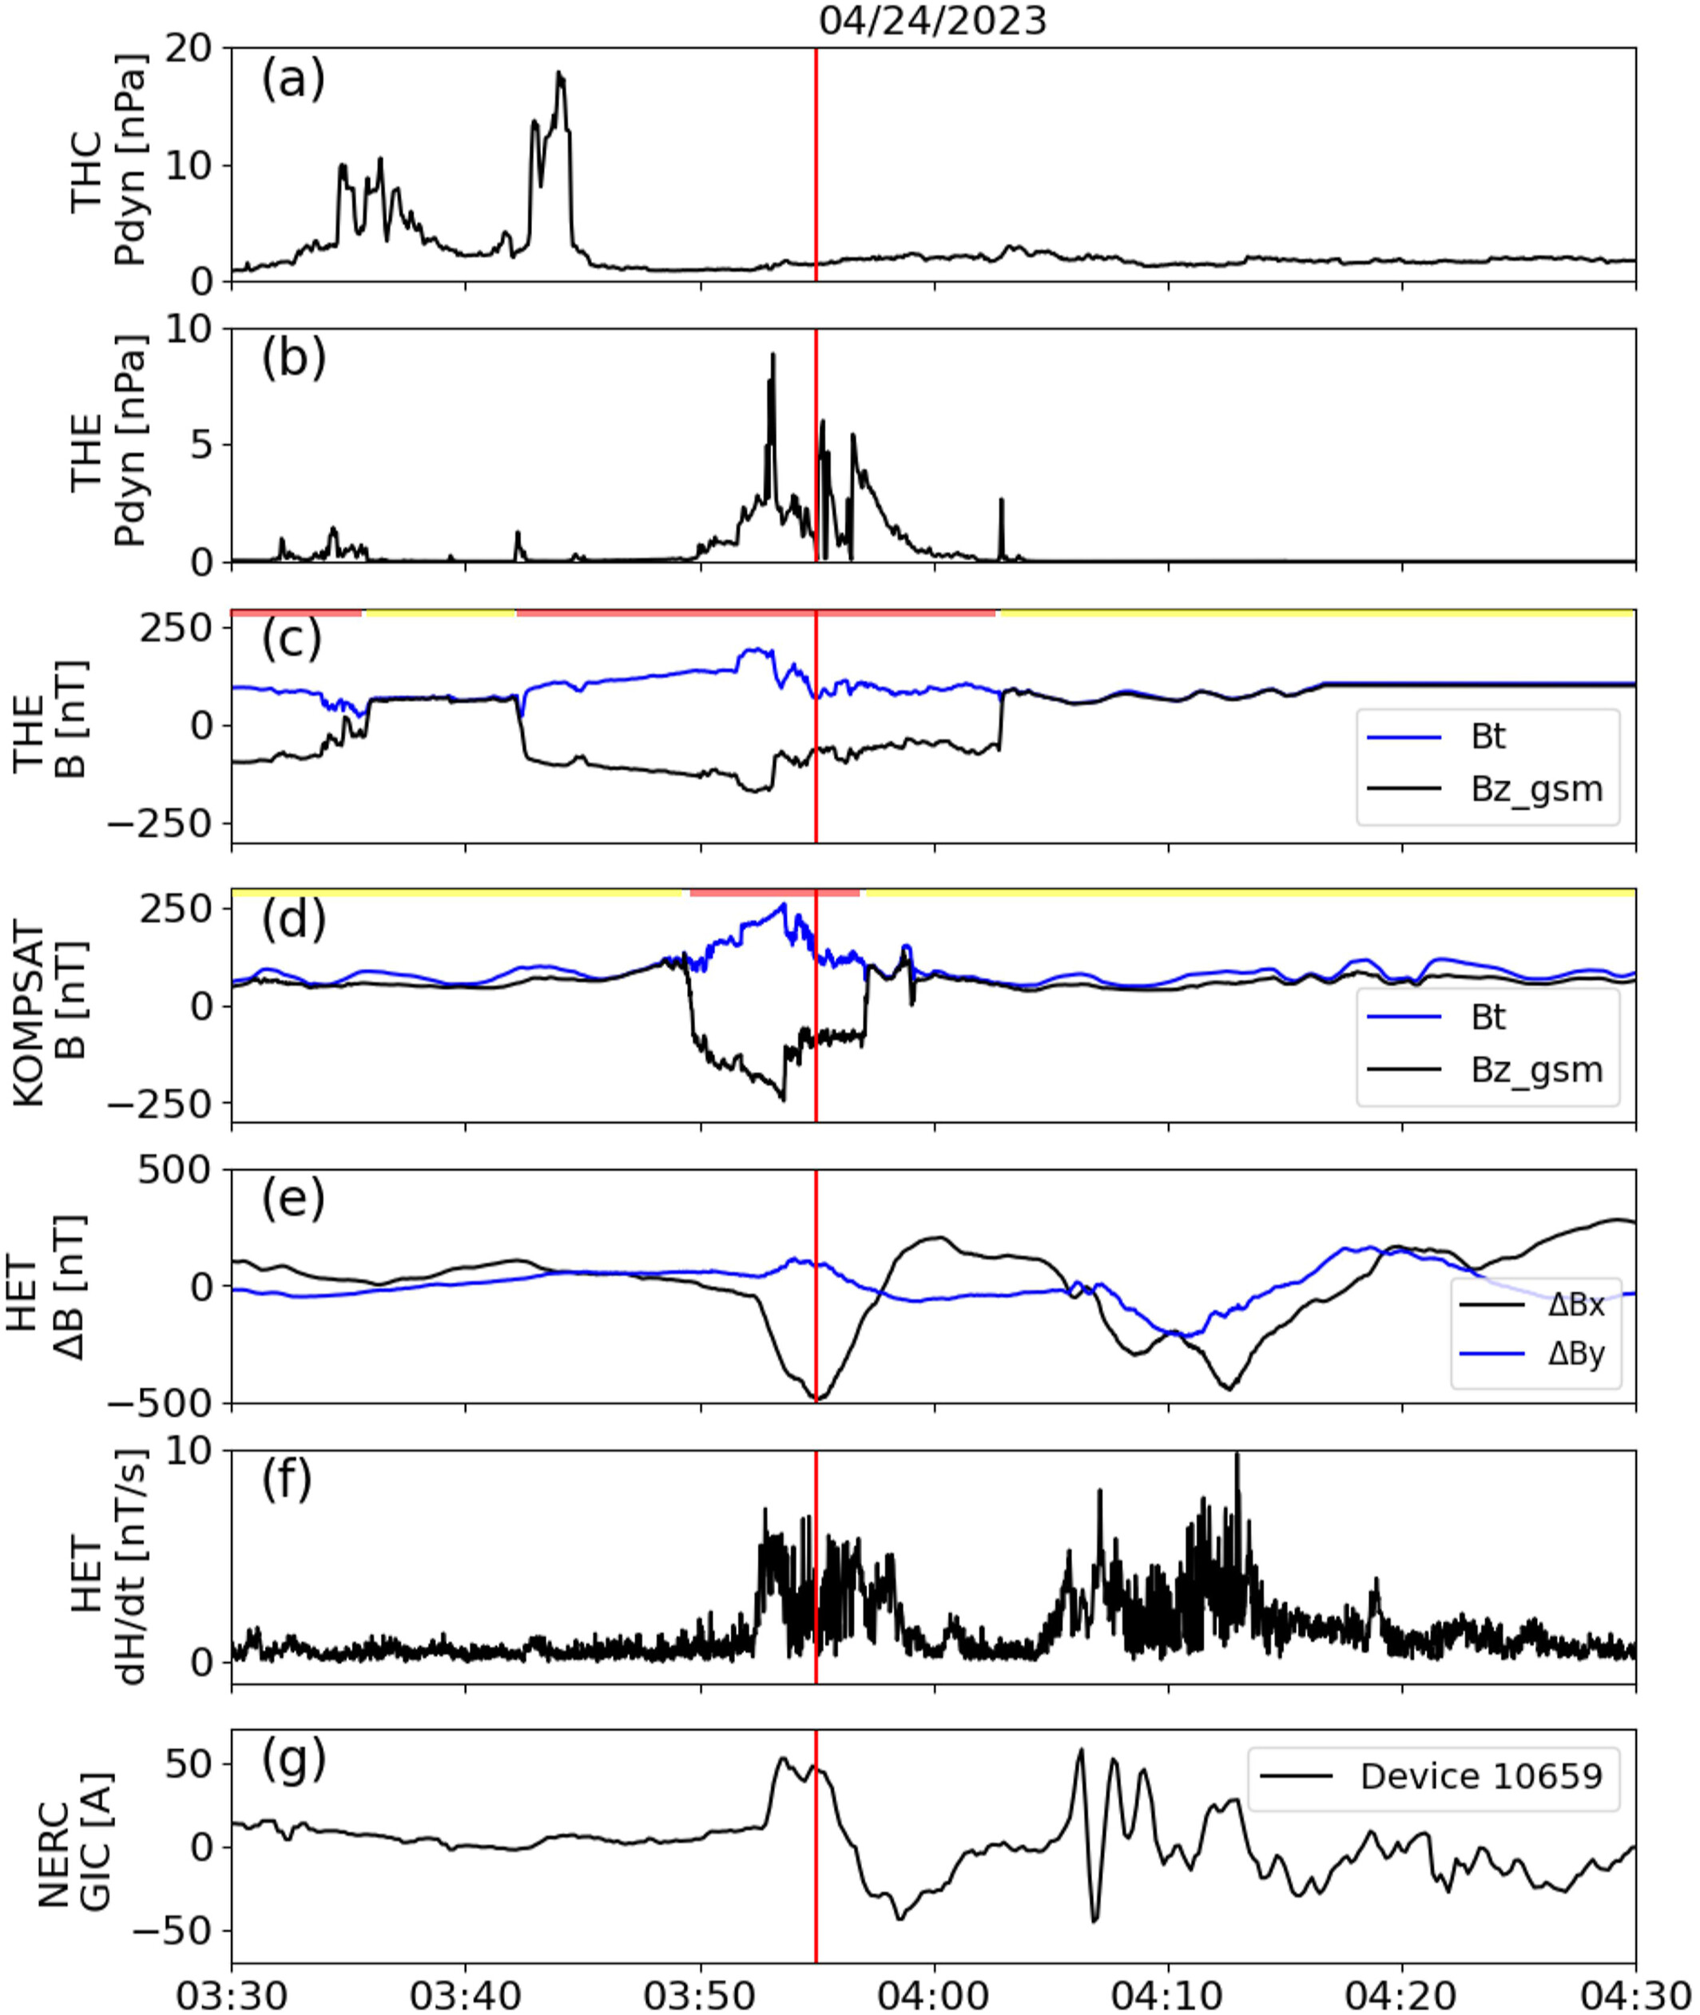
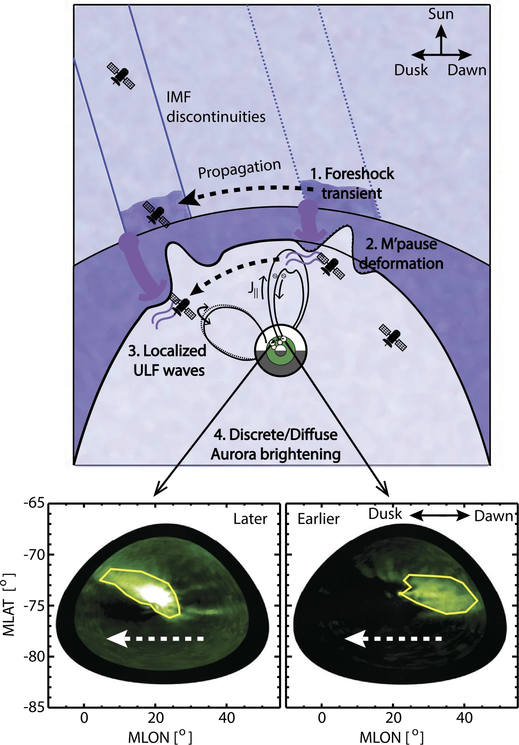
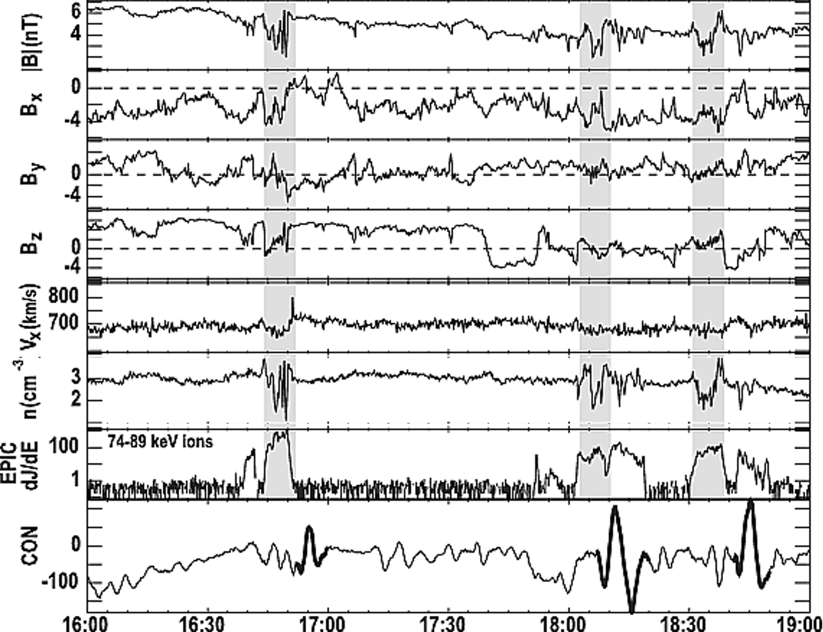
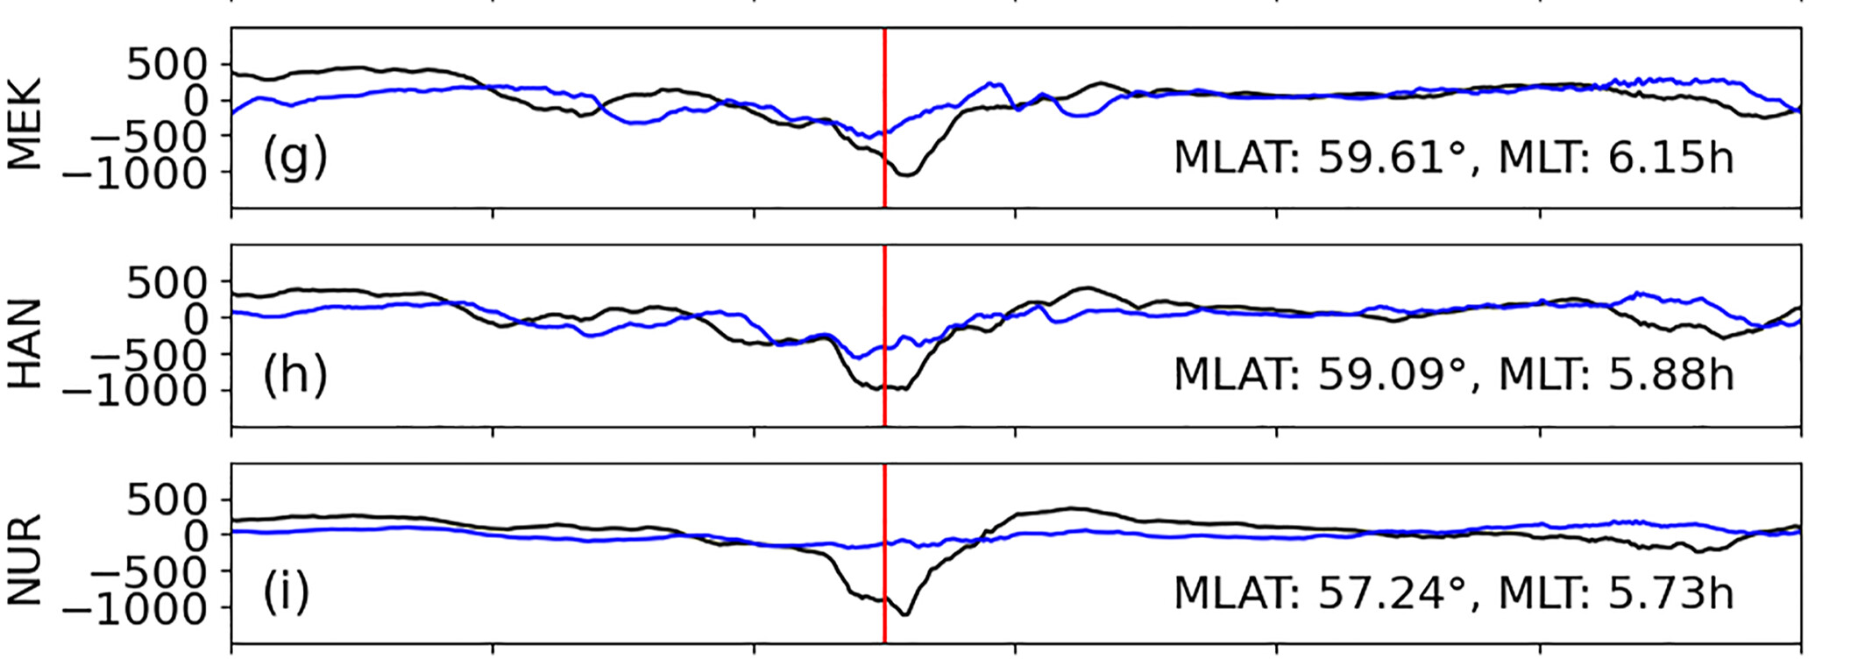
Effects on Inner magnetosphere and Ionosphere
Murr+ 2003
Can shock-generated transients cause ground perturbations?
How do shock-generated transients drive localized aurora brightening?
Liu+ 2024
Shen+2018, Wang+ 2018

Slide 12
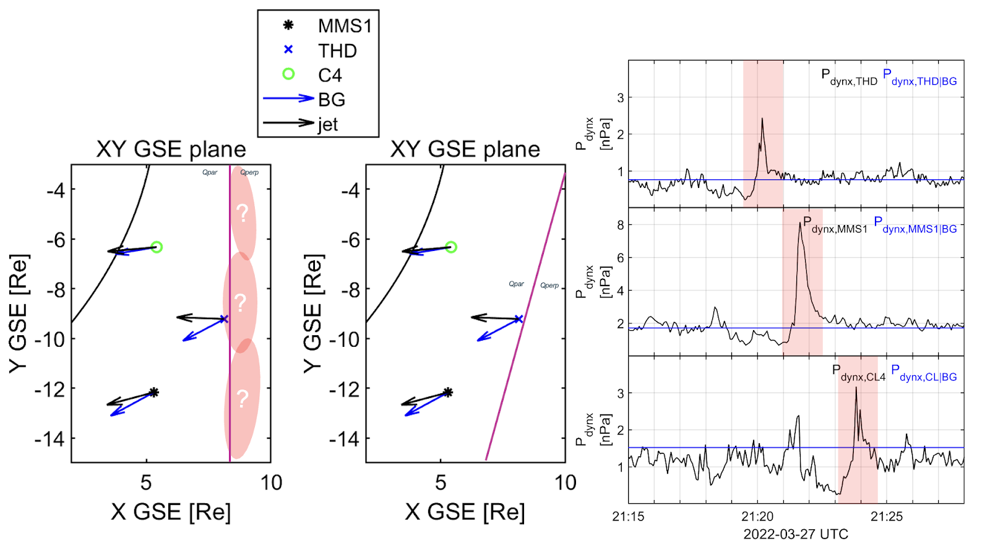
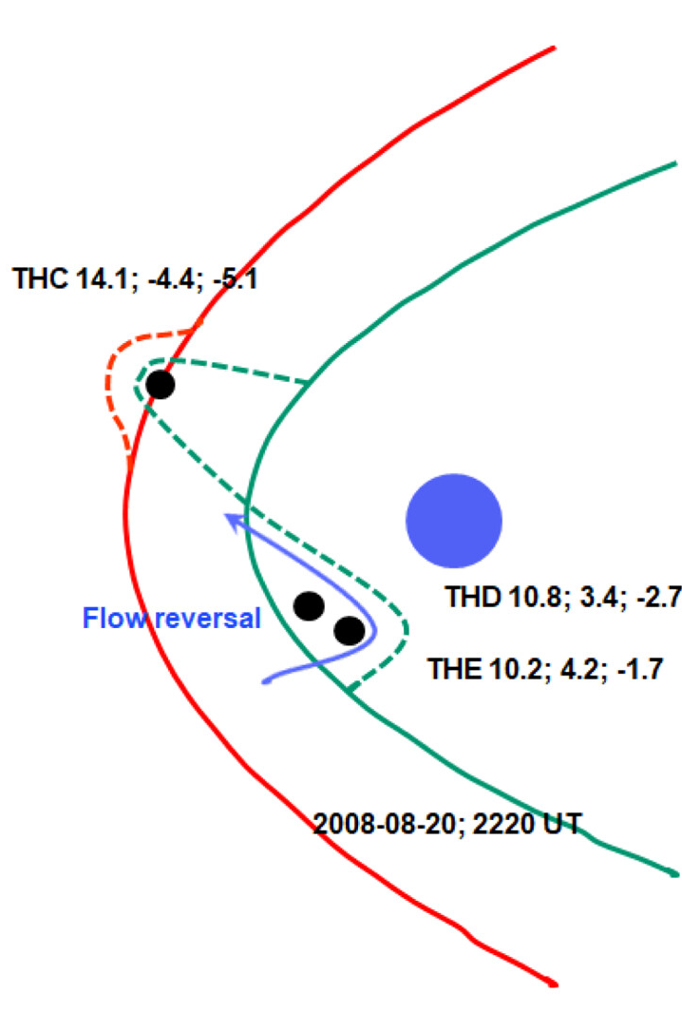
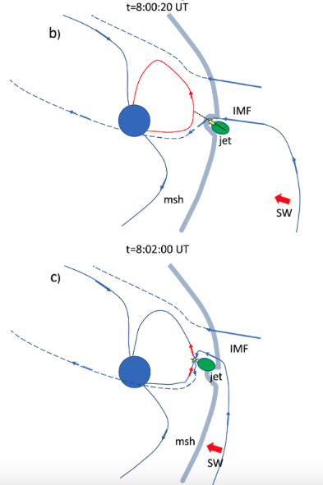
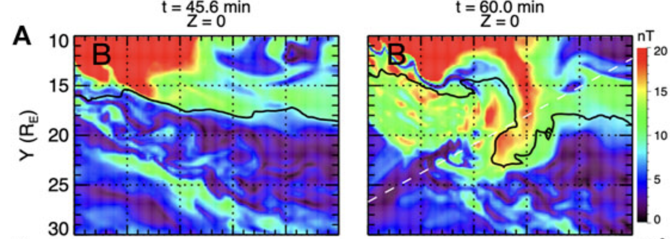
Effects of localized transients in Dayside Magnetosphere
Němeček+ 2023
How do localized shock-generated transients interact with Earth’s magnetopause?
Jets can cause MP displacement that exceed 4 R_{E} from the predicted location
Nykyri+2019
Can transient localized processes drive and adapt MP bursty reconnection?
Hietala+ 2018, Vuorinen+ 2021
HFAs can cause displacements of ~6 R_{E}
Wang+ 2021

Slide 13
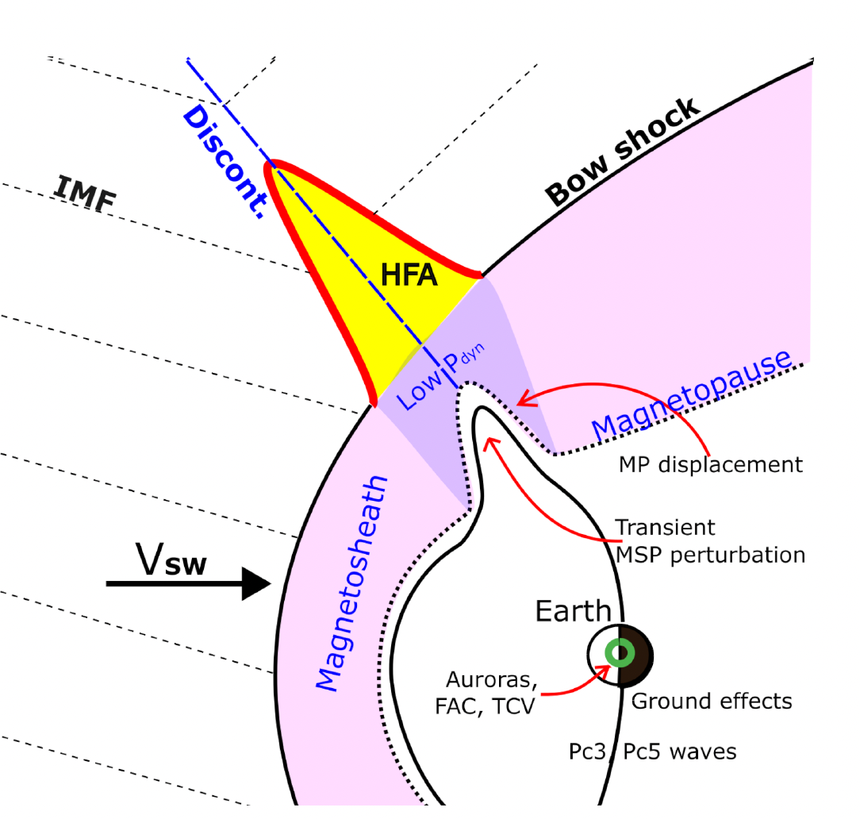
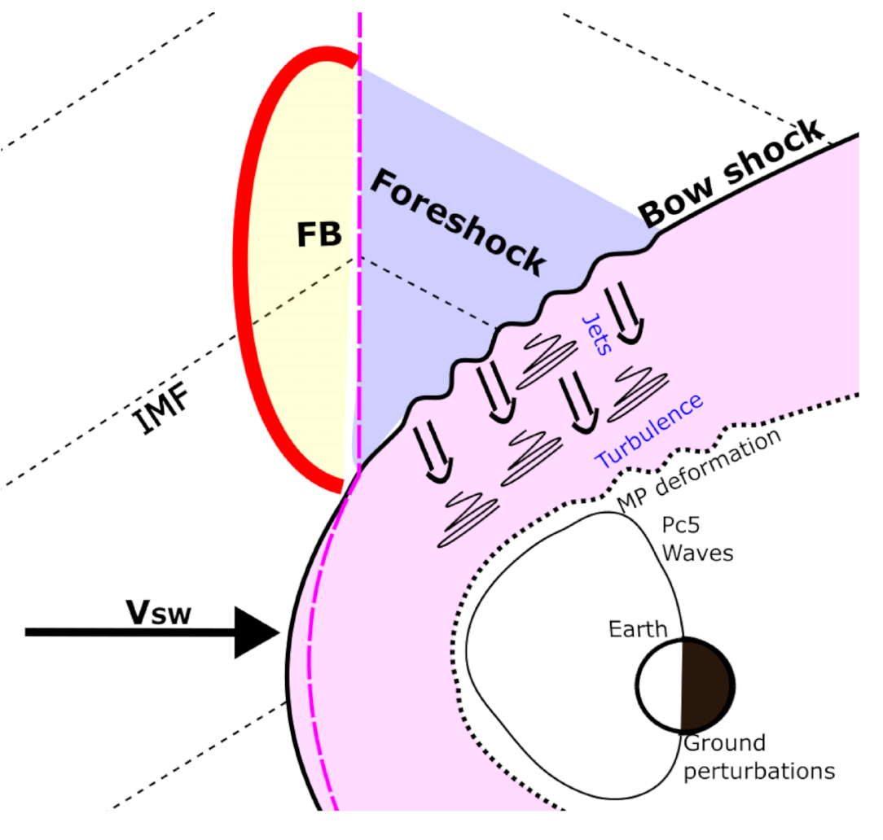
Transients with most notable impact
How many: ~several per day!
How big: ~10s of Re
HFAs
Discontinuities intersects BS and E (-V X B) points towards the sheet, ions pile up and thermalized
FBs
Discontinuity & foreshock backstream ions concentrate and create a bubble that expands into the SW
Zhang et al., (2022)
Hot Flow Anomalies (HFAs)
Foreshock Bubbles(FBs)
Primož K. et al. (2024)
TUMS (Transient Upstream Mesoscale Structures)

Slide 14
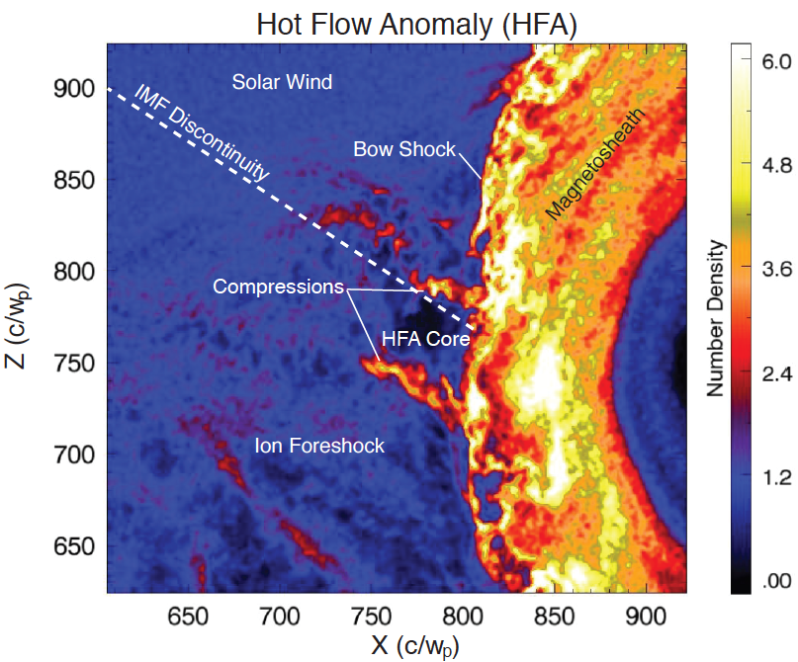
The anatomy of an HFA
How many: ~several per day!
How big: ~10s of Re
Crater-like B-field and IMF discontinuity
Upstream
shock
Solar wind beam disrupted
Density compressions and cavity
Upstream
shock
Strong plasma flow
deflections in core
Hot Flow Anomalies (HFA)
Figure by Nick Omidi
Kajdič+ (2024)
Superheated core plasma
Discontinuity intersects the bow shock and the convection electric field
(−V X B) points towards the sheet on at least one side.
Figure by Drew Turner

Slide 15
Recent Results

Slide 16
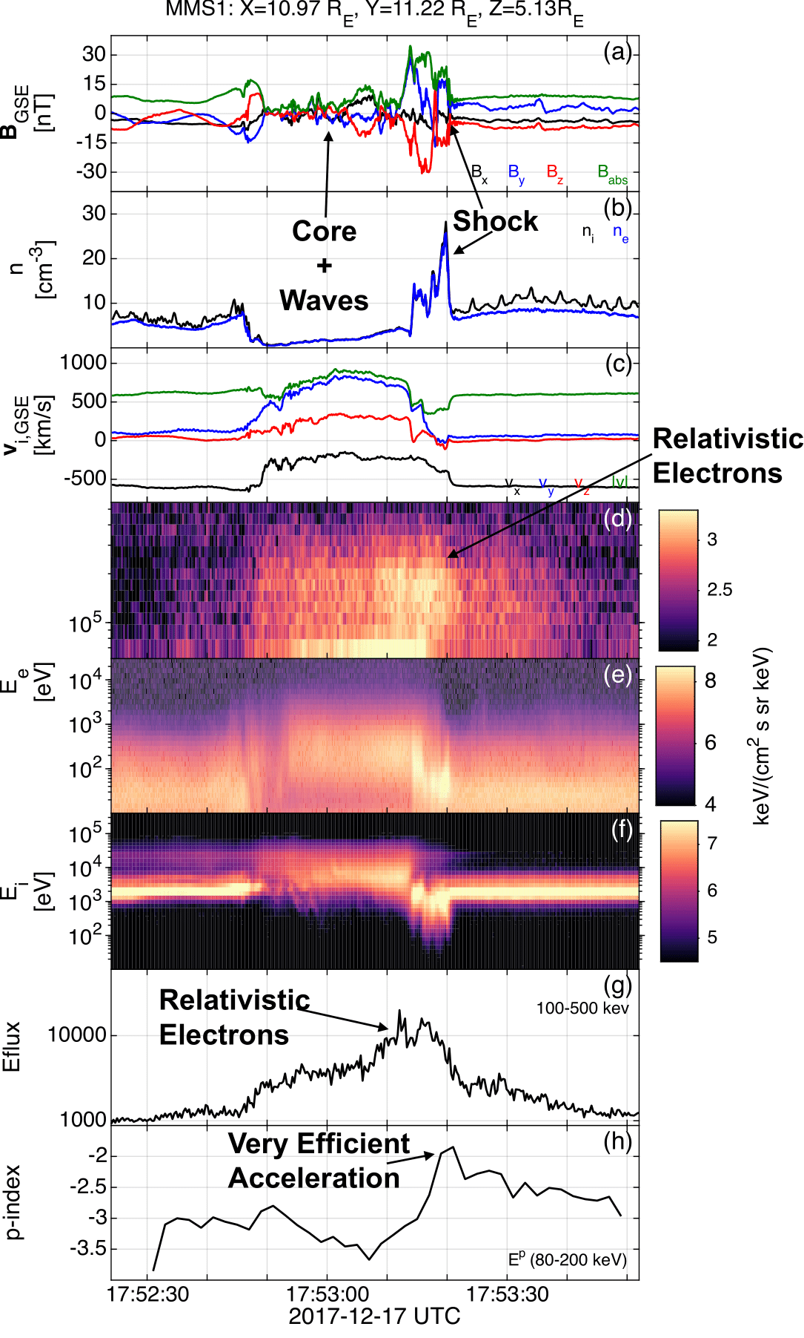


HFAs and FBs are amazing particle accelerators
Solar wind
Jets forming
Core
Magnetosheath
Relativistic electrons
Raptis et al.2025 NatComm
Note: Planetary bow shock plays a key role here
Raptis et al.2025 ApJL (preliminary arXiv)

Slide 17
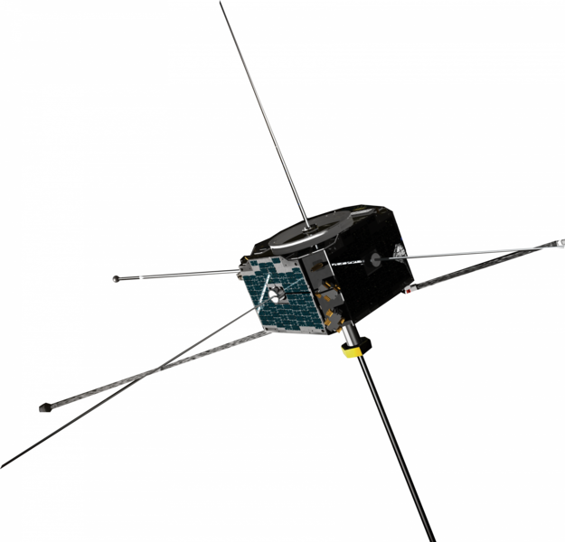
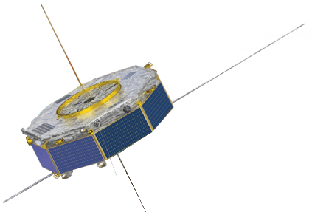


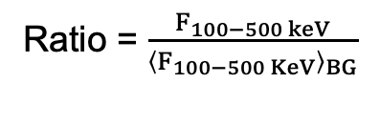
Transients & Reinforced Shock Acceleration
(A)
Discontinuity (SW) ARTEMIS
Transient (FS) MMS
(B)
Transient (FS) Cluster
Transient (MSH) MMS
Coronal Hole SW
V> 500 km/s
200 → 300 keV
~1 keV
>500 keV
Ratio = $\frac{F_{100−500 keV}}{{\left\langle F_{100−500 KeV}\right\rangle }_{BG}}$
Ratio = $\frac{F_{1−5 keV}}{{\left\langle F_{1−5 KeV}\right\rangle }_{BG}}$
Max flux ratio
Max flux ratio
SW – ARTEMIS/THEMIS
Foreshock - MMS
Magnetosheath – CL/MMS
Fast SW seeding ~keV particles
: Raptis+ 2025 (NatComm) - Revealing an Unexpectedly Low Electron Injection Threshold via Reinforced Shock Acceleration
: Raptis+ 2025 (ApJL) - Multi-Mission Observations of Relativistic Electrons and High-Speed Jets Linked to Shock Generated Transients

Slide 18
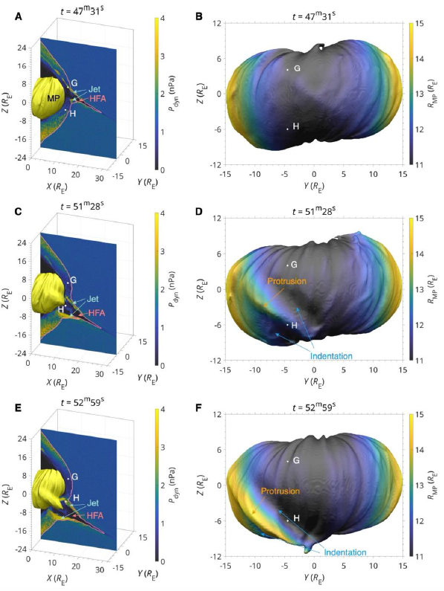
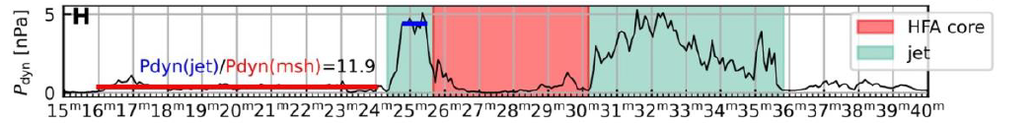
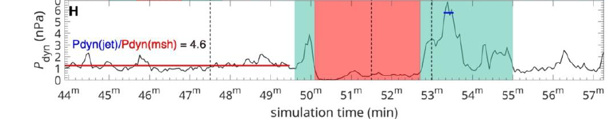
HFAs Restructuring the Entire Magnetosheath
Localized dynamic enhancements (jets) at the edges
(stuff move inwards)
Core density depletion effects
(stuff move outwards)
Leads to magnetosheath restructuring
Spatial extent: ~10s of Re
Duration: ~10s of minutes
MMS
3D Hybrid Simulations
Zhou Y, Guo J. et al., 2025 (Submitted)

Slide 19
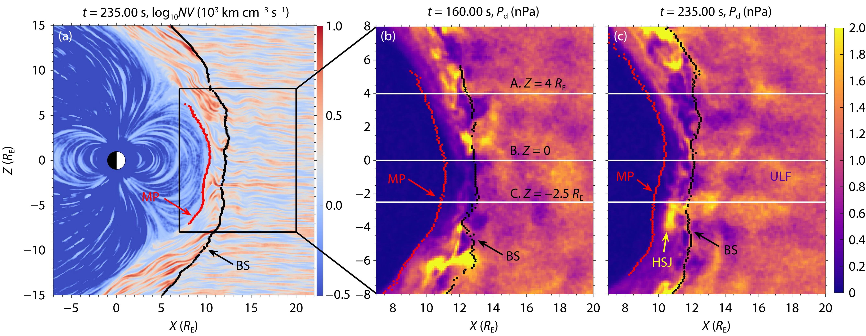
Effects of high-speed jets to MP/BS
Yang et al. (2023 - EPP)
Other relevant works: Ng et al., (2023 | GRL), Yang et al. (2023 | EPP), Guo et al. (2023 | EPP), Guo et al., (2024 | GRL), Ouyang et al., 2025

Slide 20
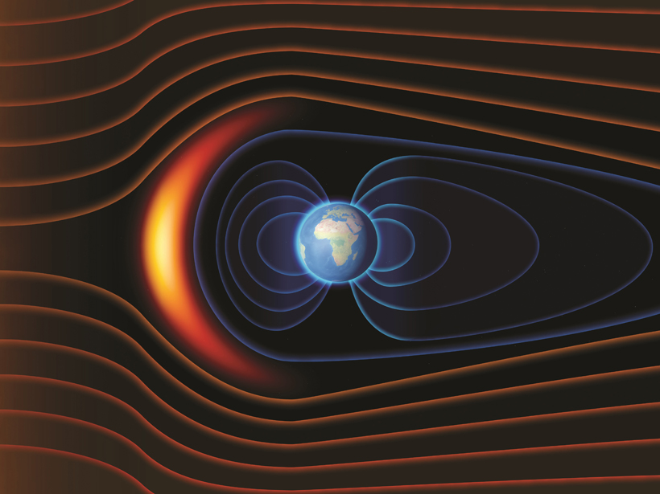
Key message: Transients can strongly disrupt dayside magnetosphere and its boundary surfaces!
Credit: © Naeblys/Shutterstock

Slide 21
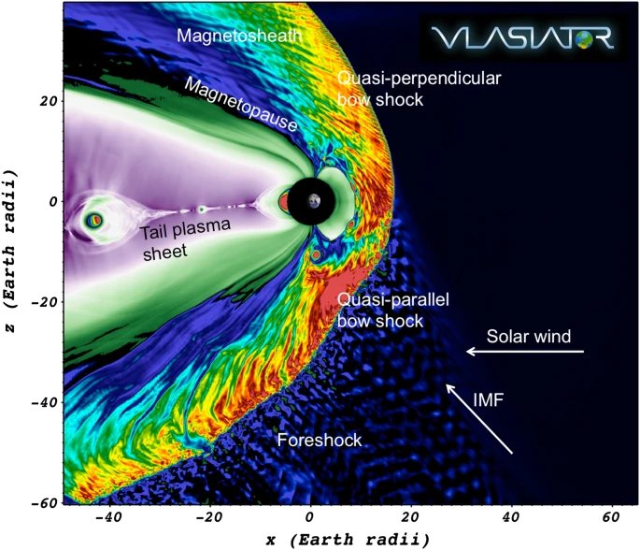
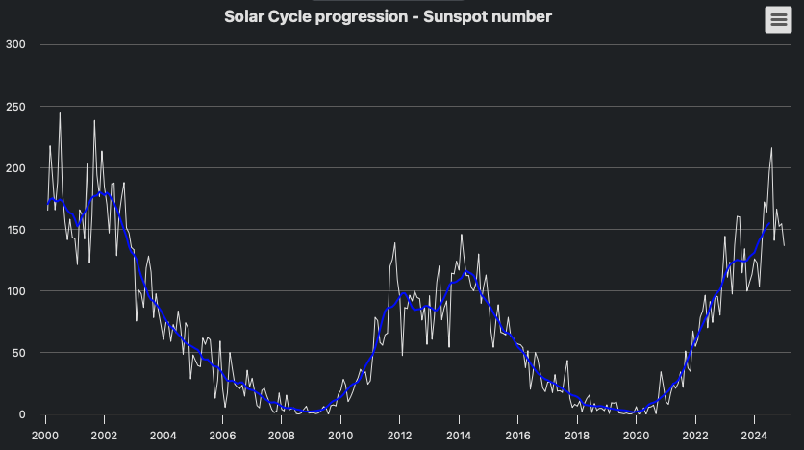




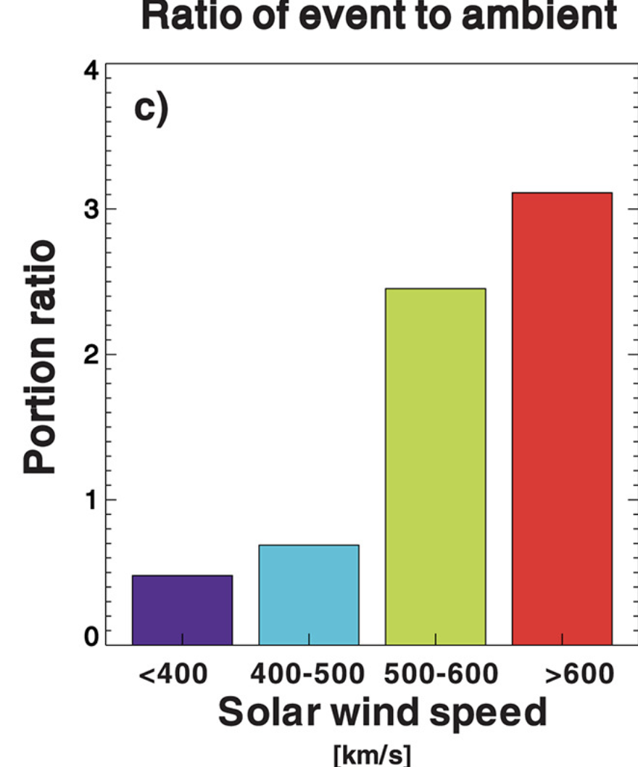
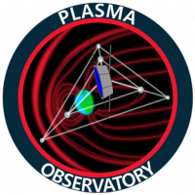
Timeliness (Bigger Picture)
Solar Cycle
We are here!
MMS
THEMIS/ARTEMIS
Sunspots
Significant developments in Hybrid/PIC simulations
Time
Reminder: More transients during fast SW conditions
Many recent and upcoming missions!
Liu+ (2017), Vuorinen+ (2023)

Slide 22
Final Words
Evaluating the global picture of these cross-scale processes is the next step
Global Magnetospheric Impact: Can we observe the global effects of large-scale transients (HFAs, FBs) across the magnetosphere? Maybe particularly dense magnetosheath jets as well?
Impulsive Penetration at the Magnetopause: Could high-speed jets lead to impulsive penetration? (e.g., Gunell et al. (2012), Karlsson et al. (2012, 2015), Dmitriev & Suvorova (2015).)
Broader Solar Transients & Their Effects: Larger solar transients (density pulses, HSSs, IP shocks etc.) will also significantly impact the dayside magnetosphere and boundary surfaces.
Reminder: Our models of BS/MP can have disagreements of 5+ Re with data
From this year, a very relevant GEM FG to keep an eye and highlight SMILE work:
FG: Multiscale Dayside Transients and their Effect on Earth's Magnetosphere (2025 - 2029; Savvas Raptis, Ivan Vansko, Imogen Gingell, Terry Z. Liu, Ying Zou)
Credits: Vuorinen et al. (2022

