Slide 1
Storm-Time Plasma Sheet: Global Convection Patterns, Bursty Bulk Flows, and Data-Driven Modeling
Savvas Raptis
APL/JHU, Laurel, MD, USA
Acknowledgments:
CGS NASA Drive Center
savvas.raptis@jhuapl.edu / https://savvasraptis.github.io

Slide 2
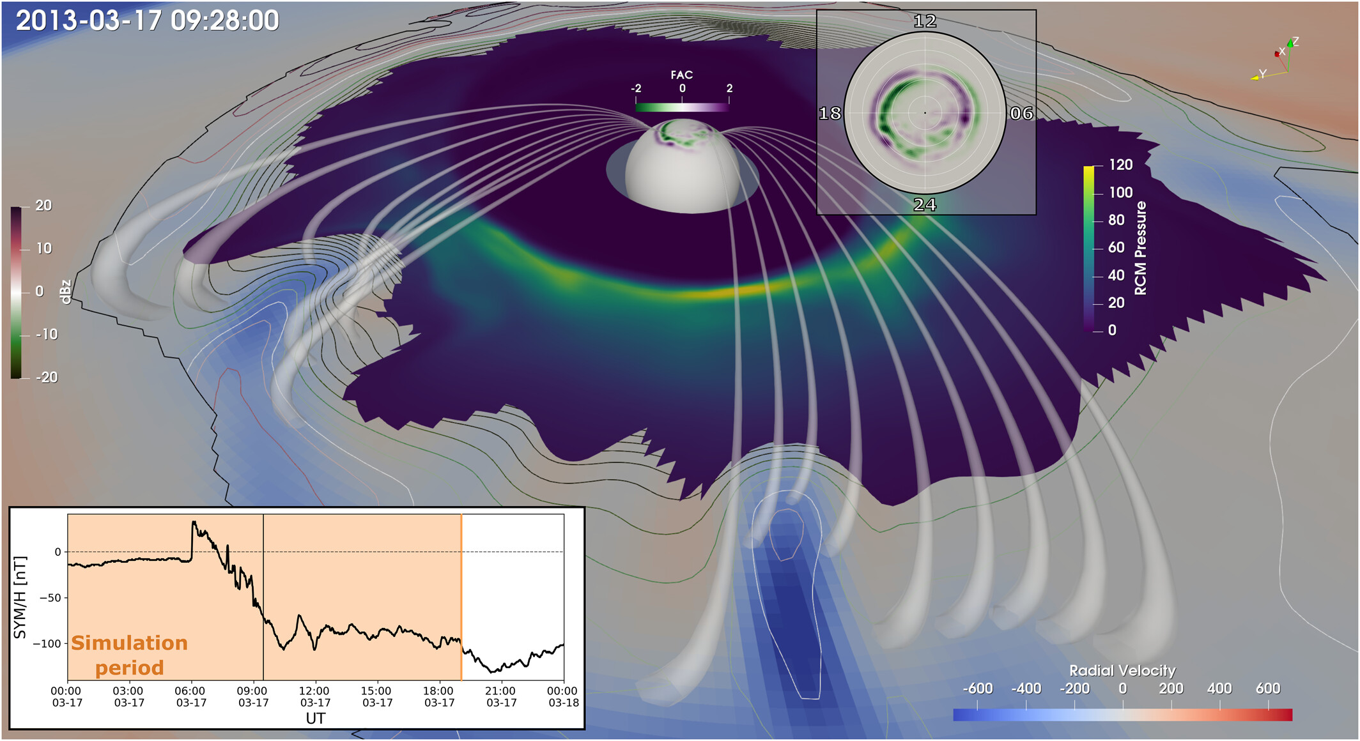
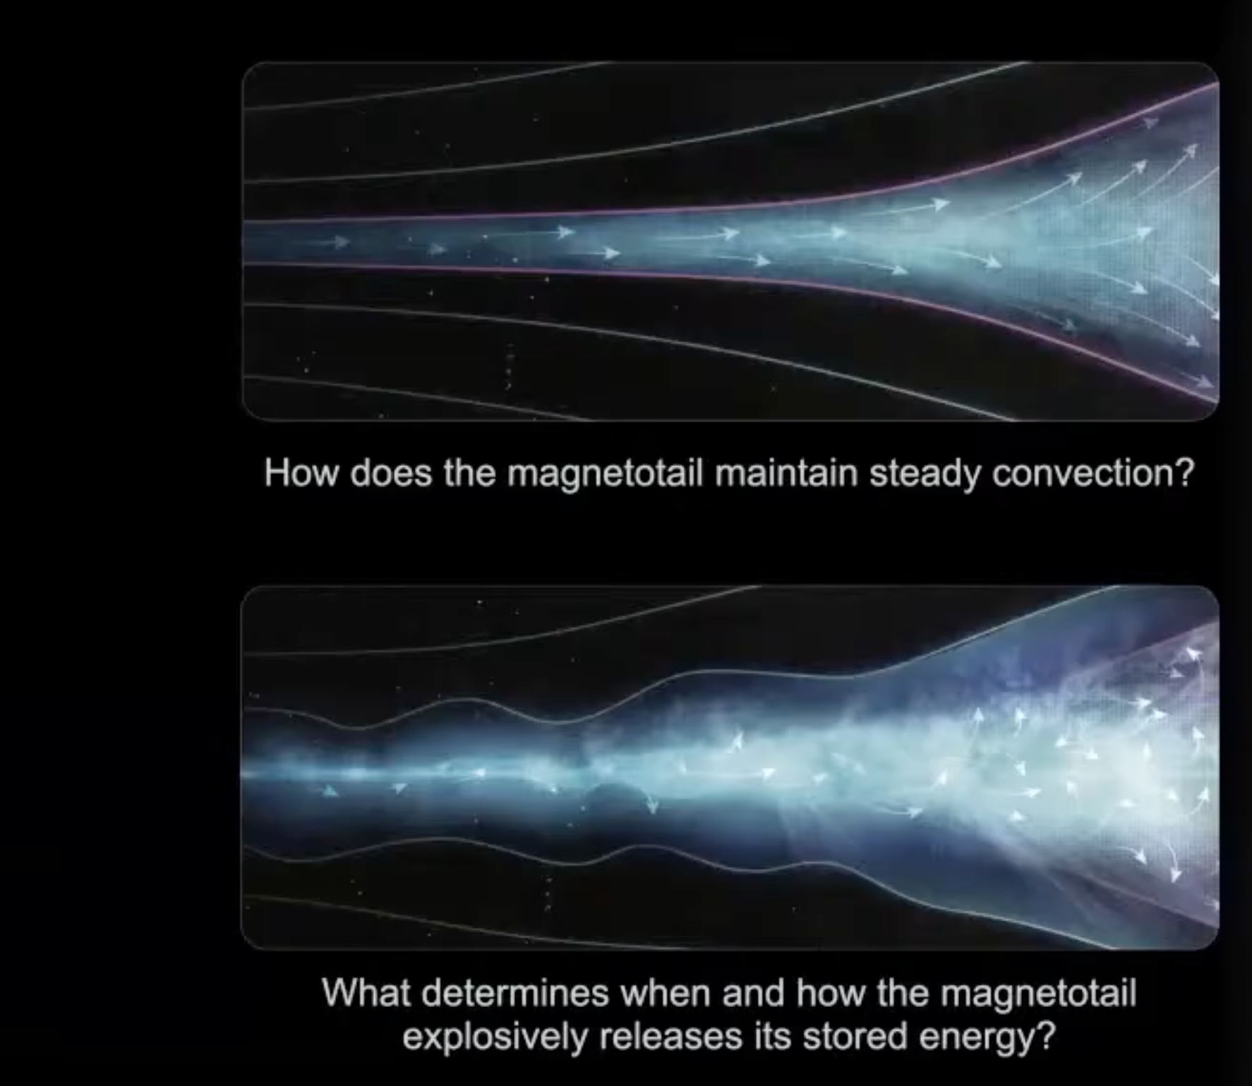
General Context & Synergy
Sciola+ 2023
One of CGS objectives:
The role of mesoscale plasma sheet transport in the ring current build-up
To tackle this we need to establish a clear understanding of the overall plasmasheet transport during quiet and storm times.
50% of total energy flux transported into the inner magnetosphere by mesoscale structures
Overaching Goal of CINEMA
Understand the role of plasma sheet structure and evolution in Earth’s multiscale magnetospheric convection cycle
Cropped from Robyn Millan Presentation 26 Feb 2026

Slide 3


Outline
Global Convection Patterns of Magnetic Flux
  Question: How does convection in the magnetotail change during storms and how it affects magnetic flux transport
Bursty Interval Contribution and Dawn/Dusk Asymmetries
  Question: Is the occurrence distribution of BBFs different during storms? How much they contribute to flux transport and how do their properties change during storms?
Machine Learning modeling of in-situ properties (“almost”* submitted)
  Question: can we use SW information and ground magnetometers to model plasmasheet properties? How this changes during storms
Basically data analysis of Geotail (1994 – 2022), and MMS (2015 – 2024) magnetotail plasmasheet observations
*Similar definition to the one used in fusion research

Slide 4
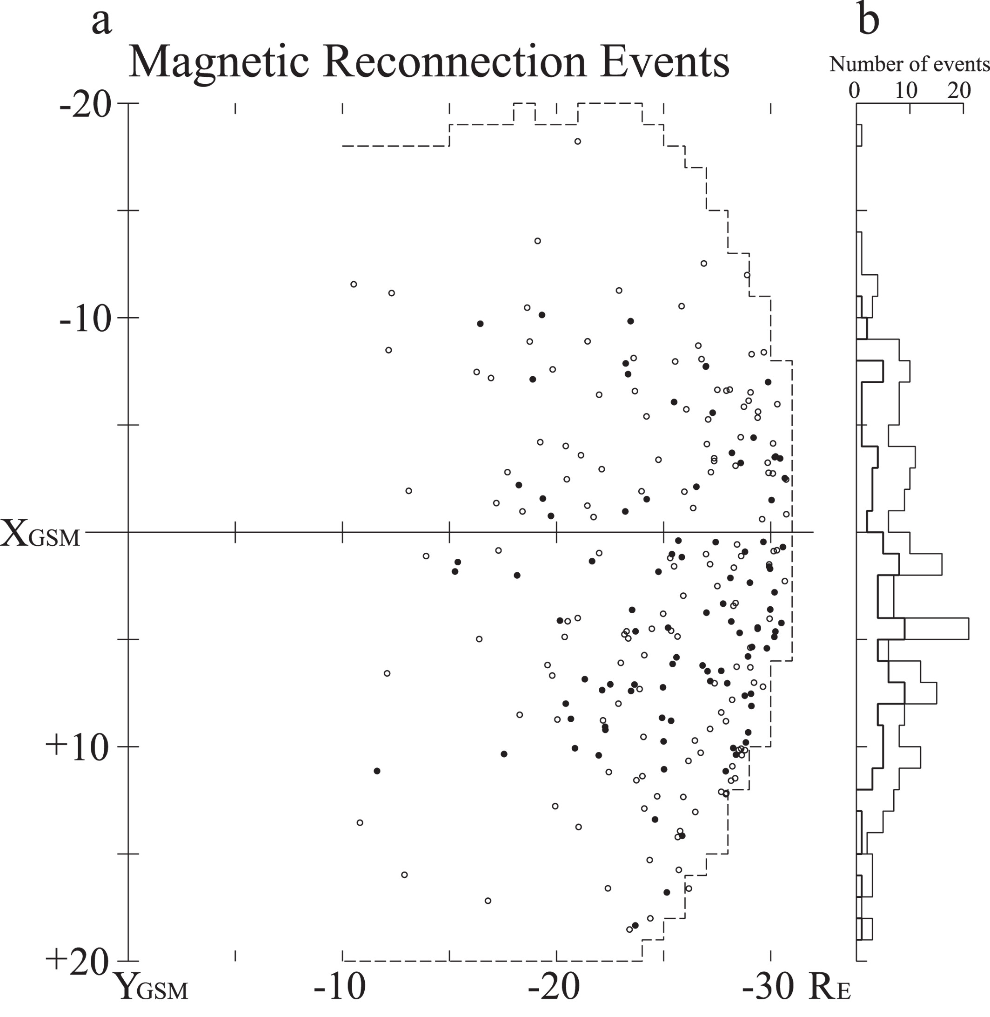
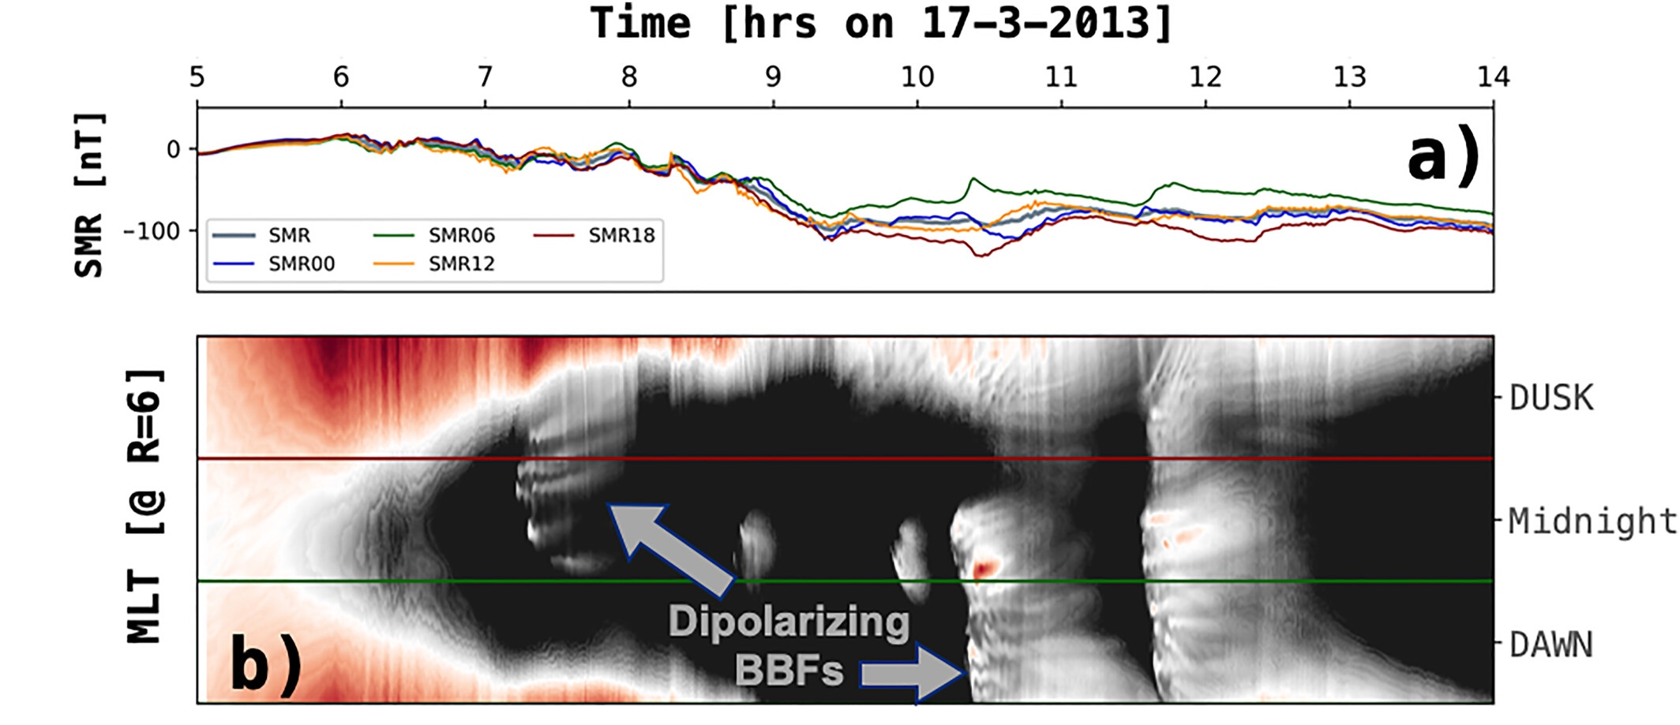
Dawnside Current Wedge & Asymmetries in Magnetotail Reconnection
*Similar results with MMS (e.g., Hubbert et al., 2022; Rogers et al., 2023).
Ohtani+ 2021, 2024, Sorathia+ 2023
Dawnside Current Wedge
DCW is a distinct storm-time phenomenon associated with increased westward auroral electrojet (AEJ) at the dawn sector.
Nagai+ 2023
Magnetotail reconnection site is spatially skewed toward the dusk (pre-midnight) sector during typical activity, but this distribution shifts dawnward when the magnetosphere is being driven intensely (such as during major storms).
Notes:
DCW = a dawn-sector version of the substorm current wedge, tied to an enhanced dawnside westward electrojet.

Slide 5
How to do data analysis for storms
STEP 1: Gather data
STEP 2: Associate these data to storms
STEP 3: ??
STEP 4: Profit (i.e., publish papers?)

Slide 6
How to do data analysis for storms
STEP 1: Gather data
STEP 2: Associate these data to storms
STEP 3: ??
STEP 4: Profit (i.e., publish papers?)

Slide 7
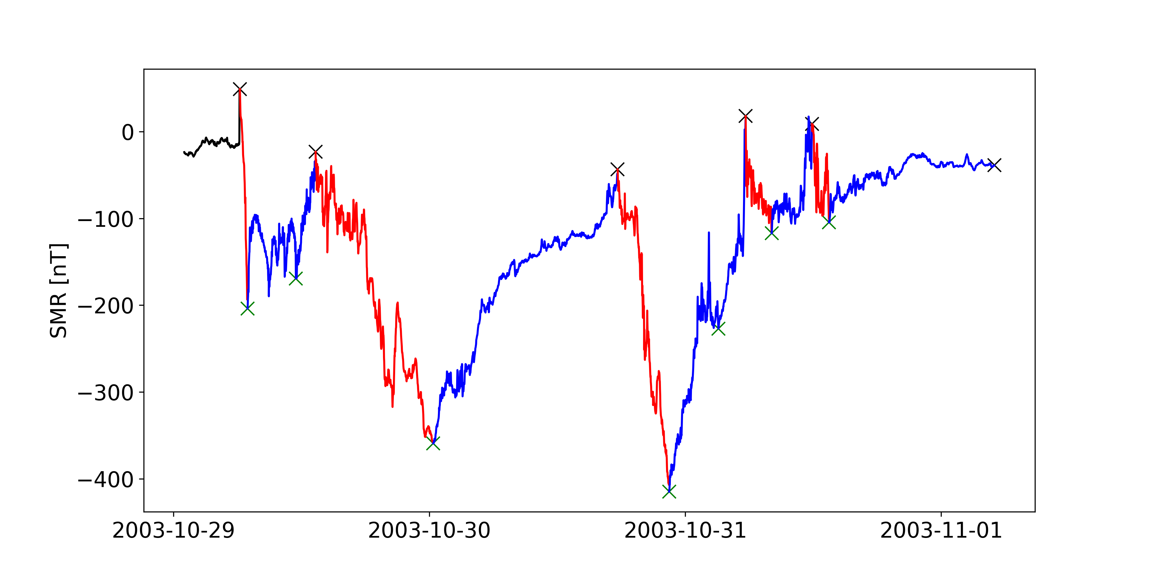
STEP 2: Storm phases classification
(semi)-automatic storm finder and classifier:
Recovery | Main
https://zenodo.org/records/15127938
(v3 updated to 2025, not yet manually verified)
List is open, easy to use, easy to maintain

Slide 8
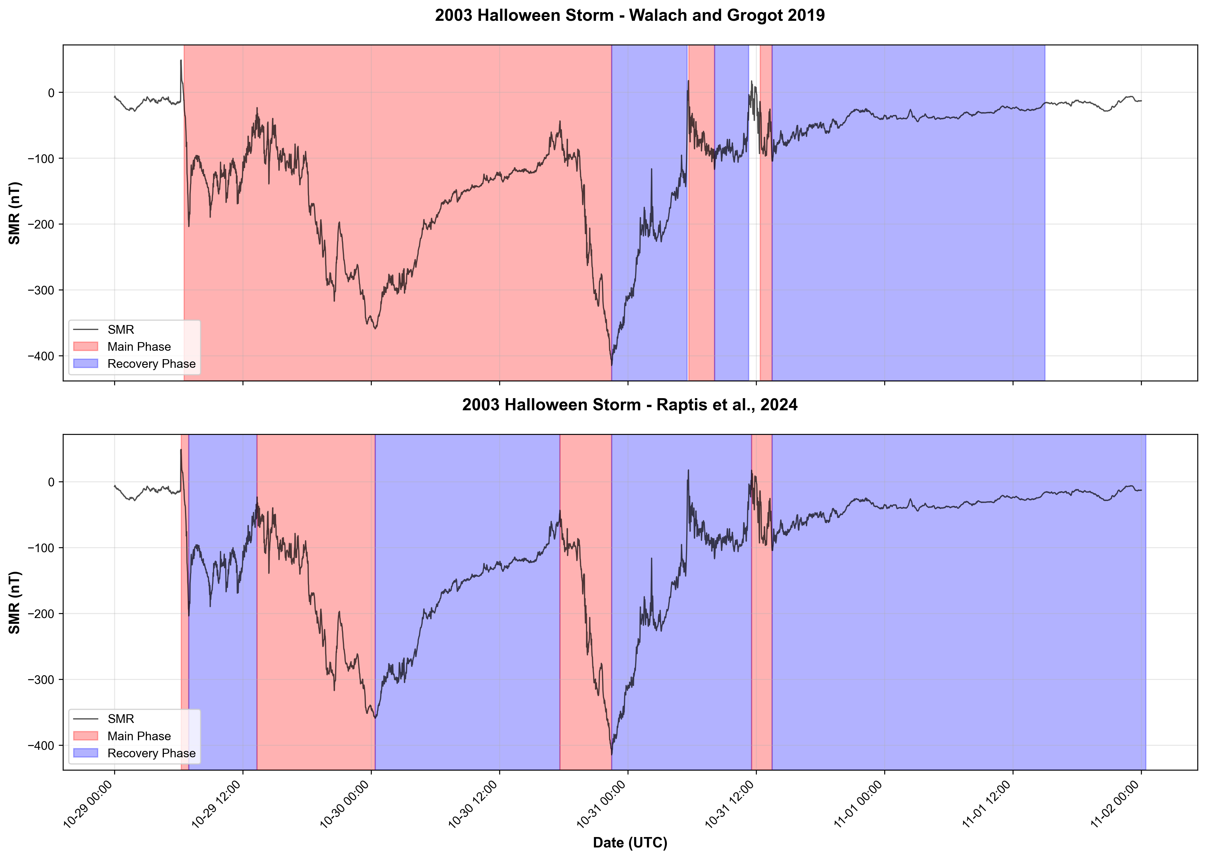
Recent Update Regarding Storm Lists
Our list is semi-automatic:
  Simple Peak finder using scipy find_peaks function.
  Hyperparameters tuned based on Halloween storm & simple cases
  ~2% manual changes visually
There are more lists out there. See Paper Published this Monday:
“How Does the Definition of a Geomagnetic Storm Affect the Contents of the Resulting Storm List? “
Patrick et al., 2026 https://agupubs.onlinelibrary.wiley.com/doi/10.1029/2025SW004857

Slide 9
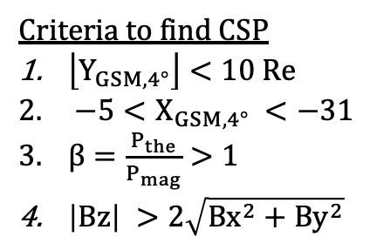
STEP3: Plasmasheet Coverage per mission
Criteria to find CSP
$\left\lfloor Y_{GSM,4°}\right\rfloor <10 Re$
$−5<X_{GSM,4°} <−31$
$β=\frac{P_{the}}{P_{mag}}>1$
$\left|Βz\right| >2\sqrt{Bx^{2}+By^{2}}$
See e.g., Ohtani+ 2008, Guild+ 2008, Roziers+ 2009, Vo+ 2023
Geotail > 1 million points ~250 storms
MMS ~ 250k points ~25 storms
Findings:
MMS have limited observations during storm times (especially main phase)
Main phase contains data from about 6 storms for MMS
Slightly more dawnside data during main phase for Geotail
Raptis+ 2024 | GRL

Slide 10
Classifying plasma sheet is not trivial
MMS Criterion
Geotail Criteria
Figure Credits: Wenli Mo (JHU/APL)
Note Vo+2023, had a multi-step process based on interval, this is just using the point-by-point classification, so comparison is only illustrative

Slide 11
Results

Slide 12

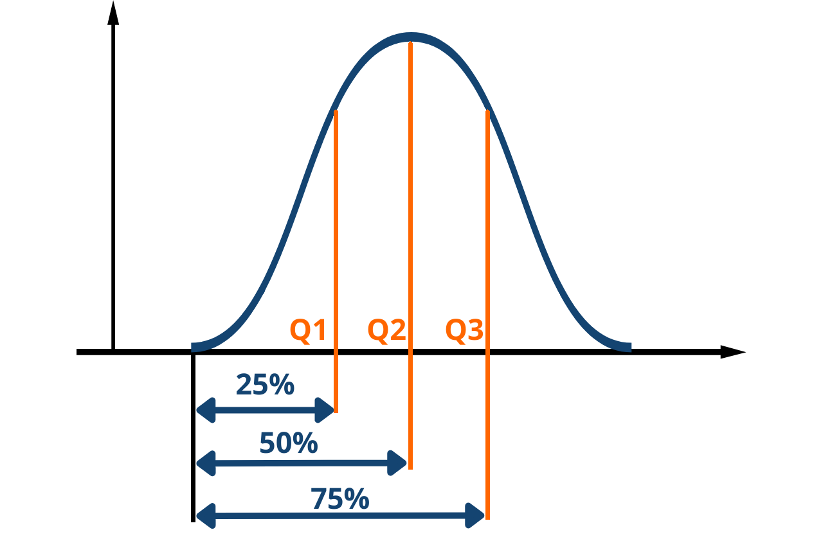



Plasma Sheet Convection – Geotail
Storm Ey $↑$
Outer
Inner
Main V⊥x $↑$
Storm Bz $↑$
Towards Earth
Similar for MMS, just noisier…
Raptis et al., 2023

Slide 13




Storm - Main Phase Difference (Geotail | 1994 - 2022)
13
Dawn sector: storm-time magnetic flux transport linked to faster plasma flows
Dusk sector: storm-time magnetic flux transport linked to stronger dipolar magnetic fields
(1)
V⊥x $↓$
(1)
Bz $↑$
Ey $↑$
Dusk
Dawn
(2)
(2)
Outer
Ey
Inner
V⊥x
V⊥x $↑$
Bz
Plasmasheet changes in an asymmetric way during storms
Raptis et al., 2023

Slide 14

Let’s move to Bursty Mesoscale Intervals!
What do we know so far?
Plasma sheet storm time:
Elevated Ey associated with increased Bz, and limited enhancement of V⊥x
Dusk observations showing more dipolar magnetic field (Bz $↑$)
Dawn are associated to relatively faster flow (V⊥x $↑$)
Notes:
~10 mins

Slide 15
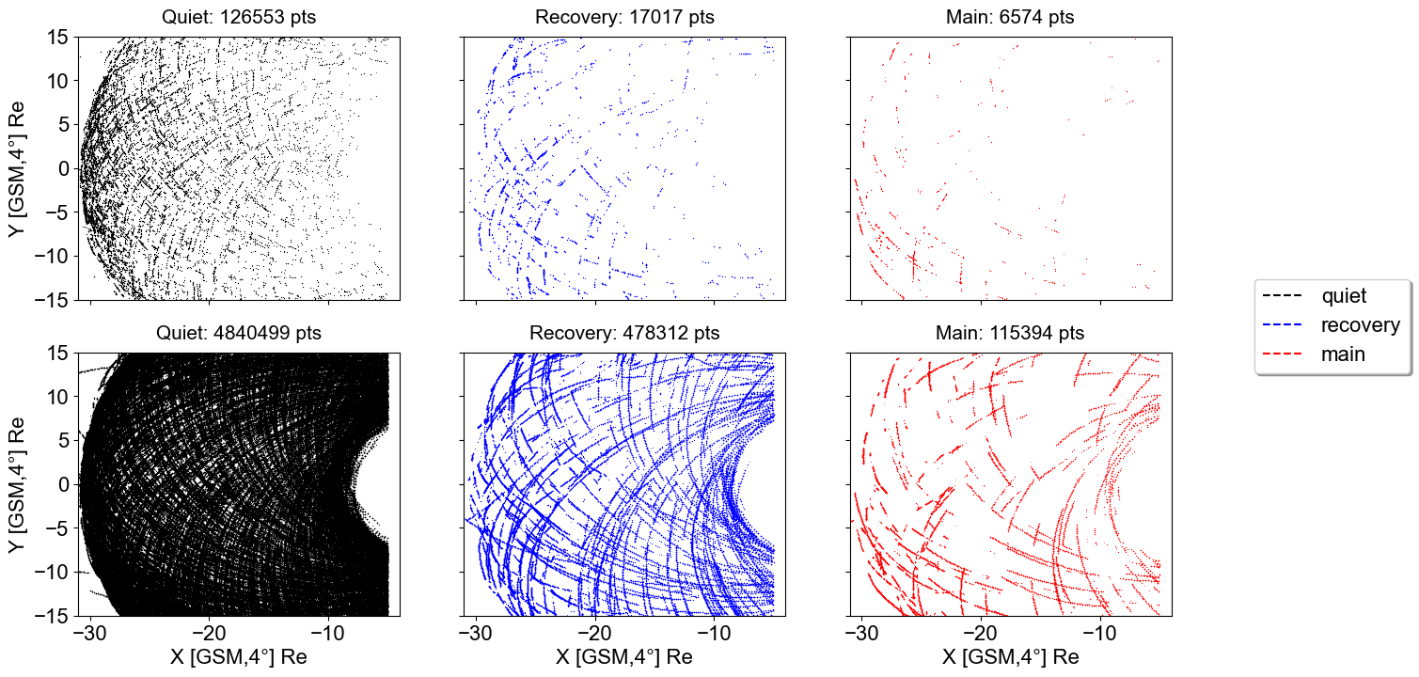
Statistics Caveat for bursty flows – Geotail (1994 – 2022)
BBFs
No BFFs
Takeway: Number of data points can be misleading

Slide 16
Bursty intervals (Jets, BBFs, BEIs, etc.) and constrains
16
Analyzing BBFs statistically is non-trivial:
Arbitrary criteria and thresholds
BBFs are bursty, they merge, and de-accelerate.
Orbital biases of each mission
Are we even in the plasmasheet? (see previous slide)
Moment calculation, composition, energy and time res
No knowledge of spatial scales and relative location
Is it a direct hit or glazing? How probable is each case?
Sparsity of data and driving condition distribution.
Fast BBFs missed by instruments (e.g., v>1500 km/s)
….
So at least, (3,6,7,9) and maybe (2, 4,5) are in principle approachable by data/model comparisons, however number (1, 8) are very complicated…
DFs
Runov+ 2009
Plasma
Jets
Richard+ 2022
BBFs
Angelopoulos+ 1991
BBFs:
Fast ion flows (v >400 km/s),
10-100s in duration
~ 4 Re size
BEIs
Schödel+ 2001

Slide 17
But we can still do things!
We just have to be careful

Slide 18

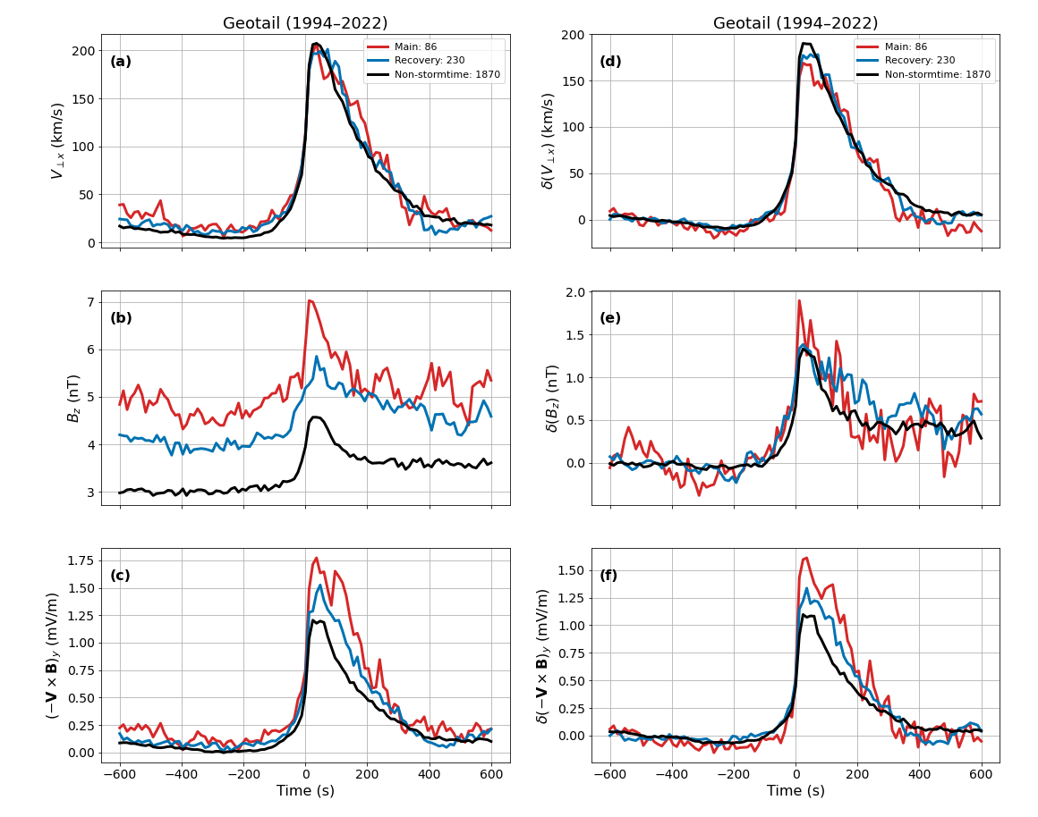






Superposed Epoch Analysis (SEA) of BBFs during storms
$$V_{⊥x }$$
$${δV}_{⊥x }$$
Key Results:
Storm-time BBFs transport more magnetic flux than non-storm BBFs.
This is linked to a stronger background Bz, while BBF velocity stays about the same.
$$B_{z }$$
$${δB}_{z }$$
$${(−V×B) }_{y }$$
$${δ(−V×B) }_{y }$$
Subtract
Background
Devanandan et al., 2026

Slide 19
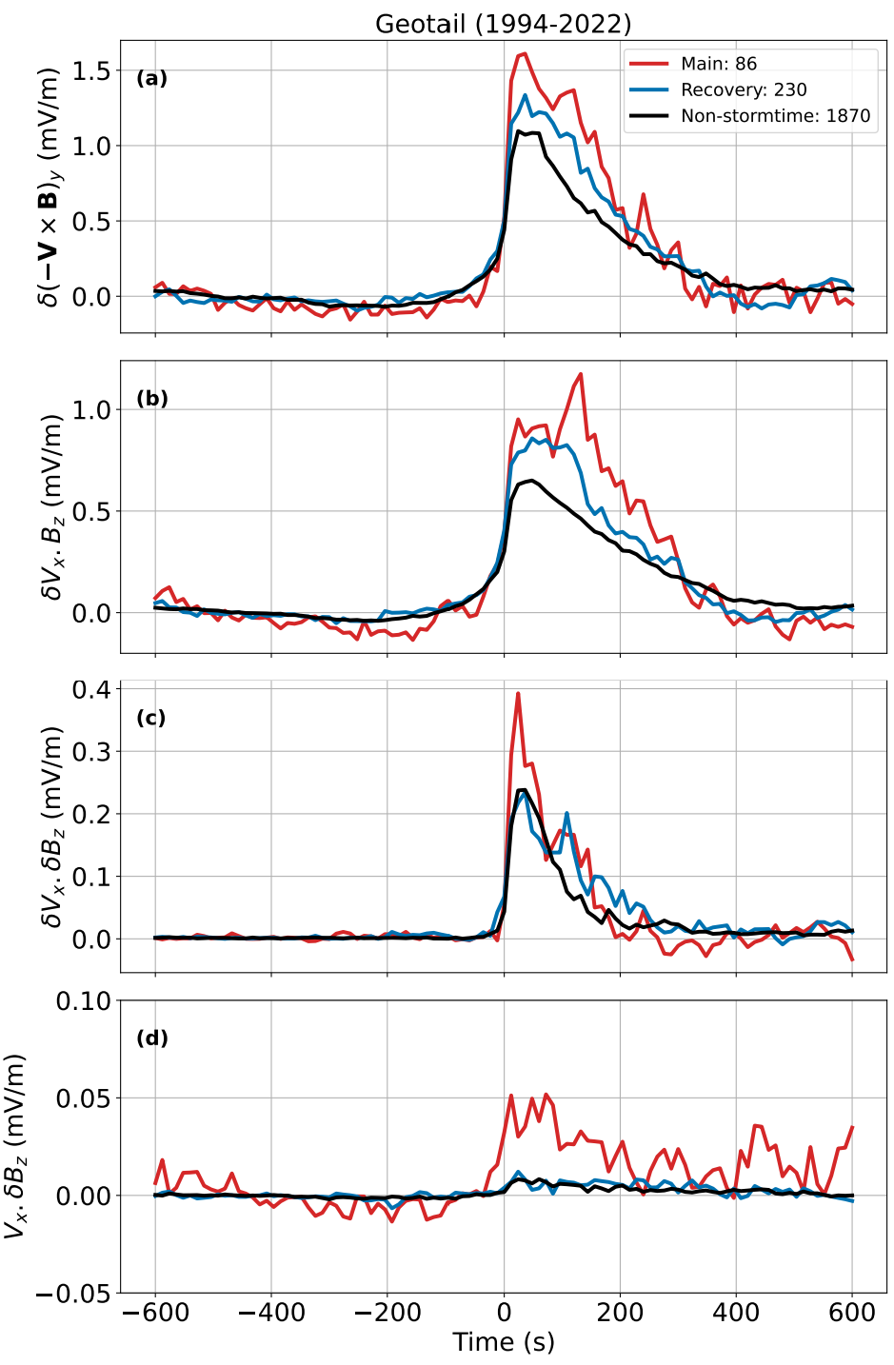




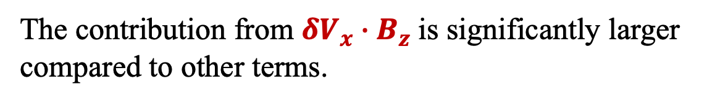
Decomposition of Magnetic Flux Enhancement
$${δ(−V×B) }_{y }$$
$${δ(−V×B)}_{y}= {δV}_{x}∙B_{z}+V_{x}∙{δB}_{z}+{δV}_{x}∙{δB}_{z}−({δV}_{z}∙B_{x}+V_{z}∙{δB}_{x}+{δV}_{z}∙{δB}_{x})$$
Negligible
$${δV}_{x}∙B_{z}$$
$${δ(−V×B)}_{y}= {δV}_{x}∙B_{z}+V_{x}∙{δB}_{z}+{δV}_{x}∙{δB}_{z}$$
The contribution from ${δV}_{x}∙B_{z}$is significantly larger compared to other terms.
$${δV}_{x}∙{δB}_{z}$$
$$V_{x}∙{δB}_{z}$$
In both storm and non-storm cases, the flux enhancement comes mainly from the elevated BBF velocity.
Devanandan et al., 2026

Slide 20
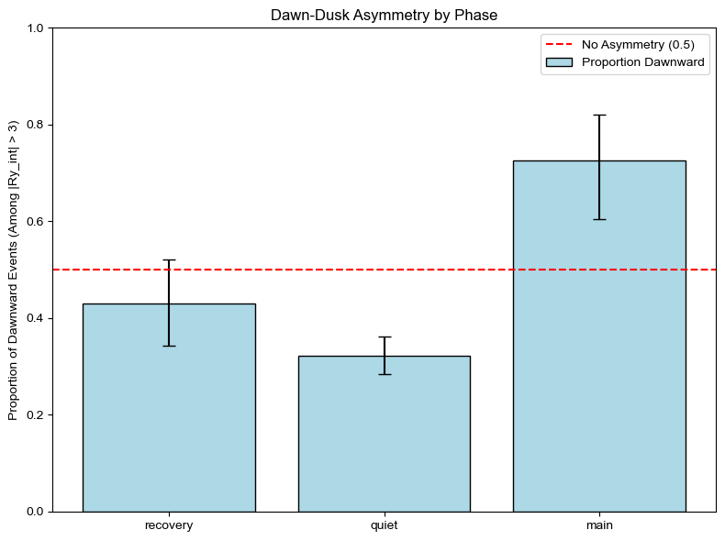
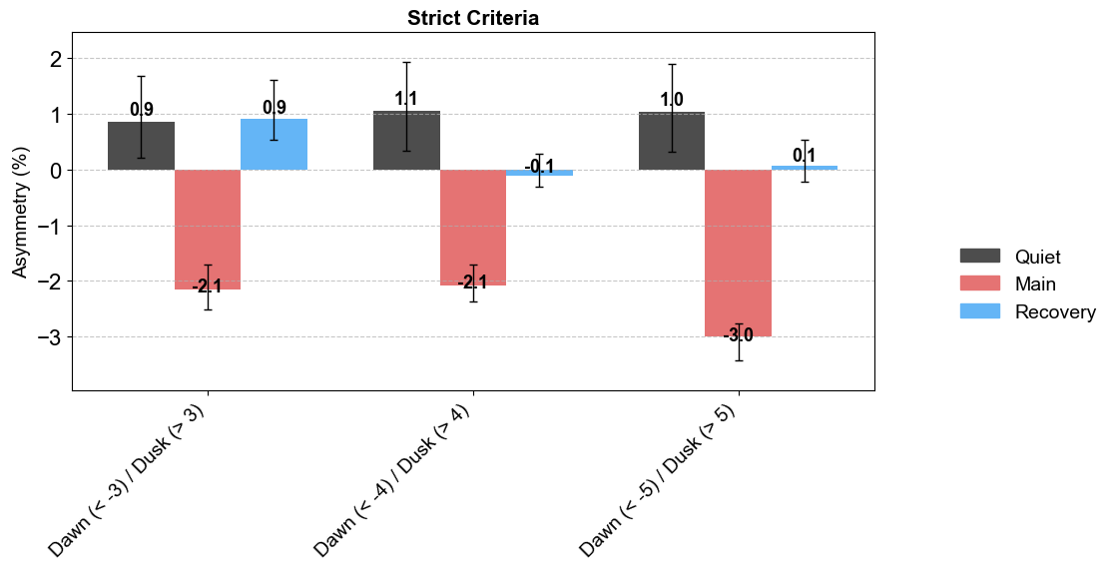
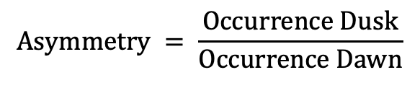
Dawn/Dusk Asymmetries - Reconnection and BBFs
Geotail dataset from Nagai+2023, Raptis+2026
Geotail dataset BBF list (Devandan+2026)
$$Asymmetry = \frac{Occurrence Dusk}{Occurrence Dawn}$$
Dawn Preference
Dusk Preference
Dusk Preference
Dawn Preference
DAWN (<-3 Re)
DUSK (>3 Re)
DAWN (<-4 Re)
DUSK (>4 Re)
DAWN (<-5 Re)
DUSK (>5 Re)
Key Point:
Asymmetries in occurrence during Main phase are shown in both BBF and Reconnection list datasets
Recovery
Quiet
Main
TODO:
Combine MMS and THEMIS statistics to get a general picture
Ongoing effort

Slide 21
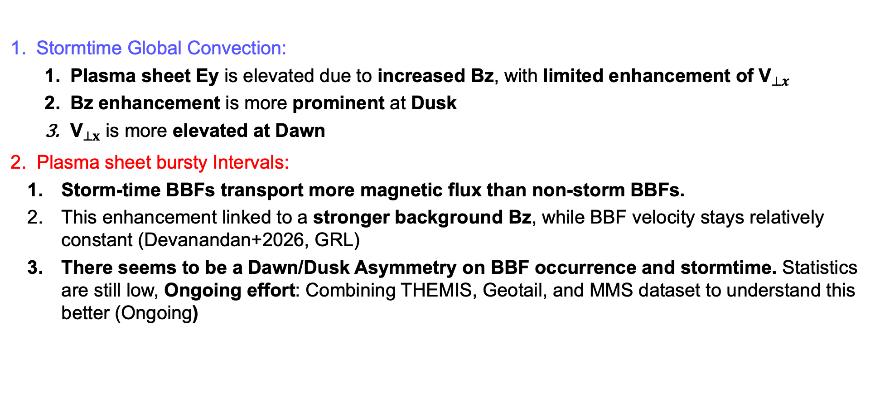
Part #1 Summary
21
Stormtime Global Convection:
  Plasma sheet Ey is elevated due to increased Bz, with limited enhancement of ${\text{V}}_{⊥x}$
  Bz enhancement is more prominent at Dusk
  ${\text{V}}_{⊥x}$ is more elevated at Dawn
Plasma sheet bursty Intervals:
  Storm-time BBFs transport more magnetic flux than non-storm BBFs.
  This enhancement linked to a stronger background Bz, while BBF velocity stays relatively constant (Devanandan+2026, GRL)
  There seems to be a Dawn/Dusk Asymmetry on BBF occurrence and stormtime. Statistics are still low, Ongoing effort: Combining THEMIS, Geotail, and MMS dataset to understand this better (Ongoing)
Raptis+2024
Devanandan+2026
Notes:
20min mark

Slide 22
What else can we do with all this data?
Machine Learning* of course!
*Statistical Modeling ~ Supervised (labelled) Machine Learning

Slide 23
Outline
Global Convection Patterns of Magnetic Flux
  Question: How does convection in the magnetotail change during storms and how it affects magnetic flux transport
Bursty Interval Contribution and Dawn/Dusk Asymmetries
  Question: Is the occurrence distribution of BBFs different during storms? How much they contribute to flux transport and how do their properties change during storms?
Machine Learning modeling of in-situ properties (“almost”* submitted)
  Question: can we use SW information and ground magnetometers to model plasmasheet properties? How this changes during storms
*Similar definition to the one used in fusion research

Slide 24
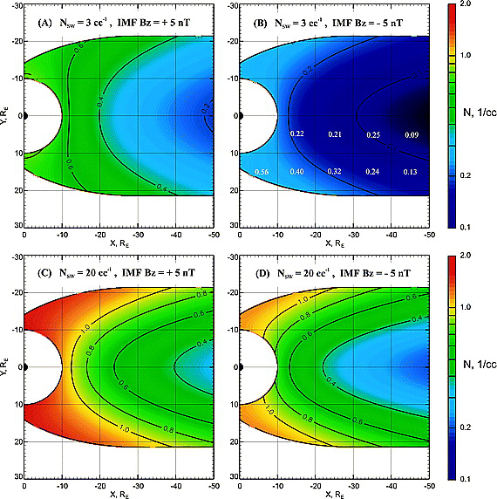
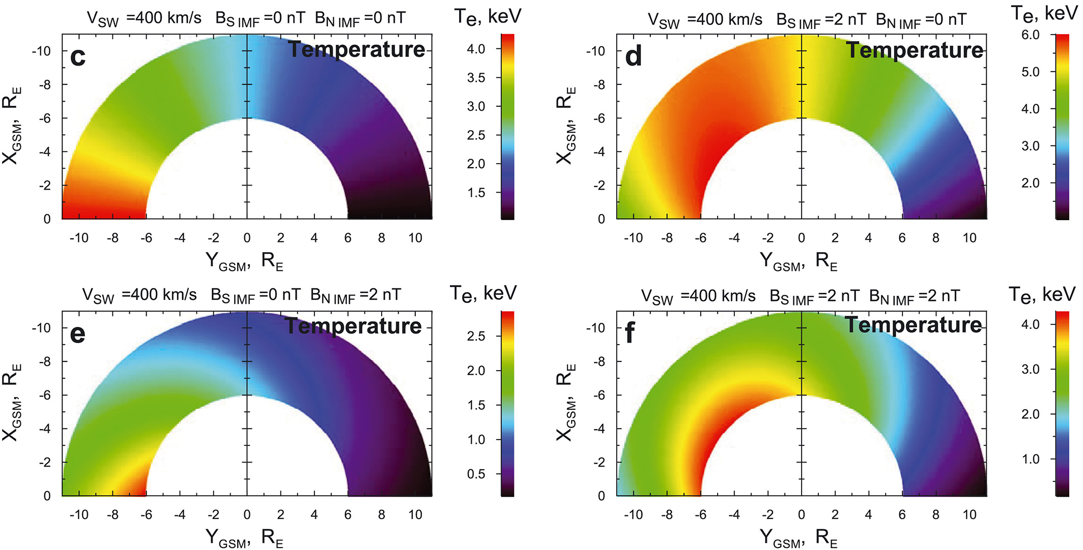
Baseline empirical models
Modelled with Geotail
Modelled with THEMIS
Dubyagin+ 2016
Why then work on this?
More data under different conditions
MMS was never used with its state-of-the-art instrumentation
These models don’t include time history
ML methods can take advantage of non-linear relationships
Never validated with statistical/ML practices (i.e., train/test splits)
Tsyganenko & Mukai 2003
This presentation: Modeling of Ti/Te and ni

Slide 25
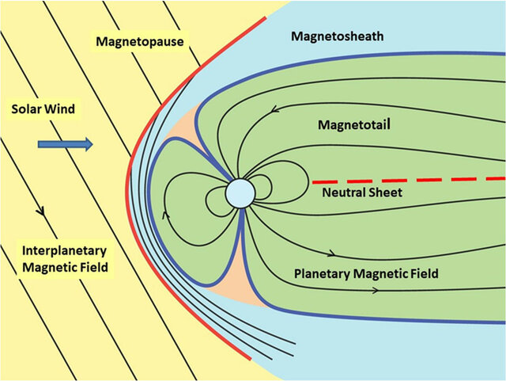
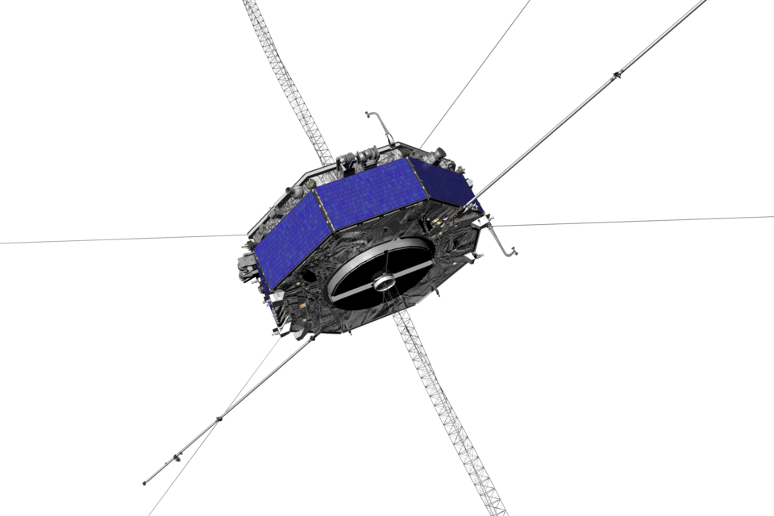
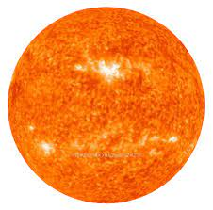


25
Where are we & what are we doing?
Credits: NASA
Input:
+Geomagnetic
ACE/WIND/DSCVR
(L1)
200$R_{E}$
Output: In-situ properties from: MMS, Geotail, THEMIS
Goal: Model Plasmasheet properties based on driving (SW) and geomagnetic conditions
$$R_{E}=6371.2 \left[km\right]$$

Slide 26
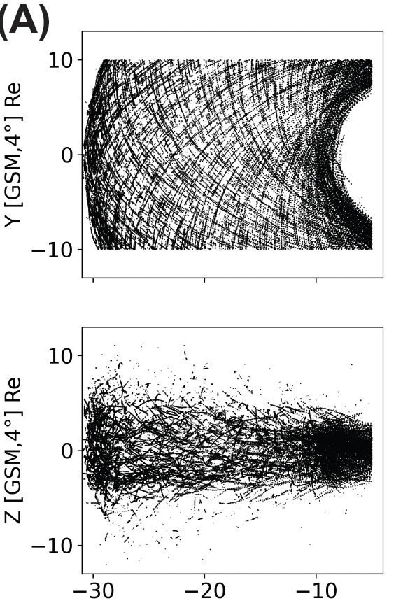
The dataset (output – Central Plasma Sheet)
Geotail (1994 - 2022)
>1 million points (~12s res)
(B) MMS (2015 – 2024)
~ 250k points (~12s res)
Output:
In principle, anything measured
(In this example plasma moments)

Slide 27
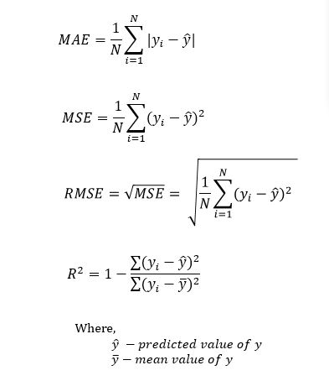
Metrics & Results

Slide 28
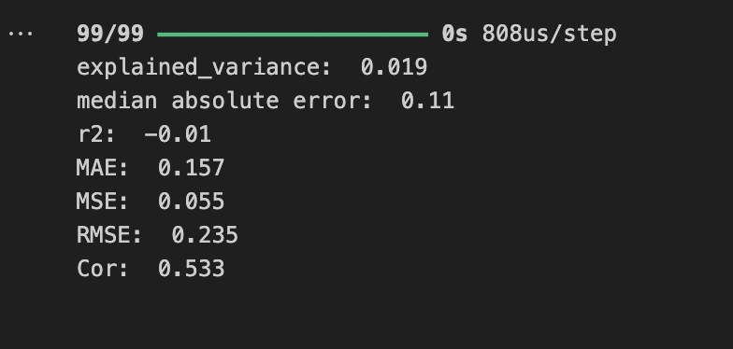
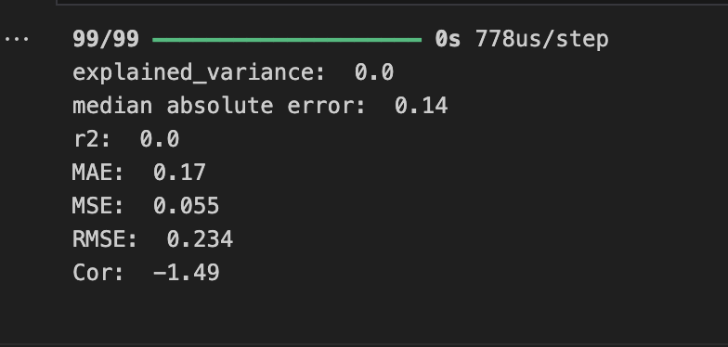

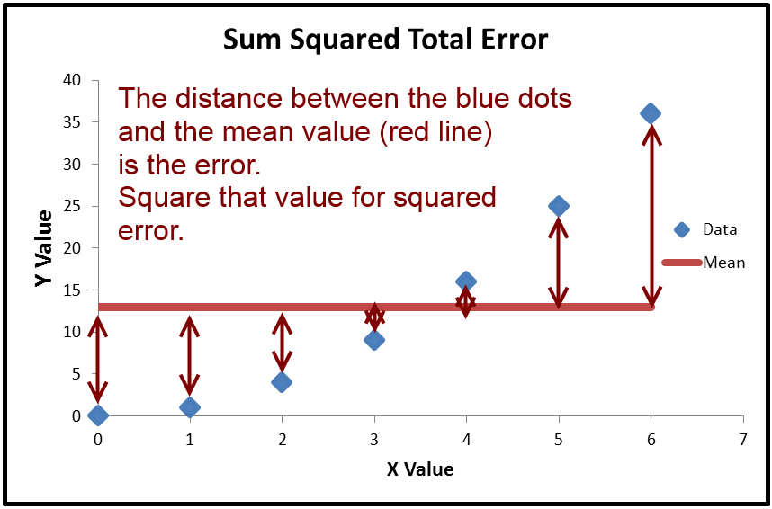
Quick reminder on model evaluation
A complex and intriguing model
np.mean()
When 𝑅2<0, the horizontal line explains the data better than your model (i.e., mean of observed).
Notes:
R2 measures how much of the variance in the dependent variable is explained by the model.

Slide 29
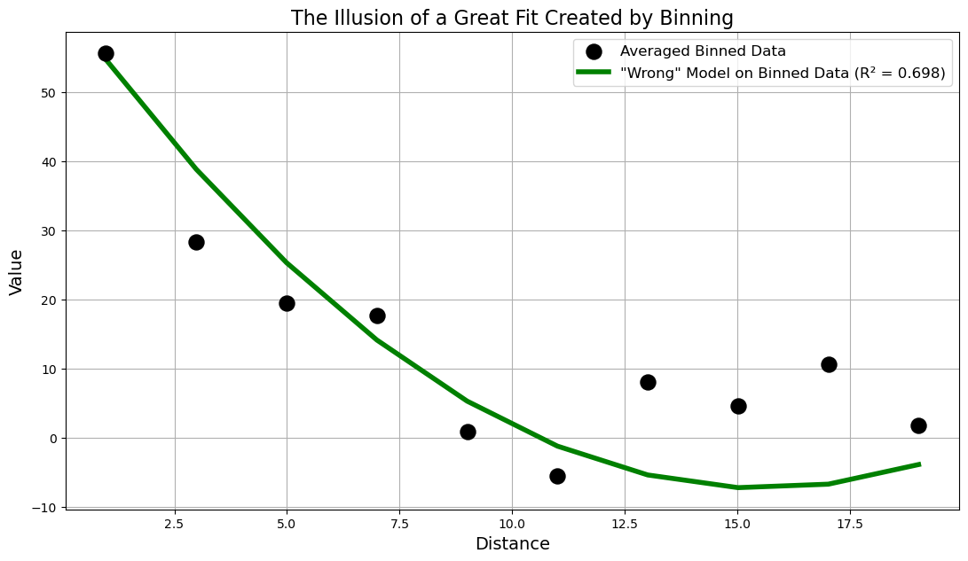
The illusion success through averaging our data
Disclaimer: Still can be a useful model.
Underlying process is structured, but the measurements and their local variations are hidden.

Slide 30
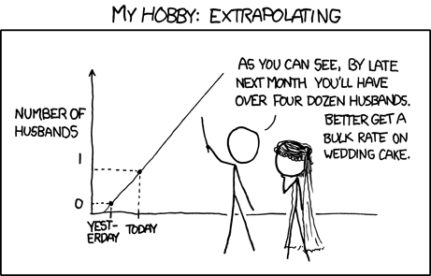
Results
https://xkcd.com

Slide 31
Methodologies & input space
PRIME Advantages: Embedded uncertainty quantification and propagation from L1
Time History | Type of Input | Architectures
1-6h | Wind (L1) | Linear Reg
 | OMNIweb | Gradient Boosting
 |  | Neural Network
 |  | RNN/LSTM/GRU (PRIME-PS)
O’Brien et al. 2023,2024
Answering hypothetical questions:
Also tried different error functions, optimizers, hyperparameters etc.
And different imbalanced learning techniques
Key Takeaway:
To quantify our method's impact, we tested multiple variations of the problem.
Raptis, O’Brien et al., 2026 (under prep.)

Slide 32
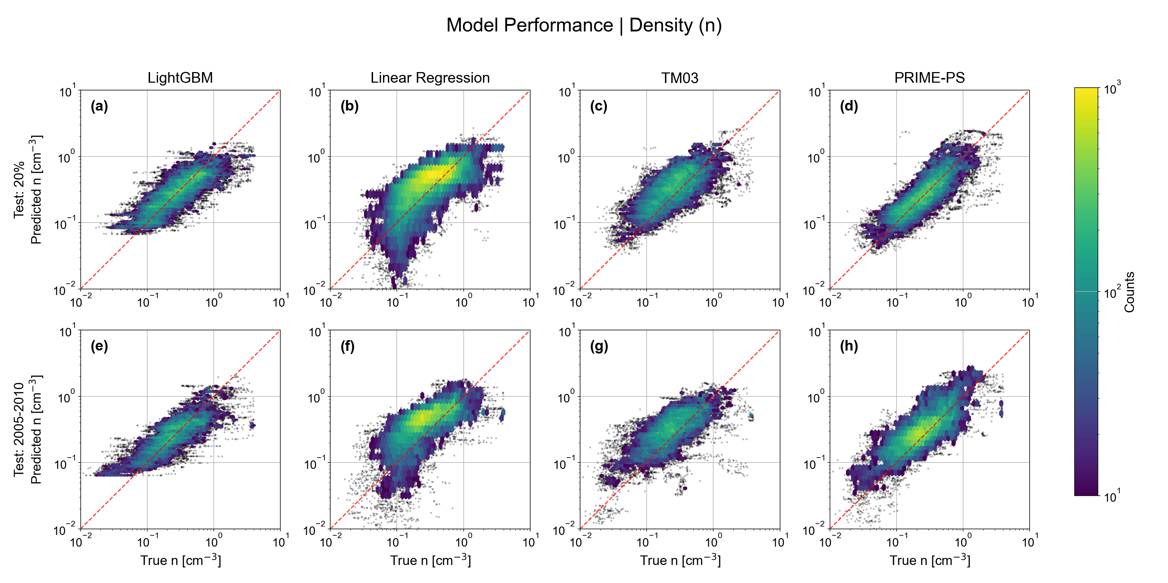

Modeling Density | Predictions vs Observations
Key Message: $PRIME/GB >Baseline ≈ TM03$
Offsets
Raptis, O’Brien et al., 2026 (under prep.)
Reminder: Close to x=y → good

Slide 33
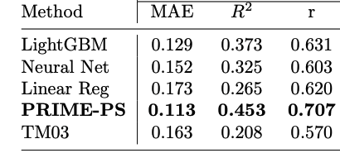
Metrics using Test set (20% of data)
Key Results:
PRIME-PS demonstrates a performance edge (~30% MAE from TM03 and ~15% from other ML approaches).
This advantage can get relatively low (other train/test splits & crossvalidation).
Different input, method, time-history, and hyperparameter tuning etc. had overall a statistically marginal effect. Why (discuss later)?
Since PRIME-PS was statistically better, and Gradient boosting can’t be used for modeling, we only keep this for next parts of analysis.
Raptis, O’Brien et al., 2026 (under prep.)

Slide 34
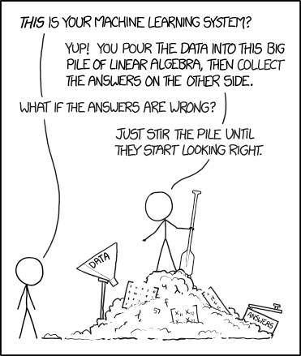
Modeling Efforts
https://xkcd.com

Slide 35
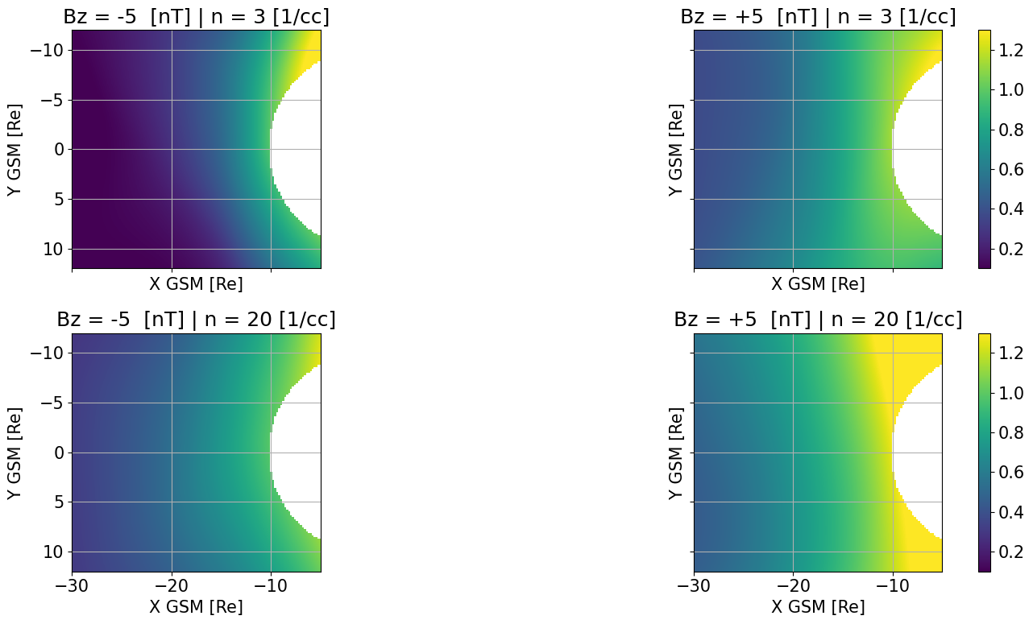
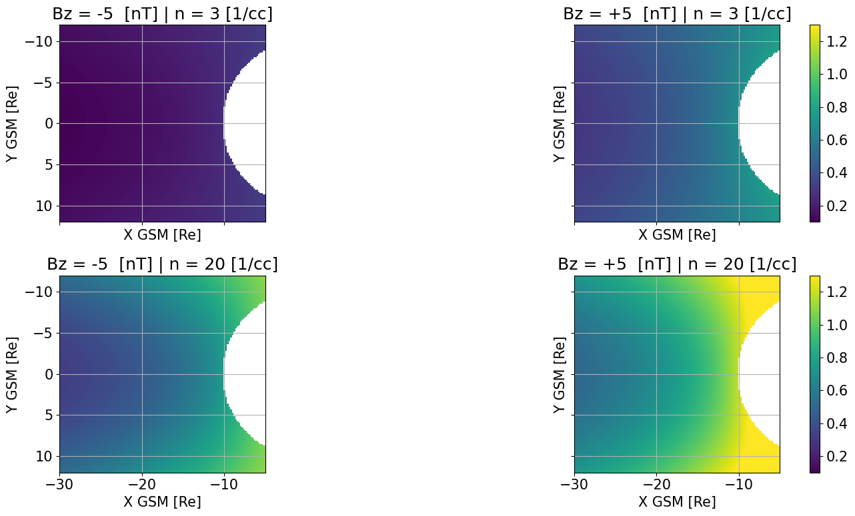
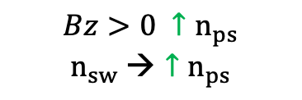
Modeling Density with Geotail | 2D Synthetic Maps
Asymmetries Introduced In agreement with previous studies
(Wing & Newell, 1998; C.-P. Wang et al., 2007)
N [1/cc]
N [1/cc]
$$Bz>0 {↑n}_{ps}$$
$$n_{sw} →{↑n}_{ps}$$
Neural Networks modeling
Empirical modeling (TM03)
Raptis, O’Brien et al., 2026 (under prep.)

Slide 36
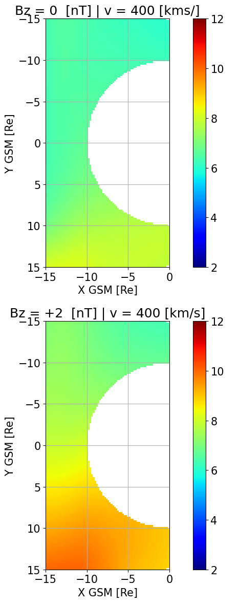
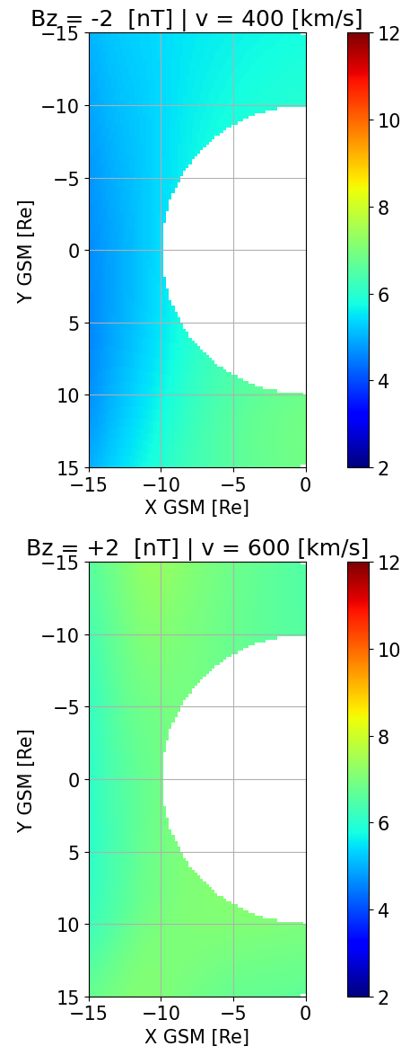
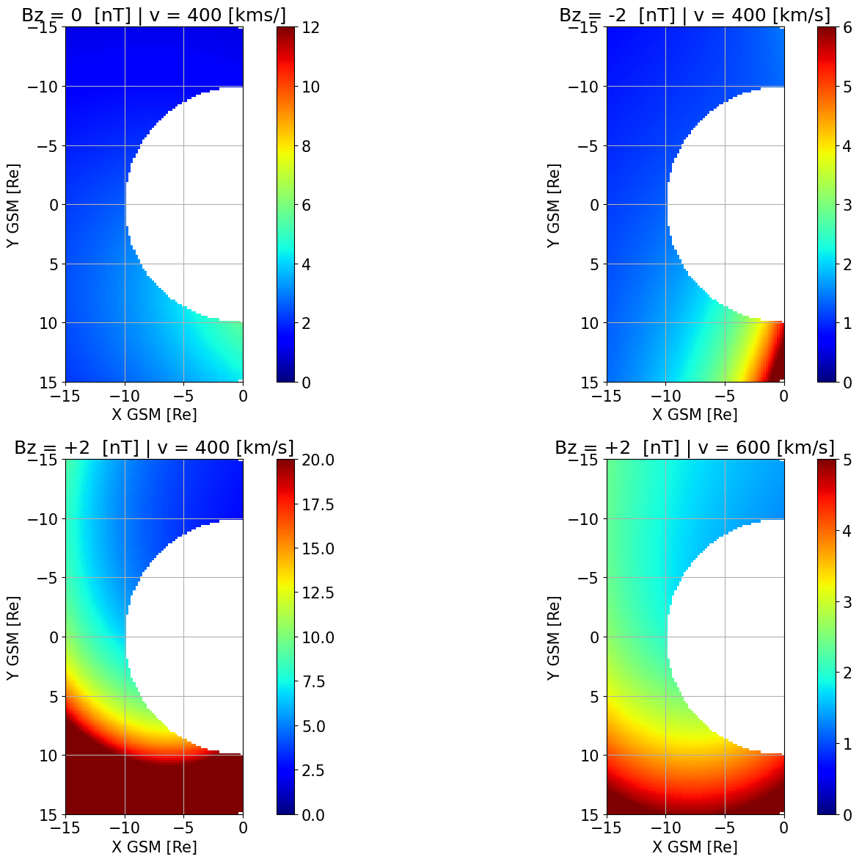
Modeling Temperature Ratios with MMS | 2D Synthetic Maps
Note: Agreement Wang et al., 2010 with dusk Ti/Te higher than dawn (Using THEMIS)
Pros:
+No extreme values
+Asymmetries shown
+ Coherent physical picture
Cons:
- Not easily available analytical form
Neural Networks modeling
Empirical modeling (TM03/DSGR16)

Slide 37
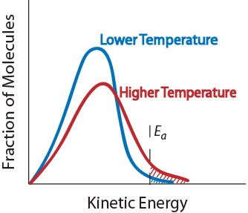
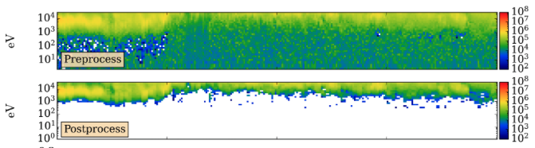
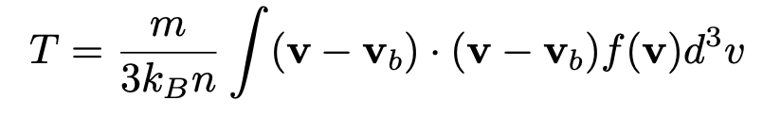
Community Reminder on Temperature
Temperature is the 2nd plasma moment
The higher the moment, the more uncertain because you rely more on the poorly sampled tails of the distribution.
So, 0 and 1st moment (Density and Velocity) are usually ok, but Temperature, we got to be careful
Ion Penetrating Radiation
Figure credits: Tien Vo
The temperature here was completely incorrect, and the velocity increased from about 200 km/s to over 1500 km/s.

Slide 38
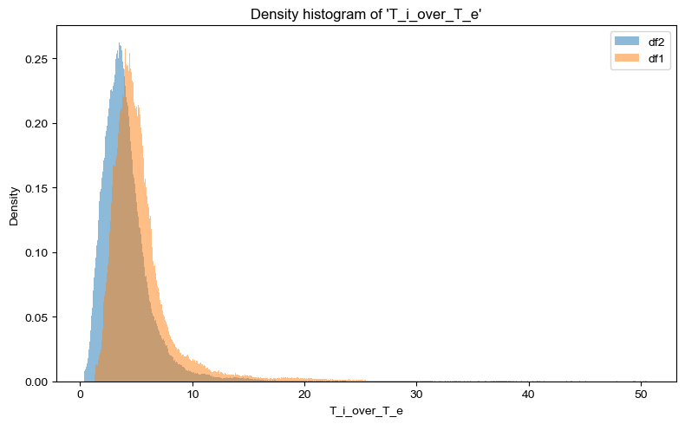
MMS Ti/Te plasmasheet ratio example (Full vs Partial moments)
mean df1 (full distribution moments): 5.5513
mean df2 (partial distribution moments): 4.0797
DF2 effectively removes the contribution from the penetrating radiation (Gershman+ 2019)
Key Message1: The mean differenced changed by 1.5 (>30%) simply by recalculating moments
Key Message2: A model with +30% is exciting, but we need to know if “ground truth” vary by the same magnitude

Slide 39
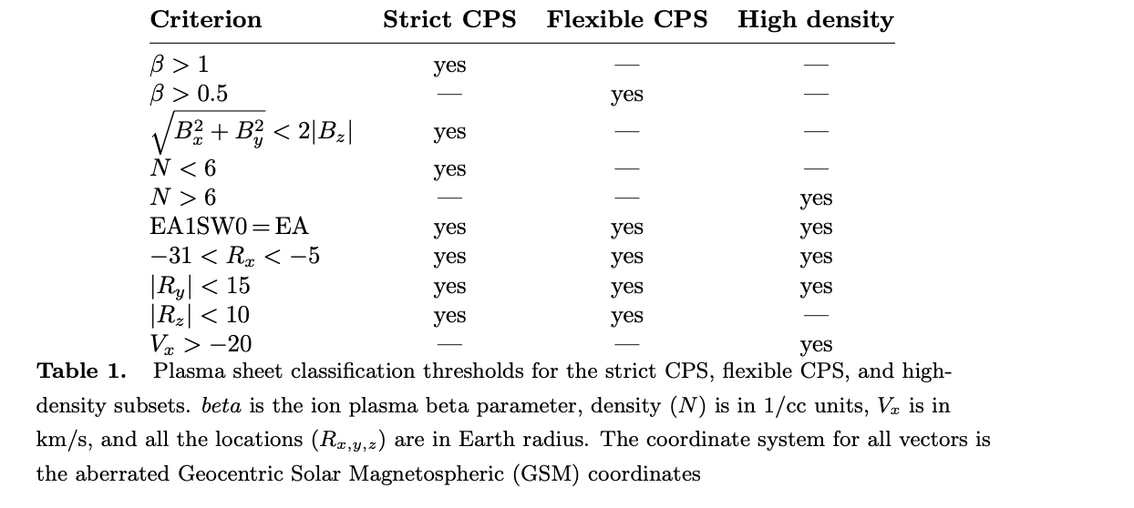
Storm Time Behavior and Importance of Outliers
The Problem: We use static thresholds for dynamic environments.
The Risk: Therefore we can mistakenly remove crucial "stormtime plasmasheet” datapoints.
The "Solution": Manually find the missing data and add it to the dataset.
Strict CPS (e.g., Ohtani et al., 2008, Raptis et al., 2024) & Flexible CPS (e.g., Richard et al., 2022)

Slide 40
Test case of a storm (05 Nov 2023) – Density (Geotail Model)
Process:
High: Includes manually picked high-density intervals from Geotail
Strict: Normal threshold-based classification of plasma sheet
Test:
THEMIS observations
Results
ML model (high dens): 0.85 [1/cc]
ML model (normal): 1.41 [1/cc]
TM03: 1.51 [1/cc]
Note: values <1 cm⁻³, are boundary layer transitions, gray shaded linear interpolation

Slide 41
Test case of a storm (05 Nov 2023) – Ti/Te (MMS Model)
Process:
Directly Predict Ti/Te as trained from MMS data
Calculate Ti/Te using the predicted Ti and Te from MMS data
Test:
THEMIS observations
Question to ask ourselves:
How bad would Ti/Te~4 would be?
Answer we reply to ourselves:
Fair, but that’s boring.
Note: values <1 cm⁻³, are boundary layer transitions, gray shaded linear interpolation

Slide 42
Preliminary Feature analysis

Slide 43
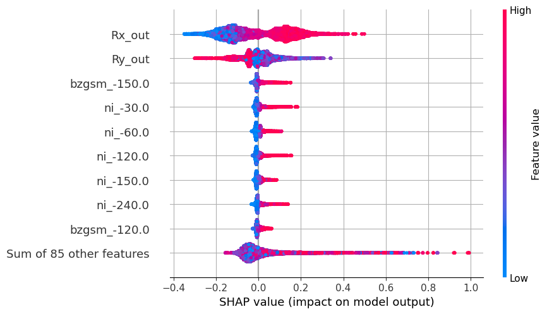
Feature Importance Analysis
Higher density close to earth and at dawn
X GSM
Y GSM
Answer: In most cases (statistically):
Model is predominantly driven by spacecraft location
Solar wind input has lower effect, although cumulative history is still important
Blue/Red: Input value
Left/Right: Output value
SHAP Values explain why a model made a specific prediction, by showing each feature's impact.

Slide 44
Feature Importance Analysis – Merged Time history
Quiet times
Generally less SW driven
T more external
Density dictated by location
Storms:
More externally driven
Location less important
Caveats
Intercorrelation between variables (e.g., ae correlated to vx)
Hidden correlations of SW type (dense solar wind is typically slower)
Combines all time history in one variable

Slide 45
High Level Takeways
Main Points
Global convection is different during storms, with duskward Bz and dawnward Vx enhancements.
Storm-time BBFs transport more magnetic flux than quiet-time BBFs, affected mostly by the global increase in Bz across the plasma sheet.
BBF observations appears to occur more at dusk during quiet times and shift dawnward during storms.
A machine-learning plasma sheet model, driven by solar wind input and geomagnetic state, outperforms earlier empirical models, generating a physically accurate picture.
Sparse data during rare conditions still degrades the model performance during extreme events such as storms.

Slide 46
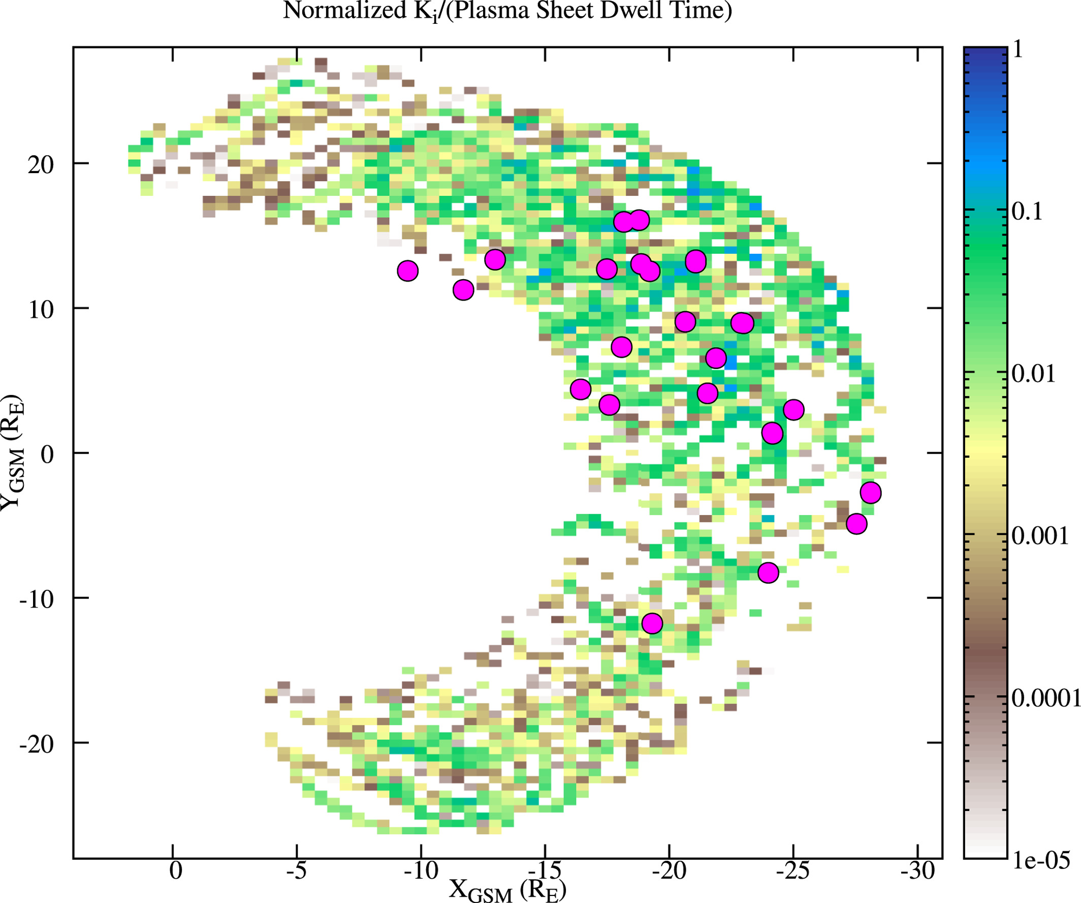
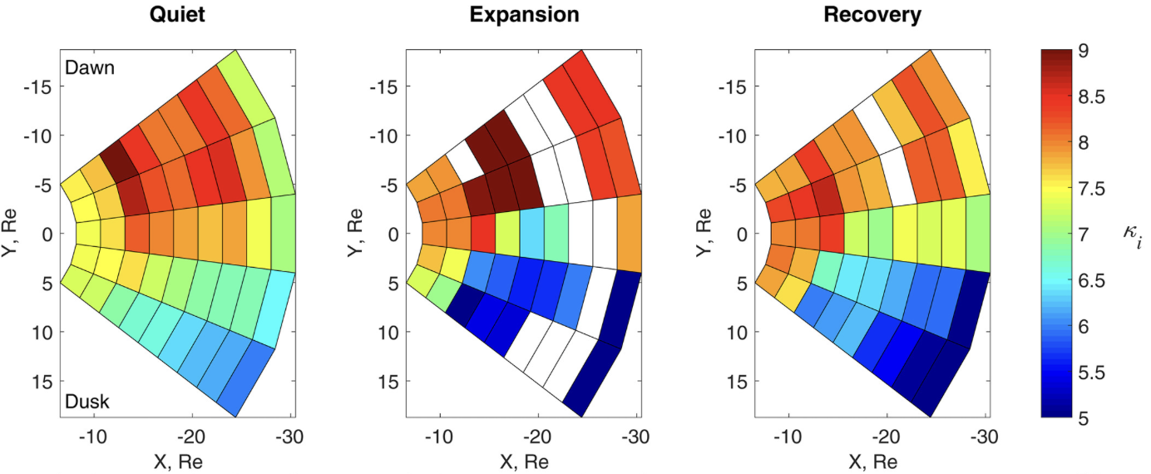
Future Steps & Discussion
Future Steps
Extend MMS coverage from 2015-2022 to 2015-2026 and add THEMIS intervals to enlarge the statistical sample. This can help us understand dawn/dusk asymmetries and improve model performance.
Extend the analysis to substorm activity and test model performance.
Evaluate more complex physical quantities, such as non-Maxwellianity of particle distributions and magnetic curvature.
Rogers et al., 2023
Espinoza et al., 2018

